Slide 1
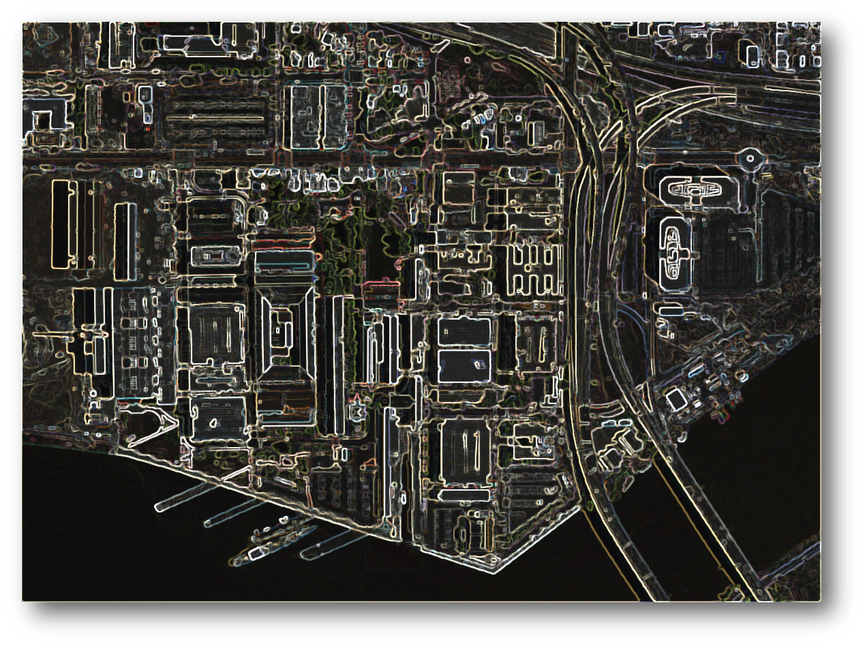
Washington Navy Yard
Environmental Restoration Update
Presented to
The Leadership Council for a Cleaner Anacostia River
December 14, 2017
Notes:
a brief overview and status update of the Environmental Restoration Program at WNY with an emphasis on the activities related to the Anacostia River sediments

Slide 2
Washington Navy Yard’s Location on the Anacostia River
Graphic showing river with WNY highlighted

Slide 3
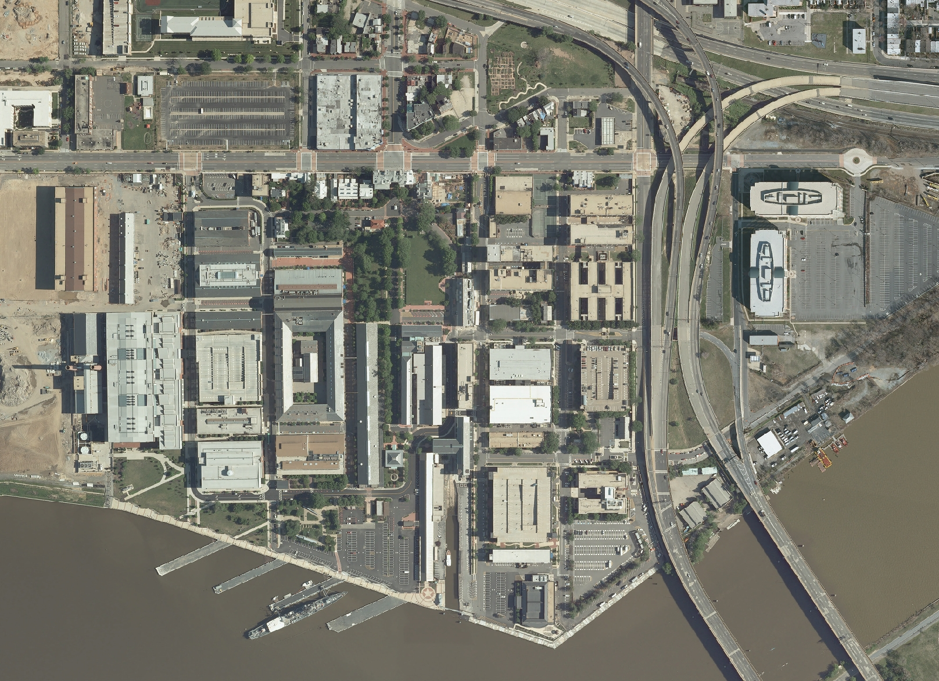
Washington Navy Yard

Slide 4
Overview
WNY has been an active Navy Yard since 1799
Most industrial activities stopped in 1960
WNY Environmental Restoration Program has been active since the 1990’s
Operating under the Superfund (CERCLA) program in partnership with EPA and DOEE
WNY is the only National Priorities List site in Washington, DC
Notes:
CERCLA -

Slide 5
Overview (cont.)
Chemicals of Concern include:
  Soil: PCBs, polycyclic aromatic hydrocarbons (PAHs), lead, petroleum, chlorinated solvents
  Groundwater: petroleum, chlorinated solvents
  Sediment: PCBs, PAHs, metals

Slide 6
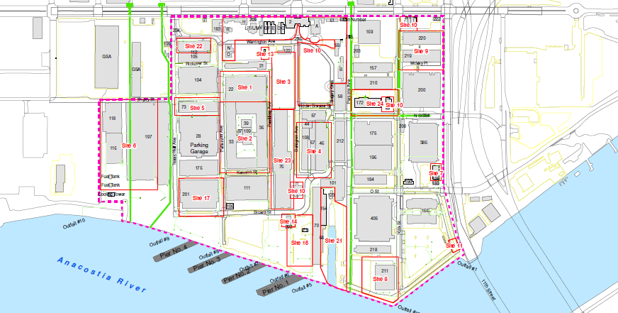
Environmental Restoration Sites (on land)
Notes:
This slide shows the locations of Environmental Restoration Sites at WNY (red outlines).

Slide 7
Environmental Restoration Program Status
Notes:
32 ER sites across the WNY where the Navy may have used chemicals in its industrial past that might have contaminated the soil, groundwater, and sediment.
Cleanup Complete – 27
Undergoing RI/FS – 4 (Site 21, 24, OU2, OU1)
Undergoing screening – 1 (SSA 4)

Slide 8
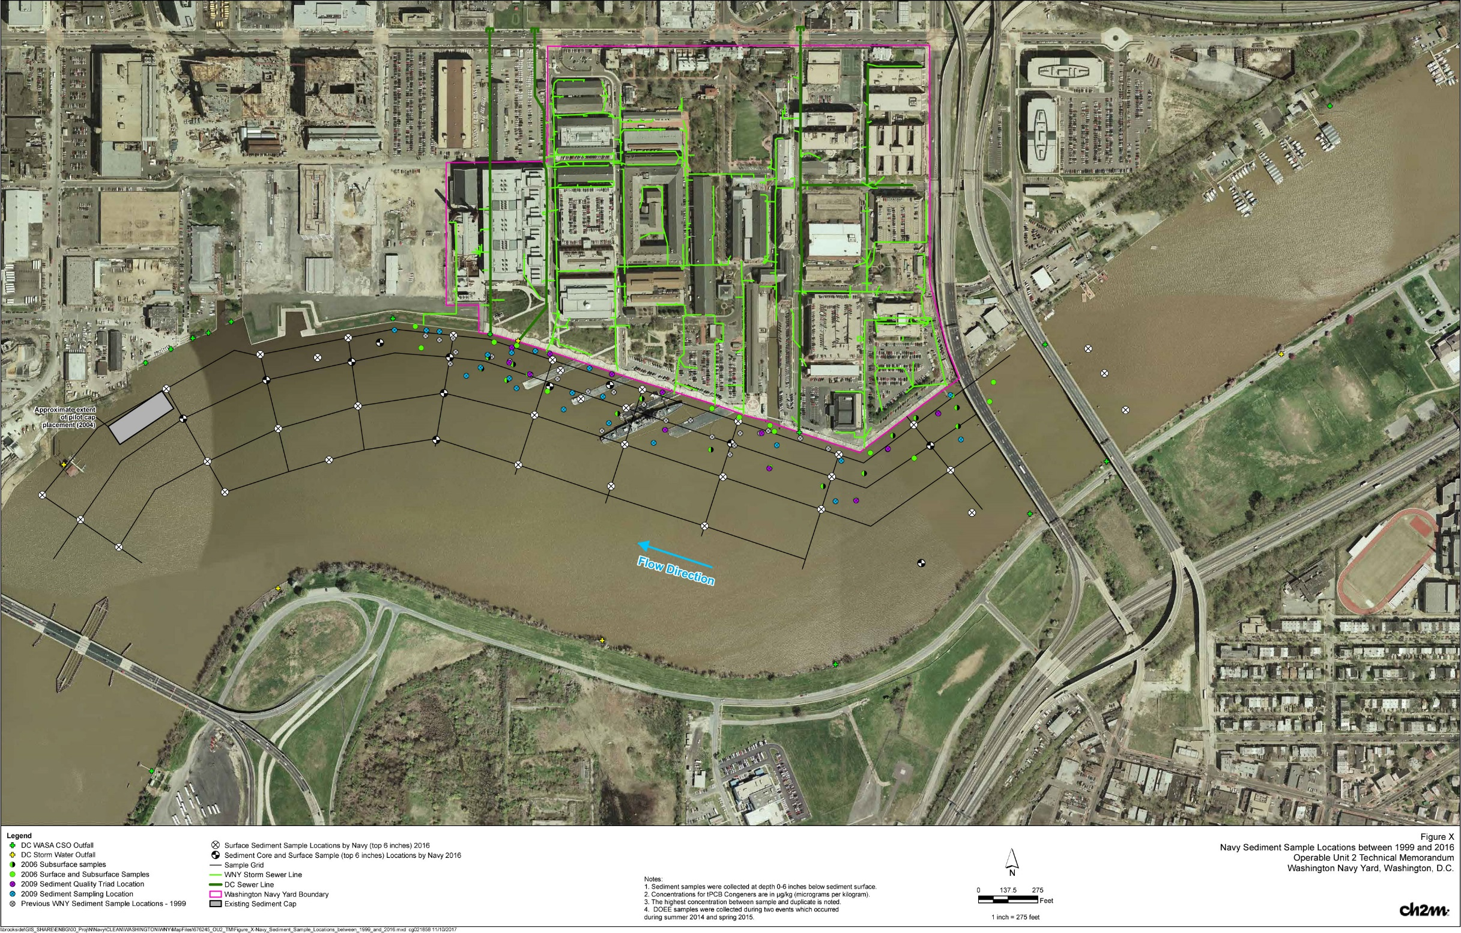
Operable Unit 2 -
Navy
Sediment
Sampling

Slide 9
History of OU2 Investigative Activities
1999: Investigated and replaced all former sewers leading to the Anacostia River
1999: Sampled surface sediment (30 samples)
2006: Sampled surface and subsurface sediment (120 samples)
2009: Sampled surface sediment (40) and fish tissue (50) and performed sediment stability testing and flow modeling
2014: Finalized Remedial Investigation report

Slide 10
Recent OU2 Investigative Activities
2015-17: Pre-FS investigation
Define lateral outline of Navy impacts by extending sampling further out into river
  Collected 46 surface sediment samples (top 6”)
Determine if surface sediment conditions are improving by collecting top 1” samples
  Collected 10 shallow surface sediment samples (top 1”)

Slide 11
Recent OU2 Investigative Activities (cont.)
2015-17: Pre-FS investigation (cont.)
  Define vertical extent of contamination to evaluate sediment volumes for actions involving dredging, by collecting sediment cores
    Collected 250 samples from 12 sediment cores to depth of up to 18 feet
  Conducted PCB and PAH forensics to aid in defining Navy impacts

Slide 12
Next Steps of OU2 Investigative Activities
  Incorporate sediment data collected by DOEE (ongoing)
  Complete forensics evaluation and develop a pre-FS data report/technical memo (draft in early 2018)
  Develop WNY-specific Feasibility Study (2018)

Slide 13
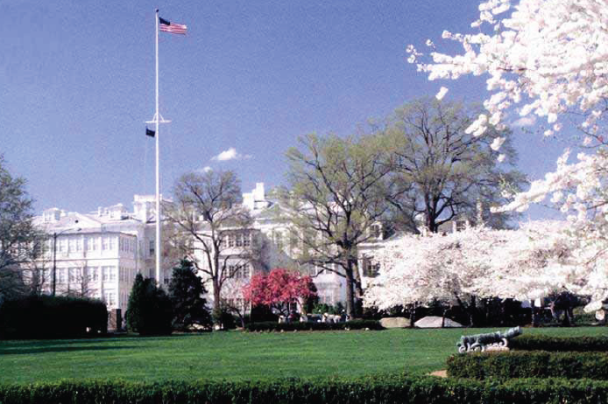
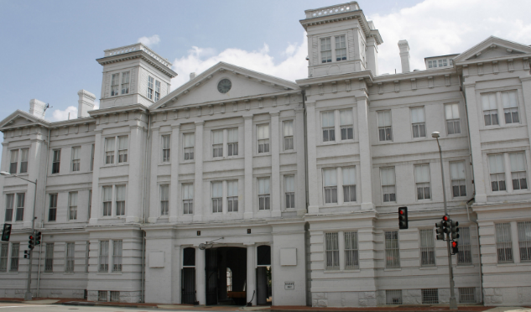
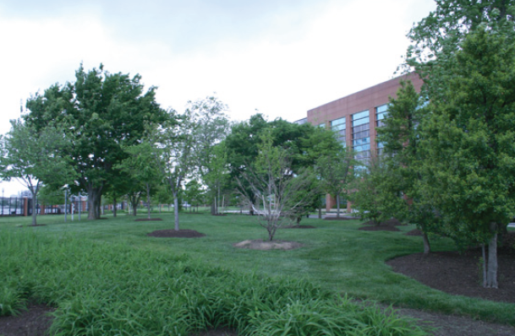
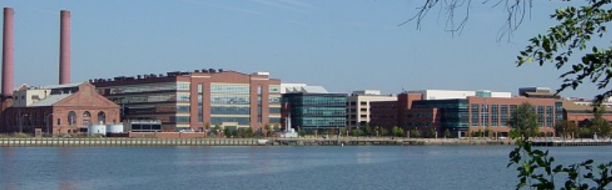
Questions?

