Slide 1
Sediment and Chemical Contaminant Loadings in Tributaries to the Anacostia River, Washington D.C. Presentation to Leadership Council, September 13, 2018
Timothy Wilson, Ph.D.
Charles Walker, Ph.D.
US Geological Survey
Baltimore Md.

Slide 2
Poster sessions and presentation title slides:
This information is preliminary and is subject to revision. It is being provided to meet the need for timely best science. The information is provided on the condition that neither the U.S. Geological Survey nor the U.S. Government shall be held liable for any damages resulting from the authorized or unauthorized use of the information.“
All subsequent presentation slides:
"Preliminary Information-Subject to Revision. Not for Citation or Distribution."
USGS Report is in Colleague and Outside Review
Release pending USGS sign-off

Slide 3
Purpose of Study Determine loadings of sediment and sediment-bound chemicals of concern (COC’s) in tributaries to the Anacostia River, Washington, DC.
Northeast Branch Anacostia (NEB)
Northwest Branch Anacostia (NWB)
Lower Beaverdam Creek (LBDC)
Watts Branch (WB)
Hickey Run (HR)
_________________________________________
Nash Run (NR)
Pope’s Branch (PB)
Ft. DuPont (FTD)
Ft. Stanton (FST)

Slide 4
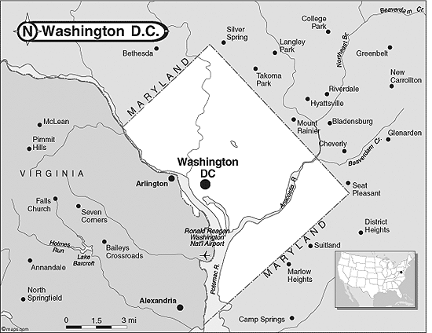
NWB
NEB
Hickey
LBDC
Watts
Non-gaged Tribs

Slide 5
Approach
Gaged Tributaries
Obtain “representative” chemistry of SS using large-volume composite samples collected during multiple storms, 2 low-flow samples, and from bed sediment
Estimated SSC from continuous turbidity and discharge (Q) using linear-regression analysis
Log SSC = a*log (turbidity) + b*log (discharge) + C
Combine estimated SSC with discharge and chemistry to obtain loadings
Non-gaged tributaries
Chemistry from 1 storm and 1 low-flow sample
Discharge and Sediment loads estimated from Watts Branch

Slide 6
Work Completed
LBDC - installed and calibrated gage (continues through 2019)
2. Monitored continuous turbidity during 2017
3. Sampled 4-5 storms (January, March, July and October-December 2017)
Sampled 1-2 low-flow events (fall 2016 and 2017)
Collected freshly deposited bed-sediment after storms
4. Analyzed Suspended-sediment and bed-sediment for:
PCB congeners
PAH compounds (non-alkylated and alkylated)
Organo-chlorine pesticides – chlordane, DDT’s, others
Trace metals (1 storm)
5. Developed predictive models for SSC from turbidity and discharge
6. Calculated sediment and chemical loads for 2017.
7. Report is written and in review

Slide 7
Discharge and Sediment Loads at Gaged Tributaries – 2017
 | NEB | NWB | LBDC | WATTS BRANCH | HICKEY RUN | TOTAL
Total Q, MG | 15,800 | 11,000 | 5,100 | 657 | 394 | 32,900 MG
% of Q | 48 | 33 | 16 | 2 | 1 | --
Total sediment load, Mkg | 11 | 16 | 4.4 | 0.61 | 0.29 | 32.6 Mkg
% Sediment Load | 34 | 50 | 13 | 2 | 1 | --
Sediment load, kg/day | 30,000 | 44,000 | 12,000 | 1,600 | 775 | 89,000 kg/d (~90 yd³/d)
Sediment Yield (kg/year/sq. mile) | 1.5e5 | 3.2e5 | 3.0e5 | 1.7e5 | 2.7E5 | --
* For calendar year 2017

Slide 8
Non-gaged Streams
Basin | Area sq. miles | Relative Area | Discharge, MG | Sediment Load, kg/yr
Watts | 3.36 | 1 | 657,000 | 560,000
Nash Run | 0.71 | 0.21 | 138,000 | 120,000
Pope Branch | 0.37 | 0.11 | 72,000 | 62,000
Ft. DuPont | 0.68 | 0.20 | 131,000 | 113,000
Ft. Stanton | 0.33 | 0.10 | 66,000 | 57,000
Total (w/o Watts) |  |  | 407,000 | 350,000
Total for gaged tribs |  |  | 32,900,000 | 32,600,000
Values Estimated Using Ratio of Basin Area to Area of Watts Basin
Pro-
Basin ratio method is traditional for non-gaged streams
2. Watts Basin has approx. same land coverage (Nash and Pope)
3. Watts originates on same ridgeline as non-gaged streams
Con-
Watts Branch has higher density of road
coverage
2. Watts may have higher # of point sources

Slide 9
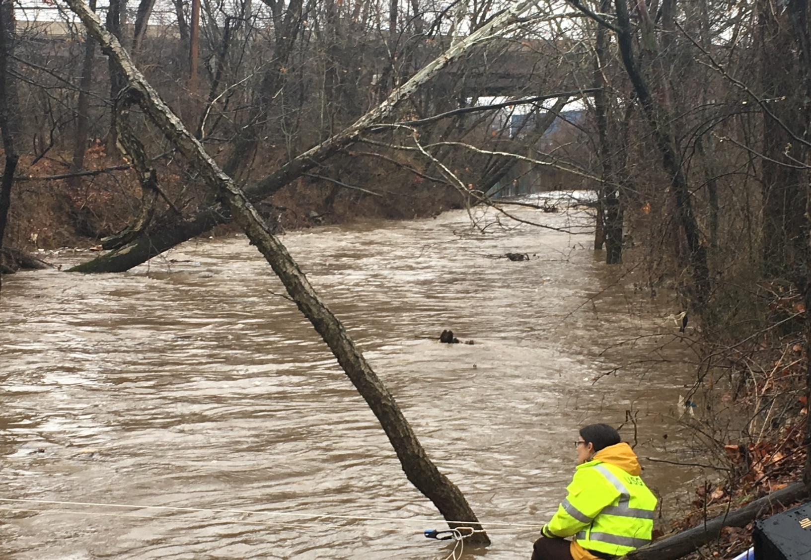
Lower Beaverdam Creek
Maximum Discharge: 1,420 cfs
( max. for NEB 4,670 cfs)
Max. Stage: 7.7 ft ft
Velocities: -1.0 to 7.8 ft/s
In 2017 LBDC provided
16% of total discharge to
L. Anacostia
LBDC supplies
~ 5X more water and sediment than Watts + Hickey

Slide 10
Average Concentration of Low-Flow and Storm Flow Samples
 | NEB (7 samples) | NWB (7) | LBDC (8) | Hickey ** (5) | Watts (6)
Total PCB ug/kg | 5.9 | 6.2 | 130 | 69 | 44
PCB TEQ, ug/kg | 1.4e-4 | 2.0e-5 | 4.0e-4 | 4.5e-4 | 1.7e-4
Total PAH* | 2,000 | 3,300 | 2,200 | 18,000 | 2,400
Total Non-alkylated PAH | 1,600 | 2,400 | 1,700 | 5,400 | 1,800
Total Alkylated PAH | 400 | 930 | 490 | 13,000 | 650
* Total PAH is sum of alkylated and non-alkylated compounds
** Hickey Run PAH influenced by low-flow samples

Slide 11
Average Concentration of Low-Flow and Storm Flow Samples
Non-Gaged Streams
 | Nash Run (2 samples) | Pope Branch (2) | Ft. DuPont (2) | Ft. Stanton (2)
Total PCB ug/kg | 65 | 1.5 | 1.2 | 4.3
PCB TEQ | 1.8e-4 | 2.1e-6 | 3.7e-5 | 2.6e-5
Total PAH | 5,500 | 630 | 350 | 610
Non-alkylated PAH | 4,200 | 370 | 270 | 470
Alkylated PAH | 1,400 | 260 | 75 | 200
Nash Run chemistry roughly similar to Watts Branch
Pope, Ft. DuPont and Ft. Stanton very low concentrations of COCs (background?)
However, these data may not represent what actually enters Lower Anacostia

Slide 12
Pesticide Concentrations and Loadings
Sampling for pesticides began in summer of 2017
Only 1 -2 storm samples analyzed
Analytic methods resulted in unexpectedly high detection levels –
few “hits” reported above MDL
Approach Taken
Concentrations used for loadings were developed using HIGHEST concentration found
in storm, low-flow, and bed-sediment in each river
However, chlordane was detectable in SS samples – used for loadings

Slide 13
Maximum Concentrations in SS and Bed-sediment Samples
(concentrations used in calculating loads)
 | NEB |  | NWB |  | LBDC |  | Watts |  | Hickey
 | # hits | ug/kg | # hits | ug/kg | # hits | ug/kg | # hits | ug/kg | # hits | ug/kg
4,4'-DDD | 1 | 0.79 | 2 | 0.46 | 1 | 2.2 | 3 | 1.8 | 5 | 4.6
4,4'-DDE | 1 | 0.25 | 1 | 1.1 | 1 | 1.5 | 3 | 2.6 | 6 | 5.5
4,4'-DDT | 0 |  | 3 | 3.2 | 1 | 2 | 4 | 560 | 4 | 23
ALDRIN | 1 | 6.1 | 0 |  | 0 |  | 0 |  | 0
ALPHA-BHC | 0 |  | 0 |  | 0 |  | 0 |  | 0
BETA-BHC | 0 |  | 0 |  | 0 |  | 0 |  | 0
CHLORDANE | 2 | 42 | 2 | 21 | 3 | 70 | 4 | 100 | 3 | 40
DELTA-BHC | 0 |  | 0 |  | 0 |  | 1 | 24 | 0
DIELDRIN | 3 | 0.46 | 4 | 150 | 1 | 0.39 | 2 | 0.6 | 4 | 0.89
ENDRIN ALDEHYDE | 0 |  | 1 | 9.4 | 0 |  | 2 | 390 | 1 | 0.15
"
Pesticides are present in newly deposited bed-sediment – so are being transported in these streams
Few “hits” of pesticides in SS, but chlordane was measurable in all gaged tribs
Pesticides found include Chlordane, suite of DDT’s, Dieldrin, Endrin Aldehyde

Slide 14
Loadings from Gaged Tributaries – 2017
 | NEB | NWB | LBDC | WATTS | HICKEY | TOTAL g/yr
Total PCB, g/yr | 65 | 100 | 580 | 27 | 20 | 790
% of total PCB | 8 | 13 | 73 | 3 | 3 | --
Total PCB TEQ, g/yr | 1.5e-3 | 3.3e-4 | 1.8e-3 | 1.0e-4 | 1.3e-4 | 3.8e-3
% of total TEQ | 39 | 10 | 47 | 2 | 3 | --
Total non-alkylated PAH, g/yr | 17,000 | 39,000 | 7,200 | 1,100 | 1,600 | 66,000
% of total | 26 | 59 | 11 | 2 | 2 | --
Total Chlordane, g/yr | 430 | 340 | 310 | 61 | 12 | 1,200
% of total chlordane | 37 | 29 | 27 | 5 | 1 | --

Slide 15
Loadings from Non-Gaged Tributaries – 2017
 | Nash Run | Pope Branch | Ft. DuPont Creek | Ft. Stanton Creek | Total non-gaged streams g/yr
Total PCB load | 8.3 | 0.10 | 0.14 | 0.26 | 8.8
% of total PCB in Watts | 31 | 0.4 | 0.6 | 1 | 33
Total PCB TEQ | 2.3e-5 | 1.4e-7 | 4.5e-6 | 1.6e-6 | 2.9e-5
% of total TEQ in Watts | 23 | 0.1 | 5 | 2 | 29
Total non-alkylated PAH load | 530 | 25 | 33 | 29 | 620
% of total PAH in Watts | 48 | 2 | 3 | 3 | 56
Chlordane load | nd | nd | nd | nd | nd
% of total chlordane | -- | -- | -- | -- | --

Slide 16
Summary of Loadings
Total Water 33,000 MG gaged streams 0.41MG non-gaged streams*
Major contributors 48% NEB 33% NWB 16% LBDC Nash Run
Total Sediment 33 Mkg gaged streams 0.35MKg non-gaged streams *
Major contributors 50% NWB 34% NEB 13% LBDC Nash Run
Total PCBs 790 g/yr gaged streams 8.8 g/yr non-gaged streams*
Major contributors 73% LBDC 13% NWB 8% NEB Nash Run
Total PAHs (non-alk) 66,000 g/yr gaged stream 620 g/yr non-gaged *
Major contributors 59% NWB 36% NEB 11% LBDC Nash Run
Total chlordane 1,200 g/yr not-detected in non-gaged tribs
Major contributors 37% NEB 29% NWB 27% LBDC
* Non-gaged streams contribute (in total) ~1% of gaged-tributary loadings

Slide 17
Take Away
Majority of water and sediment from NWB and NEB
2. LBDC contributes majority of PCBs; supplies a high proportion of COC’s
relative to its discharge and basin area
3. Non-gaged streams contribute very small amounts of sediment and COCs
(~1% of gaged), most significant is Nash Run
4. Chlordane present in all gaged tributaries, not detected in non-gaged
tributaries. Other pesticides present in fresh bed-sediment

Slide 18
Recommendations
Continue discharge and WQ monitoring at LBDC, NEB, NWB, Watts and Hickey (yearly variation of sediment load. Support for LBDC ends in FY19)
Additional sampling in LDBC, Hickey, Watts, and Nash Run
(especially for pesticides)
3. Conduct synoptic track-down sampling in LBDC, Watts, and Hickey for all COCs.
(Synoptic sampling: 3 or more locations on a river during a single storm event)

Slide 19
Recommendations - continued
4. Sample outfalls of Ft. DuPont, Ft. Stanton, and Pope at Lower Anacostia
(what actually makes it to LA)
5. Measure discharge, turbidity, and other WQ in Lower Anacostia at
confluence of NEB-NWB (Aquatic Gardens area) and near L.A.-Potomac
(mass balance of water/sediment moving through LA)
6. Investigate sources of sediment in NEB and NWB, and Ft. DuPont
(remedial actions to reduce erosion and sediment loads)

Slide 20
Much appreciation is given to Washington D.C. DOEE
Thanks!

Slide 21
Original funding from DOEE was to provide draft report using $ “left-over” from FY 17 from not using UMBC for analytic work, able to stretch this to May 1, 2018.
Needed:
Salary to take draft report to final “Official” USGS Report
Re-check all calculations and tables
Publication grade figures
Internal and external USGS and DOEE Review
Address Comments
Address comments of USGS Regional Hydrologist
Prepare USGS data release (not sure if needed)
240 hours of salary = $40,000
100 hours for meetings, reviews of other researcher work, general help to DOEE = $22,000
USGS has ~ $10,000 Match money to use in FY 18

Slide 22
Other Work:
1. Continue to operate USGS gage station at LBDC through October 1, 2019 = $21,000
2. Upstream sampling of LBDC, resample Hickey and Nash Run = $ 150,00 + analytic costs
3. Install and calibrate tidal gage at Aquatic Gardens area of Anacostia = $20,000
4. Install and calibrate tidal gage at confluence with Anacostia = $20,000
5. Study to determine bed-shear and hydrodynamic variables needed for modeling = ~$175,000
The USGS current has ~$40,000 in “Urban-watershed study” funding for FY18
Can apply for more in FY18 if available

Slide 23
Hydrodynamic and Sediment Transport Modeling
Presentation to DOEE on June 30, 2017
What “inputs” are necessary and are most important to constrain?
Tributary sediment loads and associated contaminant concentrations
Anacostia Project modeling effort is outstanding
but all numerical models can be “over- parameterized”
(too many variables that can be adjusted resulting in fit to test data)
The more measured data available to constrain inputs, the more “realistic” the output - but focus on the most important parameters!
The USGS has the capability to measure in-situ data needed for calibration

Slide 25
Sediment Loads – 2013 thru 2017
Year | Max. Q, cfs | Ave. Q,cfs | % of record with measured turbidity | Total discharge, MG | Total discharge, MG | Total discharge, L | Total discharge, L | Sed. load, kg /yr | Sediment load, kg /yr | Sediment load, kg /yr | Sediment load, Kg/d | Sediment load, Kg/d | Sediment Yield, Kg/yr/mi²
 | NEB
2017 | 4,370 | 67.4 | 95 | 15,700 |  | 5.94e10 |  | 1.11e7 | 1.11e7 |  | 30,400 |  | 153,000
 | NWB
2017 | 8,990 | 47.1 | 74 | 10,950 |  | 4.10e10 |  | 1.62e7 | 1.62e7 |  | 44,400 |  | 328,000
 | LBDC
2017 | 1420 | 21.2 |  | 5110 |  | 1.93e10 |  | 4.52e6 | 4.52e6 |  | 12,400 |  | 303,000
 |  |  |  |  |  | Watts
2017 | 878 | 2.98 | 89 | 394 |  | 2.55e9 |  |  | 6.08e5 |  | 1690 |  | 181,000
 | Hickey Run
2017 | 2,230 | 1.68 | 89 | 394 |  | 1.49e9 |  | 2.97e5 |  |  | 814 |  | 300,000
NOT FOR DISTRIBUTION

Slide 26
Poster sessions and presentation title slides:
This information is preliminary and is subject to revision. It is being provided to meet the need for timely best science. The information is provided on the condition that neither the U.S. Geological Survey nor the U.S. Government shall be held liable for any damages resulting from the authorized or unauthorized use of the information."
All subsequent presentation slides:
"Preliminary Information-Subject to Revision. Not for Citation or Distribution."

Slide 27
2017 PCB and PAH Loadings
 | Total sediment Kg/yr | Total PCB, g/yr | PCB TEQ g/yr | Total PAH, g/yr
 |  | Gaged Streams
NEB | 1.11e7 | 67 | 2.8e-4 | 22,000
NWB | 1.62e7 | 89 | 3.0e-4 | 49,000
LBDC | 4.52e6 | 580 | 1.6e-3 | 9,700
HICKEY | 2.97e5 | 20 | 1.0e-4 | 5,400
WATTS | 6.08e5 | 21 | 9.0e-5 | 1,300
TOTAL | 3.27e7 | 780 | 2.4e-3 | 86,000
 |  | Non-gaged streams
Nash Run | 1.28e2 | 5.3 | 1.6e-5 | 510
Pope Branch | 6.69e4 | 0.07 | 8.1e-8 | 34
Ft. DuPont | 1.22e5 | 0.14 | 4.5e-6 | 42
Ft. Stanton | 6.08e4 | 0.26 | 1.6e-6 | 37
Total | 2.50e5 | 5.8 | 2.1e-5 | 620

Slide 28
Models developed using MLR of SSC-T-Q, 2013-2017
n = 176
R² = 0.93
NWB
n = 176
R² = 0.95

Slide 29
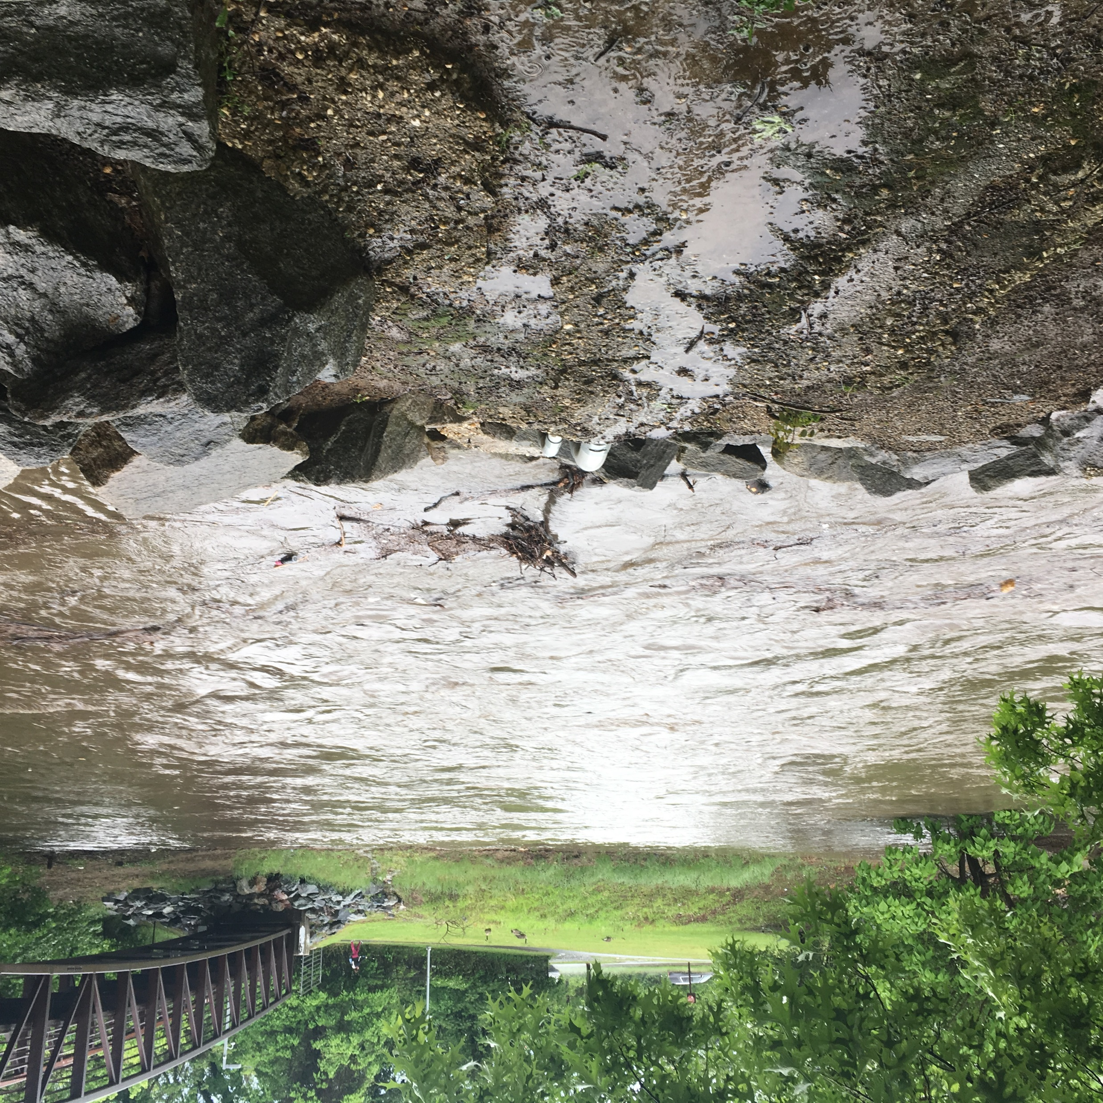
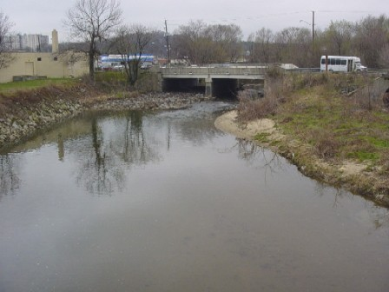
NW Branch Anacostia
Storm-Flow
Low-Flow

Slide 30
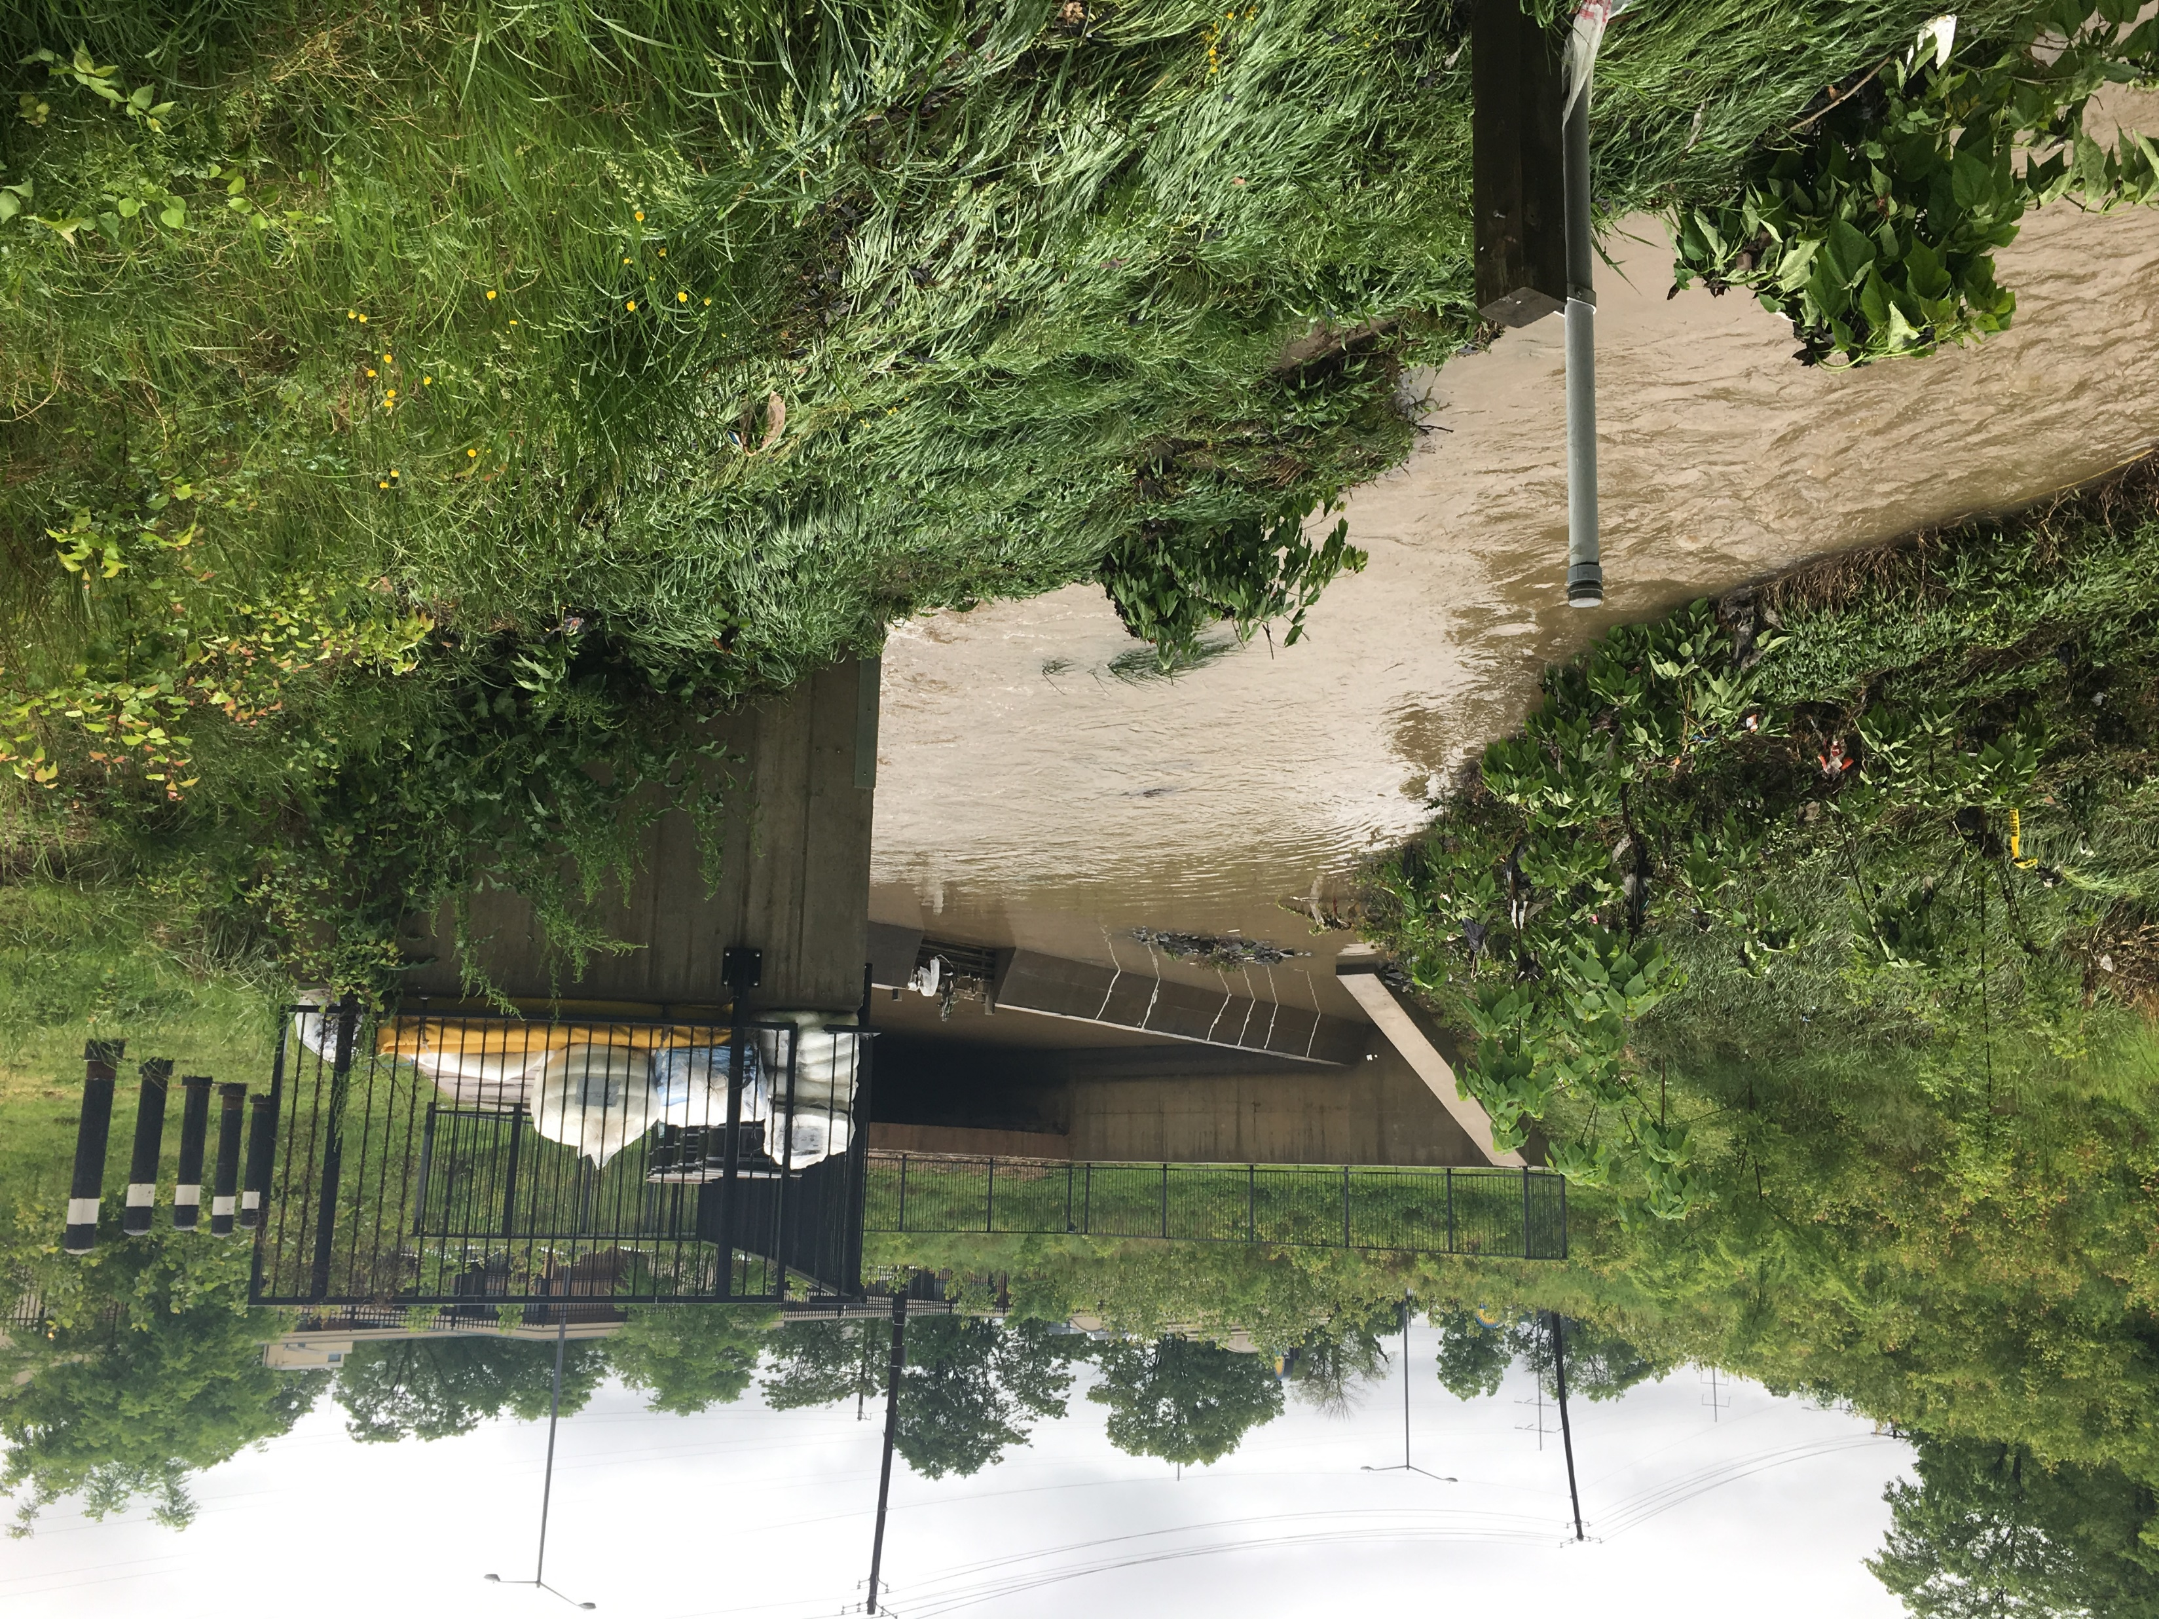
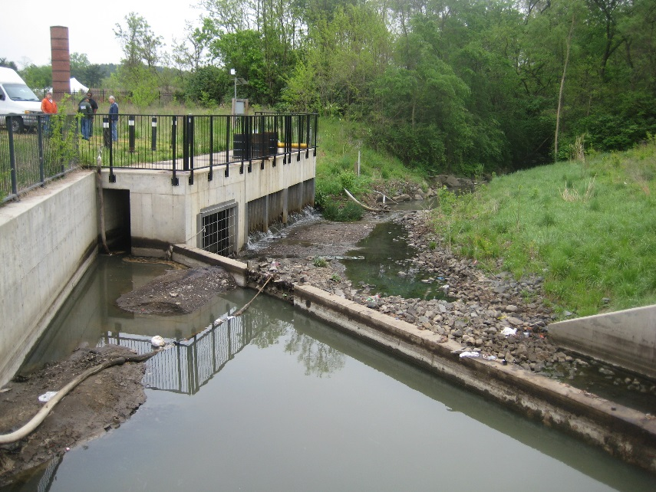
Hickey Run
Storm-Flow
Low-Flow

Slide 31
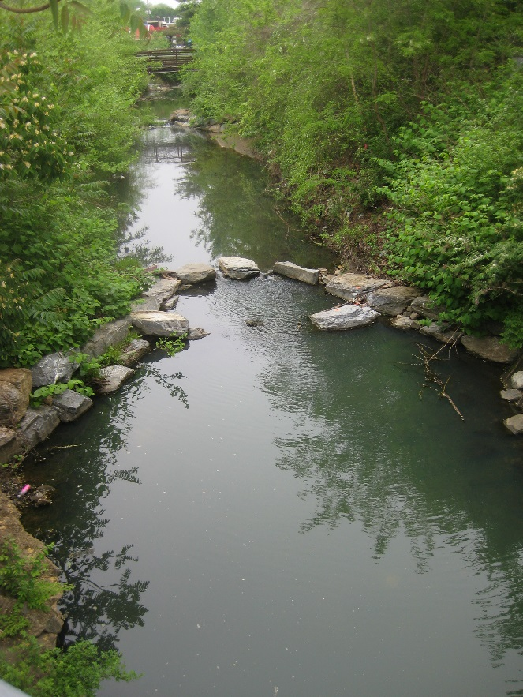
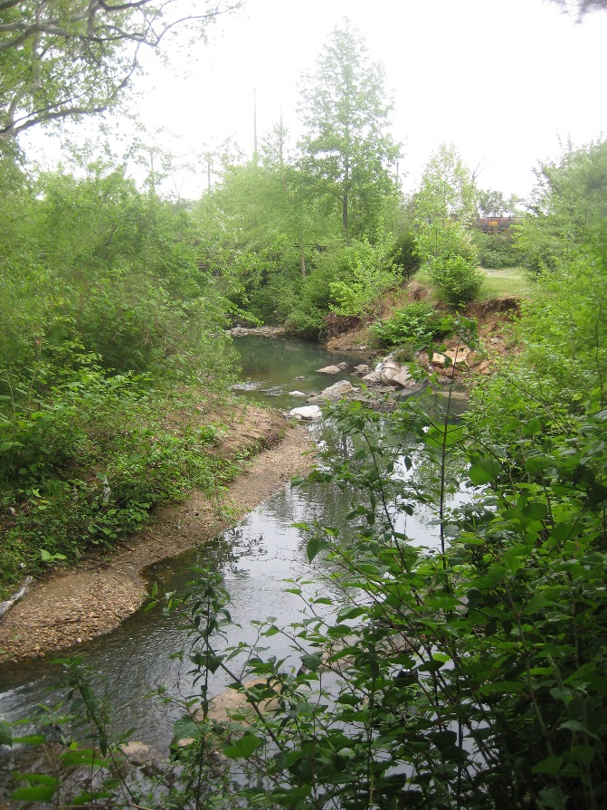
Watts Branch
Low-Flow

Slide 32
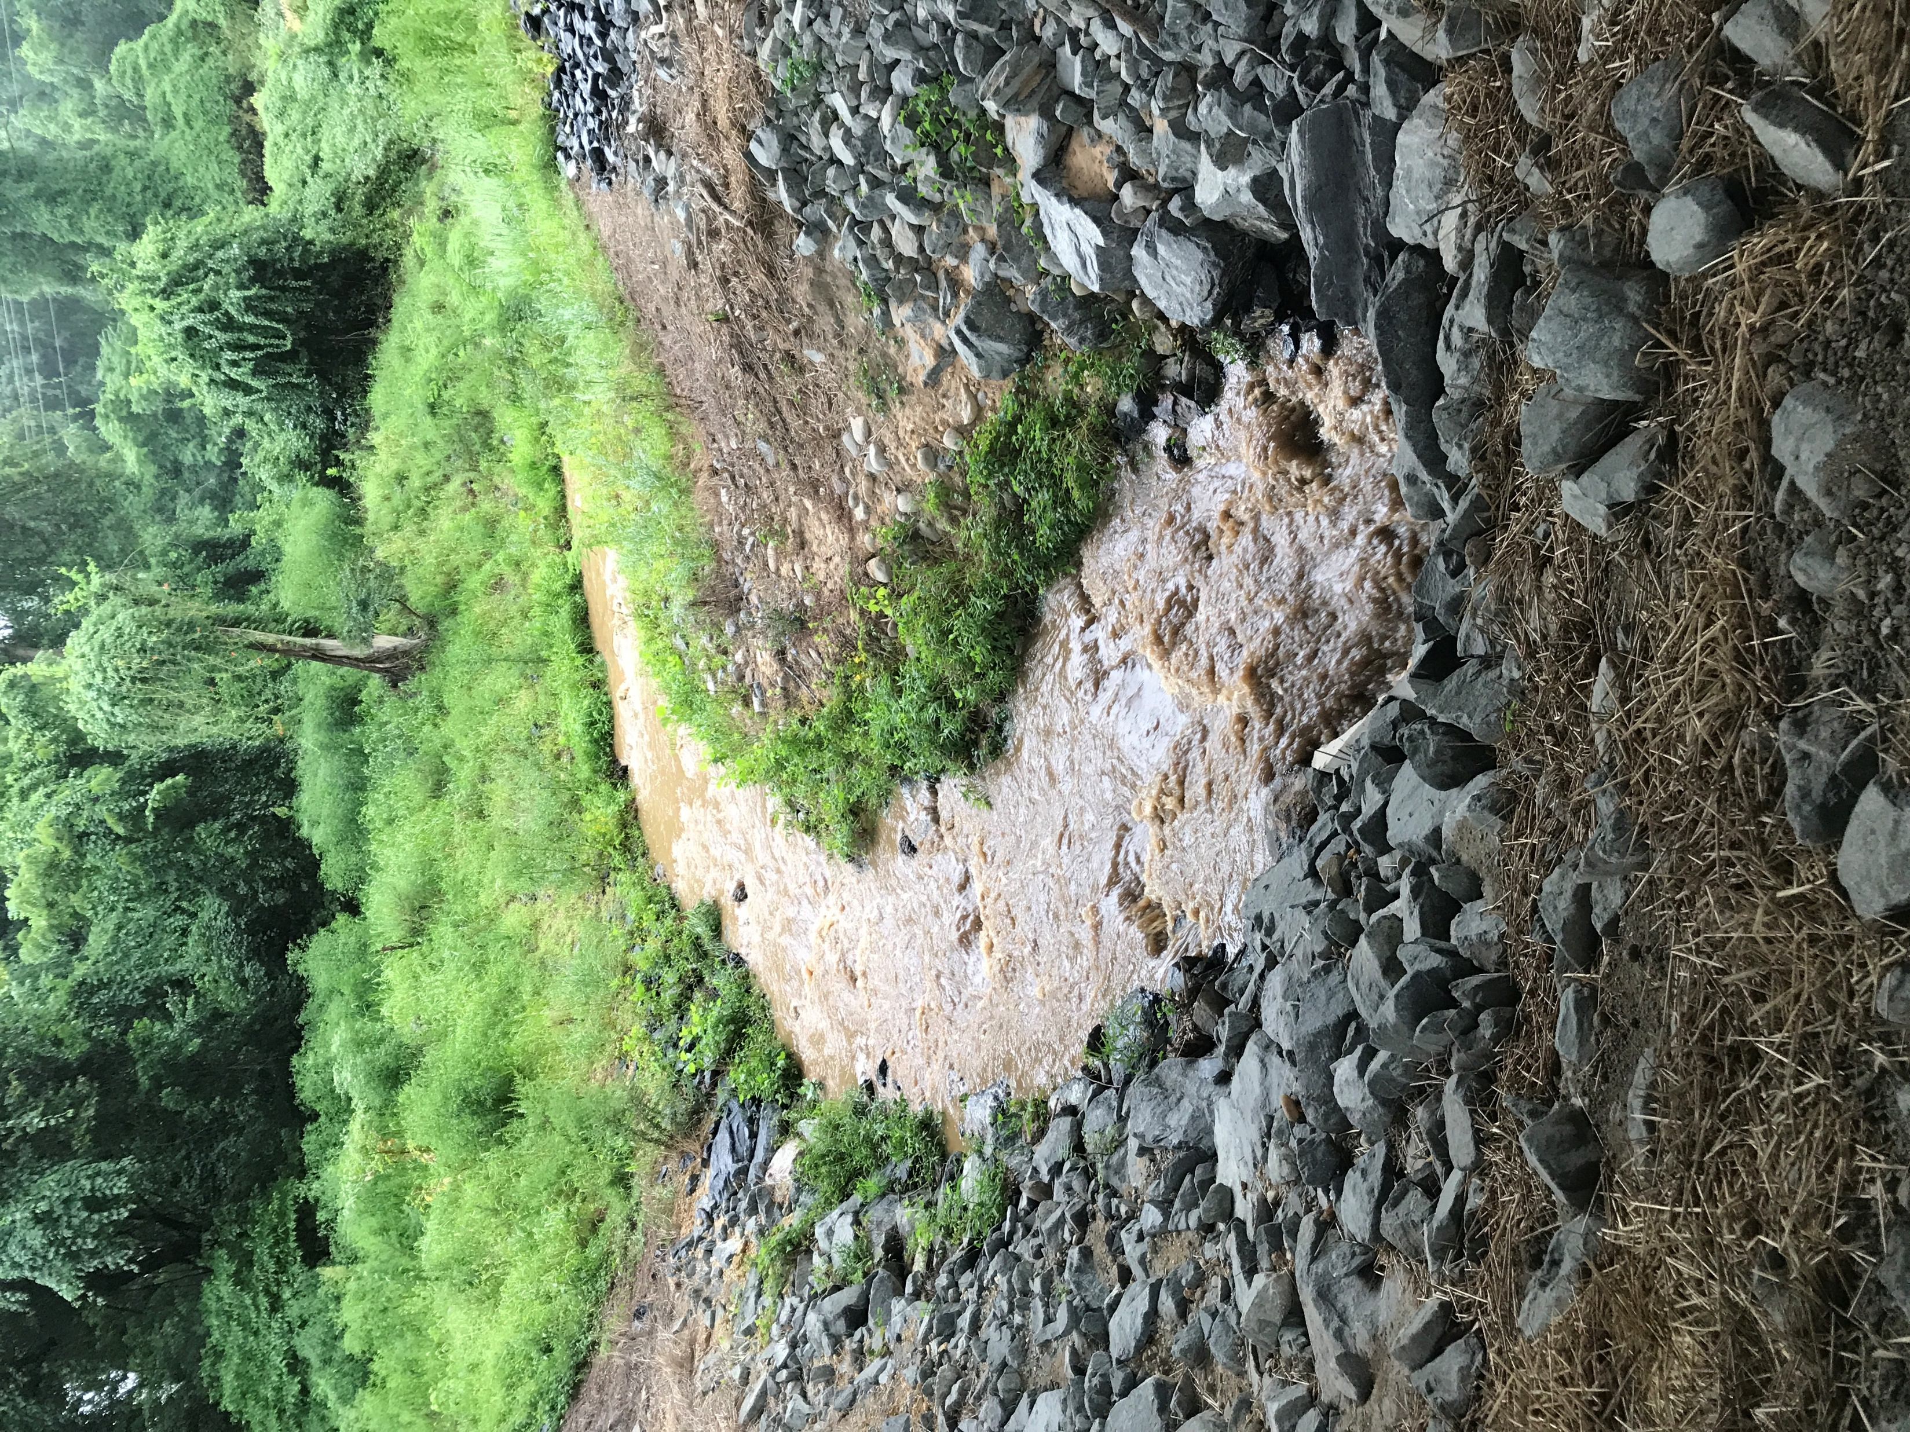
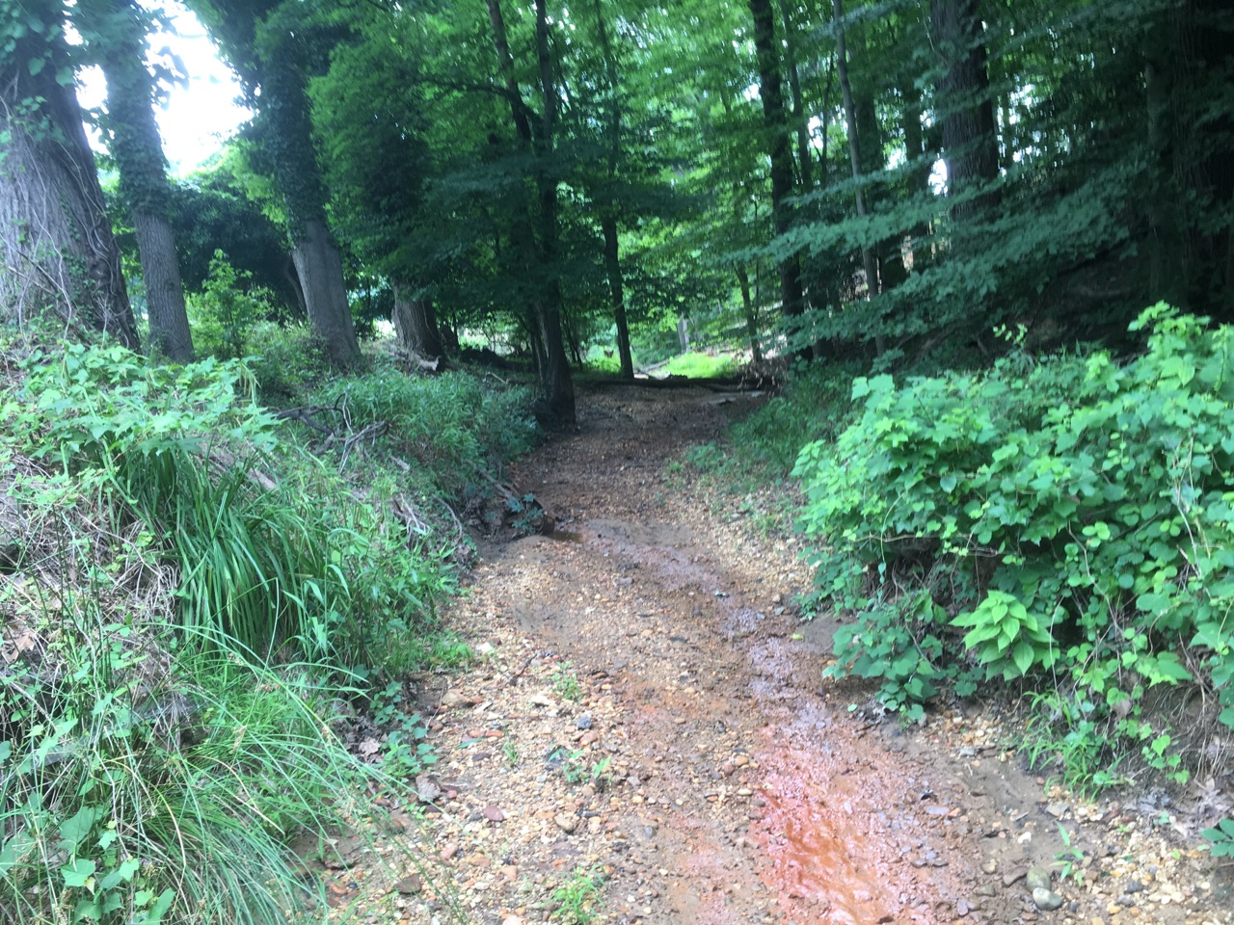
Ft. DuPont Creek
Low-Flow
Storm-Flow

Slide 33
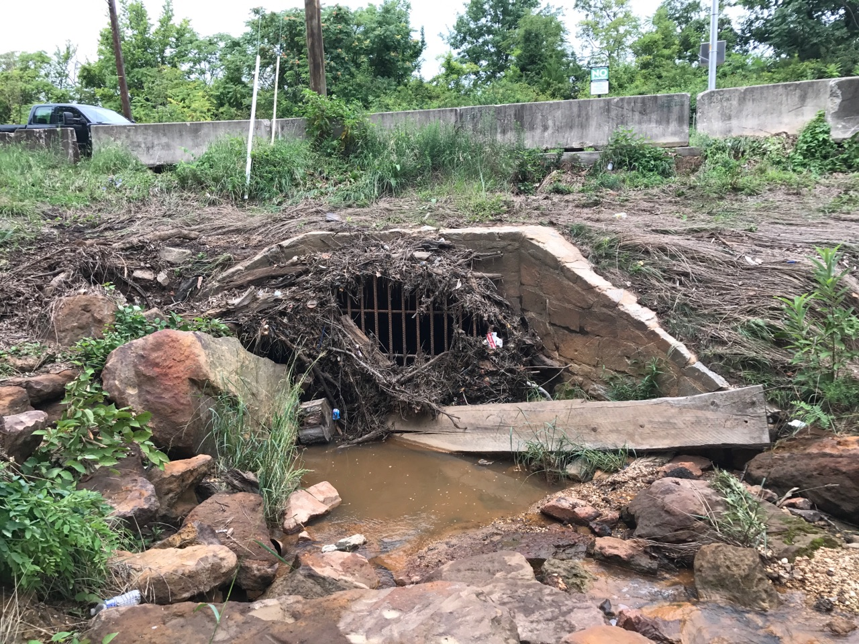
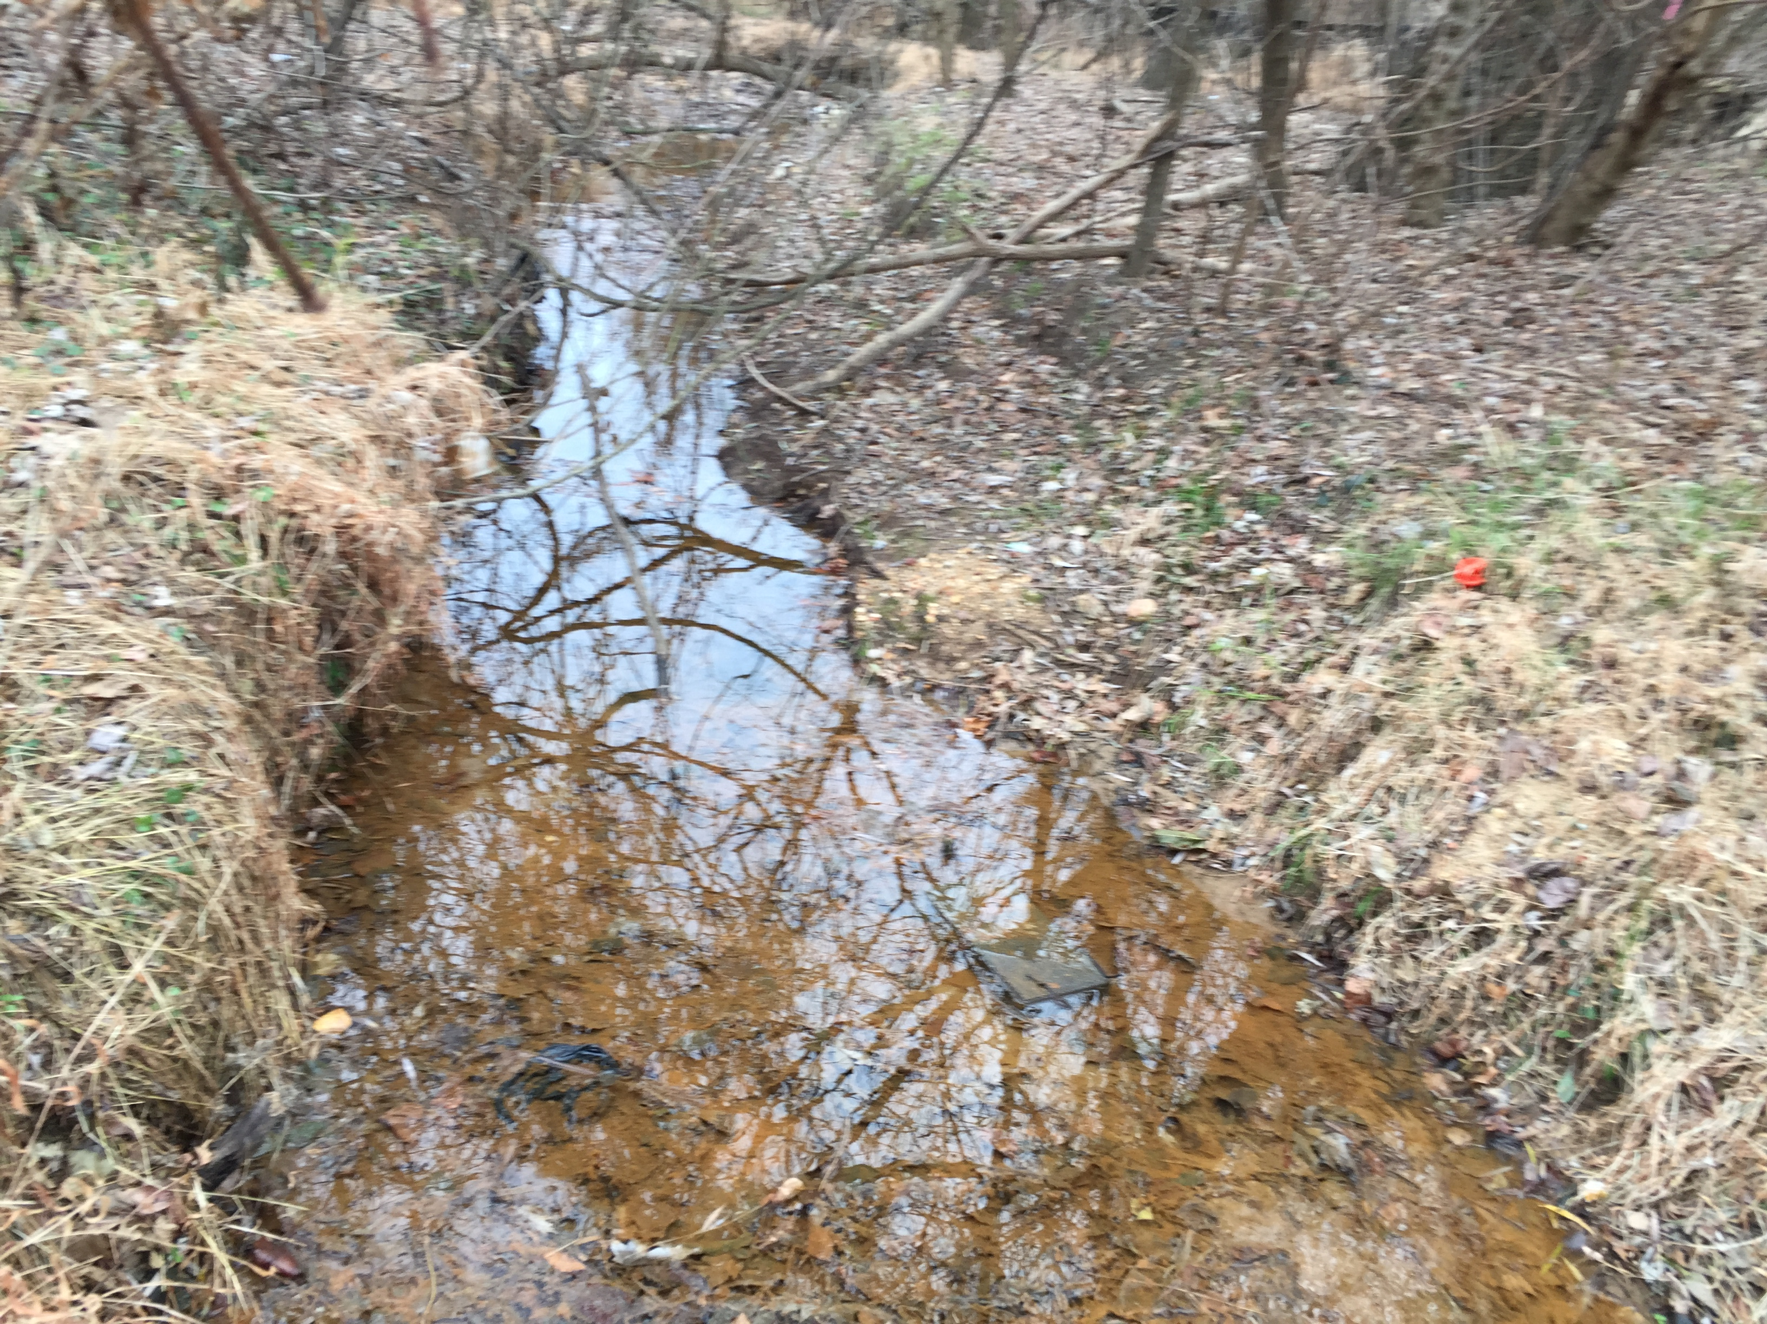
Pope Branch
After storm
Ft. Stanton Creek
Low-flow

Slide 34
LBDC Low- Flow

Slide 35
Q and Sediment at Non-Gaged Tributaries 2017 - Compared with Watts
 | Watts Branch | Nash Run | Pope Branch | Ft. DuPont | Ft. Stanton | TOTAL non-gaged tribs
Total Q, MG | 674 | 142 | 74 | 135 | 67 | 420 MG
% of Q in Watts Br. | 2% of gaged stream total | 36 | 19 | 34 | 17 | 1.1
Total sediment load, kg and % total gaged | 604,000 2% of gaged stream total | 127,000 (0.4%) | 66,000 (0.2%) | 121,000 (0.4%) | 60,000 (0.2%) | 375,000 kg (1.2%)
% Sediment Load in Watts | -- | 22 | 11 | 20 | 10 | 63% of Watts
Sediment load, kg/d | 814 | 348 | 182 | 332 | 165 | 1,030 (0.9 yd³/d)
Sediment Yield (kg/yr/mi²) | 1.8e5 | 1.8e5 | 1.8e5 | 3.6e5 | 1.8e5 | 1.8e5
Non-gaged trib data calculated using ratio of basin area to area of Watts Branch

