Slide 1
Discharge, Sediment, and Particulate Chemistry Loads in
Small Tributaries to the Anacostia River, District of Columbia
Timothy P. Wilson
Charles Walker
Brenda Majedi
Brian Banks
Shannon Jackson
Deb Bringman
US Geological Survey – MD, DE, and NJ
September 14, 2017

Slide 2
Objectives of DOEE Tributary Study
Load of suspended sediment and organic contaminants in:
NE and NW Branches of the Anacostia River,
Lower Beaverdam Creek, Watts Branch, and Hickey Run
PCBs, PAHs, Pesticides, Metals {Large Volume Samples}
Provide representative concentrations and loads
in 4 smaller tributaries for TMDL model and track-down efforts
Nash Run, Pope’s Branch, Ft. DuPont Creek
Ft. Stanton Creek

Slide 3
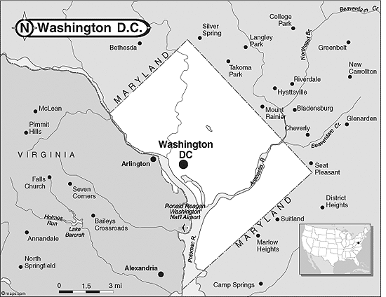
NWB
NEB
Hickey
LBDC
Watts
Small Tribs

Slide 4
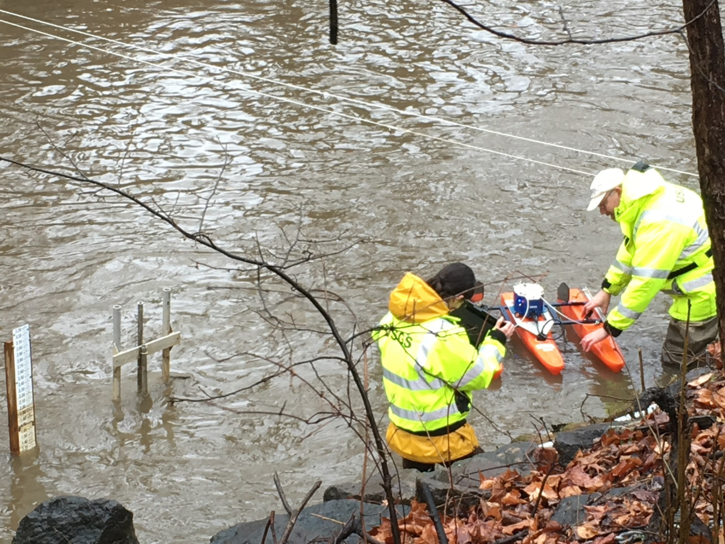
Continued Calibration of LBDC Discharge
>120 calibration measurements
Discharge:
2.3 to 745 cfs
Stage:
0.1 to >5.0 ft
Maximum Velocities:
7.8 ft/s
-1.0 ft/s
~Time from rain to rise: 30 to 60 minutes

Slide 5
Chemistry Samples to Date
 | LBDC | Hickey | Watts | NEB | NWB
Oct-Nov 2016 | Low Flow | Low Flow | -- | Low Flow | Low Flow | PCB/PAH
Dec 16, 2017 | Storm | -- | -- | Storm | Storm | PCB/PAH
Jan. 3 2017 | Storm | Storm | -- | Storm | Storm | PCB/PAH
March 31, 2017 | Storm | Storm | Storm | Storm | Storm | PCB/PAH
April 6, 2017 | Storm | Storm (discrete) | -- | -- | -- | PCB/PAH
May 5, 2017 | Storm | Storm | Storm | Storm | Storm | PCB/PAH Pesticides
July 17 2017 | -- | -- | Low Flow | -- | -- | PCB/ Pesticides
Watts Branch – Low flow sample contains oil, will be resampling

Slide 6
Gaged Streams Sampled for SS and POC
Stream | # Storms
LBDC | 14
Watts | 13
Hickey | 8
NEB | 13
NWB | 9
Needed for loading models relating
SS/POC to Q and turbidity

Slide 8
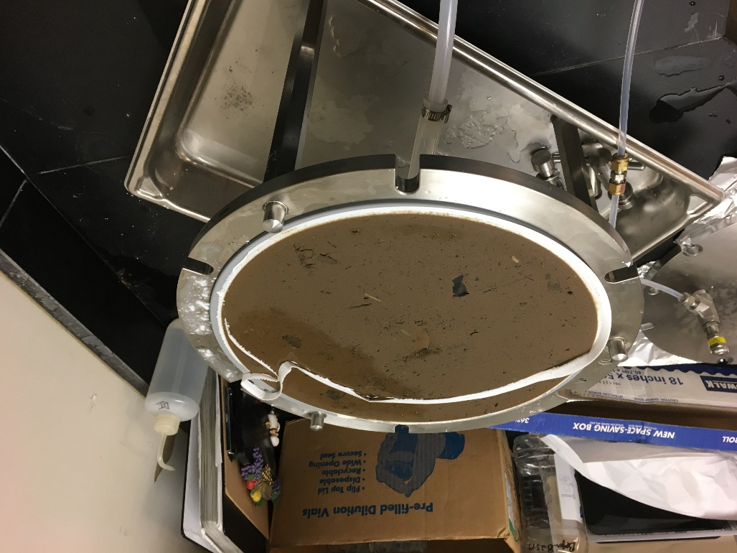
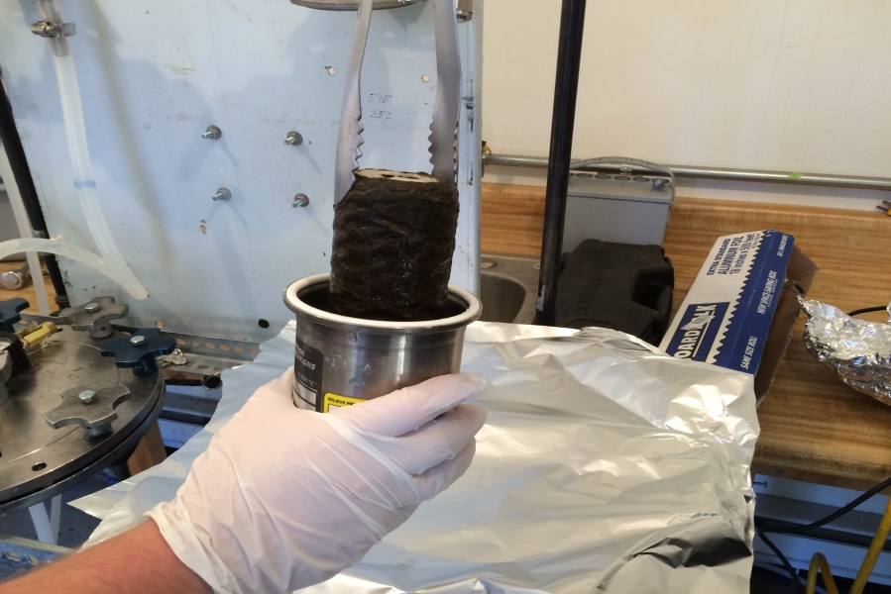
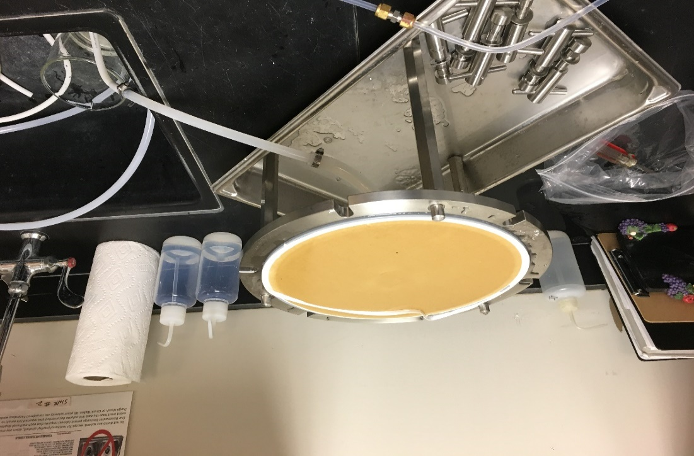
Storms: Large volume samples (75L) filtered in lab
Low Flow: up to 1000L filtered stream side with canister and flat filters

Slide 9
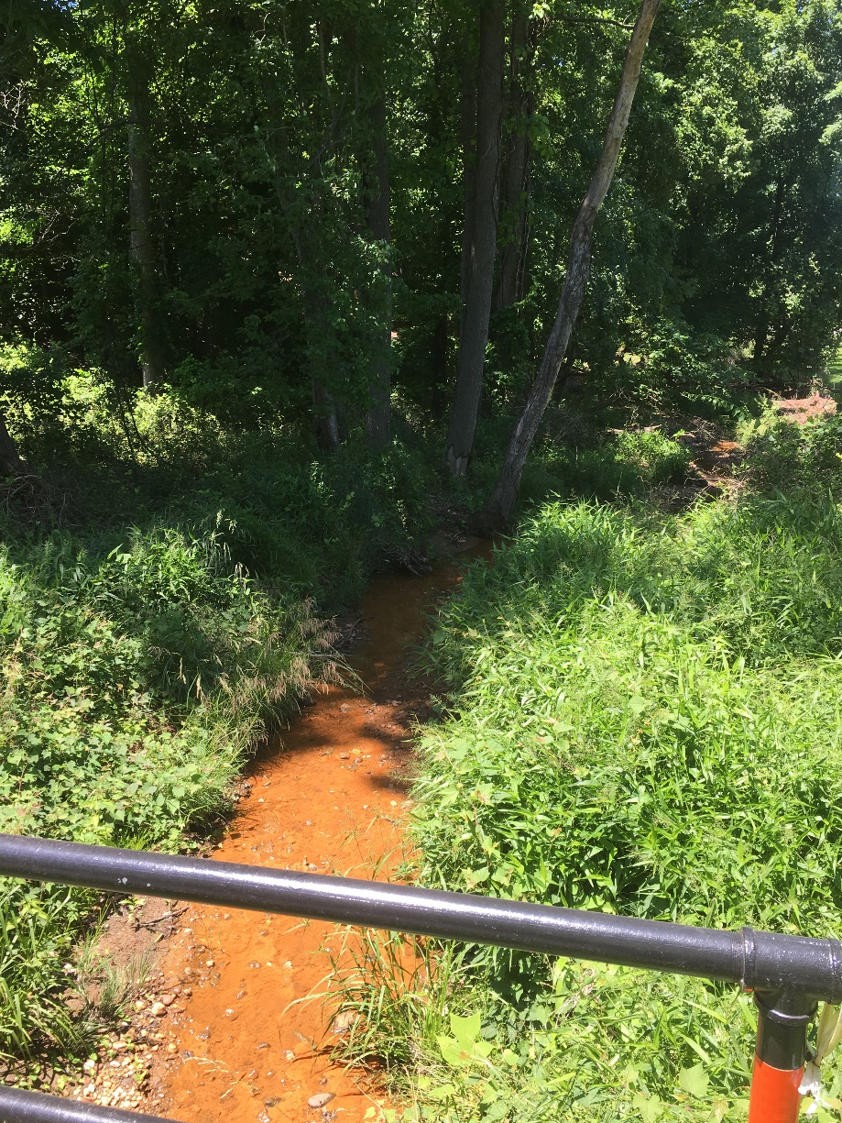
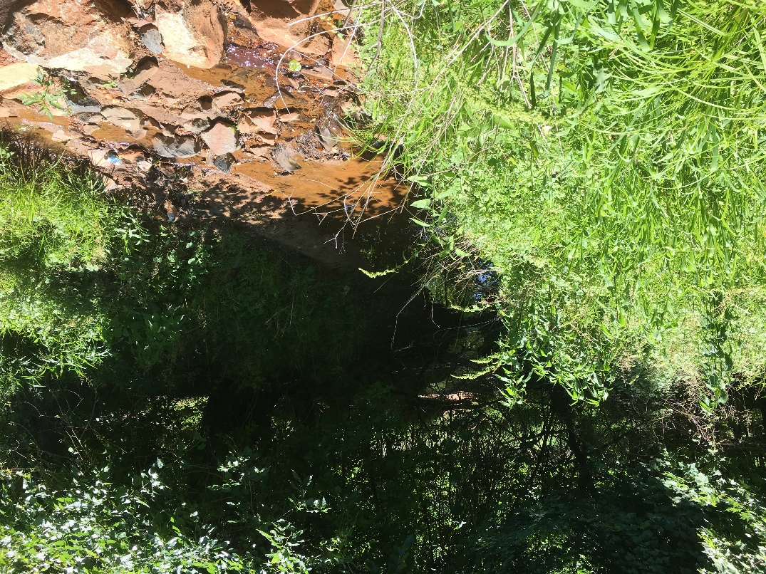
Small non-gaged Tributaries
VERY flashy – not much time to collect sufficient volume of water
Not best places to leave unattended trailers

Slide 10
Small Non-gaged Tributaries Sampled to Date
Stream | Low Flow | Storm
Nash Run | 7/25/17 | 7/28/17
Pope’s Branch | 8/2/17 | 8/7/17
Ft. DuPont Creek | TBD | 8/12/17 9/2/17
Ft. Stanton | TBD | TBD

Slide 11
Small Streams –
Difficult to sample during storms, rain passes quickly
Evidence of considerable SS load
2 Hours

Slide 12
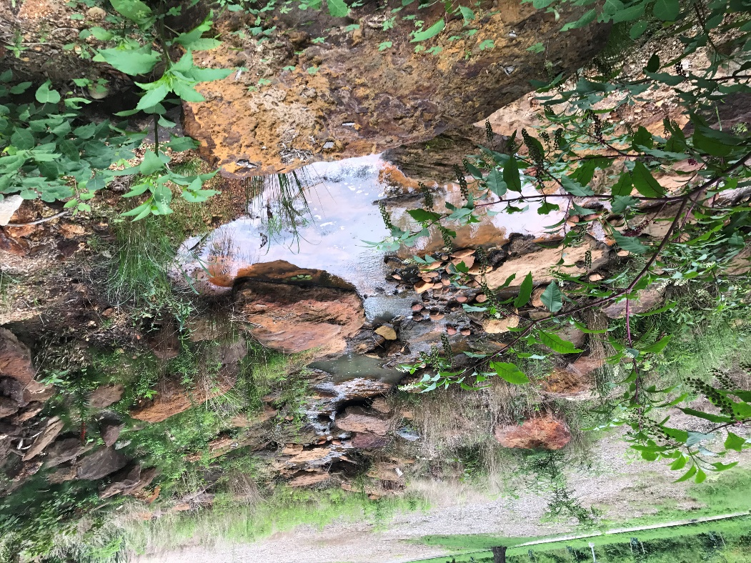
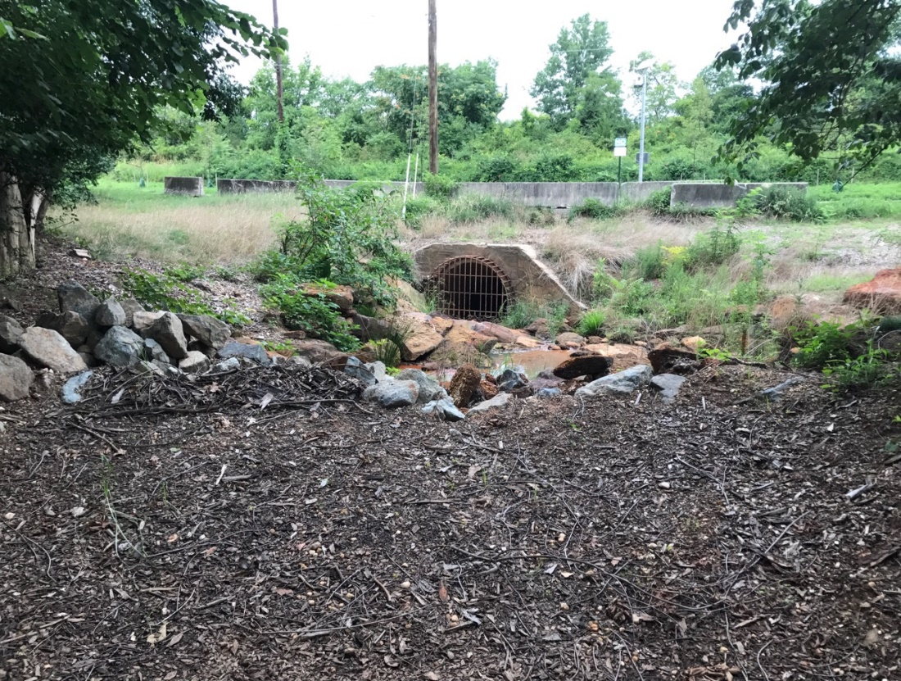
Pope’s Branch, Low Flow

Slide 13
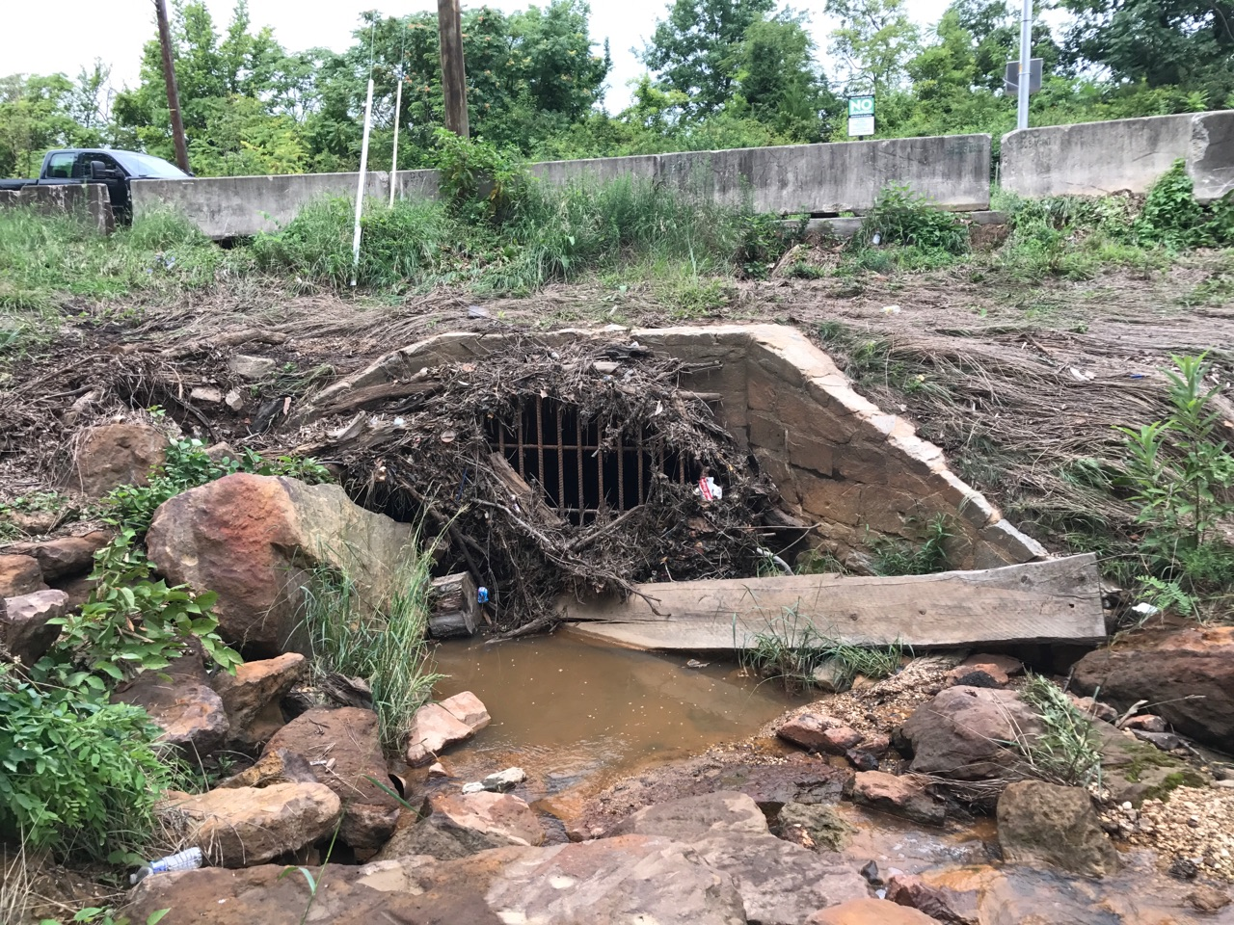
Pope’s Branch, Post Storm

Slide 14
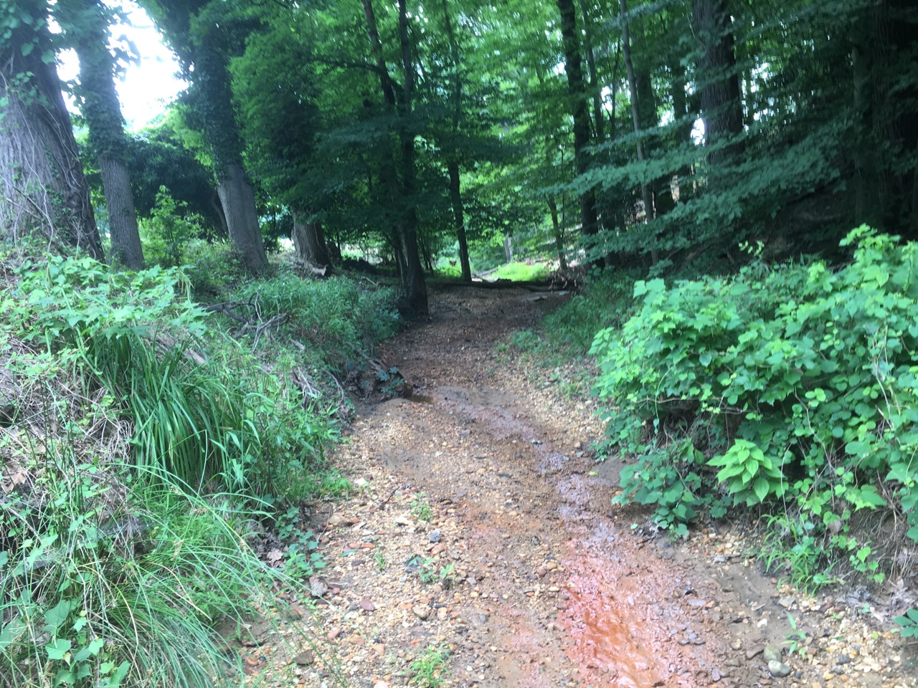
Ft. DuPont During Dry Weather

Slide 15
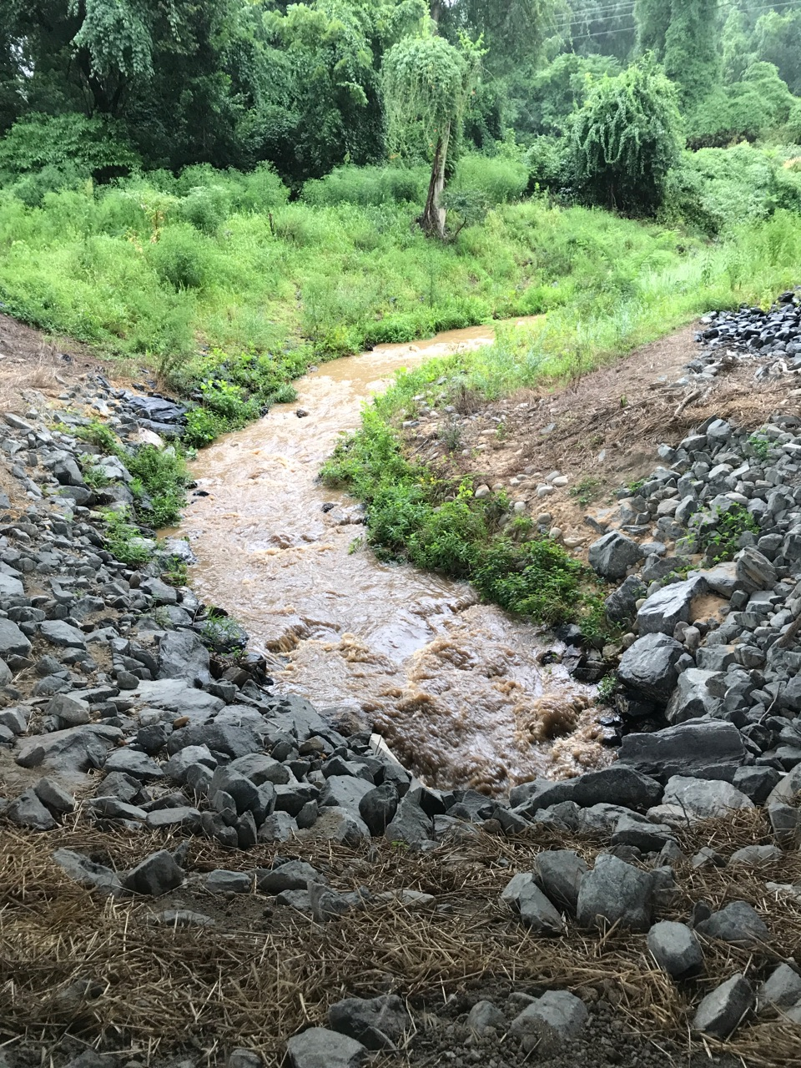
Ft. DuPont
CSX Yard Storm Flow

Slide 16
DISCLAIMER
All data presented here are “PROVISIONAL” and subject to change
2. Additional comparison is needed between blanks and samples
3. Still a lot of work remains to determine loads

Slide 17
Total PCB Concentrations in Sediment
 | LOW FLOW Conc. ug/kg |  | STORM Minimum Total Conc. ug/kg | STORM Maximum Total Conc. ug/kg |  | STORM Maximum Congener in sample | Conc. ug/kg
LBDC | 938 |  | 5.4 | 139 |  | 61/70/74/76 | 2.2
HICKEY | 1,270 |  | 20 | 39 |  | 129/138/160/ 163 | 3.7
WATTS | ? |  | 4.8 | 20 |  | 90/101/113 | 1.5
NEB | 37 |  | 1.4 | 8.1 |  | 129/138/160/ 163 | 0.76
NWB | 61 |  | 1.3 | 3.3 |  | 129/138/160/ 163 | 0.3
Work and analysis is on-going. All data, analysis, and conclusions presented here are preliminary and subject to change

Slide 18
Total PAH Concentrations
 | LOW FLOW |  | STORM Minimum Total Concentration ug/kg | STORM Maximum Total Concentration ug/kg
LBDC | 372 |  | 272 | 2,870
HICKEY | 189,000 |  | 3,490 | 6,500
WATTS | tbd |  | 813 | `1,140
NEB | 4,660 |  | 982 | 2,750
NWB | 19,200 |  | 1,010 | 1,750
LBDC, WATTS, NEB, NWB
Fluoranthene 150 to 450 ug/kg
Benzo(B)fluoranthene
Pyrene
HICKEY
C2-Phenanthrenes/anthracenes 43,000 to 47,000 ug/kg
C4-Naphthalenes
C3-Pheanthrenes/anthracenes
PRELIMINARY DATA, SUBJECT TO CHANGE

Slide 19
Detected Pesticide Concentrations – Storm Samples
 | Detected Species | Concentration ug/kg
LBDC | Heptachlor epoxide Gamma-Chlordane | 7.5 4.1
HICKEY | 4,4’-DDE | 4.6
WATTS | Gamma-Chlordane | 6.9
NEB | Aldrin Gamm-Chlordane Methoxychlor | 6.1 3.4 1.6
NWB | Gamma-Chlordane | 6.0
Few species detected – but only 1 storm sampled so far
Work and analysis is on-going. All data, analysis, and conclusions presented here are preliminary and subject to change

Slide 20
Next Steps
Ft. DuPont Creek
Low Flow
Ft. Stanton Creek
Storm and Low Flow
LBDC, NEB, NWB
Low Flow for PCB/PAH and pesticides
LBDC, Watts, Hickey, NEB, NWB
Fall Storm Sample
PCB/PAH, pesticides, and metals

Slide 21
Recommendations
Consider resampling Nash, Popes, and Ft. DuPont storms (first wait to see initial results)
Continue discrete sampling (SSC/POC/turbidity) at LBDC, Watts, Hickey
Continue recording stage and make discharge measurements at un-gaged tribs:
Ft. DuPont, Popes, Nash, Ft. Stanton
Continue sampling LBDC storms for PCB/PAH and pesticides

Slide 22
Recommendations
Sample other small tributaries and outfalls
(including Ft. DuPont outfall)
Install and calibrate stream gage (ADVM) on Anacostia River at Aquatic Gardens
Deploy ADCP’s in Anacostia to determine velocity and turbidity profiles

Slide 23
Thanks to:
USGS-Md
DC DOEE
DC DOEE

