Slide 1
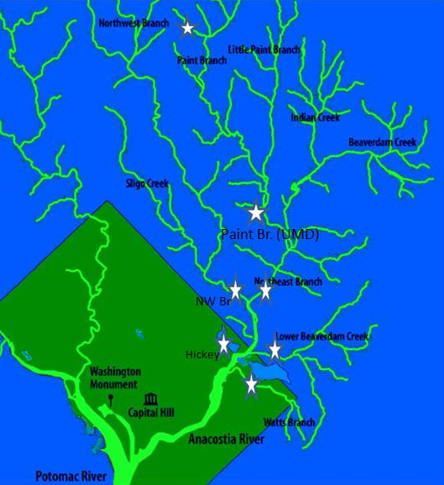

ONGOING INPUTS OF PERSISTENT ORGANIC POLLUTANTS TO THE ANACOSTIA RIVER
Nathalie Lombard, Mandar Bokare, Varapapa Thodpanich, Sam Magee, Upal Ghosh
Department of Chemical, Biochemical, and Environmental Engineering
UMBC
Study partners:
USFWS
USGS
UMBC
UMCP
DOEE
DC Leadership Council Meeting, Dec 14, 2017

Slide 2
DC Fish Consumption Advisory
Effective 2016, DOEE urges limited consumption of Anacostia and Potomac river fish.
PCBs, pesticides, and other chemical contaminants
Source: https://doee.dc.gov/service/fishing-district

Slide 3
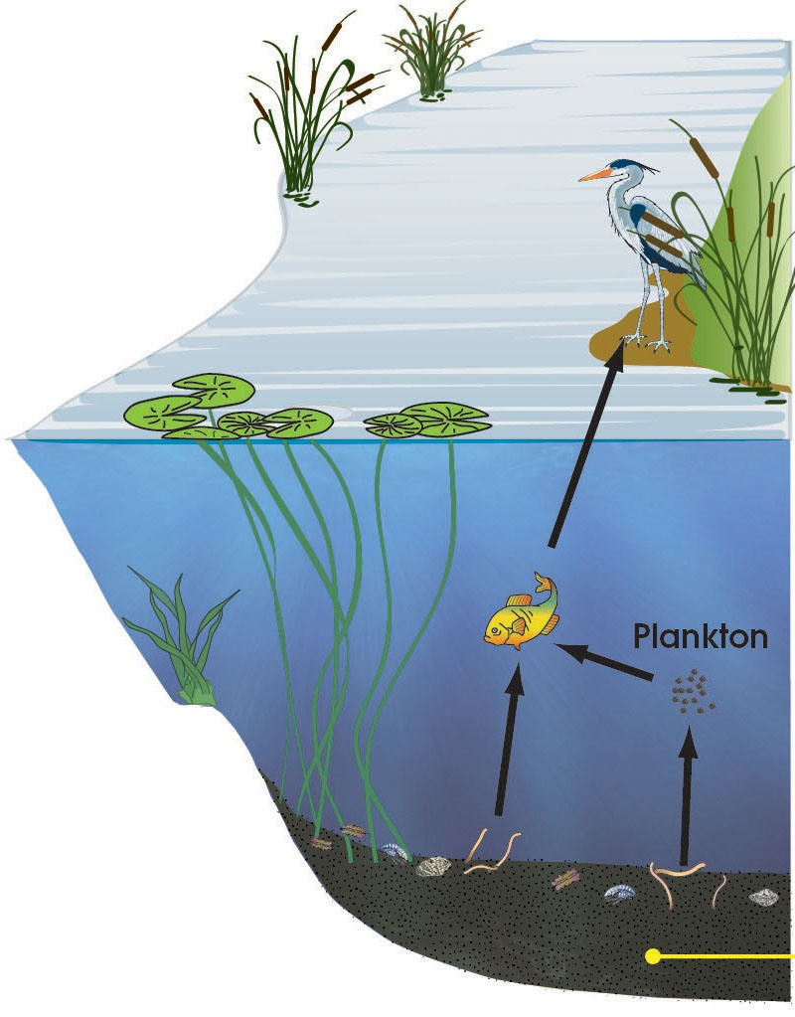
ONGOING INPUTS OF POLLUTANTS
Air-water exchange
Upstream inputs
Need to understand quantitatively contributions from:
1) Bed sediments
2) Inputs from tributaries and outfalls (storm & baseflow)
3) Air-water exchange
Human exposure primarily through food chain
Ongoing inputs can have a major contribution in an urban system – often not well characterized
Water measurements are challenged by low concentrations for strongly hydrophobic chemicals
Tributary
inputs
Flux from sediment

Slide 4
STUDY STRATEGY
1) MEASURE POLLUTANT LEVELS IN WATER
C_{total} = C_{free} + C_{DOC} + C_{SS}
During Baseflow:
measure C_{free} using passive samplers
take measurements of DOC & SS
estimate pollutant concentrations associated with DOC & SS
During Stormflow:
SS –associated pollutant loads dominate
Collect SS during storm flow and measure pollutant conc.
estimate pollutant concentrations associated with DOC & C_{free}
3) MEASURE FLOWS
2) AIR-WATER AND SEDIMENT-WATER FLUXES
4) MEASURE POLLUTANT ACCUMULATION IN DEPLOYED MUSSELS

Slide 5
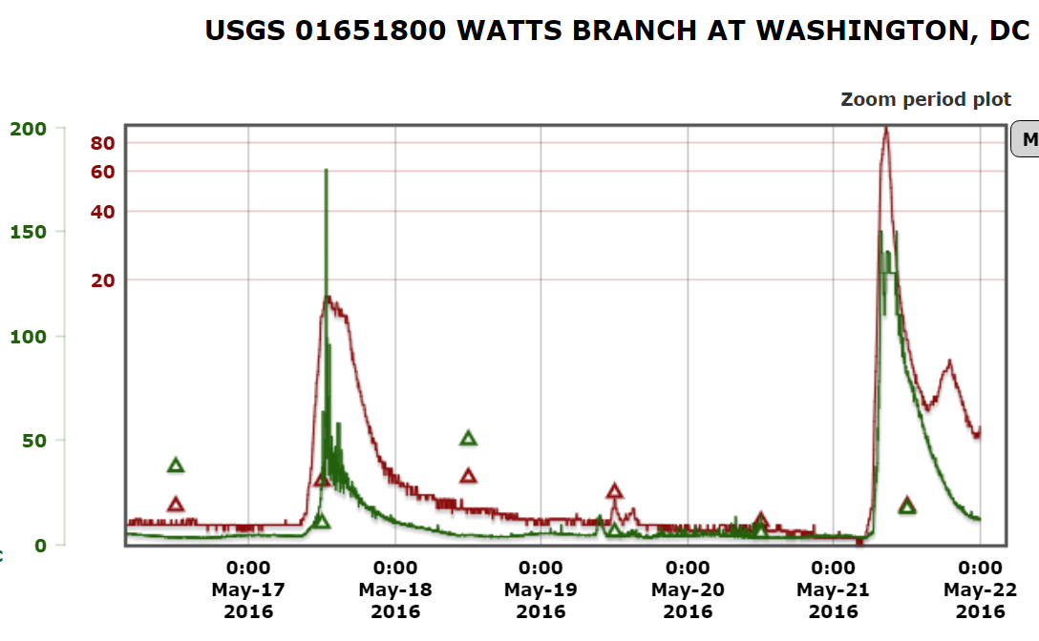
CLOSER LOOK AT A STORM EVENT
Turbidity
Flow

Slide 6
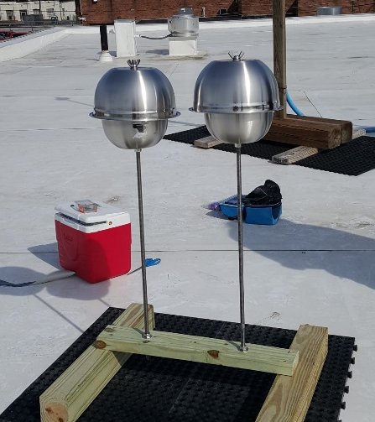
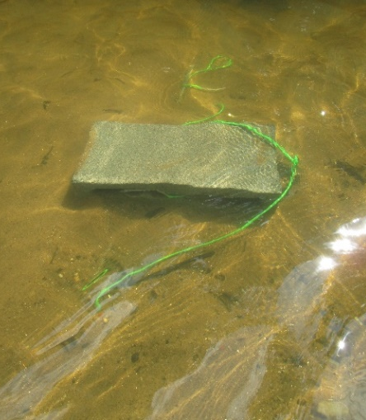
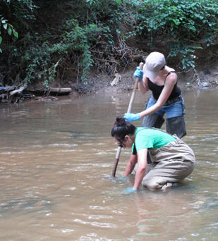
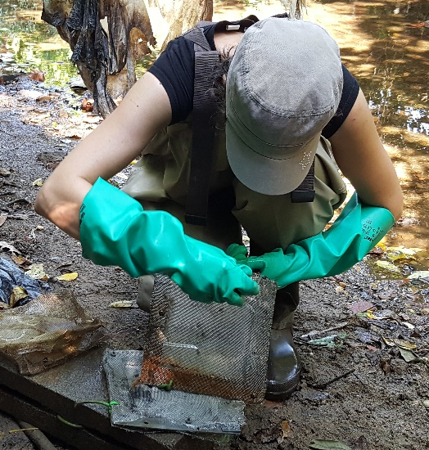
PASSIVE SAMPLING FOR MEASURING FREELY DISSOLVED CONCENTRATIONS
Hydrophobic chemicals partition between water and solid phases
Concentration in polymer can be related to the concentration in water
Performance reference compounds used to correct for non-equilibrium
New approach: Integrative passive sampler

Slide 7
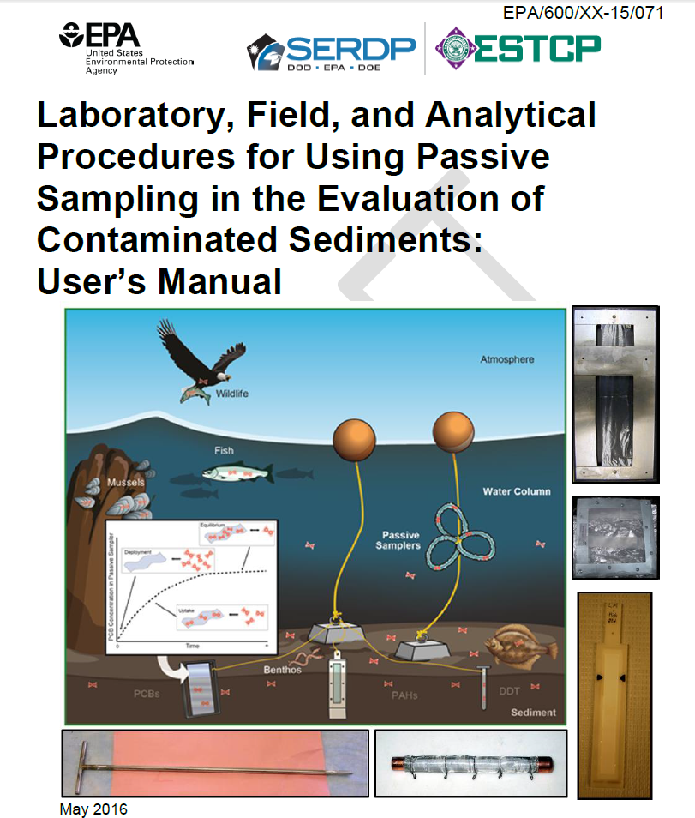

2017 NEW USEPA GUIDANCES:
Deriving Sediment Interstitial Water Remediation Goals (IWRGs) at Superfund Sites for the Protection of Benthic Organisms from Direct Toxicity
Lawrence P Burkhard and David R. Mount. U.S. EPA, Duluth, MN
Robert M. Burgess. U.S. EPA, Narragansett, RI
Draft May 2016
2017 New start project from DoD ESTCP
Developing standard method (EPA SW-846) for passive sampling of sediments using common polymer sorbents (PDMS, PE)

Slide 8
SAMPLING LOCATIONS
Location | Mussels | Passive sampler (pore water) | Passive sampler (water column)
NE branch near gage | X | X | X
NW branch near gage | X | X | X
Lower Beaverdam Crk | X | X | X
Hickey Run (near gage) | X | X | X
Watts Branch (near gage) | X | X | X
Beaverdam Crk | X | X | X
Mussel collection site | X | X | X
Anacostia site 1 |  | X | X
Anacostia site 2 |  | X | X
Anacostia site 3 |  | X | X
Anacostia site 4 |  | X | X
Pollutants:
PCBs
Pesticides
PAHs
Location | Passive sampler | Suspended sediment | Flow Measurements | Passive sediment sampler & suspended sediments
1) Nash Run | X | X | X | X
2) Ft. Dupont | X | X | X | X
3) Pope’s Branch | X | X | X | X
4) Texas Ave | X | X | _ | X
5) Ft. Stanton | X | X | _ | X

Slide 9
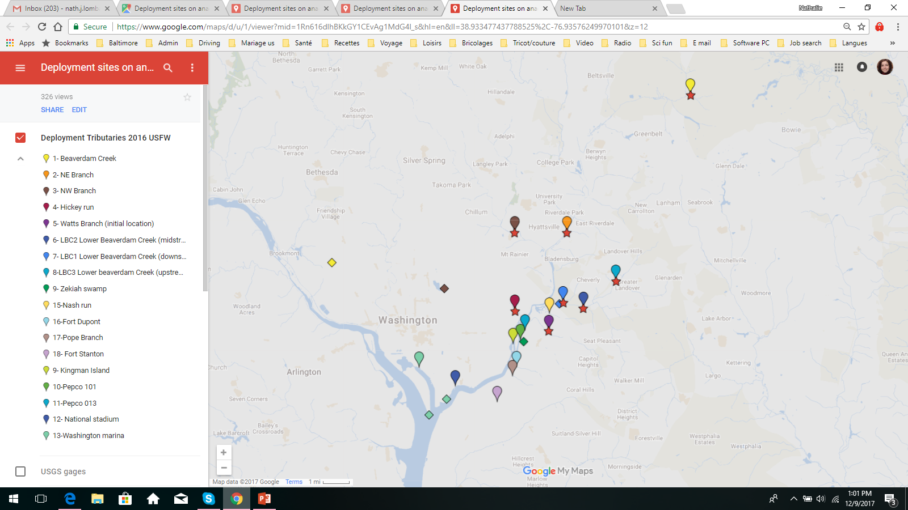
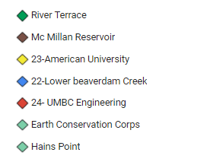
SAMPLING LOCATIONS
Water sampler
Air sampler
Mussel

Slide 10
PCBs in water
Tributaries
Anacostia River
Water column
Legend
Pore water
Total PCB in Baltimore Inner Harbor: 0.5 ng/L
(Bamford, Ko, and Baker, 2002)
1x10⁻⁵ cancer risk PCB tot 0.064 ng/L
1x10⁻⁶ cancer risk PCB tot 0.64ng/L
Provisional data subject to change

Slide 11
PCBs in mussel
Mussel
Water column
Provisional data subject to change

Slide 12
Pesticides in water
Tributaries
Anacostia River
Water column
Sediment pore water
Provisional data subject to change

Slide 13
Pesticides in water: Tributaries:
1x10⁻⁵ cancer risk Aldrin 0.01ng/l
1x10⁻⁶ cancer risk Aldrin 0.001ng/l
1x10⁻⁵ cancer risk dieldrin 0.01ng/l
1x10⁻⁶ cancer risk dieldrin 0.001ng/l
1x10⁻⁵ cancer risk DDE 0.18ng/l
1x10⁻⁶ cancer risk DDE 0.018ng/l
1x10⁻⁵ cancer risk tot chlord 3.1ng/l
1x10⁻⁶ cancer risk tot chlord. 0.31ng/l
Provisional data subject to change

Slide 14
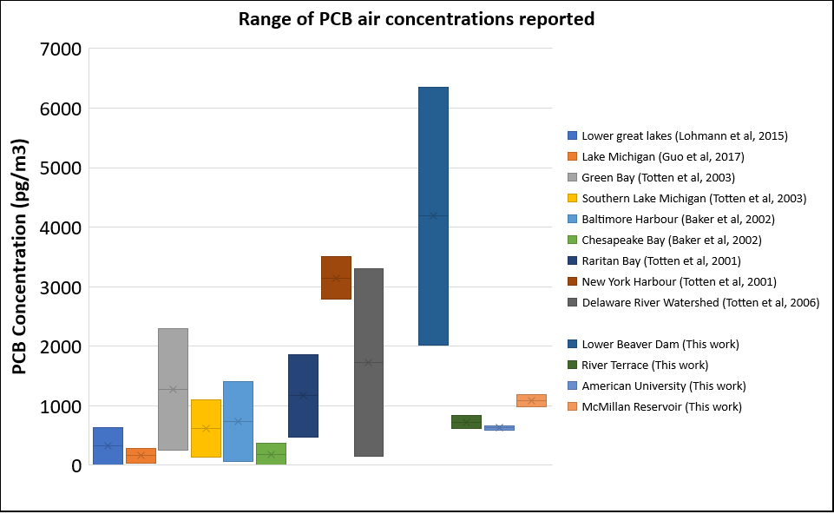
PCB in air - comparison with other studies
Previous Studies
Current Work
Provisional data subject to change

Slide 15
PCB Flux
Provisional data subject to change

Slide 16
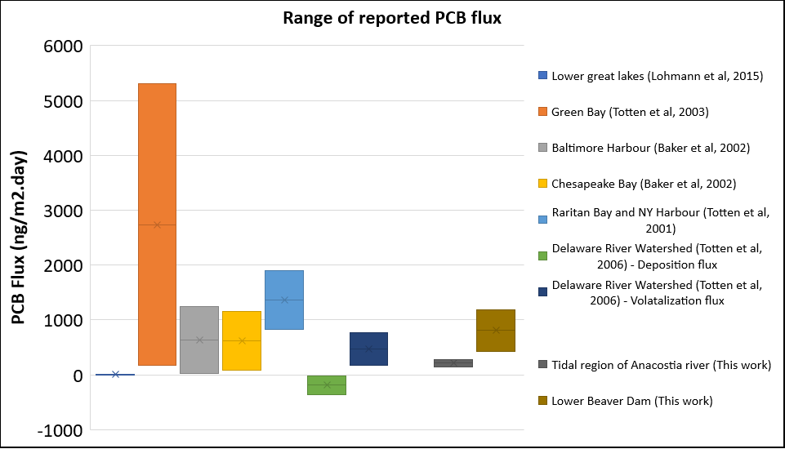
Comparison with Other Studies
Previous Studies
Present Work
Provisional data subject to change

Slide 17
Initial Conclusions
Upstream inputs
New data using latest technology for measuring low levels of pollutants in air and water
Water concentration exceedances for human cancer risk
High concentrations of pollutants entering from several tributaries
Contaminated sediment source at several locations
Pollutant concentrations in mussel reflect concentrations in water
Air concentrations comparable to data from Chesapeake Bay and Delaware
High concentration in water causing net PCB volatilization from Anacostia River
Air-water flux
Tributary
Inputs
Flux from sediment
?
Outflow
Provisional data subject to change

Slide 18
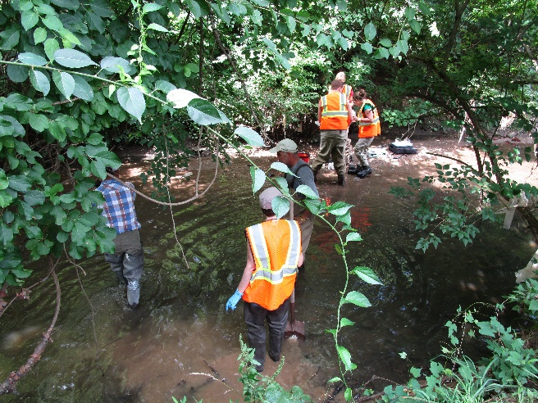
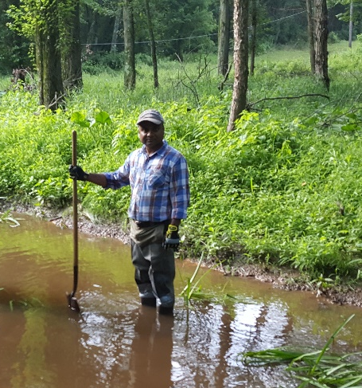

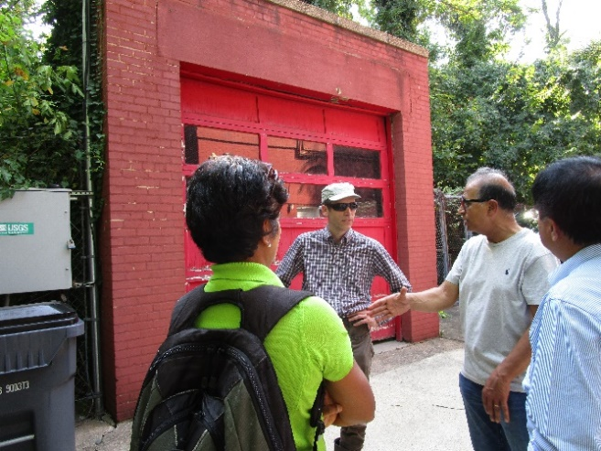
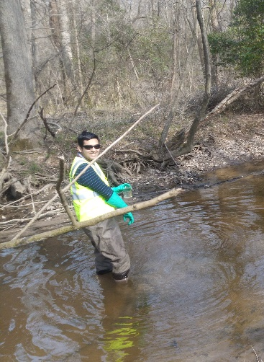
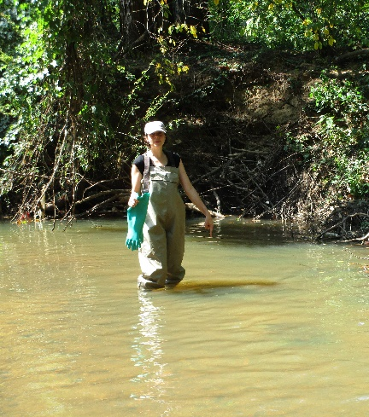

Questions?

