Slide 1
Think Before You Spank
Dr. Satira Streeter, Licensed Clinical Psychologist
Chair, Mayor’s Advisory Committee on Child Abuse and Neglect

Slide 2
Workshop Goals
To give caregivers information about the harmful impact of spanking
To discuss effective discipline methods
To explore current parenting tactics (including generational parenting and “updates” based on science)
To acknowledge that while spanking is not against the law, it can have serious and detrimental outcomes
To help caregivers recognize that they have a choice in the corrective measures that they use
To help caregivers fill their “parenting toolkits” with knowledge, alternatives, and community resources

Slide 3
Lessons Learned About Parent’s Attitudes toward Spanking
Many of our parent are not aware of the relationship between spanking or hitting their child and the increased risk of child abuse.
Most of our parents tell us that they were hit as a child, and they “turned out okay.”
Many of our parents tell us they “don’t believe the research, especially for their children.”
Some parents tell us, they “don’t need anyone to tell them how to raise their children.”
Many parents say “The Bible tells me to spare the rod, spoil the child.”

Slide 4
“Sometimes people hold a core belief that is very strong. When they are presented with evidence that works against that belief, the new evidence cannot be accepted. It would create a feeling that is extremely uncomfortable, called cognitive dissonance. And because it is so important to protect the core belief, they will rationalize, ignore and even deny anything that doesn’t fit in with the core belief.”
-Frantz Fanon
Afro-Caribbean psychiatrist and philosopher b.1925 – d.1961

Slide 5
Physical Punishment Continuum
Spanking - hitting a child on their buttocks or extremities using an open hand
Hitting with Objects - belts, switches, paddles, extension cords
Methods that cause harm/injury - beating, burning, choking, whipping
Methods that are expressions of parent displeasure without a clear disciplinary component – pulling hair, shaking, shoving

Slide 6
Why do they spank?
A slave in 1830
A black mother of four in the year 1960
The head deacon at Mt. Zion Baptist Church
A wealthy white business man
A Black single father of three boys
A DC parent in 2017

Slide 7
Who Spanks?
Over 75% of Parents in the world spank their children
African Americans are more likely to spank their children than any other racial or ethnic group in the United States
Parents in the South and those who have conservative religious beliefs
Younger parents
Parents with lower incomes
Parents with lower levels of education/ exposure

Slide 8
How Common is Physical Punishment?
Percentage | Age of Child | Frequency/Time | Reference
17 percent of mothers spank | 6-to-13 months old infants | Previous week | Combs-Orme & Cain, 2008
26 percent of mothers spank | 3-years-old | > 2 times in previous month | Taylor et al, 2010
35 percent of parents physically punish | 4-to 5-years old | Past week | National Longitudinal Surveys Youth, 2002
80 percent of children have been physically punished | By time they reach 5th grade | Lifetime | Gershoff & Bitensky, 2007

Slide 9
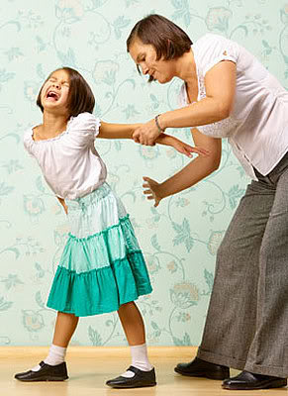
Spanking Hurts!
Bruises, broken bones, or nerve
damage can occur
More likely if the caregiver
is frustrated, stressed, or angry
Most caregivers do not report
being calm while administering a spanking

Slide 10
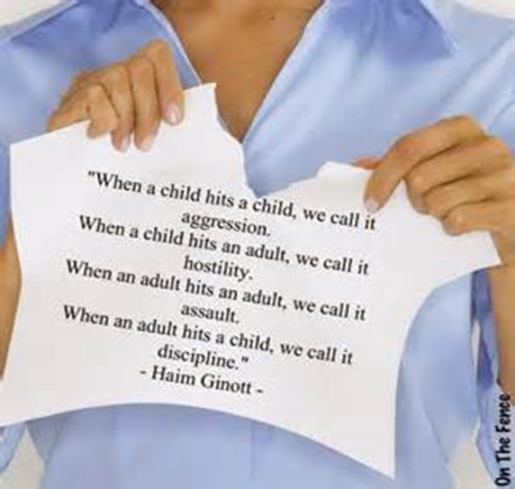
Spanking Damages Trust
Children may become scared of their caregiver.
It may be hard to trust that the person who hits you will keep you safe.
Parents have to demonstrate a “Do as I say not as I do” philosophy.
Parents may say that “I’m doing this for your own good” but most parents hit to vent their own anger and frustration.

Slide 11
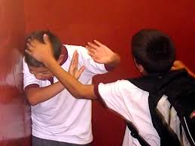
Spanking Can Increase Bad Behavior
To avoid being “caught” in behavior that might result in a spanking, children my lie, steal, or cheat.
Children learn to use violence to get others to do what they want them to do.
Children may become angry and act out more.
Respect may be lost and children may behave “well” only to avoid spanking, but not with an understanding of the positive reasons for “good behavior.”

Slide 12
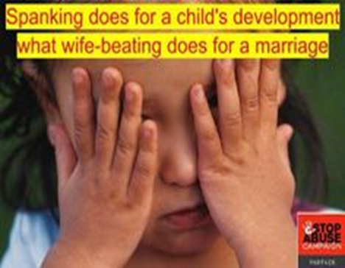
Spanking Supports Violence
Spanking is hitting.
Spanking teaches a child that it is okay to hit when you are displeased.
Children may learn that hitting equates to love.
There is no research that supports the effectiveness of physical punishment.
When physical punishment doesn’t work, parents think they have to keep increasing it which makes spanking even more dangerous.

Slide 13
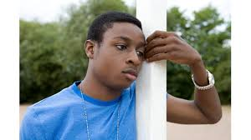
Spanking Creates Bad Memories
Children may hold on to feelings of anger.
Children may become adults that harbor feelings of resentment which distance them from their caregivers.
"Smacking a child to quiet him will startle him and shame him into either tears or silence. Whatever the momentary gain for the disciplinarian, for the child, the lesson in shame and anger is lasting."
(Drs. Kindlon and Thompson, authors of Raising Cain – Protecting the Emotional Life of Boys)

Slide 14
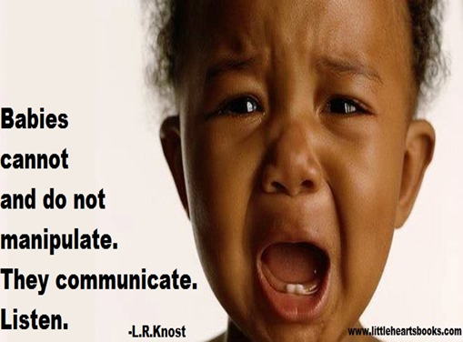
Spanking Ignores the Needs of Children
Children act out because of their need for direction, attention, nutrition, sleep, and/or exploration.

Slide 15
Spanking Undermines Great Parenting
Spanking temporarily stops misbehavior, but takes away an important opportunity to teach and model appropriate, self-disciplined behavior.
No long-term behavioral positive change typically results from children being hit.
When a child is being hit he is not in the frame of mind to learn.
They become overwhelmed with sadness or anger which is directed either inward or externally.
Children show long-term positive behavior change when they
Understand expectations,
Want their caregivers to be proud of them,
Have self pride and awareness, and
Understand the reasons for rules.

Slide 16
Spanking Does More Harm than Good
Spanking has been linked to…
Low moral internalization
Aggression
Antisocial behavior
Externalizing behavior problems
Internalizing behavior problems
Depression

Slide 17
Spanking Does More Harm than Good (continued)
Spanking has been linked to…
Anxiety
Negative parent-child relationships
Impaired cognitive ability
Low self-esteem
Substance Abuse
Physical abuse of one’s spouse and children as adults
Poorer quality of relationship with parents
Reference: Gershoff, 2008; Gershoff, 2016; Grogan-Kaylor et al, 2005; Mulvaney et al, 2007; Pardini et al, 2008; Slade et al, 2004; Straus 1994.

Slide 18
Spanking is Passed Down Through Generations
Most parents spank because they were spanked
Many parents believe that their parents could have taken another approach
Many parents indicate that they have never considered not spanking or utilizing other methods.

Slide 19
Discipline is helping a child solve a problem. Punishment is making a child suffer for having a problem. To raise problem solvers, focus on solutions, not retribution. -L.R. Knost (independent child development researcher, award-winning author)

Slide 20
What could your parents have done instead?

Slide 21
“Discipline teaches, improves, corrects, and prevents. Punishment retaliates, humiliates, and/or causes physical pain.”

Slide 22
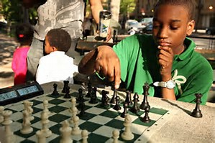
Set Children Up for Success
Make rules and expectations clear and prevent situations for misbehavior to happen to help children demonstrate their best behavior.
Know developmental milestones so that you don’t expect too much or too little from your child.
Child-proof the house.
Remind children of the expectations and rewards before entering potential difficult situations i.e. church, grocery store, appointments.

Slide 23
Praise and Reward Positive Behaviors
Children learn expectations and which behaviors to repeat.
“Catch” children engaged in positive behaviors.
Let them know that you are proud of their decisions.
Provide small incentives/grant privileges for positive behavior.
Look children in the eye, offer a hug or a high five, tell them the behavior you noticed, them know how proud you are.

Slide 24
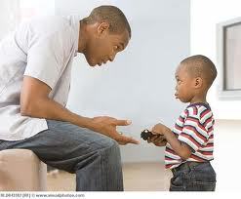
Utilize Teachable Moments
Caregivers can help children to manage emotions, problem solve, and compromise with everyday moments:
As you’re watching TV
Listening to the radio
Out in public
Observing the behavior of others
Reading
Ask the child to reflect, share your reflections.

Slide 25
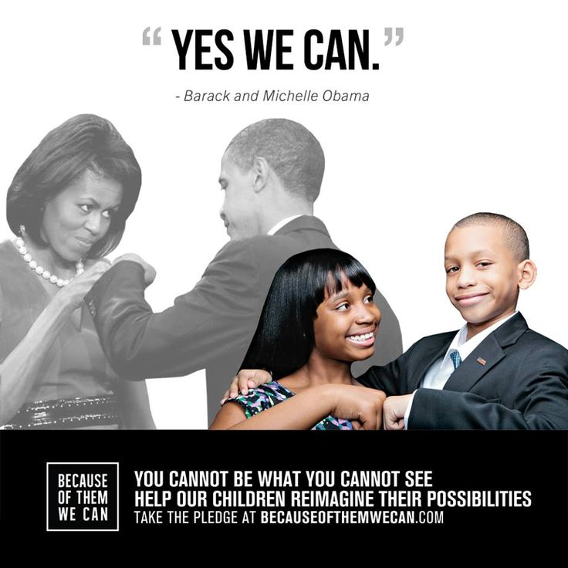
Model
Demonstrate how to manage relationships, self-care, and responsibilities daily. Children are a reflection of their caregivers positive and negative behaviors.

Slide 26
Use the Village
Talk to trusted friends, family, church members, elders, teachers, and other people who know your children to gain support and share ideas on how to correct difficult behaviors.

Slide 27
Allow Natural and Logical Consequences
Children will understand the link between their behavior and what follows to learn from their own mistake:
Spills something - help to clean it up.
Breaks something - earns money to replace it.
Doesn’t do homework - has to do it during family movie night.
Misuses a toy or household item - doesn’t get to use it for awhile.
Hurts a friend or a sibling - has to write a letter or draw a picture to make them feel better.

Slide 28
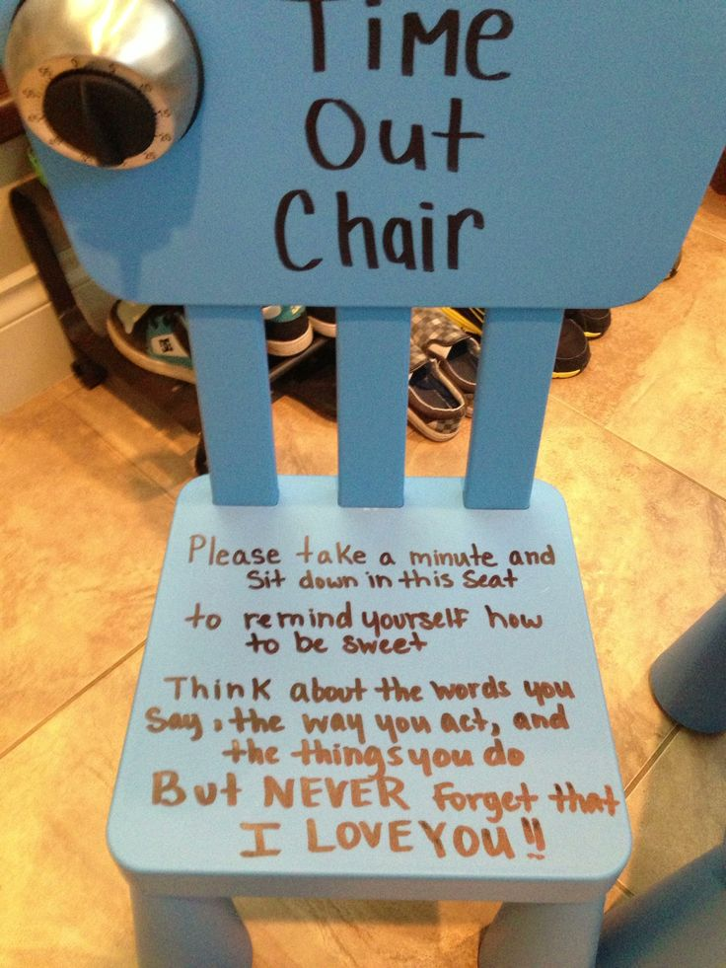
Time Out
Temporarily removing a child from the situation is an excellent way for children and adults to calm themselves down.
Time out should be in a safe, quiet place, with no entertainment.
A general rule is one minute for every year of life (e.g., 5 year old = 5 minutes of time out).
Caregiver should use this time to breathe and think about most appropriate form of further discipline, if necessary

Slide 29
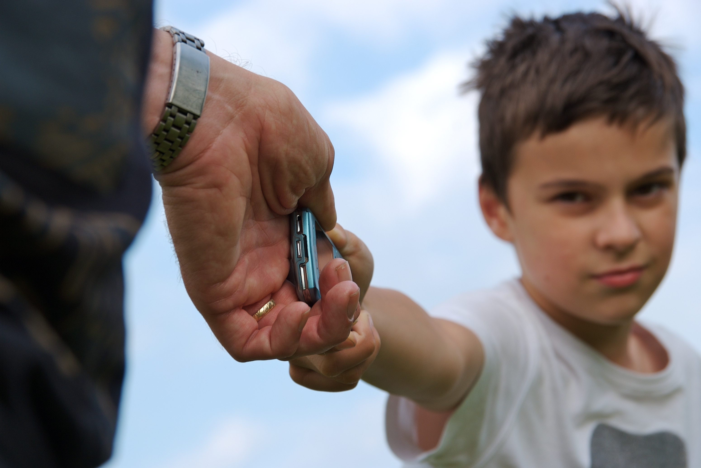
Take Away Privileges, Toys, or Technology
Consistent and fair loss of privileges allows children to reflect on their behavior and recognize consequences:
Phone
Computer
Video games
Television time
Fun time with friends
Treats
More importantly, teaching children how to earn privileges can help them make good behavioral decisions.

Slide 30
What if my friends and family ridicule me for not spanking?
Remember your goals for your children
Ask friends and family to help you come up with new strategies for discipline
Share information that you have learned about effective discipline
Be empowered to be your child’s biggest advocate

Slide 31
What if my friends and family ridicule me for not spanking?

Slide 32
Government of the District of Columbia Mayor’s Advisory Committee on Child Abuse and Neglect Membership as of December 8, 2016

Slide 33
Questions?
202-889-4344
www.thinkbeforeyouspank.com

