Slide 1
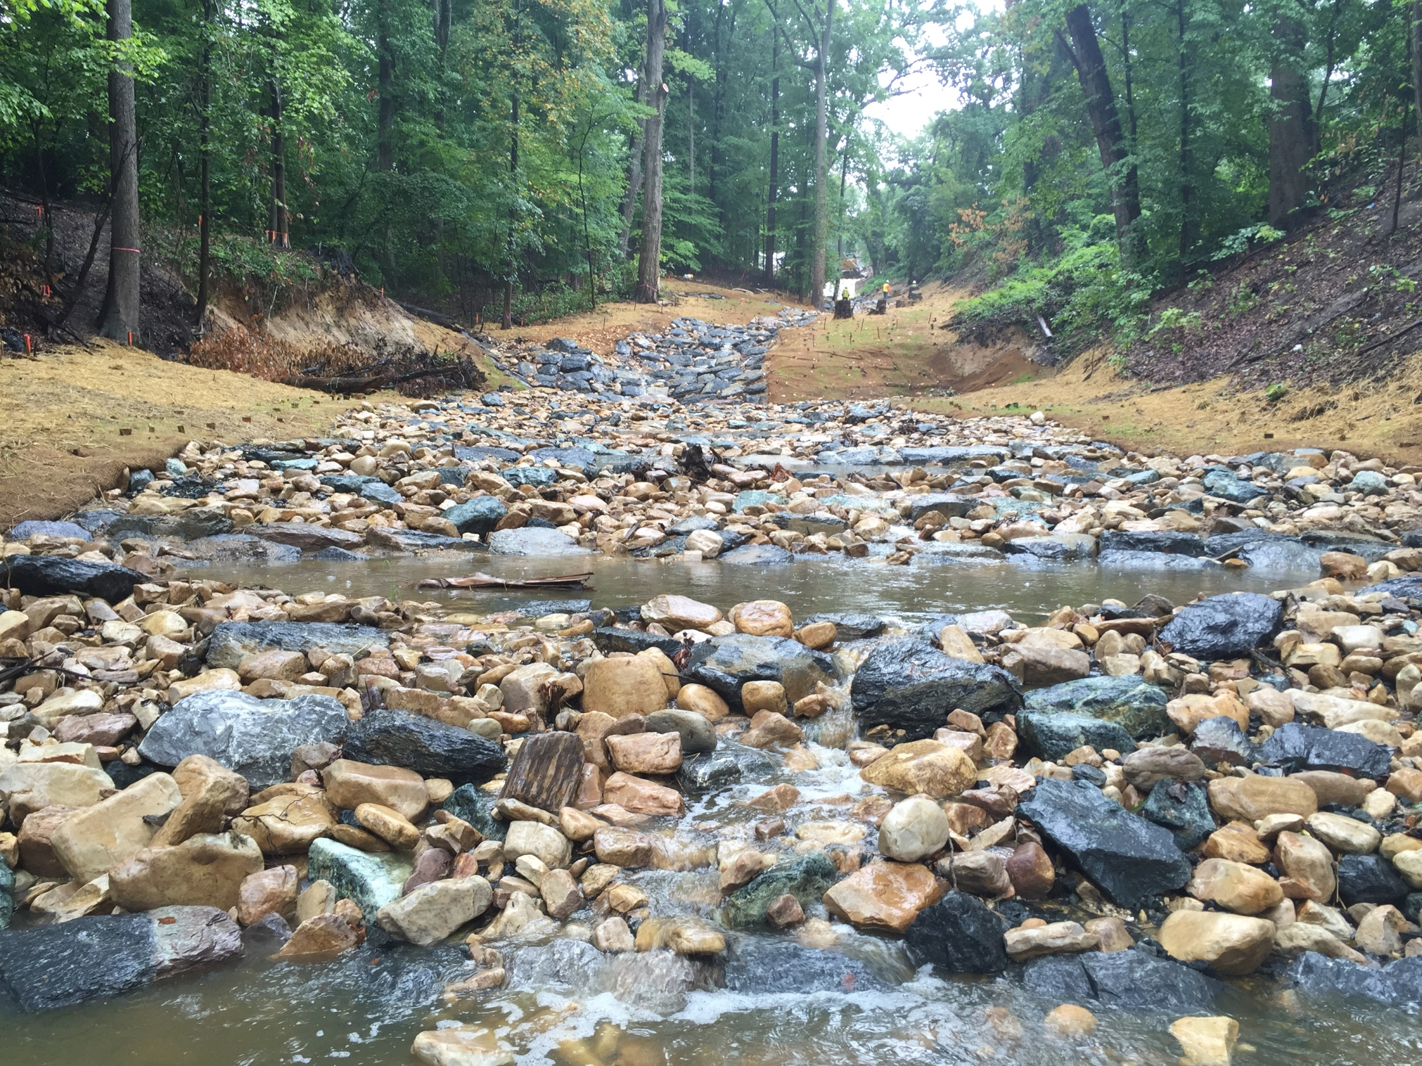

Stream Restoration
The District’s Streams
TAG THIS PRESENTATION @DOEE_DC

Slide 2
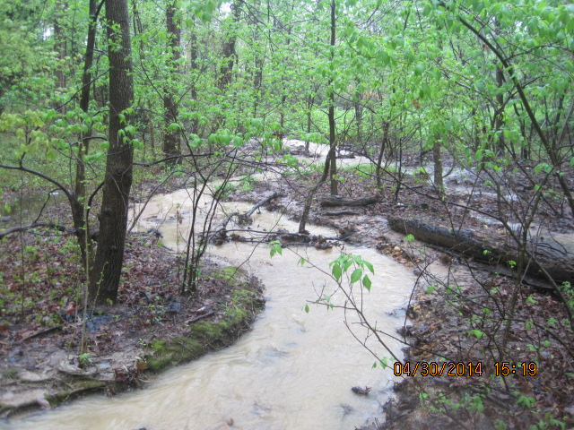
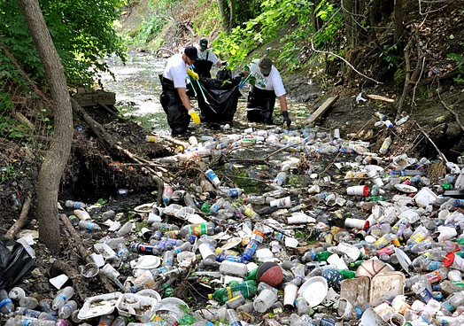
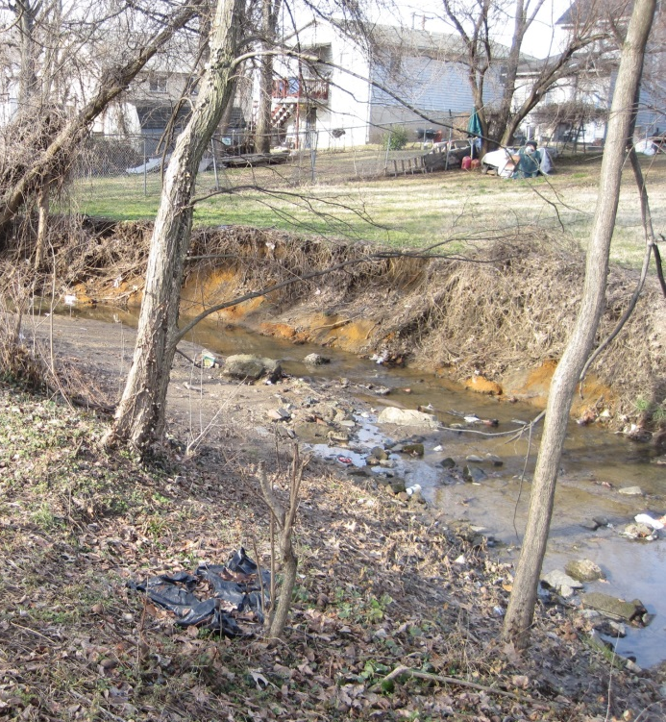
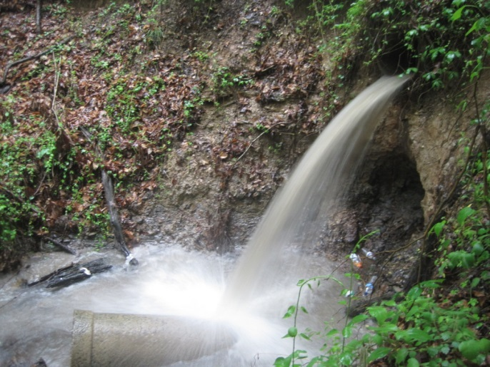
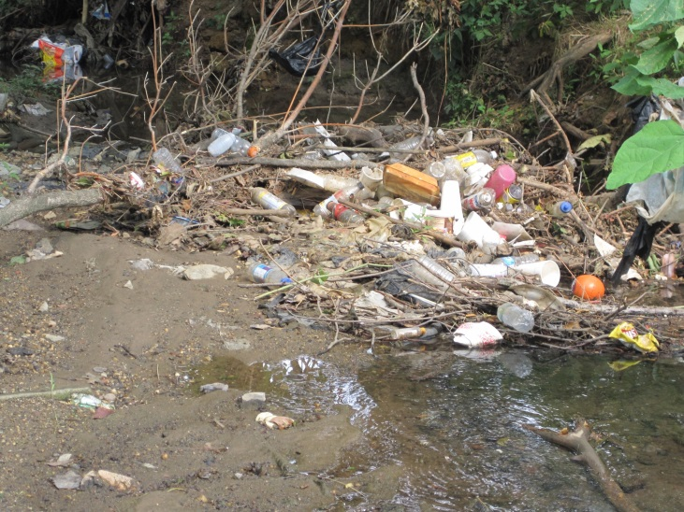

Stream Problems
Large Sediment Load
Trash
Bank Erosion
Stormwater
Habitat Loss
@DOEE_DC

Slide 3
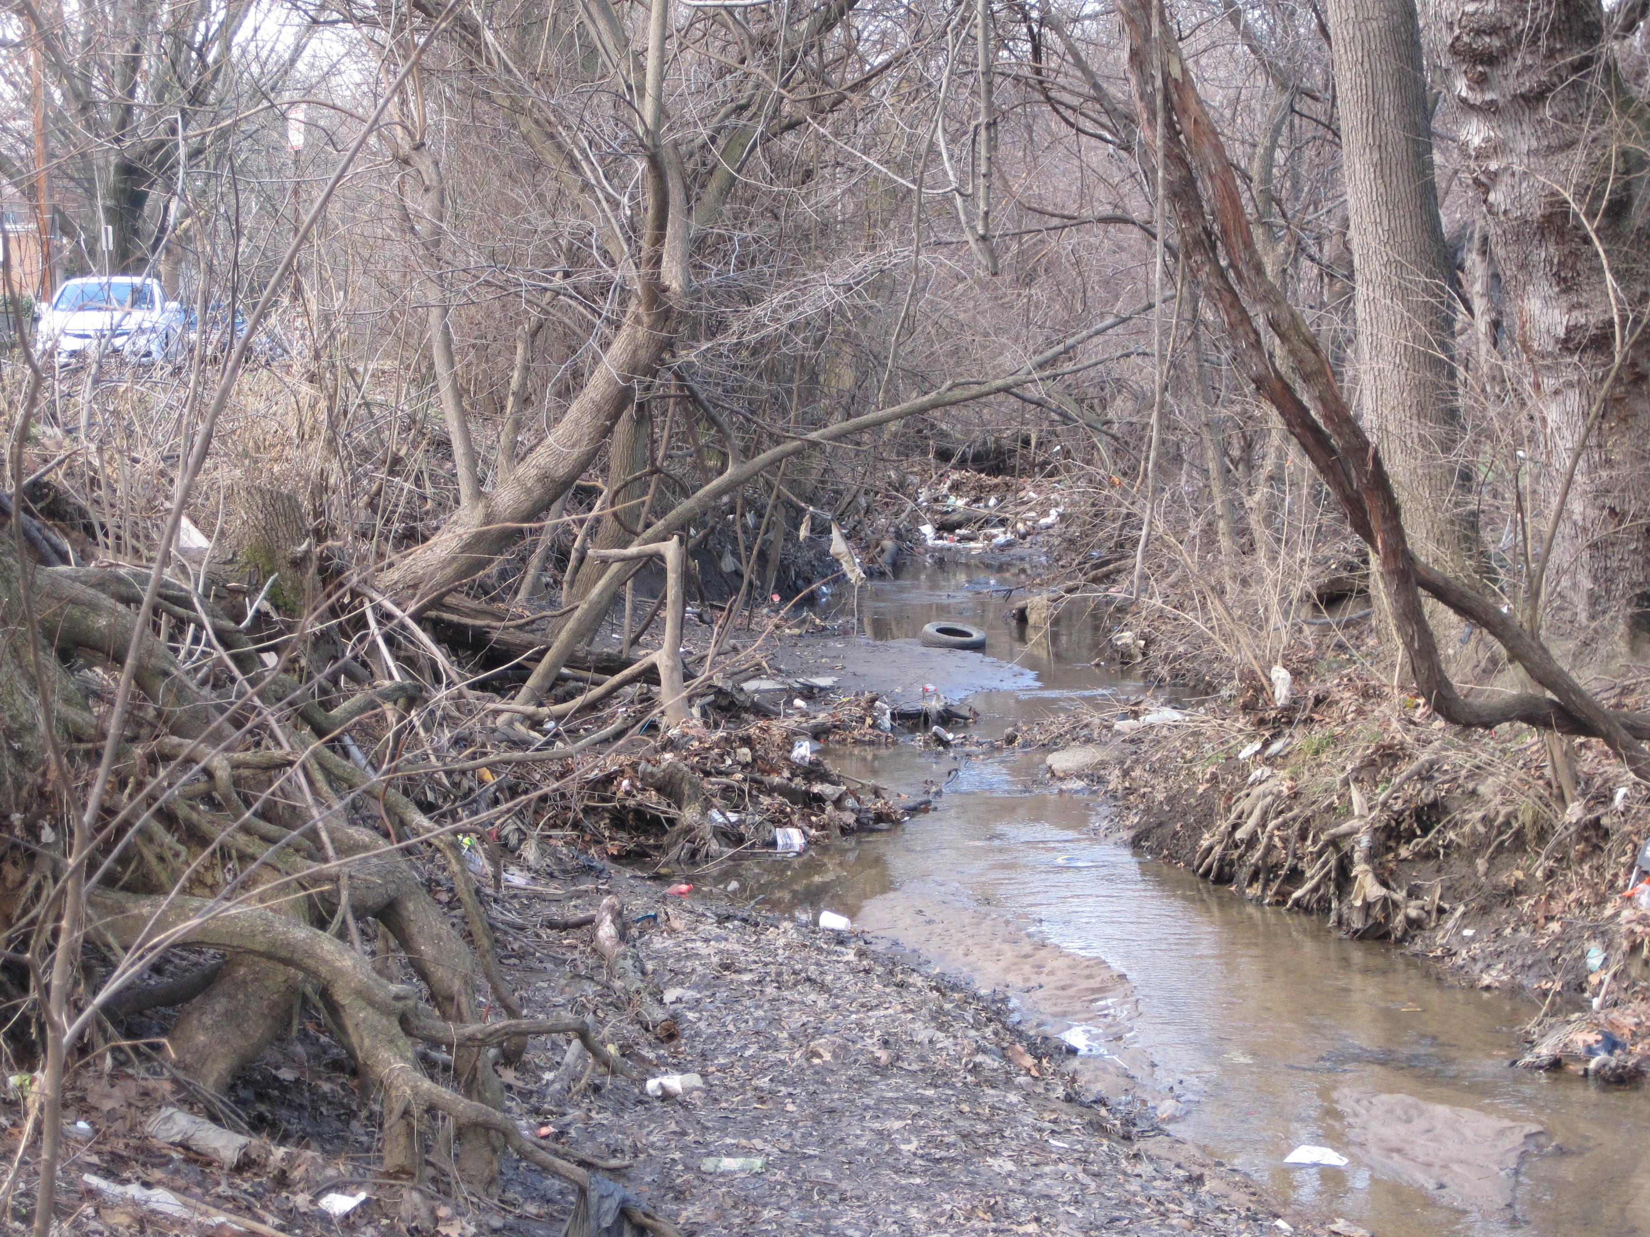
Nash Run

Slide 4
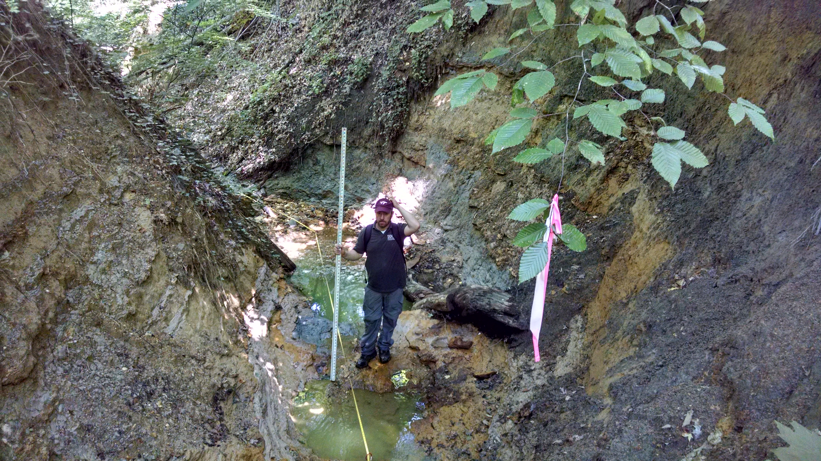
Alger Park
TAG THIS PRESENTATION @DOEE_DC

Slide 5
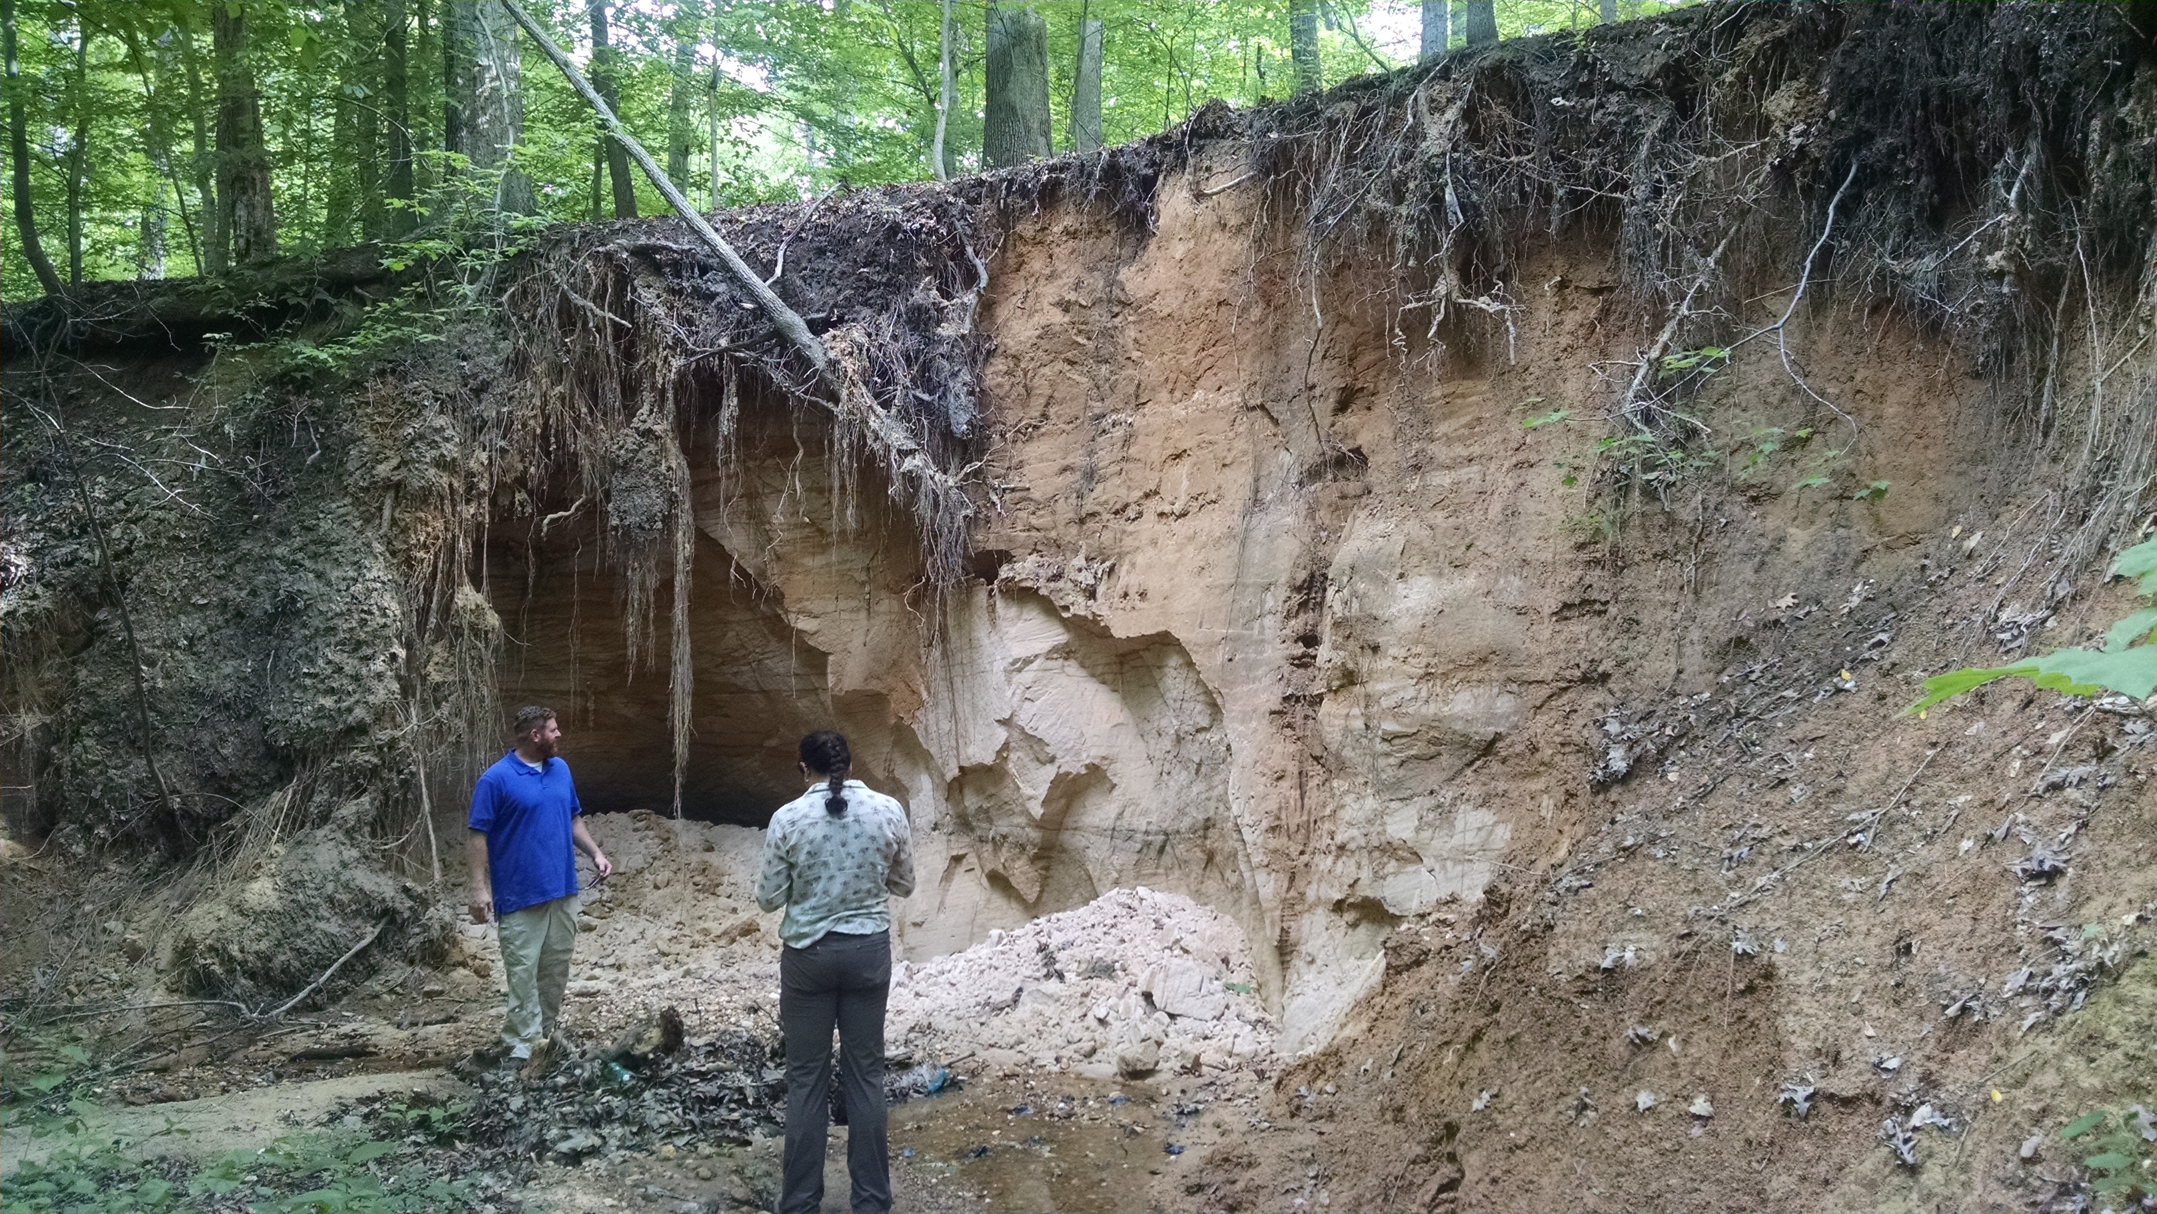
Fort Dupont

Slide 6
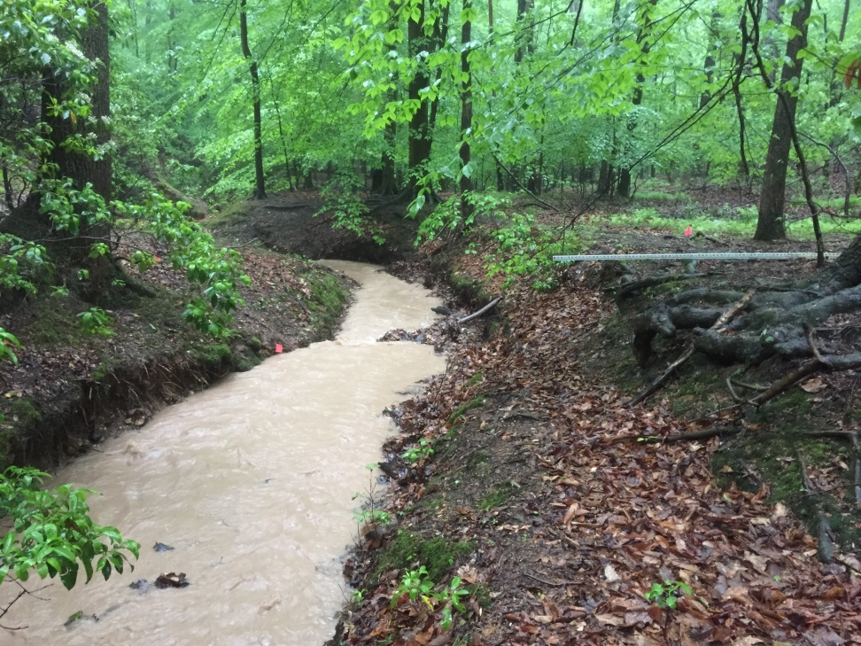
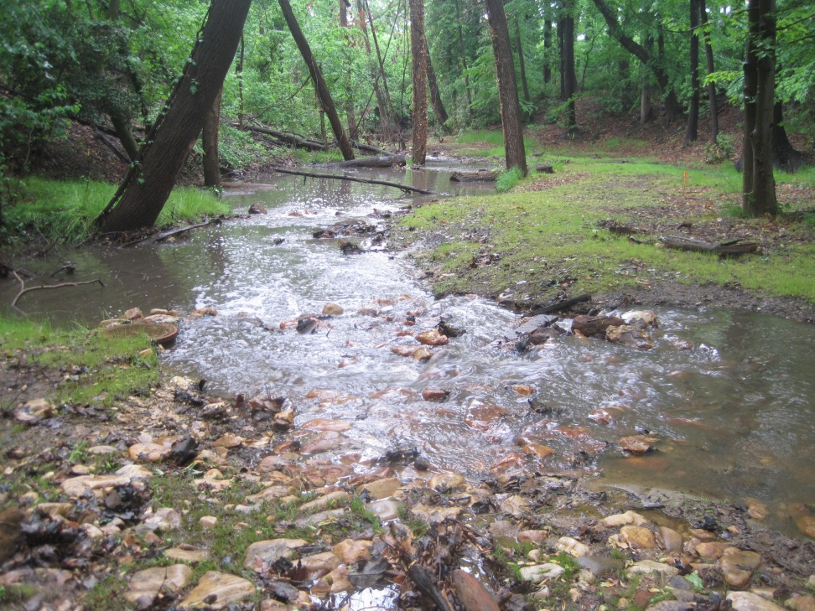
Key Goals
Prevent Erosion
Improve Water Quality
Enhance In-Stream & Riparian Habitat
Protect Infrastructure

Slide 7
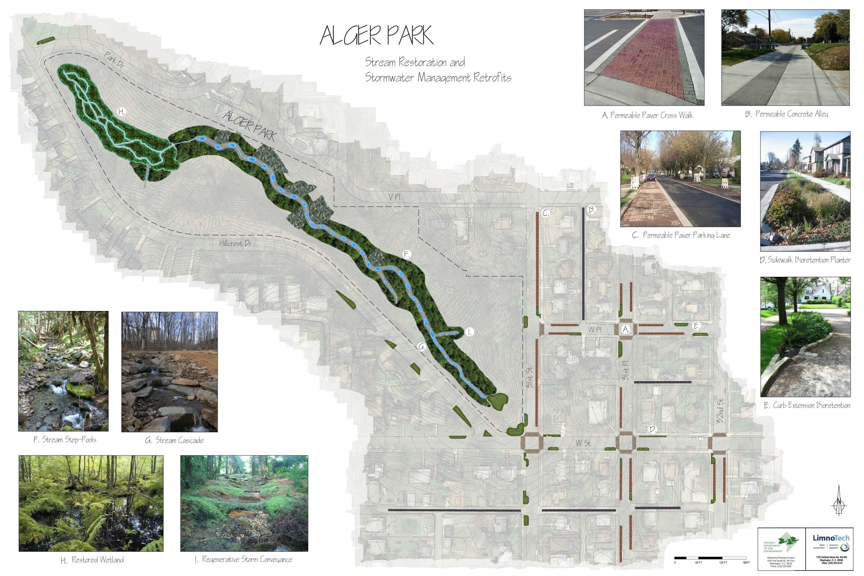

Slide 8
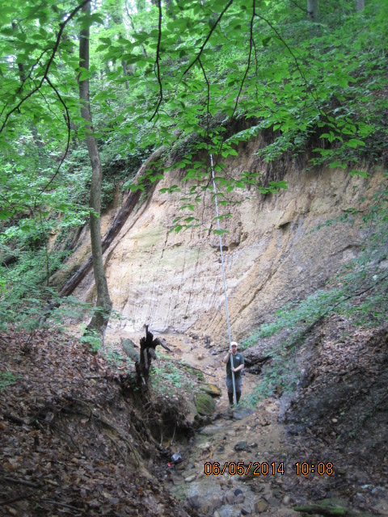
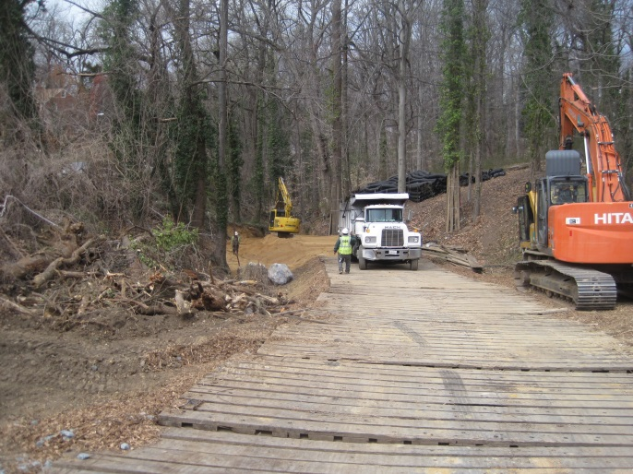
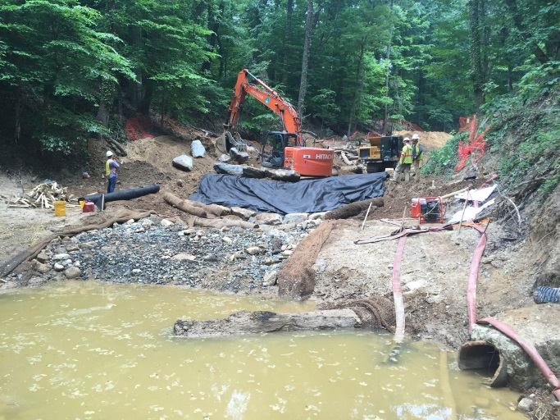
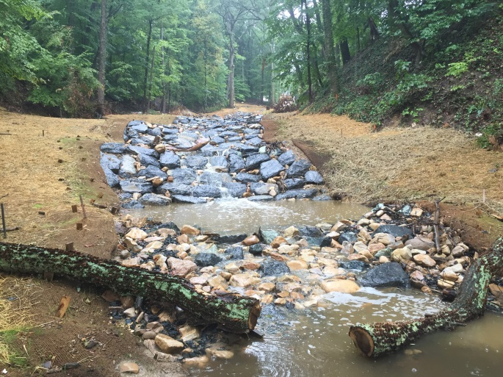
Restoration Step-by-Step
Designs & Monitoring
Construction
Site Selection
Construction
Monitoring & Enjoy!
@DOEE_DC

Slide 9

Alger Park

Slide 10
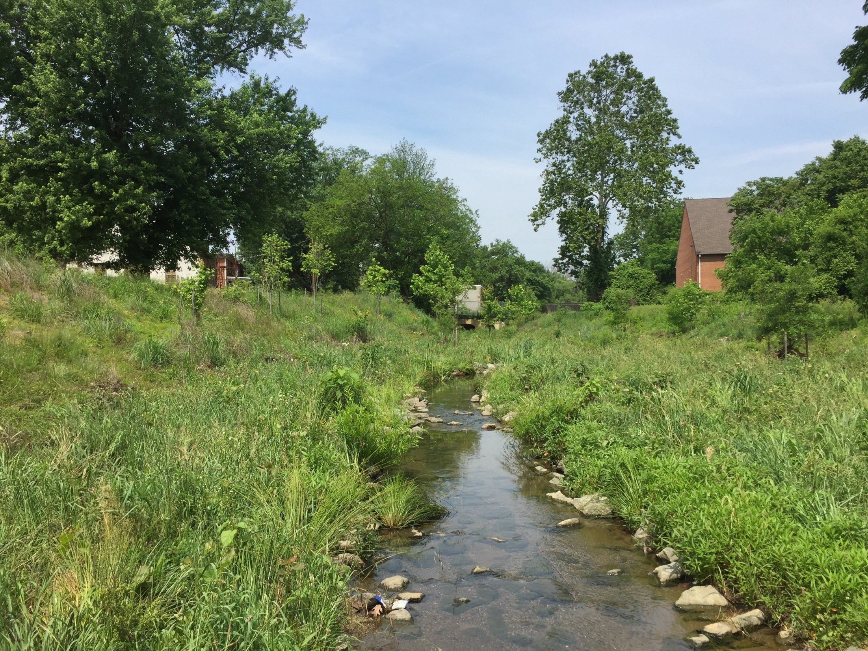
Nash Run

Slide 11
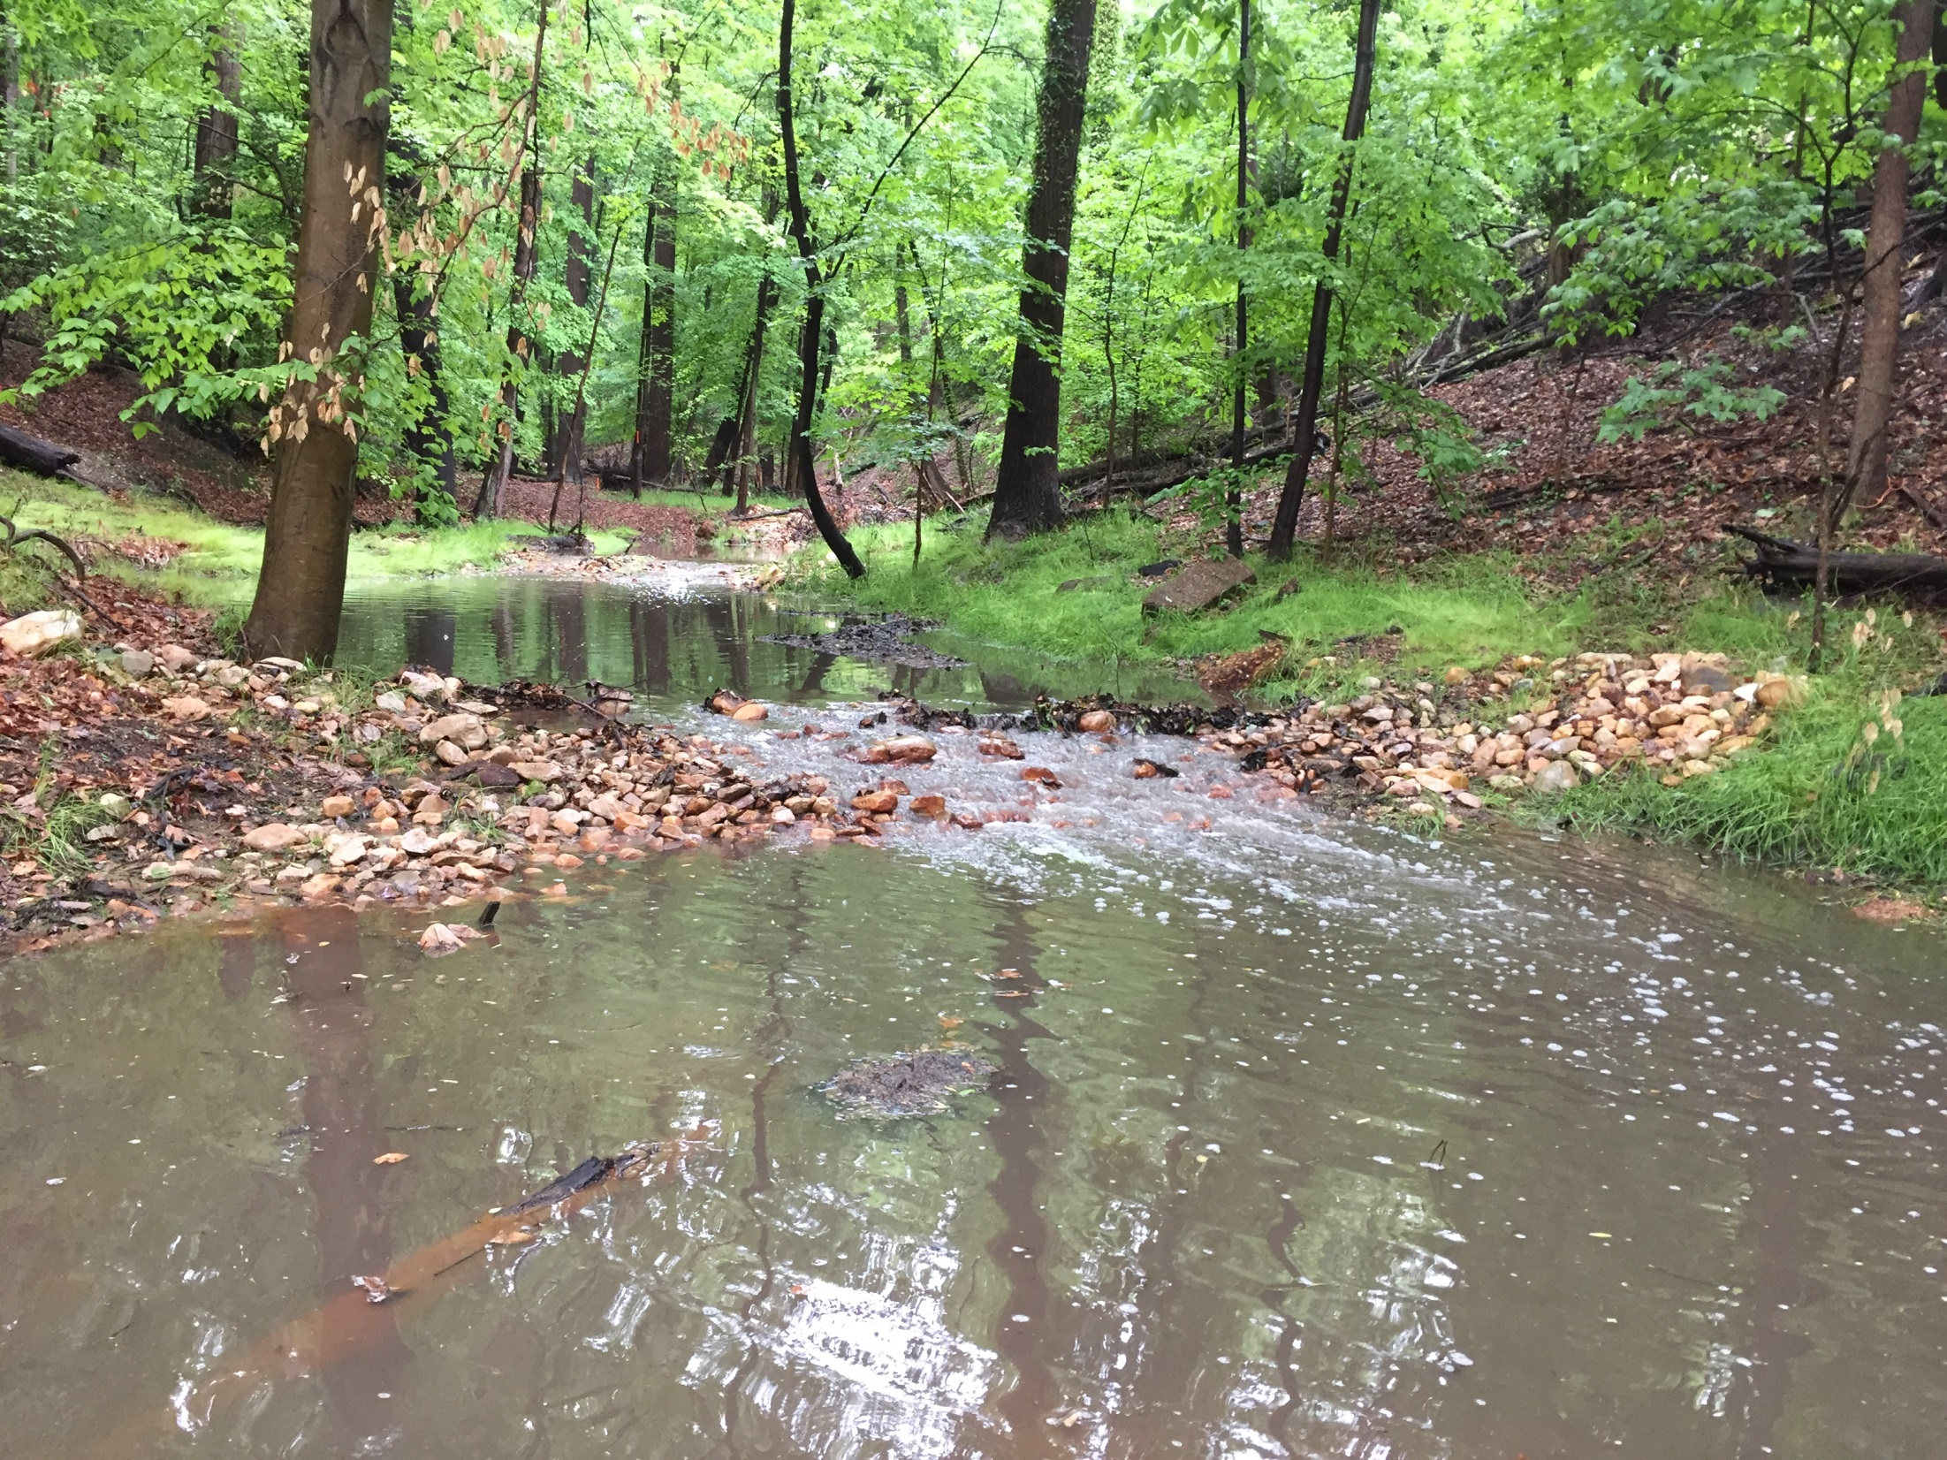
Pope Branch

Slide 12
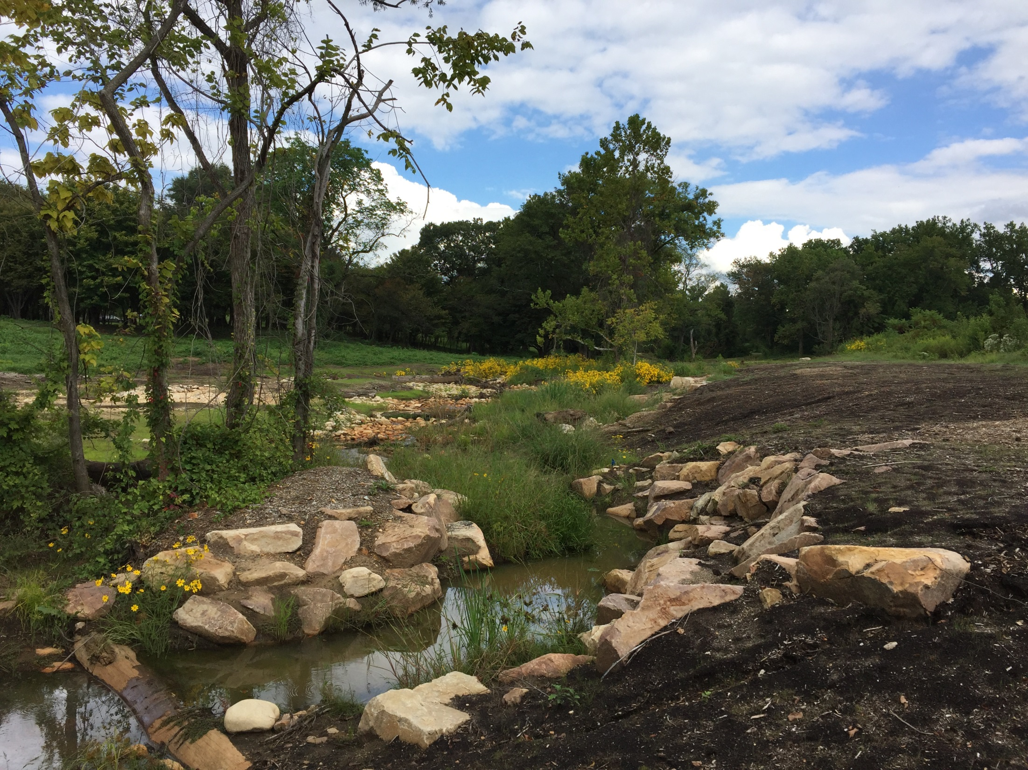
Springhouse Run

Slide 13
Key Challenges
Property Owner Consent
Design & Permitting
Rising Costs
Access
Construction Phase
Post-Restoration

Slide 14
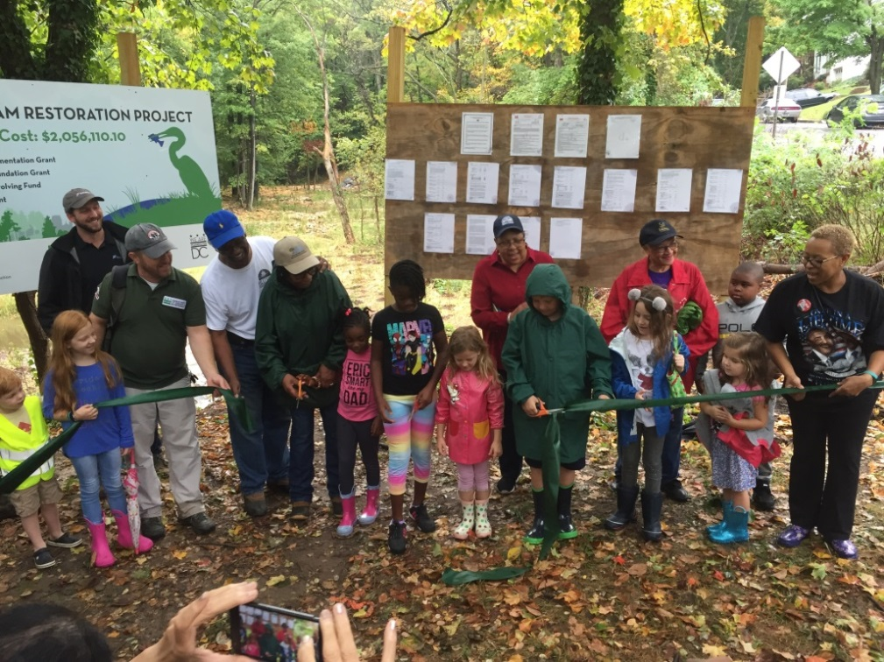
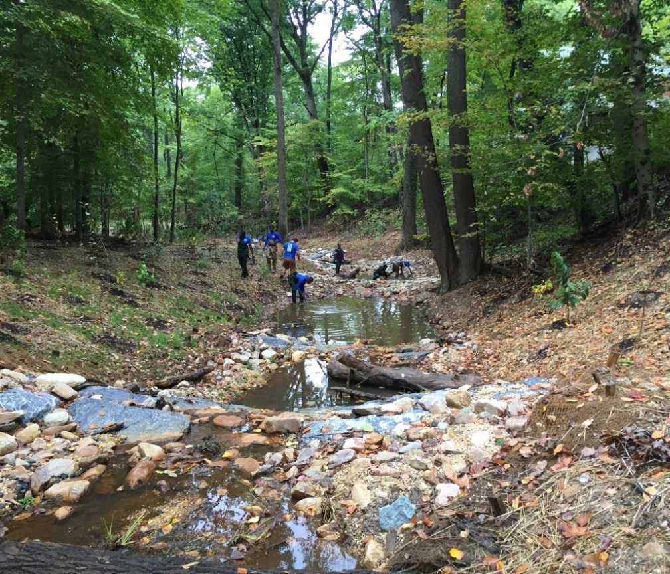
Successes
20,000 feet of stream restored
Load Reductions to Anacostia, Potomac, & Chesapeake Bay
Restored Native Vegetation
Private and Public Space LID Projects
Improved Fish Passage Corridors
Recreational Stream Corridors

Slide 15
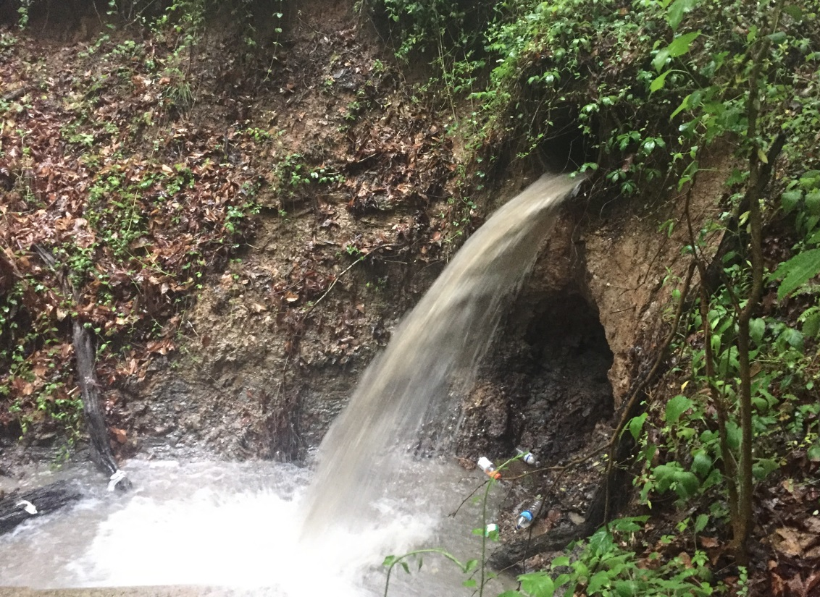
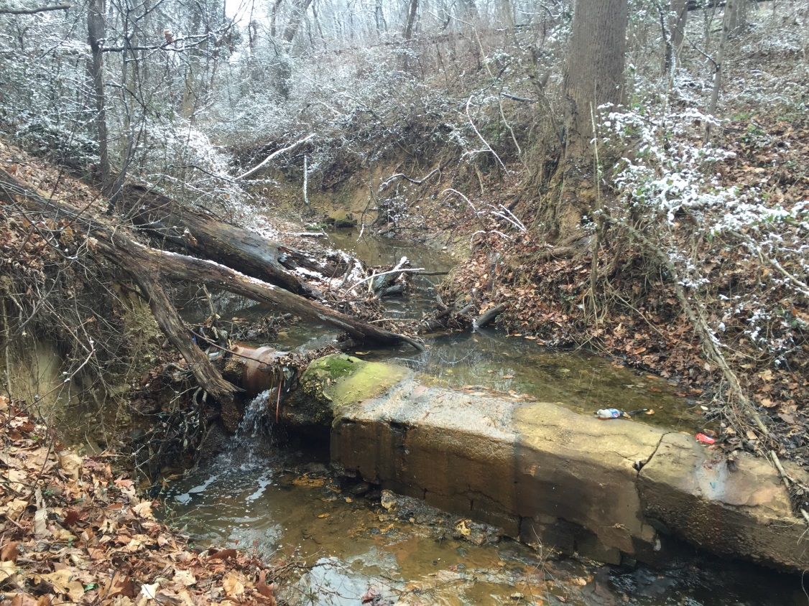
What’s Next?
Fort Dupont
Stickfoot
Outfall Restoration
Wetland & Living Shorelines

Slide 16
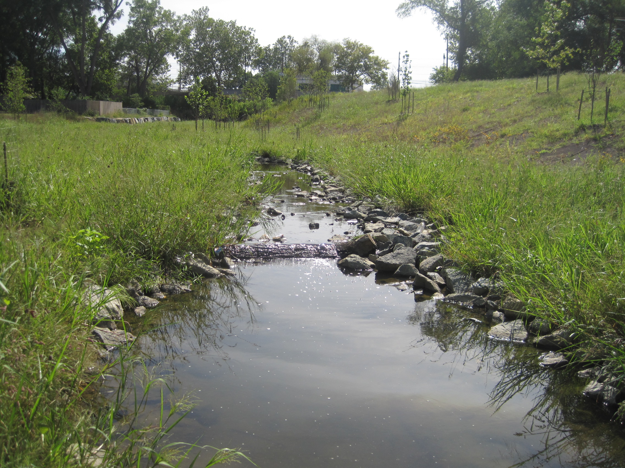
Questions?
TAG THIS PRESENTATION @DOEE_DC

