Slide 1

Takeaways from the 10th International Conference on Remediation and Management of Contaminated Sediments
February 11-14, 2019
New Orleans, LA

Slide 2
General Information
Biennial conference attracting over 1000 government, academic, consultant participants from US, Canada, and Europe
5 Technical Tracks:
  Remedy and Restoration Implementation
  Remediation and Restoration Alternatives
  Management Approaches and Policy
  Environmental Processes and Modeling
  Characterization, Assessment, and Monitoring
4 Panel Discussions:
  Track A: Incorporating Sustainability Principles in Superfund Sediment Remediation Projects
  Track A: Rethinking Environmental Dredging: A Roundtable Discussion
  Track C: Alternative Financial Models for Funding Contaminated Sediment Cleanup: Public-Private Partnerships, Local Sponsorship, and Redevelopment Benefit: How Can We Get More Done?
  Track D: Challenges in Evaluating Fish-Sediment Exposure at Contaminated Sediment Sites
More than 500 platform talks and poster presentations
Representatives from DOEE, Washington Gas Light, NOAA, Tetra Tech, AECOM

Slide 3
ARSP Related Presentations or Posters
Panels
  Innovative Characterization and Assessment Approaches (U. Ghosh, UMBC)
Posters
  Fate and Transport of PCBs and OCPs in the Anacostia River (UMBC, USFWS, USGS, DOEE)
  Anacostia River Swimming – A Path Forward (DOEE and Anacostia Waterfront Trust)
  Comprehensive Source Tracking of Illicit Discharges in an Urban Sewershed (Tetra Tech and DOEE)
  Canine Source Tracking of Illicit Discharges in an Urban Sewershed (Tetra Tech and DOEE)
  Methods for Setting Sediment Goals to Address Fish Consumption (Tetra Tech and DOEE)
Notes:
Other UMBC papers: Long-Term Performance of In Situ Treatment of Sediment with AC at Two Pilot-Scale Study Locations; Actively Shaken In Situ Deployment: An Innovative Approach to Accelerate Equilibrium in Passive Samplers; Development and Testing of a Novel Passive Sampler for Methylmercury in Sediment and Soil Porewaters; Standardization of Polymeric Sampling for Measuring Freely-Dissolved Organic Contaminant Concentrations in Sediment. Student Paper Winner: Kinetics of PCB Microbial Dechlorination Explained by Freely Dissolved Concentration in Sediment Microcosms. Other related TT papers: Exploring Beneficial Use Options for Dredged Sediment from Toledo Harbor; Habitat Restoration and Enhancement: Maximizing Benefits from Sediment Remediation Projects; In Situ Treatment for PCBs in Sediment: Treatability to Implementation;

Slide 4
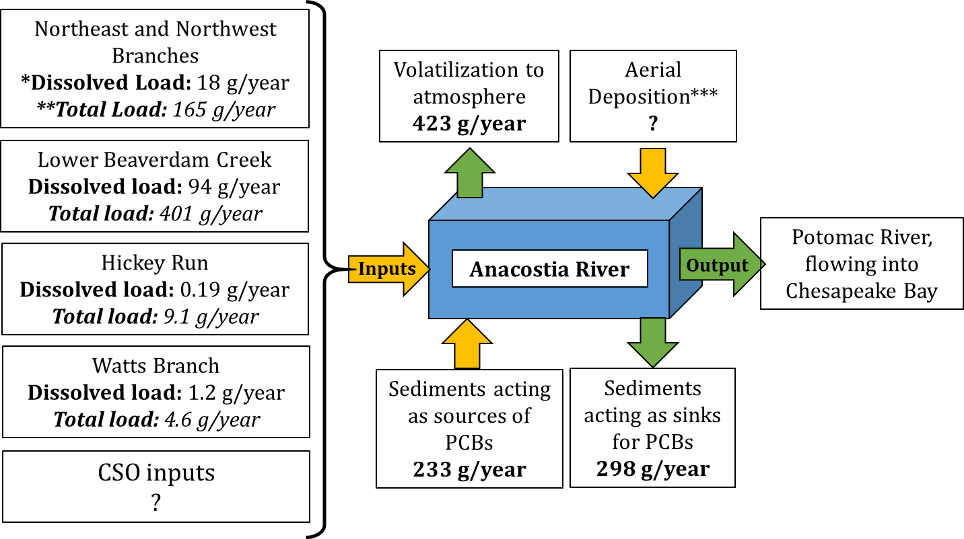




Summary of Work presented by UMBC
Poster: Fate and Transport of PCBs and OCPs in the Anacostia River. Bokare et al.
Platform: Passive sampling to monitor persistent organic pollutant in the Anacostia watershed and predict bioaccumulation in freshwater organisms. Lombard et al.
0.64
EPA WQC cancer risk 1x10⁻⁵
* Freely-dissolved PCBs only
** PCBs associated with suspended sediments and dissolved organic carbon
*** PCBs entering through deposition of air-borne particulates and precipitation (rain, snow etc.)
Freely dissolved water concentrations C_{w} exceed EPA Water Quality Criteria (WQC) for Human Health in Anacostia River and some tributaries
Bed sediments in tributaries acts as a source of contamination to overlying water for PCBs and PAHs at several locations, but as a sink for pesticides
Net deposition of PCBs in the river from surface water into sediments
Atmosphere a possible sink for PCBs in surface water
Base flows: Dissolved loads 5 – 16 times higher than those at storm-flow at NEB, NWB and WAB
Lower Beaverdam Creek: 69% of total load; 83% of total dissolved load
Partitioning based model allowed reasonable prediction of pollutant uptake by mussels and bioaccumulation in fish within an order of magnitude (factor of 4). Typical predictions within 1-2 orders of magnitude (Joyce et al., 2016)
Legend: ZEK: Zekiah Swamp, BDC: Beaverdam Creek, NEB: NE Branch, NWB: NW Branch, HIR: Hickey Run, WAB: Watts Branch, LBC2: Lower Beaverdam Creek.

Slide 5
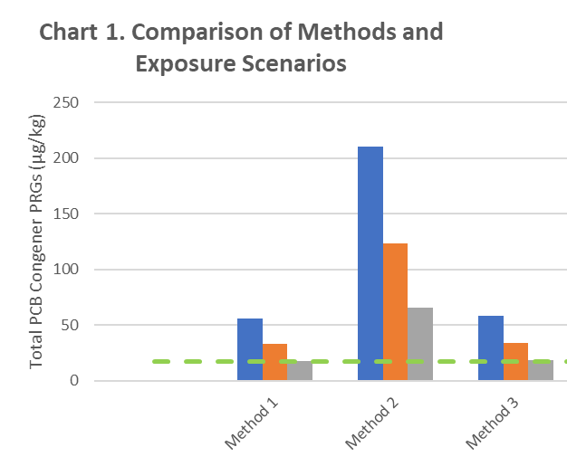
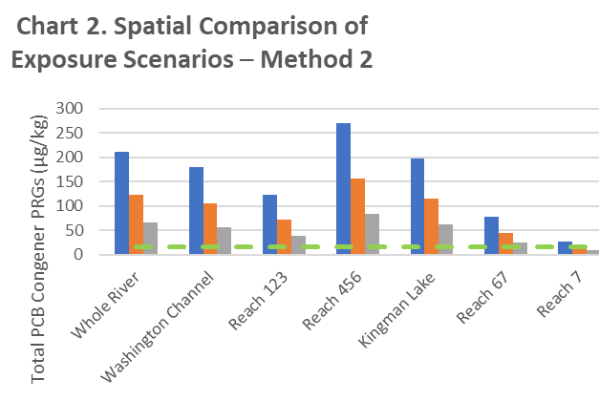
Methods for Setting Sediment Goals to
Address Fish Consumption
RAO 1 – Fish Consumption – Human Health: Reduce risks associated with the consumption of fish from the tidal Anacostia River by people with the highest potential exposure.
3 sediment-to-fish bioaccumulation pathways were considered for risk to subsistence and recreational anglers.
Sediment is considered the primary medium for remediation.
Direct Analysis of Gamefish Fillets
Direct Analysis of Forage Fish Modeled to Gamefish Fillets
Direct Analysis of Invertebrate Prey and
Mid-Trophic Whole Fish
Current Recreational Angler PRGs
Future Recreational Angler PRGs
Subsistence Angler PRGs
BTVs

Slide 6
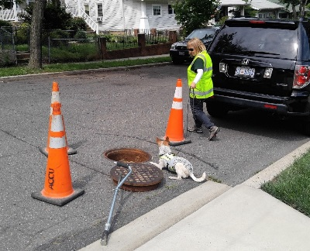
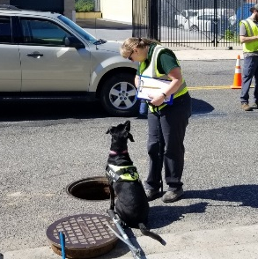
Comprehensive Source Tracking of Illicit Discharges Including Canine Surveys in an Urban Sewershed- Hickey Run
Objective: identify and eliminate sources of contamination in the Hickey Run sewershed using the following techniques:
In-pipe closed circuit television (CCTV) surveying
Passive and discrete sampling for sucralose as an indicator of sewage
Discrete sediment and water sampling for chemical analysis, forensic fingerprinting, and human DNA analysis
Canine surveys to identify the presence or absence of human sewage
Physical dye testing of suspected facilities
Illicit Connection Area
Canines signal "alert to" the presence of human waste indicate a possible illicit connection

Slide 7
WG Thoughts on the Battelle Sediments Conference
WG attended both the 2017 and 2019 Battelle Sediments Conferences
Within the remedial community (Federal, State, Local, Utilities, Consultants), there is an increasing recognition of the importance of expanding the tool box for dealing with impacted sediments
  Adaptive Management
  In-situ stabilization
  Capping
2019 Battelle Sediment Conference Take-Aways
  Great Lakes Legacy Act program of federal cost-sharing and local sponsors promotes collaboration, cooperation, reasonable objectives, and cost-effective solutions
  Understand – don’t assume – what is driving the body burden of contaminants in fish and where they are coming from
  A growing acceptance of the potential value of adaptive management and consideration of sustainbability (consisting of a broader array of social, economic, and environmental metrics that includes but goes beyond the nine NCP criteria) when evaluating sediment management alternatives
  Monitored Natural Attenuation
  Amendments
  Selective, Focused Dredging

Slide 8
Presentations or Posters With ARSP Applicability
More than 500 platform talks and poster presentations with varying degrees of ARSP applicability. Highlights include:
Panels
  Challenges in Evaluating Fish-Sediment Exposure at Contaminated Sediment Sites (B. Ruffle, AECOM)
    See attached summary slides
Platform Presentations
  Session on Ecological and Human-Health Risk Assessment (B. Ruffle, AECOM)
    See attached summary slides
  Tracking and Recovering Fish at a PCB-Contaminated Site to Understand Contaminant Exposure Areas and Uptake ( K. Gustavson, EPA)
    See https://www.battelle.org/newsroom/conferences/sediments-conference
  Estimating Sustainable Fish Productivity: Effect on Remediation Goals at Contaminated Sediment Sites (P. Anderson, Arcadis)
    See https://www.battelle.org/newsroom/conferences/sediments-conference
And many more

Slide 9
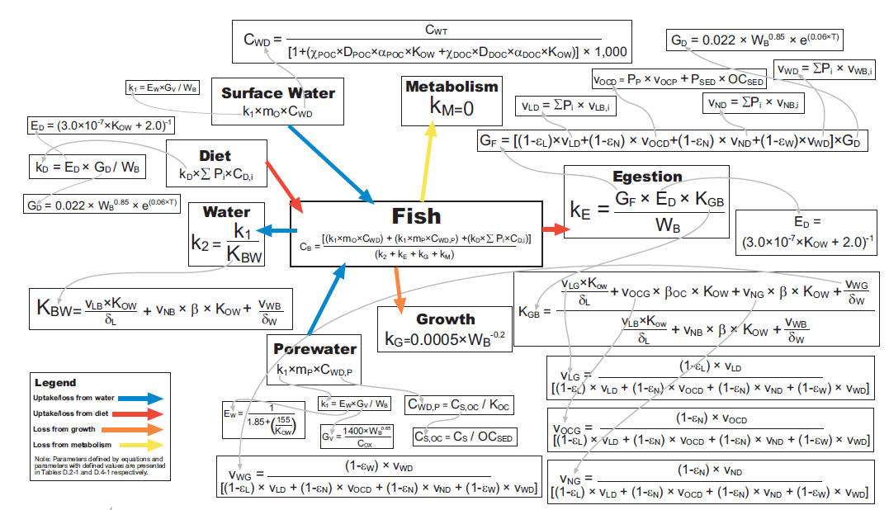
Challenges in Evaluating Fish-Sediment Exposure at Contaminated Sediment Sites
Battelle Panel Discussion Summary
Panel Discussion Topics
Fish Behavior Modeling
Fish Natural History and Species Selection
Bioaccumulation Modeling
Fish Consumption Rates and Data Collection
Exposure and Data Analysis
Risk Management & Remedy Decisions
Panel Participants
Todd Bridges, U.S. Army Corps of Engineers
Karl Gustavson, U.S. EPA
Deborah A. Edwards, ExxonMobil
Katrina von Stackelberg, Harvard School of Public Health
Betsy Ruffle, AECOM

Slide 10
Key Takeaways
Topic | Opportunities
Fish Matter Risk often driven by fish consumption Actions to reduce risk require understanding of fish tissue contaminant sources/pathways (sediments vs. water column vs. diet) Fish Move Fish behavior not random and not well represented by summary statistics Exposure assessment should consider specific fish species, seasonal variations, and local environmental factors Fish Consumption Exposure & Risk Challenges in characterizing human exposure Uncertainty and conservative assumptions Fish consumption survey uncertainties How to account for high-end consumers Is waterway productivity sufficient to support long-term consumption? Will consumption rates change post-remedy? How to predict? Bioaccumulation Modeling Range in complexity Substantial uncertainties | What is driving body burdens? Fish tracking studies combined with modeling Relating tracking data to habitat to better understand body burdens Prey/food web structure studies Passive samplers critical Need for site-specific data Lack of adequate understanding of underlying site-specific mechanisms can result in ineffective remediation Need to understand “sinks”: water column particulates, organic matter, passive samplers, etc. Adequate survey data to support assumptions regarding long-term consumption rates Risk Management What are the key areas of uncertainty and what can be done to fill data gaps? Are we relying too heavily on modeling? What is remedy timeframe and uncertainty associated with predictions decades into future? Is background risk acknowledged and taken into account? Are post-remedy fish targets realistic? What role does adaptive management play and is it being used effectively to deal with uncertainty? Need for a wide variety of guidance, studies, including post remedy performance monitoring, adaptive management work group, etc.

Slide 11
Wrap Up and Future Projects
Three active workgroups currently being developed
  Fish Biology and Bioaccumulation
  Exposure and Fish Consumption
  Risk Management and Decision-Making
Collaborative effort involving stakeholders from industry, academia, regulatory
Need for government/private joint research to address or reduce key uncertainties
Encourage participation of interested parties

Slide 12
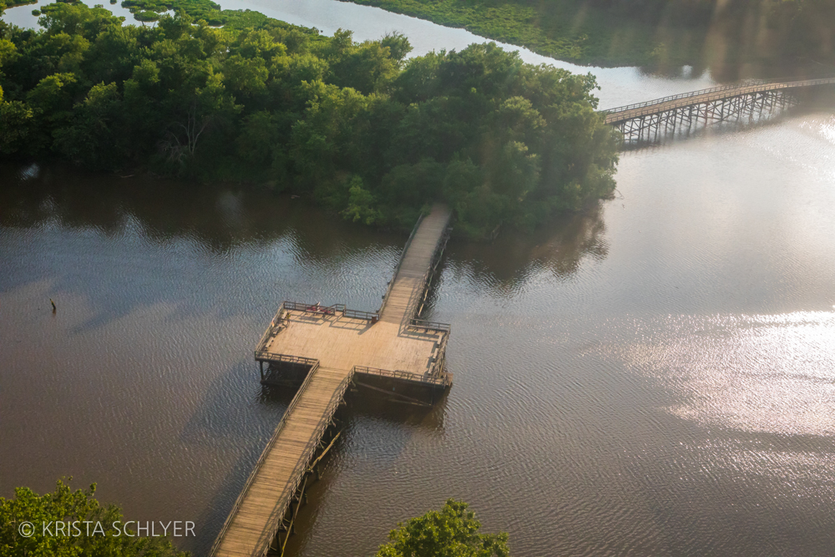

Questions?

