Slide 1
Substance Abuse Services at CFSA

Slide 2
Importance of Substance Use Services
Why it matters:
Build more nurturing and safer environments
Facilitate reunification
Promote positive developmental experiences
Encourage more positive coping strategies for traumatic life experiences
What we can do about it:
Early Screening
Assessment
Treatment
Better Outcomes!

Slide 3
Substance Abuse Service Overview
Consultations and Trainings
Adult Linkage to Assessments and Resources
DBH Co-located Staff for SA Assessments (to be filled)
Family Treatment Court and the linkage of Recovery Specialists
Ability to Capture Some Drug Screening Results
Youth Linkage Directly to DBH for Collaboration with ASTEP and TAY Providers

Slide 4
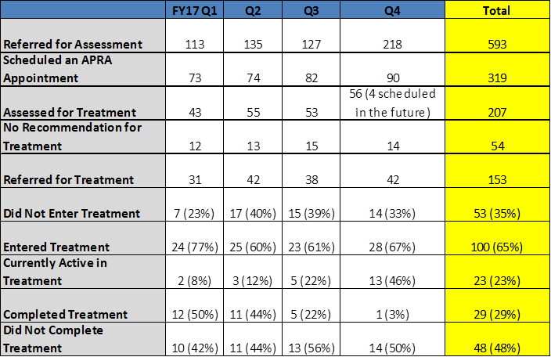
Adult drop-off analysis
Helped to identify gaps and needed services
Used information to inform strategies going forward

Slide 5
Substances Reported on Referrals
Notes:
Marijuana- 224
Alcohol- 89
Rx Pills- 10
Cocaine- 56
Heroin- 7
K2/Synthetics- 26
Meth- 1
PCP- 136
Not Indicated- 44

Slide 6
Referrals by Administration

Slide 7
Well Being
Education Updates
Family Treatment Court
An alternative to traditional justice system case processing. Courts keep individuals in treatment long enough for it work while providing wrap-around support and close monitoring. Participants are accountable to the Judge, submit to regular and random urinalysis and are rewarded or sanctioned based on behavior. The appeal for parents is FTC parents typically reunify faster with their children.
FTC Redesign 2015 and upcoming in 2018
Tiered court model- 4 phases (to be changed to 5 in FY18)
Addition of Recovery Specialists (reduction to 2 in FY18)
Now fathers are included
SA options expanded (all levels of care offered)
Stipulation requirement being eliminated (to be changed to acknowledgement or stipulation in FY18)
Reunification based on progress and compliance

Slide 8
FTC Outcomes

Slide 9
Support Services
Recovery Specialist
Recovery Specialist help to navigate the system and help steer caregivers to an appropriate and accessible treatment option that will meet their individual needs. Some task are:
Outreach to potential clients; engage to enter FTC
Collaborate with treatment providers to develop recovery plans and relapse prevention plan (to include child welfare and treatment goals)
Collaborate with social workers on client progress and challenges
Monitor and support clients through treatment progression
Attend court hearings, staffing's, red team meetings, family team meetings and other meetings scheduled around case planning
Complete court reports and attend FTC weekly

Slide 10
Recovery Specialist Outcomes

Slide 11
Moving Forward
What we learned… | Challenges we face…
Clients are more likely to attend assessments at CFSA then at APRA-ARC or Urgent Care. The CARA Act has significantly increased substance abuse referrals in FY18 thus far. Clients are more successful when linked to a Recovery Specialist services but their caseloads are limited. | Engaging adult and youth clients to complete assessments and treatment (if recommended). Increasing the utilization of Family Treatment Court (program capacity is 30, we averaged around 20 participants per month in Fy17). Triaging referrals for substance affected families by risk need.

Slide 12
Contact Information
Sarah Koreishi – Deputy Director for Well Being 442-6174
Nicole Gilbert – Administrator for Well Being 442-6963
Valerie Kanya – Substance Abuse Program Specialist 727-4283

