Slide 1
PRINCE GEORGE’S COUNTY
DEPARTMENT OF THE ENVIRONMENT
Jeff DeHan, Associate Director, Stormwater Management Division
Chris Clark, Senior Watershed Planner

Slide 2
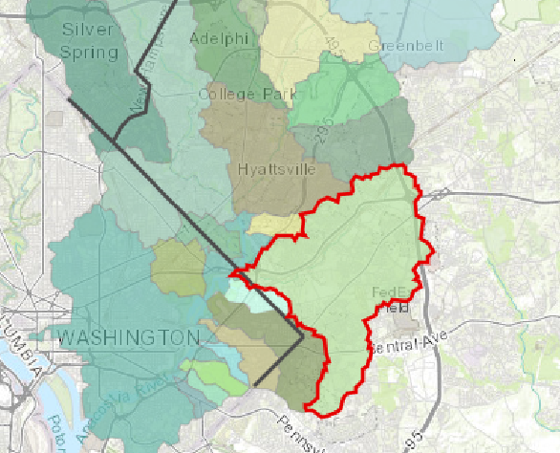
LOWER BEAVERDAM CREEK WATERSHED
STORM
Nearly 15 Square Miles
Notes:
Our efforts in Prince George’s County are underway to provide for a sound and effective approach to characterize the existing resource, develop a plan to identify potential areas of concern, and develop a dataset that can better inform any future efforts. Currently, the County is targeting the Lower Beaverdam Watershed which consists of approximately 9,500 acres or about 15 square miles.

Slide 3
Watershed Characterization
Source Identification
Targeted Sampling
Data Analysis
Action
STORM
Notes:
For example, Working in conjunction with the stakeholders, Prince George’s County would like to continue the efforts related to the ongoing monitoring of the water column in the Little Beaverdam Creek Watershed with oversight from MDE and sampling by the University of Baltimore. The previous sampling was a good initial indicator but expanding this effort should provide valuable information over varying flow conditions in the Creek. Continuing these synergies like these will provide the stakeholders with a transparent view the data collected to help inform neighboring jurisdictions.
Going forward, we are in the process of adding additional information to the already robust GIS database. The resulting desktop Watershed Characterization will be a valuable tool utilizing these extensive datasets by providing for the ability to conduct analyses on a variety of scales with multiple variables.
Using the data from the desktop analysis the County is already beginning to work on the development of a Source Identification Plan that will provide for the appropriate level fieldwork to assist in targeting and tracking down current and historic sources of contamination. This effort will most likely involve continued multi-media sampling of soil and water. The County will request input from MDE and others to develop a sound, reasonable approach that can address non-point source contamination. This information could be collected from a particular site, Lower Beaverdam Creek and its tributaries, their buffers, existing BMPs, stormwater catchments, outfalls, etc. depending on the drainage area and source ID.
The initial data analysis will create action items that could include, at the onset, more focused sampling around a specific area that will feed back into the Watershed Characterization and continue to inform the Plan. This should enable the County to develop a more refined model that can result in other action items in the future.

Slide 4
SOURCE IDENTIFICATION WORKGROUP
Phong Trieu, MW Council of Governments
Amy Foster, MD-National Capital Park and Planning Commission
Kate Bennett , Montgomery County Department of Environmental Protection
Christine Fanning, Prince Georges County Parks
Ed Dunne, D.C. Department of Energy and Environment
Jerry Maldonado, Prince George’s County Department of the Environment
Kyle Lowe, Prince George’s County Park and Recreation Department
Len Schugram, Maryland Department of the Environment
Jeff White, Maryland Department of the Environment
Dev Murali, D.C. Department of Energy and Environment
Amy Stevens, Montgomery County Department of Environmental Protection
Joshua Rodriguez, D.C. Department of Energy and Environment
Donna Davies, US National Park Service
Fred Pinkney, US Fish and Wildlife Service
Jillian Adair, US Environmental Protection Agency
Michelle Peck, US Environmental Protection Agency
Upal Ghosh, University of MD Baltimore County

Slide 5
CONTACT
Chris Clark, Senior Watershed Planner
Prince George’s County
Department of the Environment
ckclark@co.pg.md.us
301-883-5824

