Slide 1
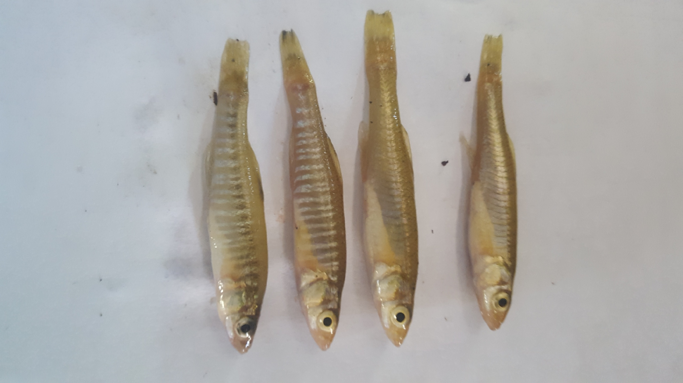
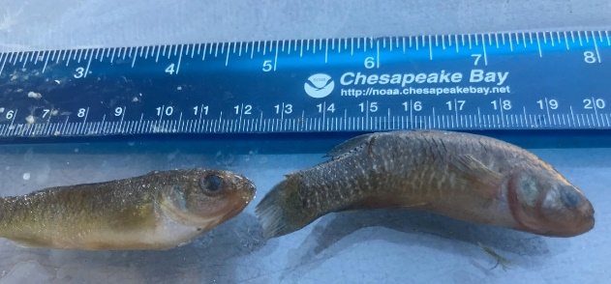
PCBs and Pesticides in Mummichogs and Banded Killifish in the Anacostia Watershed: Work in Progress
Fred Pinkney
U.S. Fish and Wildlife Service, Chesapeake Bay Field Office
Funding: DOEE
Leadership Council for a Cleaner Anacostia River
December 13, 2018

Slide 2
Background: Anacostia River Sediment Project (ARSP) Goals
Extent of contamination in tidal river (RI)
Assess human health and ecological risks (RI)
Evaluate options (FS)
Propose a cleanup plan

Slide 3
USGS and USFWS-UMCP-UMBC study evaluated tributary loadings
Rationale: identify tributary sources that need to be controlled to avoid re-contamination of the tidal river
Key Findings: Ghosh et al. (2018), Wilson et al. (in prep)
PCBs: Lower Beaverdam Creek is major source of PCB loading--suspended sediment and freely dissolved phase
Passive samplers and caged mussels show what is bioavailable and likely to be accumulated in fish
Chlordane: NW Branch, NE Branch, LBC similar loadings

Slide 4
Chemicals of Concern for Fish: PCBs and organochlorine (OC) pesticides
Bioaccumulate in fish (vs. PAHs which are metabolized)
Fish advisories: driven by PCBs
Preliminary remediation goals: PCBs
No additional cost to analyze OC pesticides

Slide 5
Study Rationale: Why study small, stationary fish vs. what people eat?
Site-specific monitoring for PCBs and OC pesticides: consider home range to be 0.5 miles or less
Short-lived: ~3-4 years so will respond more quickly to changes to contaminant concentrations in water and sediment
Pre vs. post-remedial monitoring in tributaries and tidal river
Can isolate areas of tributaries that are high vs. low to focus source tracking
Compare between tributaries and mainstem
Compare Potomac vs. Anacostia
We will also collect and archive sediment samples for possible analyses of the same compounds at the fish sampling locations

Slide 6
Mummichogs and Banded Killifish
Mummichogs: home range in 100s of meters (Lotrich 1975)
Banded Killifish: home range (~78 ha) 200 acres (Pinkney and McGowan 2006)
Feed on invertebrates in sediments, accumulate contaminants
Mummichogs: used in tumor surveys in Elizabeth River (VA, Vogelbein et al. 1990) and Hershey Run (DE, Pinkney and Harshbarger 2006), because of site fidelity and hardiness to acute toxicity

Slide 7
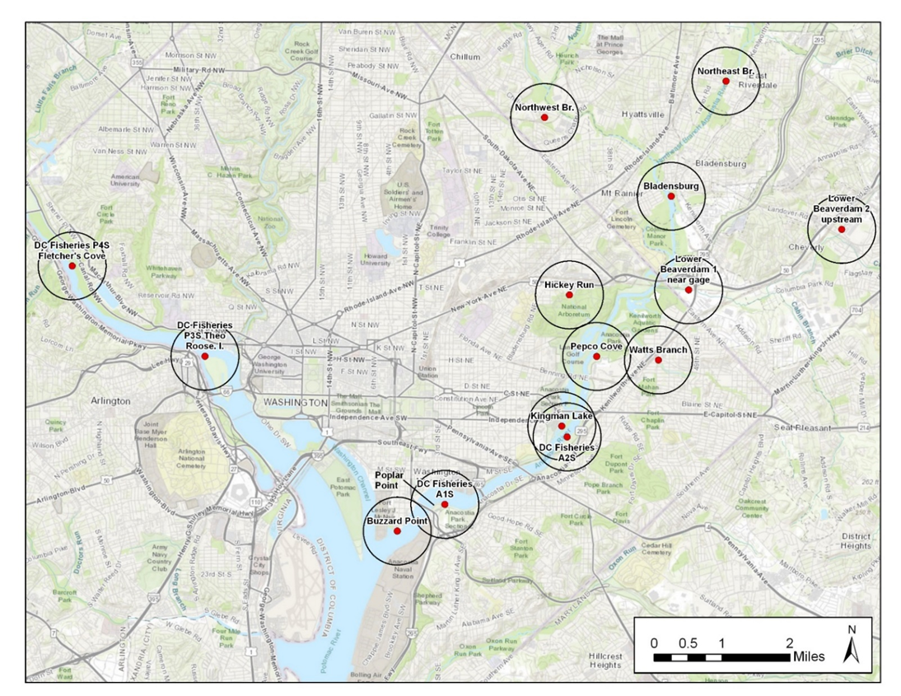
Target Locations: Circles=0.5 mi radius; bars = 0.5 mi
Wash. Ch.

Slide 8
Location | Map label | Lat | Long | Notes*
Gravel bar north of Boat Ramp/inlet | Bladensburg | 38.93624 | -76.93960
Downstream of USGS gage | Northwest Br. | 38.95250 | -76.97472 | M/P
Downstream of USGS gage | Northeast Br. | 38.96109 | -76.92528 | M/P
Upstream of USGS gage | Watts Branch | 38.90118 | -76.94217 | M/P
Downstream of USGS gage | Hickey Run | 38.91182 | -76.96451 | M/P
Near USGS gage | Lower Beaverdam 1 near gage | 38.91631 | -76.93431 | M/P
Between Landover and Cheverly Metro | Lower Beaverdam 2 upstream | 38.92756 | 76.89603 | M/P
E. Capitol Br. north to footbridge | Kingman Lake | 38.89403 | -76.96585
Above CSX Bridge | DOEE A2S | 38.88432 | -76.96668 | DOEE
Pepco Cove (above Benning Road) | Pepco Cove | 38.90166 | -76.95908
Near Poplar Point | DOEE A1S | 38.86935 | -76.99969 | DOEE
Buzzard Point | Buzzard Point | 38.86384 | 77.01220
Theo Roosevelt Island (Potomac) | DOEE P3S Theo Roose. Island | 38.89985 | -77.06617 | DOEE
Fletcher's Cove (Potomac) | DOEE P4S Fletcher's Cove | 38.91850 | -77.10303 | DOEE
Washington Channel (nr 395 Bridge) | Wash Channel | 38.88198 | -77.02929
* M/P: Ghosh et al. (2018) mussel/passive sampler location;
DOEE: Fisheries and Wildlife Division seining station

Slide 9
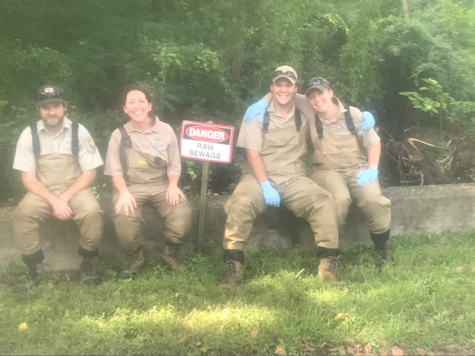
Sampling Crew: several looking for jobs, contact me

Slide 10
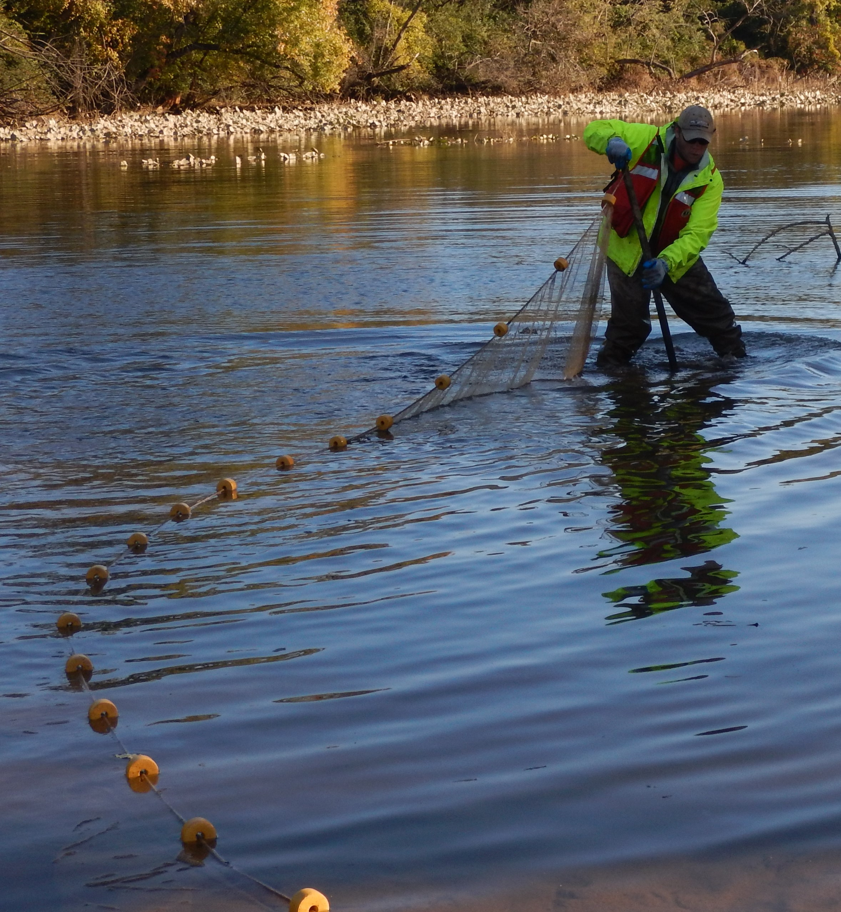
Beach seining in Kingman Lake

Slide 11
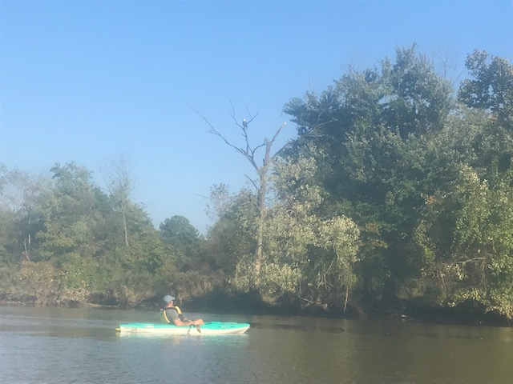
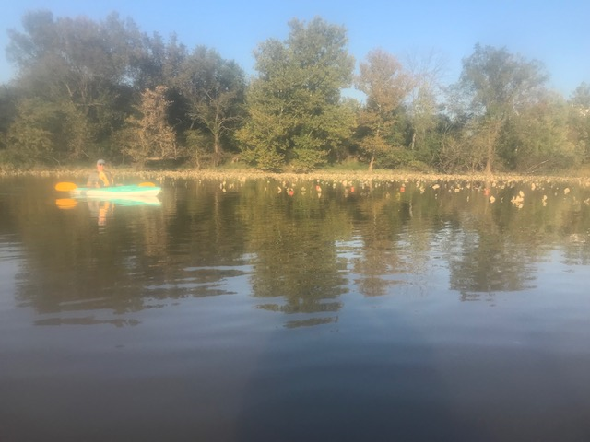
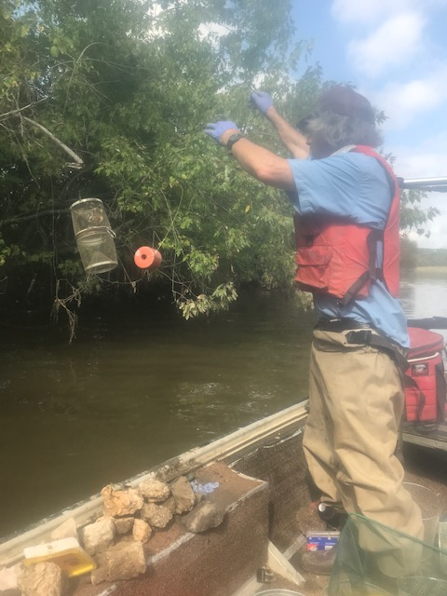
Sunday on the River with Doug
8 miles round trip kayaking from Bladensburg to Pepco Cove to place minnow traps (in trees and sediment); traps were allowed to fish for 24 hours

Slide 12
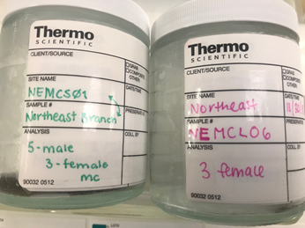
Samples: Size ranges (mm): Small (50-65 KF, 45-65 MC; Large: 66-84; Jumbo: >85
Female (L) and Male (R) Mummichogs
Male (L) and Female (R) Banded killifish

Slide 13
Fish Sampling Status as of 12/13/2018
Abbreviations: MC--Mummichog, BK--Banded killifish;
S=Small, L=Large, J=Jumbo length class
DOEE=0: DOEE Division of Fisheries and Wildlife sampled 4 times during Fall 2018 with no samples obtained
Batch 2: New samples to be collected in March 2019
NS: Not sampled

Slide 14
Schedule
Ship 70 samples as Batch 1 next week (December)
~ 6-8 week lab turnaround, then QA
Review results—collect Batch 2: additional samples and sediment samples (late February-March)
Prepare interim report by March 15 (Batch 1 data)
Ship Batch 2 ~March 30
Final report by early July

Slide 15
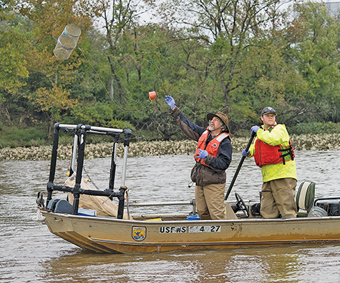
Toxics, long-ignored, once again on cleanup radar
After being on back burner behind nutrients and sediment, PCBs are getting more attention
By Timothy B. Wheeler on November 05, 2018
Bay Journal
Questions:
Fred_Pinkney@fws.gov

