Slide 1
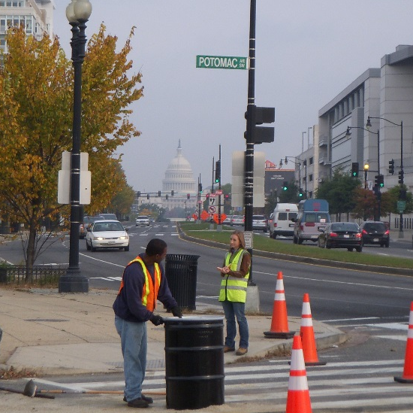
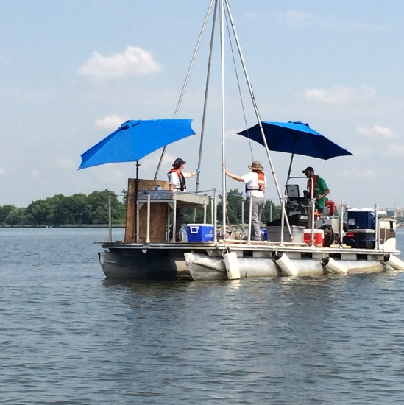
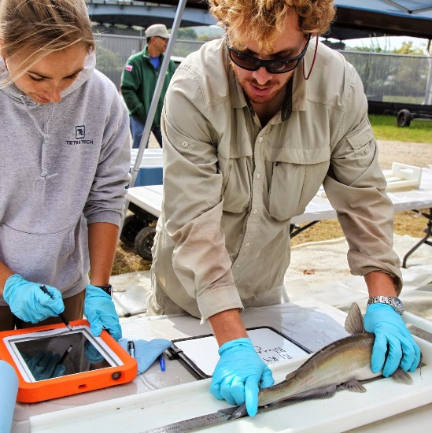
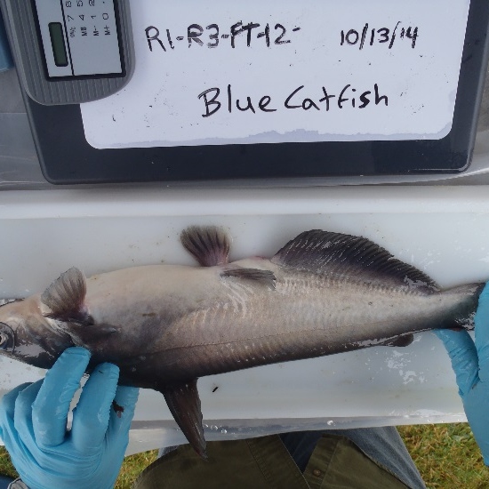
ARSP Outreach Schedule
Date: June 8, 2017

Slide 2
Upcoming Outreach Events
Meeting Date | Meeting Title | Meeting Objective | Audience
June 19 10:00 AM – 12:00 PM (DOEE) | LC/NGO Roundtable | 1. Discuss River contamination issues-what is contaminating the river, where? 2. Discuss River hydrodynamics 3. Discuss range of alternatives to address the contamination | LC members, NGOs from previous ARSP meetings
June 21 10:00 AM – 12:00 PM (Thurgood Marshall PCS) | Stakeholder Meeting (recurring) – 3 meetings planned before ROD | 1. Discuss the current health of the Anacostia River 2. Describe the basics of ARSP 3. Envision how a cleaner Anacostia could enhance our community | Stakeholders, civic leaders

Slide 3
Questions?
Name: Gretchen Mikeska, P.E.
Email: gretchen.mikeska@dc.gov
Phone: 202 535 2972

