Slide 1
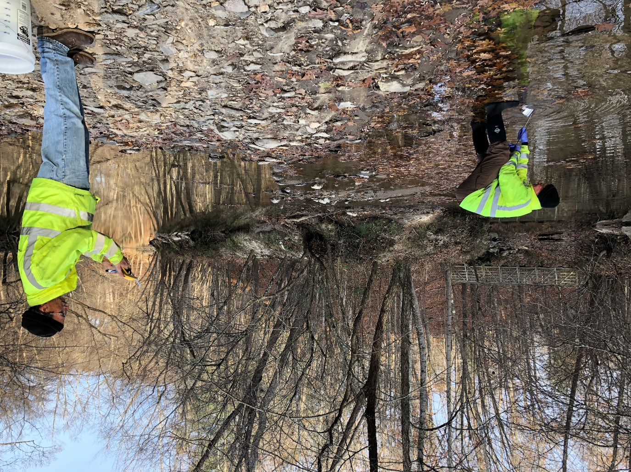
Anacostia River 2018 Tributary Background Study

Slide 2
Purpose of the NPS Anacostia River Tributary Sediment Sampling
2
Provide data to determine concentrations of COCs in bottom sediment located upstream of the tidal Anacostia River to assist in determination of anthropogenic background concentrations.
Provide evidence of possible point sources of COCs located upstream of ARSP area.
To address comments received on RI regarding use of Potomac River Reference Area to determine background concentrations of COCs.
EPA Definition of Anthropogenic Background – “Human-made substances present in the environment as a result of human activities (not specifically related to the CERCLA release in question)” (Role of Background in the CERCLA Cleanup Program April 26, 2002)

Slide 3
USGS Tributary Study
3
Work Completed by USGS in 2017 indicated the following five tributaries are responsible for majority of flow into tidal Anacostia River:
Northwest Branch
Northeast Branch
Lower Beaverdam Creek
Watts Branch
Hickey Run
Lower Beaverdam Creek found to contain highest level of PCBs in suspended sediments.
Notes:
Informed scope of NPS Trib Study

Slide 4
4
Potomac Reference Area
Tidal Anacostia River

Slide 5
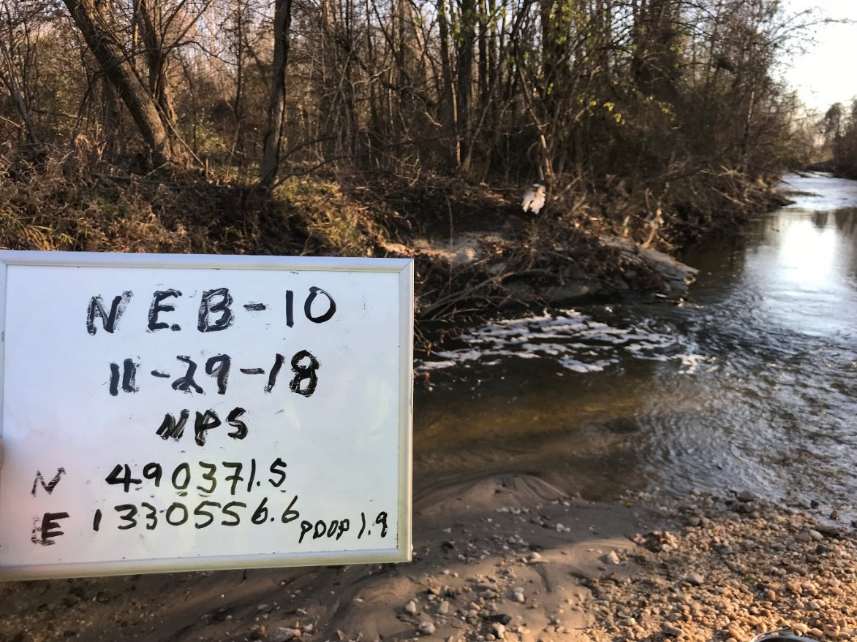
NPS Background Tributary Study
5
Collected bottom sediment samples (top 6 inches of sediment) from the five major tributaries
Comparable to surface sediment samples collected during RI in Anacostia and Potomac Reference Area
Analyzed for following COCs:
PCB Congeners
Dioxins and Furans
Parent and alkylated PAHs
Pesticides
Mercury
Also analyzed for TOC and grain size
Notes:
Risk assessment based on fish exposure to top 6 inches of sediment.
Fine grained material for comparability with Anacostia River sediment

Slide 6
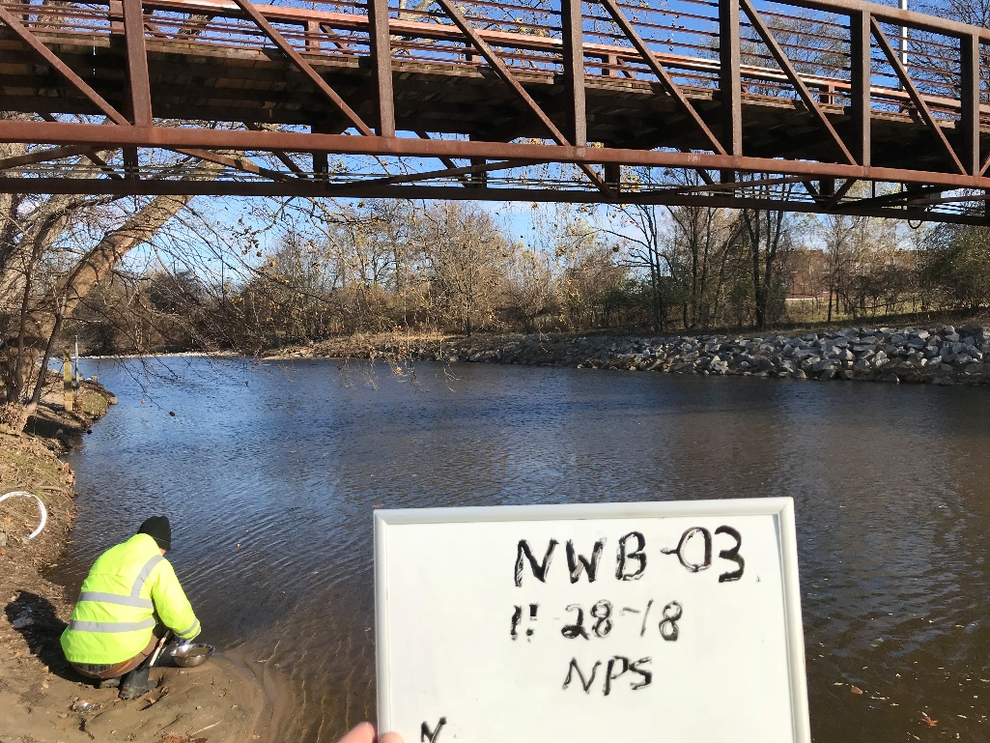
NPS Background Tributary Study
Total of 64 samples collected from 55 locations week of November 26th
Sample collection biased for fine grained material

Slide 7
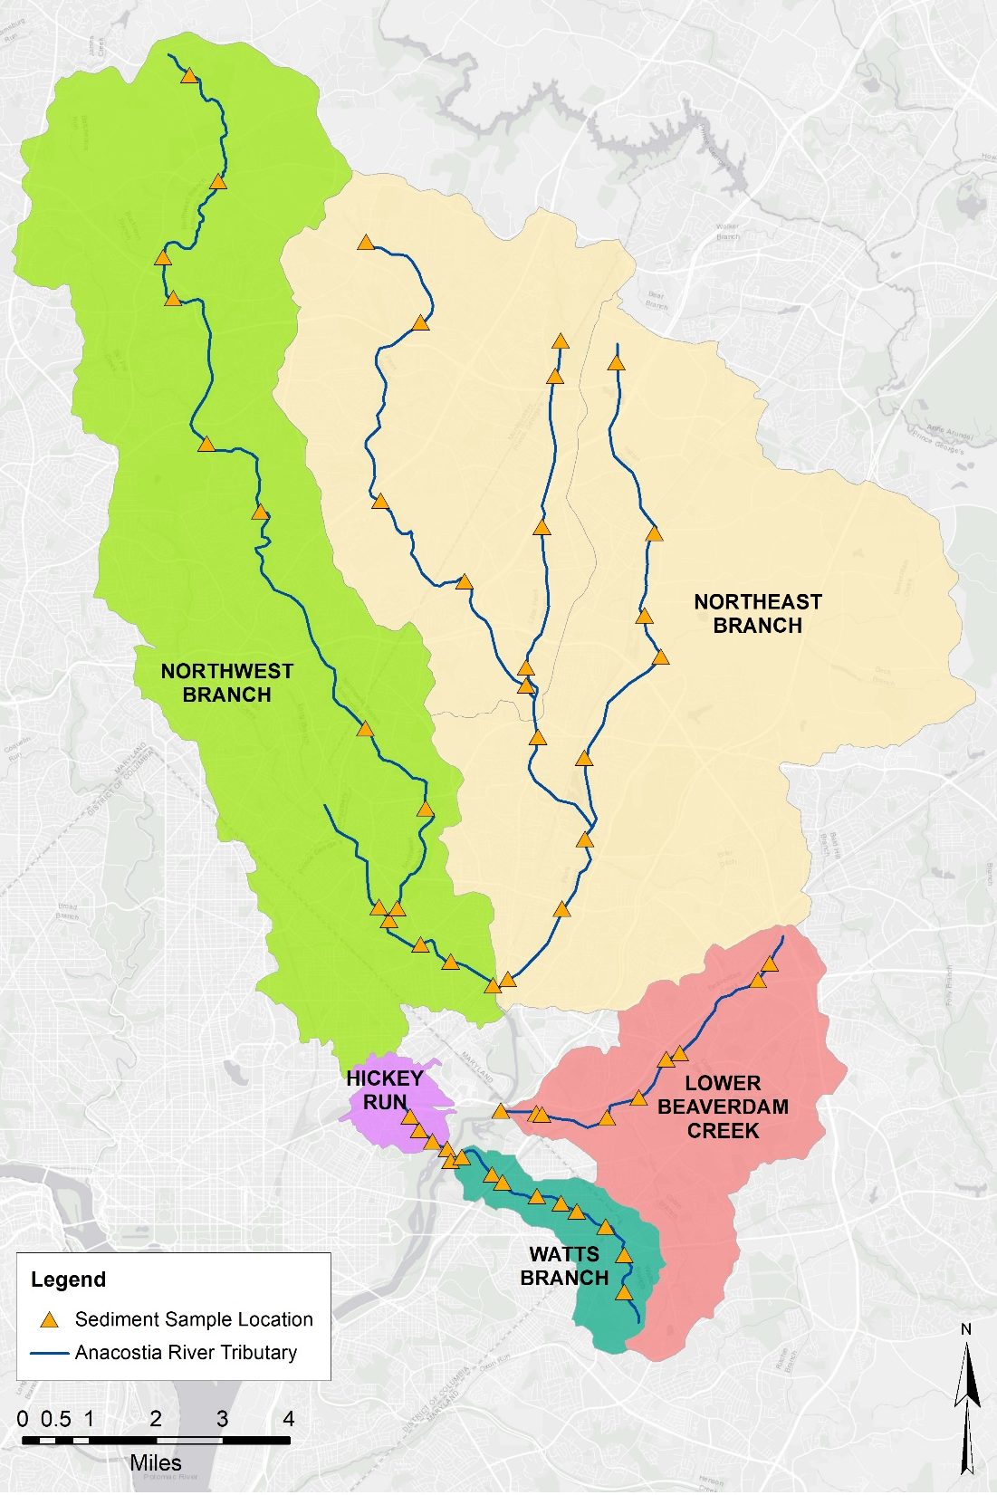

Slide 8
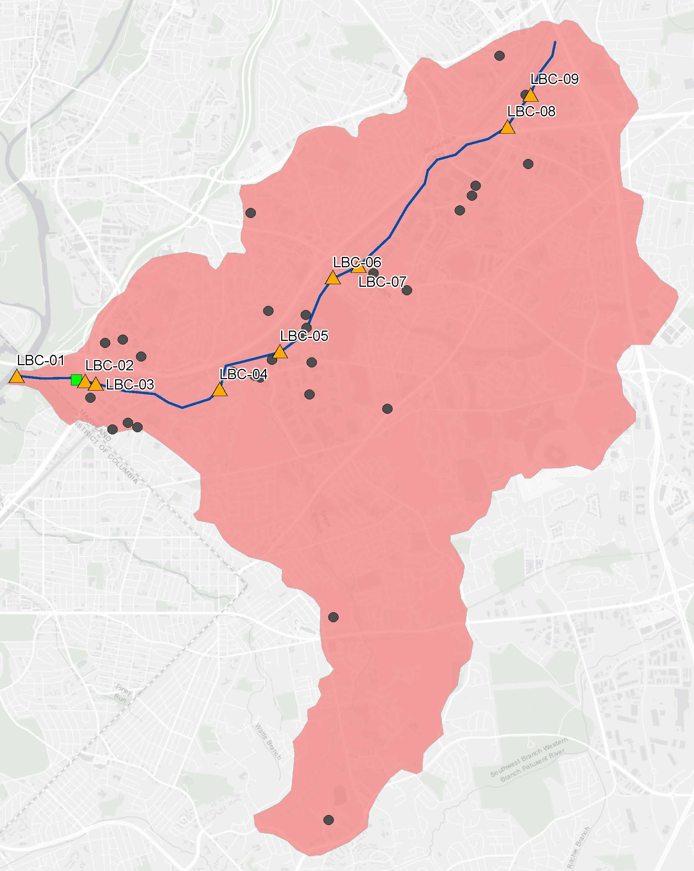

Slide 9
Statistical Analysis of Data
9
Compare sample results within each tributary to consider influence from suspected point sources.
Filter data set to remove obvious point source bias/influence for each COC.
Compare tributary data to Anacostia River and Potomac River reference area data to potentially refine anthropogenic background concentrations.

Slide 10
Schedule
10
Unvalidated laboratory data due December 2018
Validated data due early March 2019
NPS will prepare report summarizing sampling results and will work with DOEE to incorporate results into RI and FS as appropriate
Draft report completed May 2019

