Slide 1
Addressing PCBs in the Anacostia River
Greg Busch
Leadership Council
for a Cleaner Anacostia River
March 14, 2019

Slide 2
Summary of Clean Water Act PCB Activities in Maryland’s Anacostia River watershed
2019
BMPs for USDA
WWTPs
Permitting
2011
Maryland
non-tidal
PCB TMDL
TMDL Process
2019
Montgomery Co
source tracking plan
2013
Montgomery Co PCB
Implementation plan
Pre-2000
Fish consumption
advisories
2002 Non-tidal PCB listing
2006
Tidal PCB
listing
2007 Tidal PCB TMDL
2014
Prince George’s Co PCB
Implementation plan
2019
Prince George’s Co
source tracking plan
Source Tracking
2005
Statewide
clam
study
2007
Follow-up
clam
study
2011-13
Anacostia contaminated
site track-down
2009-11
LBDC source
track-down
2014 Industrial stormwater permit
2008-12
Anacostia
contaminated
site investigations
2014-19 Compliance Inspections
Site Cleanup
2
2015 Construction stormwater permit

Slide 3
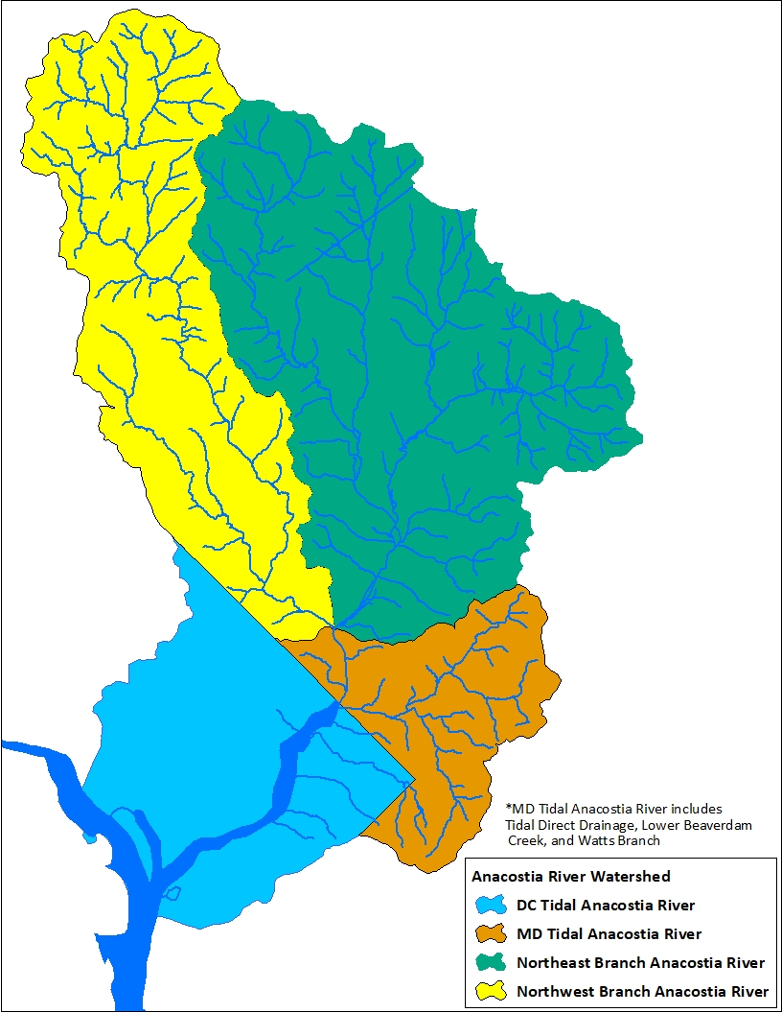
Tidal Anacostia River PCB TMDL Loads
Tidal Anacostia PCB TMDL
  DC Watershed Load: 74%
  MD Watershed Load: 26%
Lower Beaverdam Creek: 75% of MD’s watershed load
TMDL reductions over 98% to DC and MD
3

Slide 4
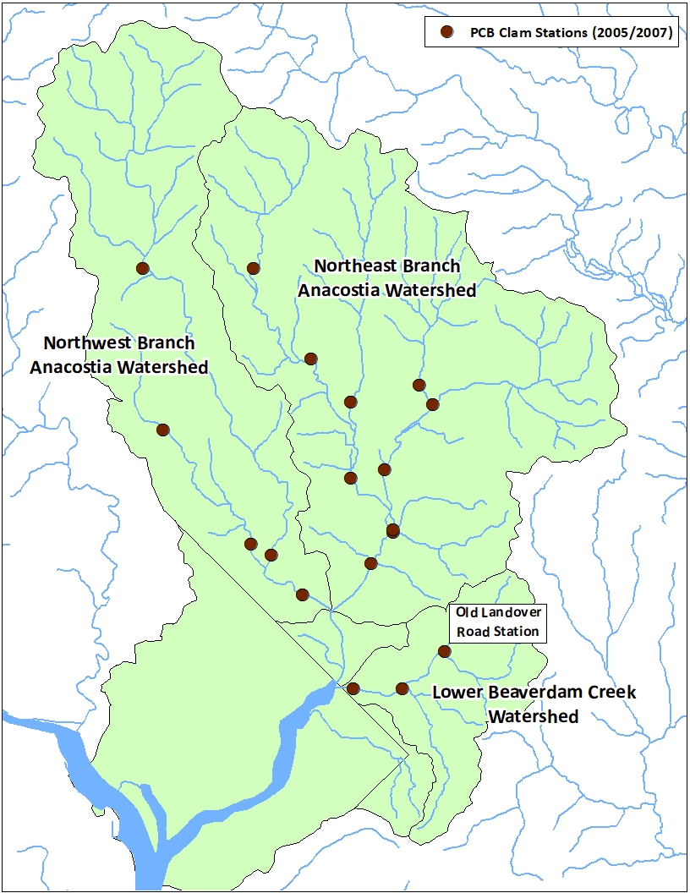
Statewide PCB Clam Studies (2005/2007)
2005
  State-wide PCB Biomonitoring Clam Study
  4 stations in Anacostia River
2007
  State-wide Follow-up PCB Biomonitoring
  19 stations in the Anacostia River
  Highest clam PCB concentrations in Lower Beaverdam Creek (Old Landover Road Station)
4

Slide 5
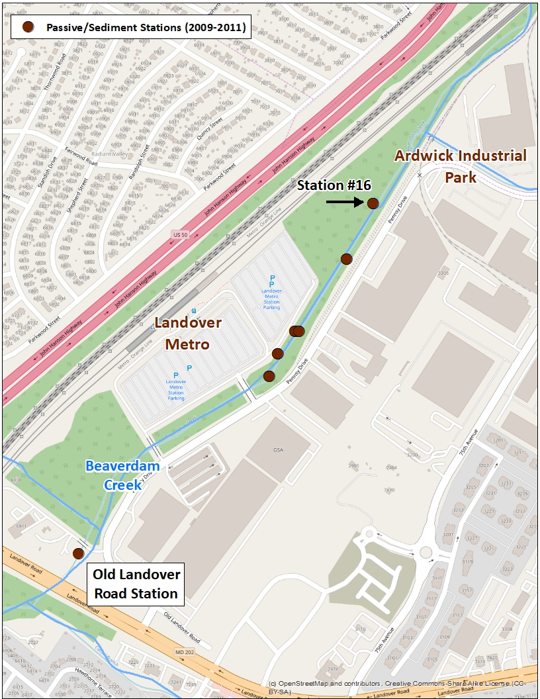
Lower Beaverdam Creek PCB Source Trackdown Study (2009-2011)
Stream Survey (Landover Metro Area)
2009 - Highest PCB concentrations in Station #16 outfall draining portion of Ardwick Industrial Park
2011 - Follow up sampling found PCB levels dropped in Station #16 outfall
PCB levels remain high in stream
5

Slide 6
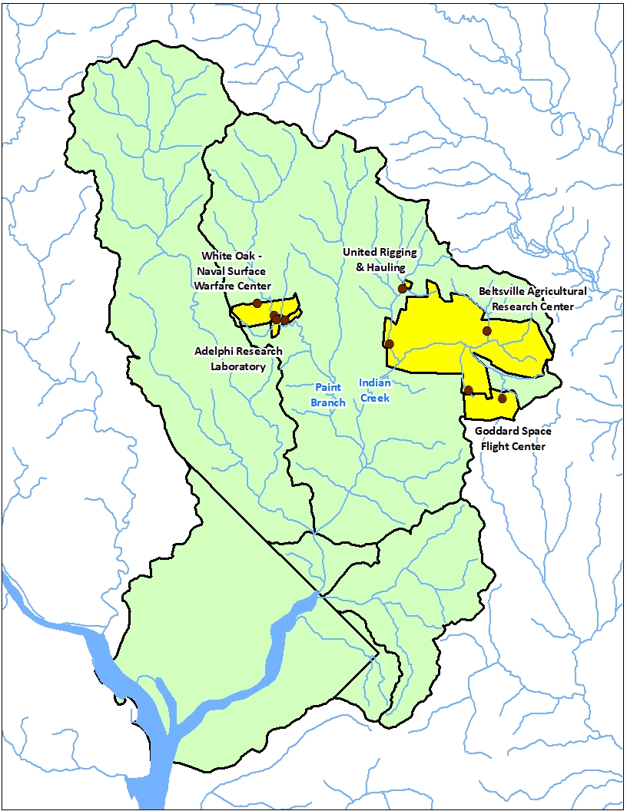
Anacostia Contaminated Site PCB Source Trackdown Study (2011-2013)
Study targeted contaminated sites that have undergone PCB remediation
Sampling conducted below five sites (2011)
Sediment PCB concentrations elevated below Adelphi Research Laboratory in Paint Branch
Follow-up sampling found no downstream impact (2013)
6

Slide 7
PCB TMDL MS4 Stormwater Implementation
MS4 PCB implementation plans
  MO County (2013)
  PG County (2014)
Source Trackdown Approach Development
Sampling Studies (2019)
  Northeast/Northwest Branch (MO County)
  Lower Beaverdam Creek (PG County)
  MDE contracts w/ UMBC
Collaboration w/ DOEE and Anacostia Stakeholders
Feedback through Anacostia Tributary Source Control Workgroup (Anacostia River Sediment Project)
7

Slide 8
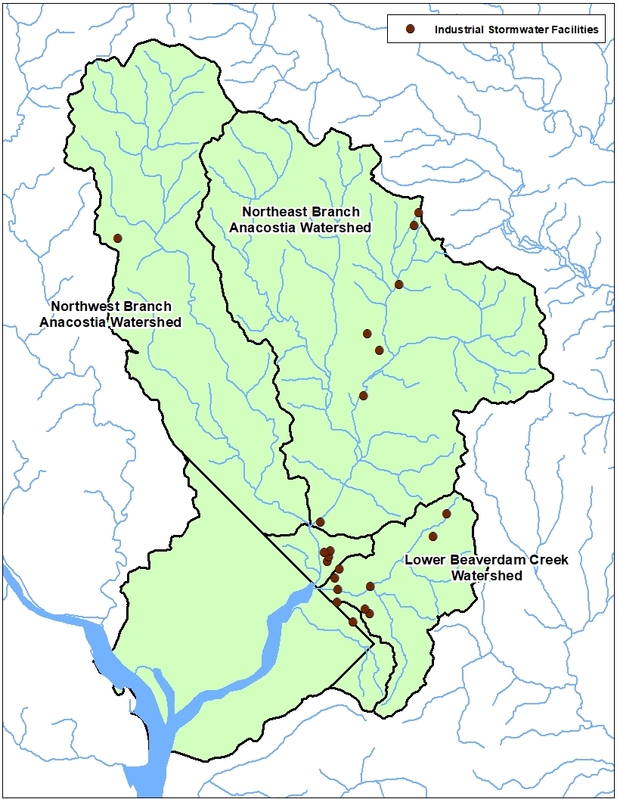
Industrial Stormwater Facilities (General Permit)
Twenty-two Industrial Stormwater Facilities with potential for PCB discharges
Permit TSS benchmark monitoring (Scrap and automotive salvage yards)
Permit Requirements to address oil and fluids leaking from stored materials
MDE has conducted 80 inspections in the last five years in Lower Beaverdam Creek
Review pollution prevention plans
  Do controls adequately address PCBs
  Screening for scrapped transformers
MDE considering options for PCB sampling
8

Slide 9
Stormwater associated with Construction Activities (General Permit)
Construction permit addresses pollutants through sediment and erosion controls
Controls reduce PCBs associated with sediments
MDE considering PCB measures from EPA general permit
  Restrictions on building washdown
  Controls for demolishing buildings w/ PCB materials
  Stormwater Pollution Prevention Plan (SWPPP)
MDE considering options for PCB sampling
9

Slide 10
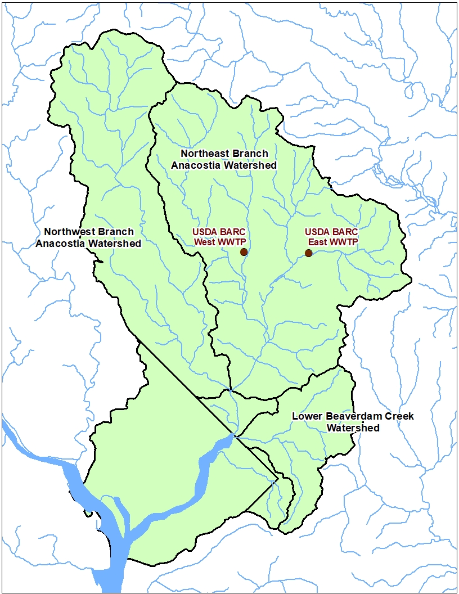
Municipal WWTPs
Municipal WWTPs
  USDA BARC East
  USDA BARC West
Allocations from Anacostia PCB TMDL
Quarterly PCB monitoring (load estimation)
Best Management Practices (BMPs) required if loads exceed “Action Level”
Both USDA WWTPs require BMPs
10

Slide 11
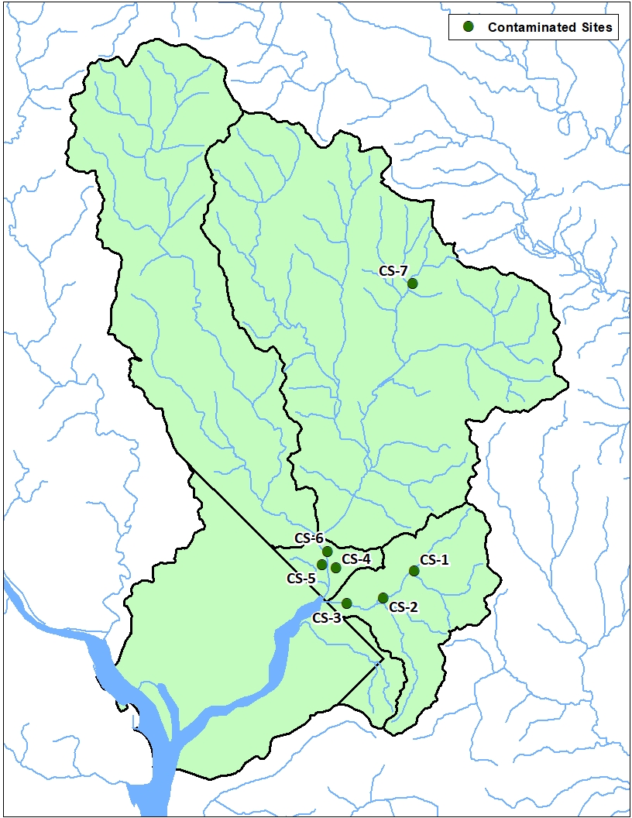
Anacostia River Contaminated Site PCB Investigations
MDE investigated eight contaminated sites for PCB contamination (2008-2012)
  Joseph Smith & Sons
  Beaverdam Creek/Pennsy Drive
  Rogers Electric
  United Rigging and Hauling
  GSA Bladensburg
  Bladensburg Acetylene
  Anacostia River Park
Findings
  Met regulatory requirements
Map ID | Contaminated Site
CS-1 | Beaverdam Creek PCB
CS-2 | Rogers Electric
CS-3 | Joseph Smith & Sons, Inc
CS-4 | Bladensburg Acetylene
CS-5 | Anacostia River Park
CS-6 | GSA Bladensburg
CS-7 | United Rigging and Hauling
11

Slide 12
Ongoing Actions
MO and PG Source Trackdown Studies (2018 - )
Site Inspections
Review of pollution prevention plans
Developing Protocols for Industrial Stormwater and Construction Activity PCB sampling
USDA East & West WWTP BMP
12

Slide 13
For More Information
Integrated Water Planning Program
Greg Busch, P.E.
Deputy Program Manager
Email: gregory.busch@maryland.gov
Phone: 410-537-3901
Leonard Schugam
TMDL Development/Implementation
Email: leonard.schugam@maryland.gov Phone: 410-537-3935
13

