Slide 1
Leadership Council for a Cleaner Anacostia River
Legal Update
Anacostia River Sediment Project
October 6, 2016

Slide 2
Legal Update: Overview
Partnership between DOEE and the National Park Service and Department of the Interior
Consultative Work Group Process
Publicly Available Information

Slide 3
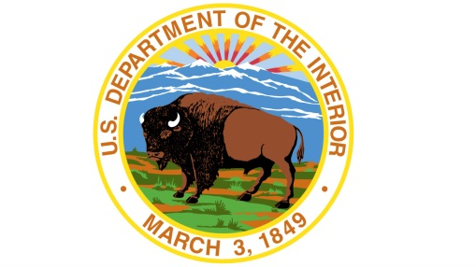
Legal Update: DOEE-NPS/DOI
Jointly working on sediment project
Joint Technical Teams
Joint Communications Teams
Joint Legal Teams
Joint enforcement against private potentially responsible parties

Slide 4
Legal Update: DOEE and NPS/DOI Joint Enforcement
Joint enforcement includes:
Issuing information requests
Effective tool to develop evidence to support allocation negotiations and/or cost recovery litigation.
Reviewing Potentially Responsible Party (PRP) Search materials
DOEE will be performing a PRP search to identify additional PRPs and develop relevant evidence.
Negotiating with PRPs including members of the Consultative Work Group.

Slide 5
Legal Update: Consultative Work Group
DOEE and DOI have identified parties who may have responsibility for river contamination.
Parties include:
Pepco
Department of Navy
DC Water
Washington Gas
District of Columbia
Additional parties may be added in the future.

Slide 6
Legal Update: Consultative Work Group
Not a decision-making body.
Three main purposes of the Consultative Work Group:
Coordinate efforts to identify additional PRPs
Provide a forum for sharing technical information and viewpoints
Initiate a two-phased approach for allocating costs
First CWG meeting held in September, next meeting in November, with additional meetings scheduled over the coming months.

Slide 7
Legal Update: Publicly Available Information
Documents obtained via information requests will be made available on a webpage for the public, which
Improves transparency with the public, and
Assists with PRP negotiations.
Information obtained by DOEE-DOI is useful to all parties in expediting allocation negotiations among all PRPs.
DOEE maintains an administrative record file, which includes all of the technical sediment project documents.
doee.dc.gov/anacostiasediment

Slide 8
Legal Update: Questions?
David Dickman
General Counsel
Department of Energy and Environment
Casey S. Padgett
Senior Attorney
Department of the Interior

