Slide 1
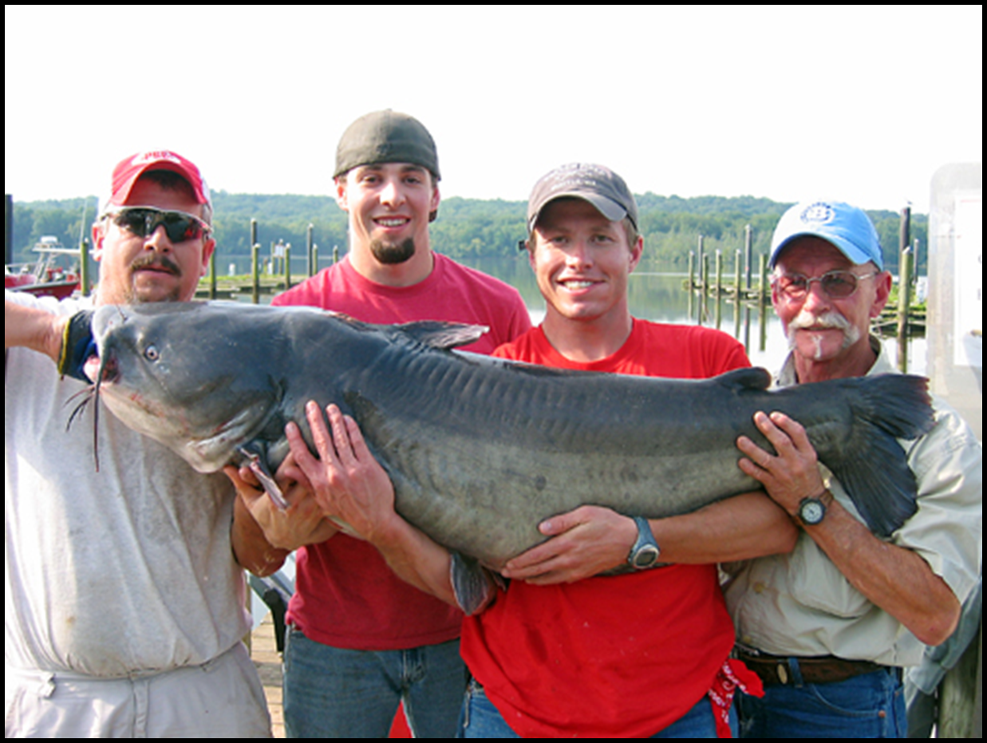
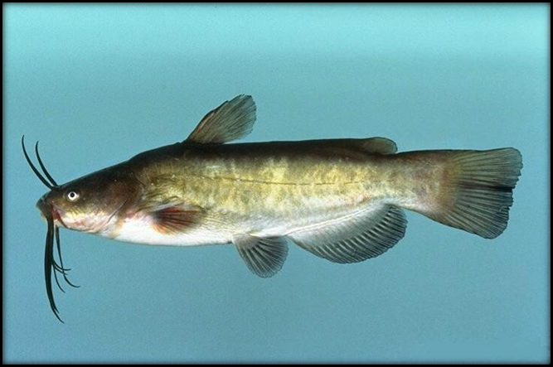
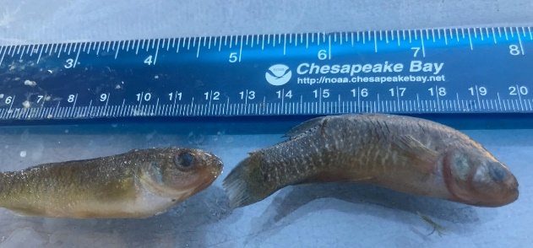
Use of Different Fish Species for Pre and Post Remedial Monitoring in the Anacostia River
Fred Pinkney
U.S. Fish and Wildlife Service
Chesapeake Bay Field Office
Presented to
Leadership Council for a Cleaner Anacostia River
Funding: DOEE
December 12, 2019

Slide 2
TO EVERY FISH THERE IS A REASON
Mummichog/Banded Killifish: Highly localized (<0.5 mile home range); forage fish, not eaten by people; measure whole body
Brown Bullhead (BB): Local (1.2- 2.5 mile range), eaten but not as big or as prized as CC BC
Channel Catfish (CC): More mobile—moves between Potomac and Anacostia; eaten and prized but out competed by Anglers
Blue Catfish (BC): Most mobile--average minimum distance = 15 miles with some moving up to 60 miles; favorite catfish of DC anglers

Slide 3
Chemicals of Concern: PCBs and Organochlorine (OC) Pesticides
Bioaccumulate in fish (vs. PAHs which are metabolized)
Fish advisories: driven by PCBs
Preliminary remediation goals: PCBs
No additional cost to analyze OC pesticides

Slide 4
Why study Mummichogs or Killifish?
Site fidelity and short-lived: ~2-3 years so will respond more quickly to changes to contaminant concentrations in water and sediment
Pre vs. post-remedial monitoring in tributaries and tidal river
Can isolate areas of tributaries that are high vs. low to focus source tracking
Compare between tributaries and main stem
Compare Potomac vs. Anacostia

Slide 5
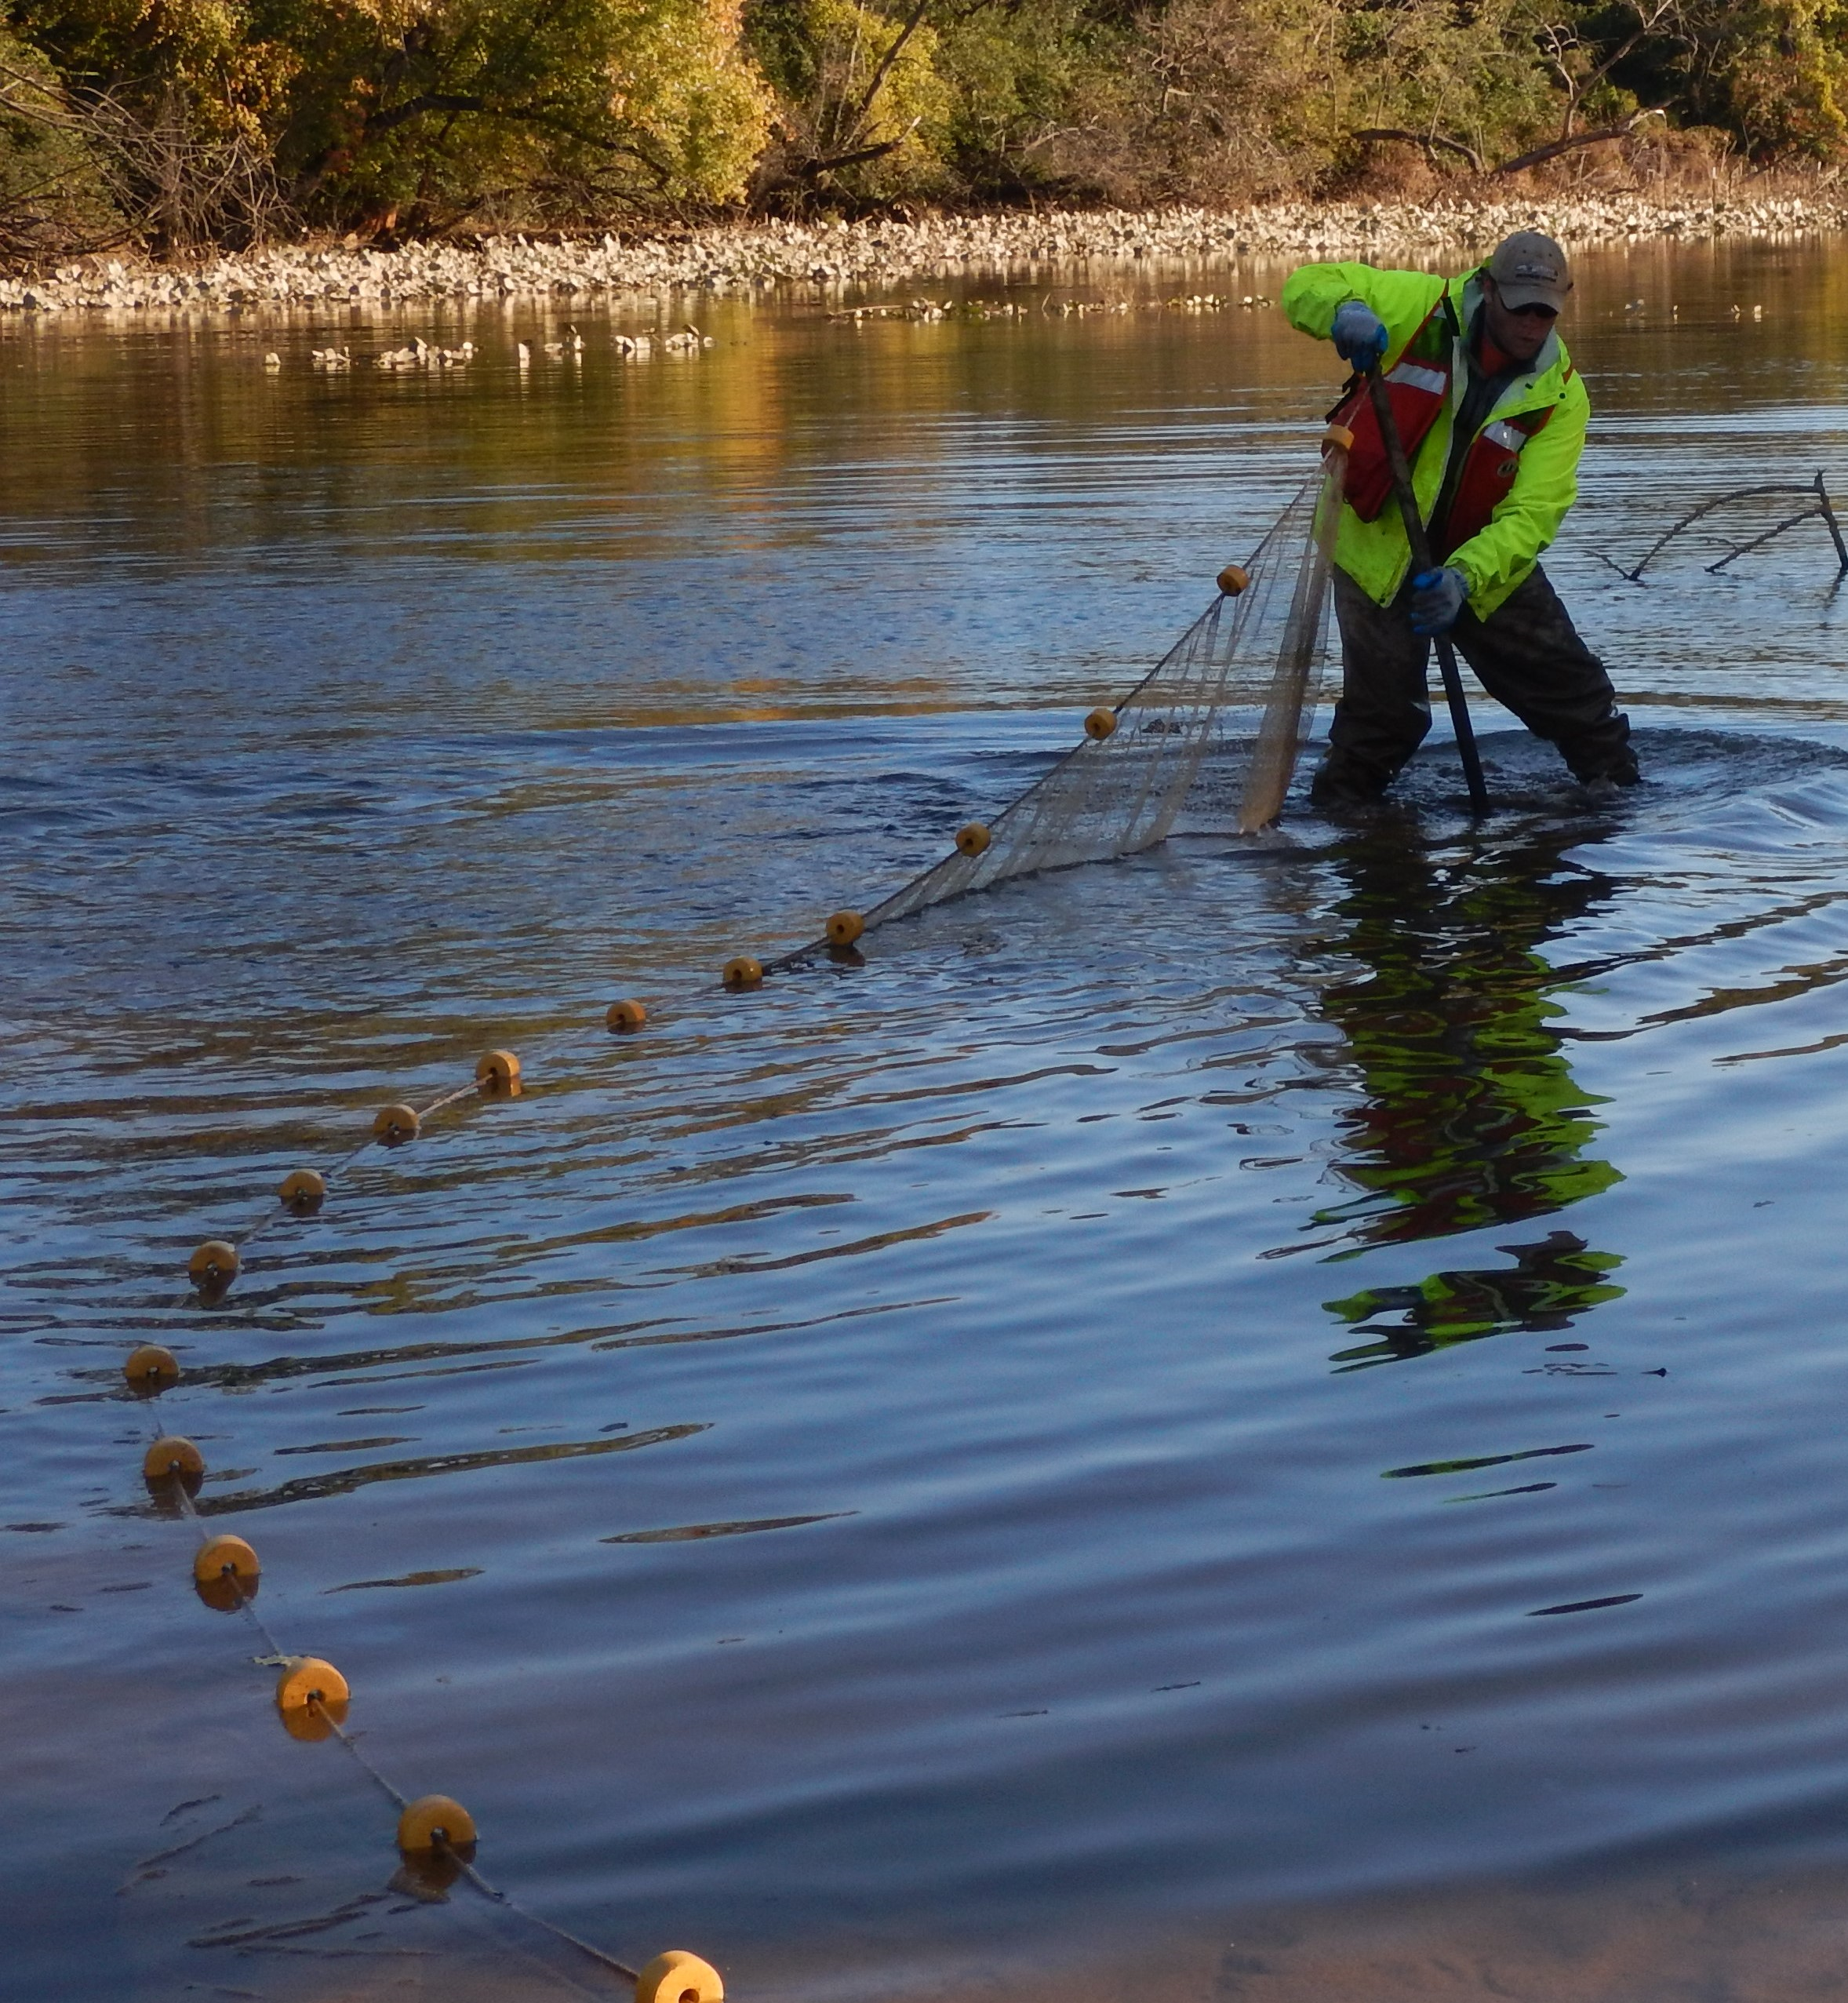
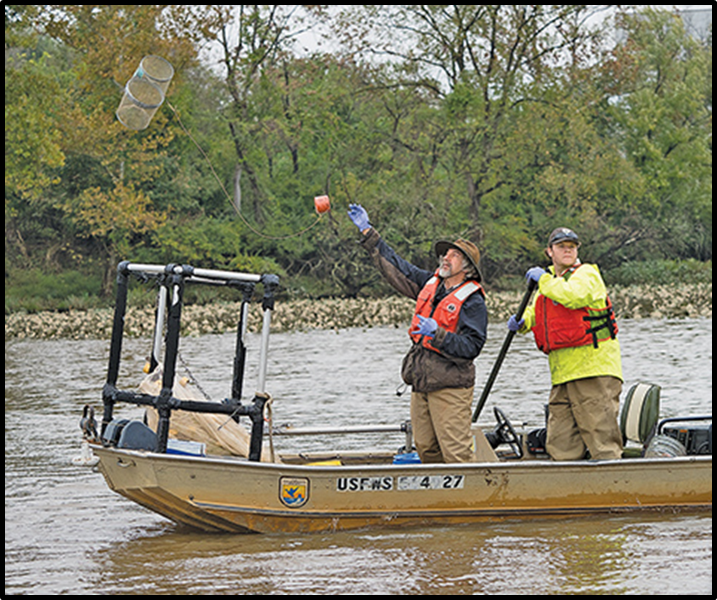
Beach Seining: Kingman Lake
Minnow Traps: Pepco Cove

Slide 6
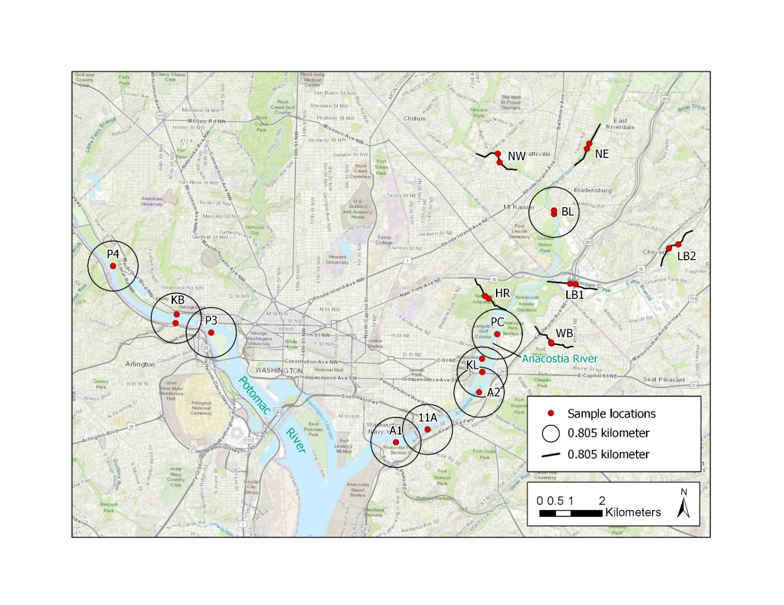
Mummmichog/Banded Killfish: Sampling locations: circles and lines show 0.5 mi.
2018: Anacostia + tribs; 2019: Potomac + Pepco, 11A
LEGEND
NW- Northwest Branch
NE- Northeast Branch
LB- Lower Beaverdam 1&2
BL- Bladensburg
HR- Hickey Run
WB- Watts Branch
PC- Pepco Cove
KL- Kingman Lake
A2-Upp. Anacostia
A1- Low. Anacostia
11A- 11th St & Pennsylvania Bridge
P4- Fletcher’s Cove- U. Potomac
P3- T. Roosevelt Island -L. Potomac
KB- Key Bridge
Wash. Ch.

Slide 8
Model-based Results: Banded Killifish
Location | Estimated TPCB (ppb) | 95% Lower limit | 95% Upper limit | Group
LB1 | 1,021 | 660 | 1,582 | A
LB2 | 996 | 638 | 1,559 | A
PC | 662 | 395 | 1,084 | A | B
A1 | 417 | 251 | 674 |  | B
WB | 407 | 263 | 663 |  | B
KL | 323 | 199 | 512 |  | B | C
A2 | 276 | 183 | 446 |  | B | C
HR | 185 | 112 | 301 |  |  | C
BL | 116 | 77.1 | 180 |  |  | C | D
NE | 88.2 | 56.8 | 144 |  |  |  | D | E
NW | 52.3 | 32.2 | 84.4 |  |  |  |  | E

Slide 9
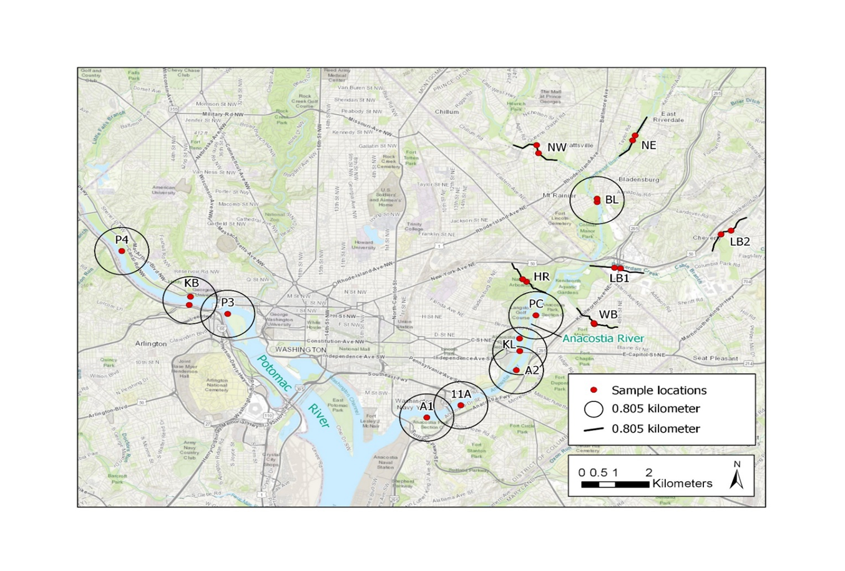
2020 and every 3 Years:
Tributaries: Lower Beaverdam 1, 2; Hickey, Watts
Mainstem: Bladensburg, Kingman Lake, Pepco Cove, 11A
Potomac: Key Bridge, Dyke Marsh

Slide 10
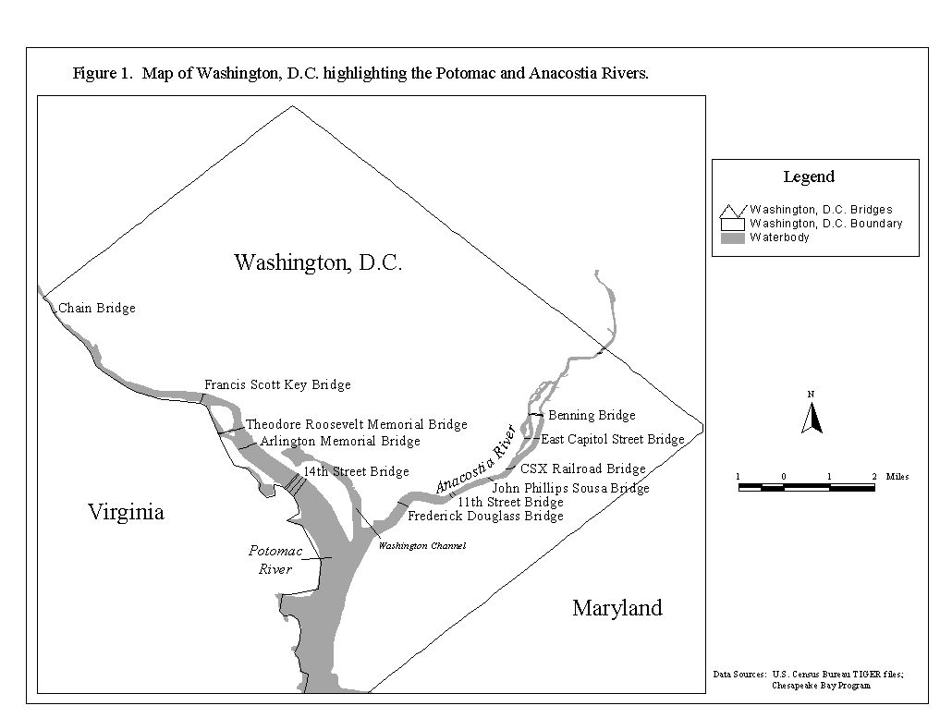
Brown Bullhead locations—Fillet PCB, OC pesticide concentrations
Bladensburg

Slide 11
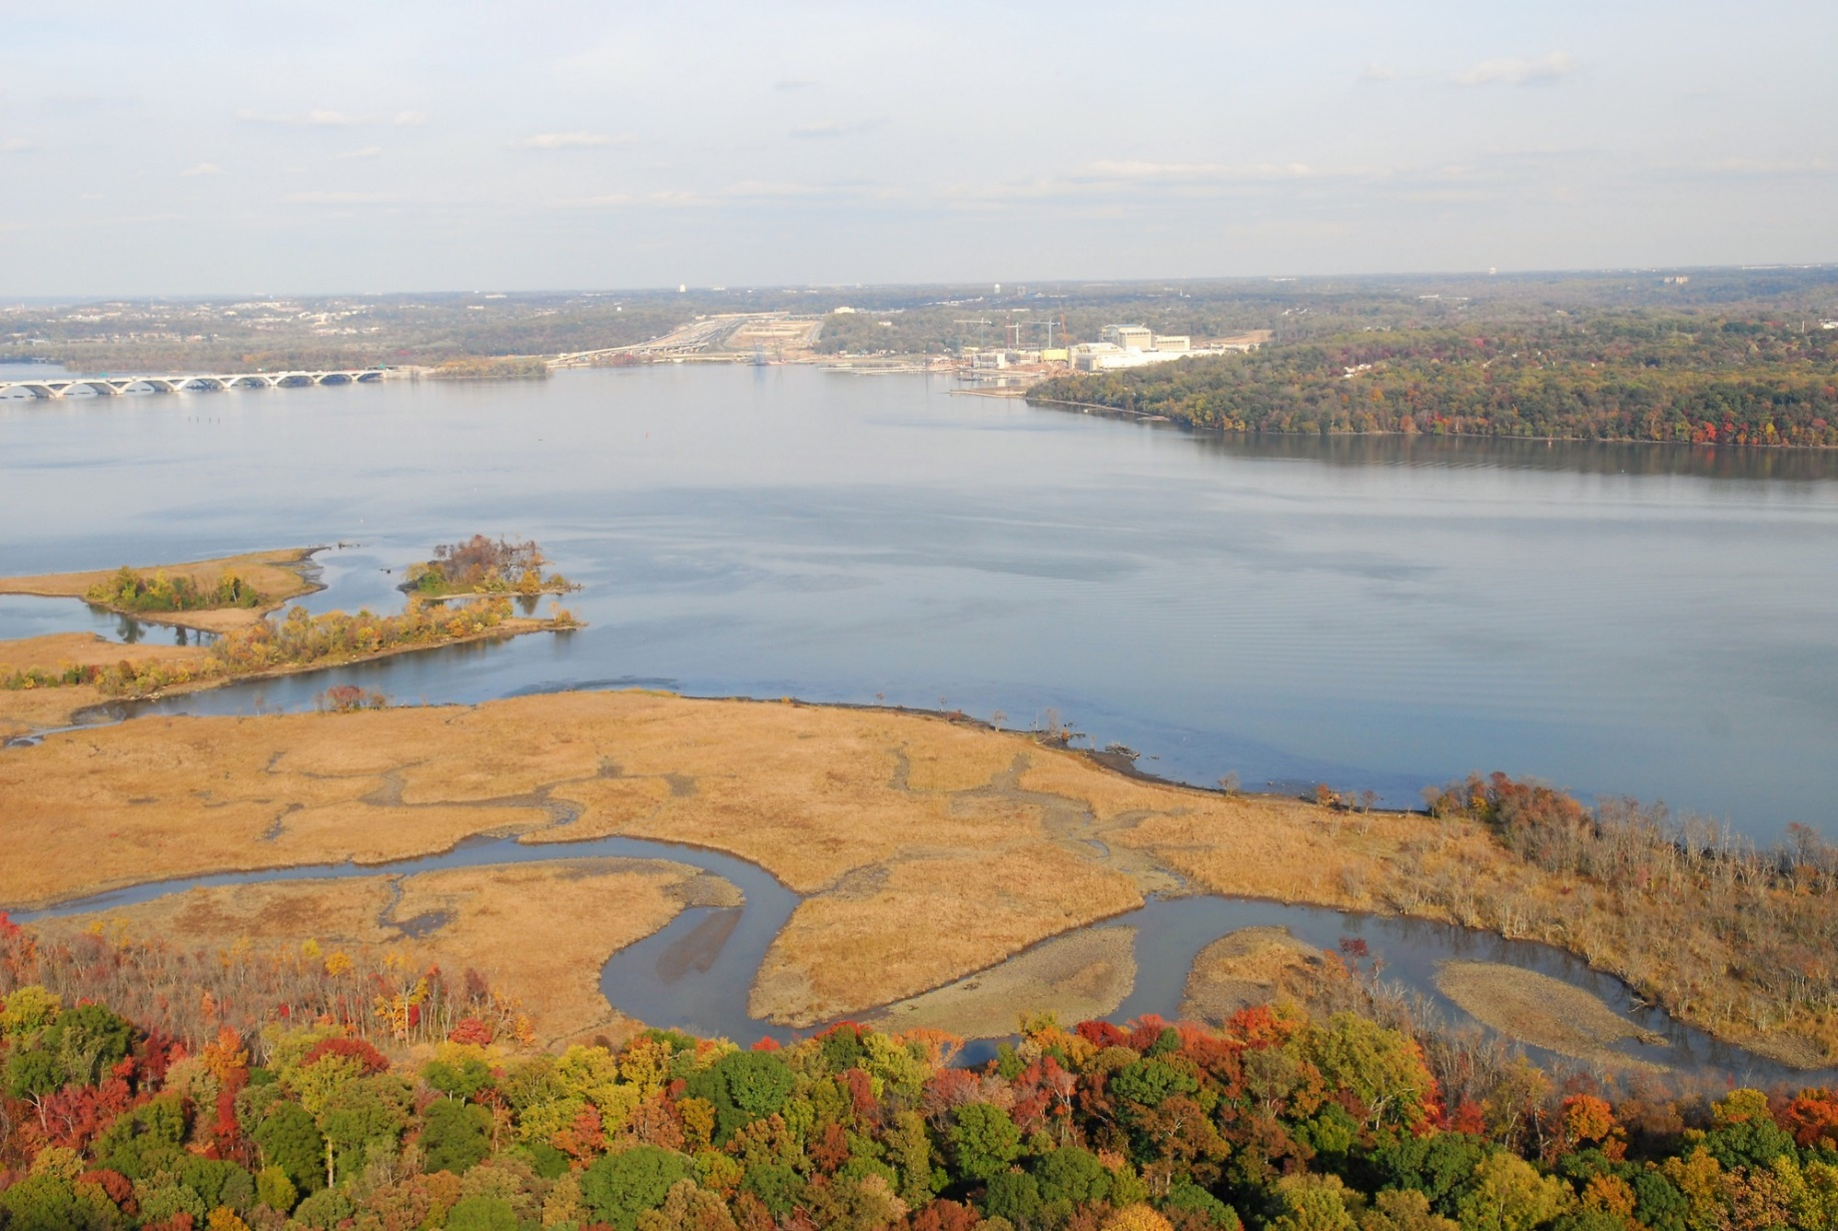
Dyke Marsh—3 miles south of Wilson Bridge—380 acres;
Surface Sediment: tPCB 10 ppb, tPAH 7 ppm, tChlordane 4 ppb

Slide 12
MDE guidance (ppm)
Do not eat (0.34)
1 meal/mon (0.17)
2 meal/mon (0.085)
1 meal/wk (0.042)
Unlimited (0.02)

Slide 13
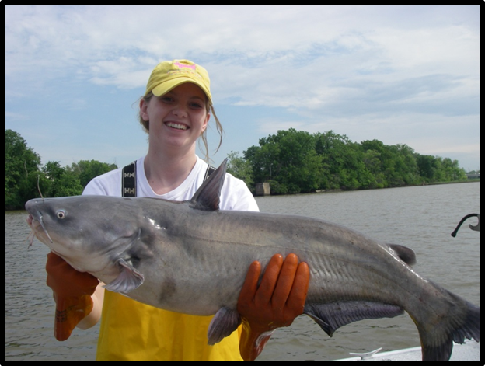
Mobile species: Channel Catfish and Blue Catfish PCBs and Organochlorine Pesticides
Why monitor as part of the ARSP?
The prized target species—largest commonly caught
Concentrations are decreasing but current advisory:
Do not eat: Eel, carp or striped bass.
May eat: Four servings per month of sunfish, three servings per month of blue catfish or white perch, two servings per month of largemouth bass, one serving per month of brown bullhead catfish or channel catfish
Goal is to enhance the sample size of these two species per quadrant to reduce uncertainty in monitoring status and trends; add Dyke Marsh as regional reference

Slide 14
3-Pronged Approach to Fish Monitoring
Mummichog/Killifish: tributary specific whole body
Brown bullhead: Bladensburg vs. CSX vs. Potomac fillets
Channel cat/blue catfish: increase sample size to reduce uncertainty--fillets
Dyke Marsh as regional reference—all species if possible
Timing: Before and after cleanup actions—cycle depends on when actions take place
Questions: Fred_Pinkney@fws.gov

