Slide 1
Maryland’s 2019/2020 PCB Source Trackdown and Source Control Strategy
MDE WSA – Water and Science Administration
MDE LMA – Land and Materials Administration
Leadership Council for a Cleaner Anacostia River
December 12, 2019

Slide 2
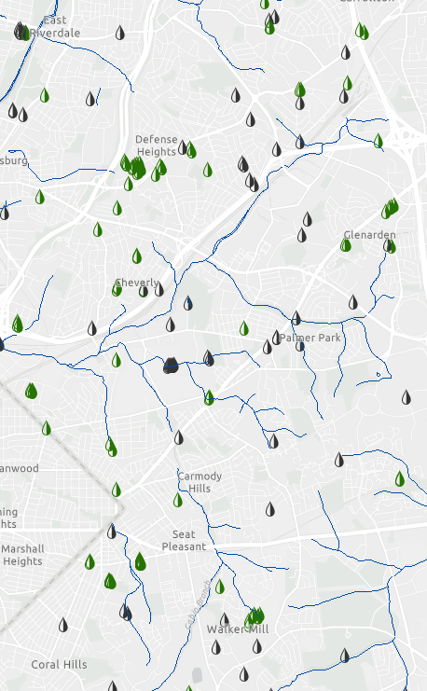
Maryland’s Anacostia Source Control Strategy
MD Phase I MS4s
Montgomery & Prince George’s Counties
Restoration Requirement
PCB TMDL Implementation Plan
Source Trackdown
MDE funding & conducting PCB source trackdown study
2019-2020: Lower Beaverdam Creek
MD Industrial Stormwater Facilities
General permit for stormwater from construction sites
mdewin64.mde.state.md.us/SSDS/SWP/index.html
2

Slide 3
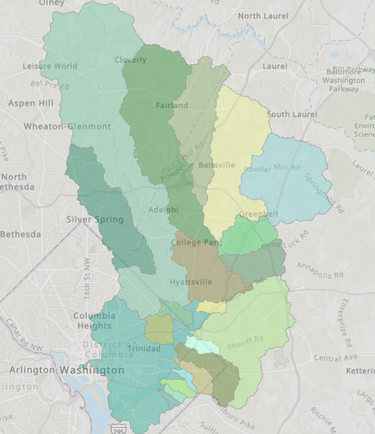
Lower Beaverdam Creek: Previous Studies
USGS Tributary Study
UMBC Passive Sampler Study
NPS Background Study
Previous MDE-LMA work
Previous academic work
Anacostia Subwatersheds
3

Slide 4
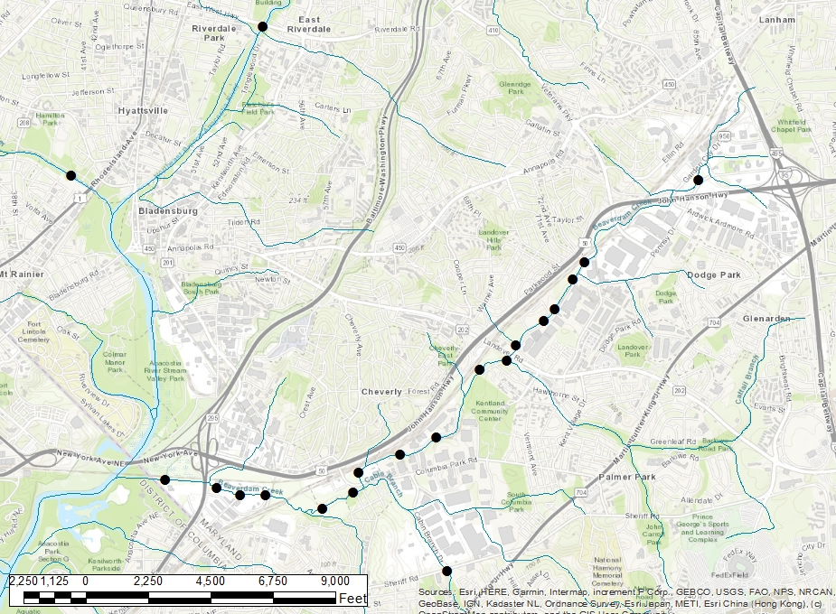
Fall 2019 Sampling Effort
4

Slide 5
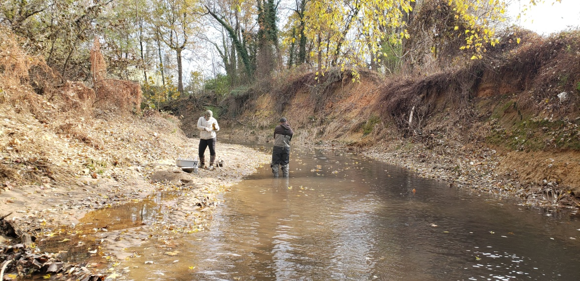
Fall 2019 Sampling Effort
Multiple locations sampled within Northeast Branch, Northwest Branch, focusing on Lower Beaverdam Creek
Aqueous samples for PCBs (EPA Method 1668c)
Sediment samples for PCBs (EPA Method 1668c), Total Organic Carbon, and Grain Size Distribution
Composite of 3 samples from stream transect
Mobilization November 21, 2019
Anticipate release of a report in Spring 2020
5

Slide 6
Upcoming Trackdown Efforts
Data-driven process
Follow-up sampling efforts
Based on results of Fall 2019 samples
Potential future work by MDE LMA’s Controlled Hazardous Substances Division
Cooperation between MDE (WSA & LMA) and MS4s
6

