Slide 1
Washington Navy Yard
OU2 – Nearshore Sediments
Project Update
December 2020
Notes:
a brief overview of the WNY Sediment Project

Slide 2
Washington Navy Yard’s Location on the Anacostia River
Graphic showing river with WNY highlighted

Slide 3
WNY OU2 (Anacostia River) Update
OU2 is defined as the near-shore sediments of the WNY
Conducted full investigations of nature and extent of Navy contribution to river (sediment and fish tissue sampling, background studies, risk assessments and forensics study)
  Remedial Investigation – completed 2014
  Data Gaps Investigation (Forensics/Fingerprint) Study – completed 2018
Currently working on Feasibility Study which will identify cleanup options (i.e., capping, dredging, and other technologies being considered)
  Draft OU2 FS Report submitted to regulators - March 2020
  Regulator comments received - September 2020
  Navy response to regulator comments – December 2020
  Technical meeting (Navy, EPA, DOEE) to discuss comments – TBD
  Draft Final OU2 FS – March 2021 (estimated)
  Final OU2 FS – Summer 2021 (estimated)

Slide 4
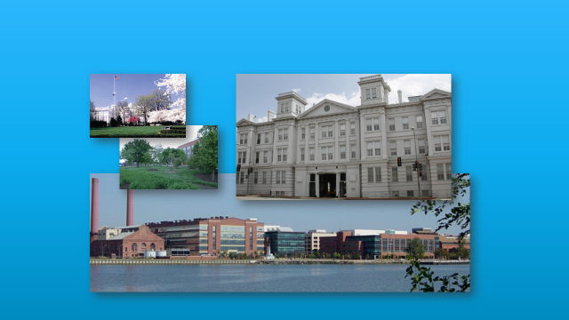
Next Steps.….Proposed Plan & ROD
Notes:
Ariel view of the Navy Yard to show the dense population
Highway/bridge to the east
GSA to the west
Capital Hill to the North
Old pic – now down to 2 piers and the Barry ship is no longer there

