Slide 1
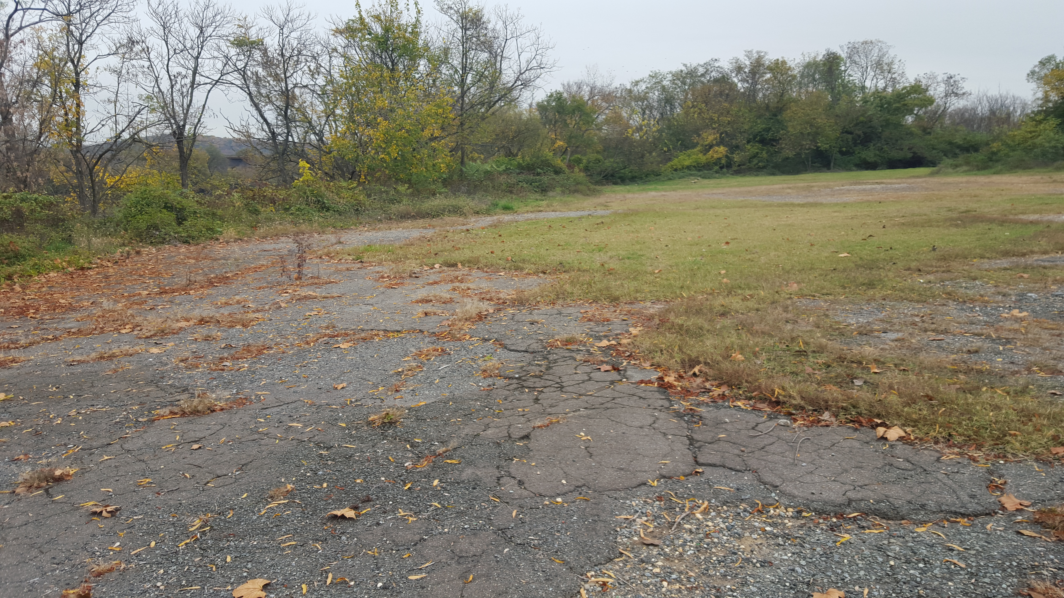

Kingman Island
Soil Pile Investigations
Asphalt Removal and Site Improvements
October 2016

Slide 2
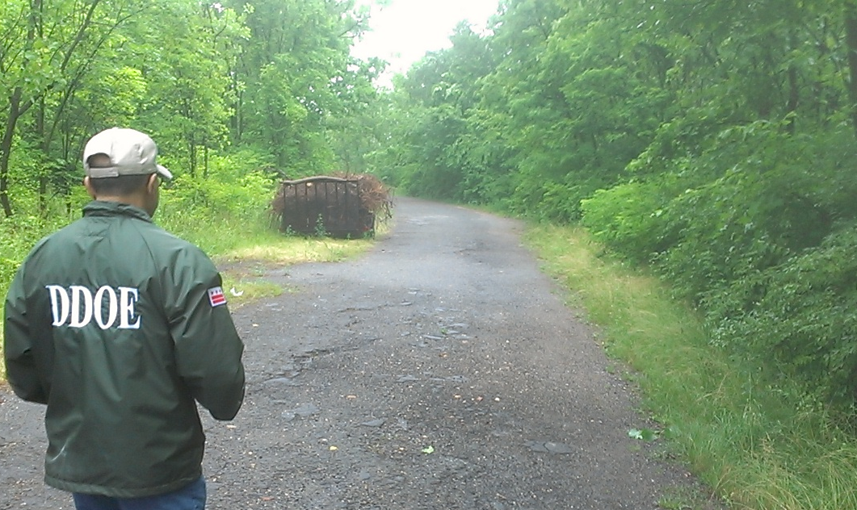
Presentation Overview
Soil Piles Investigation
Methodology
Findings
Remediation Options
Asphalt Removal Project
Asphalt Site Restoration
Community Benefits

Slide 3
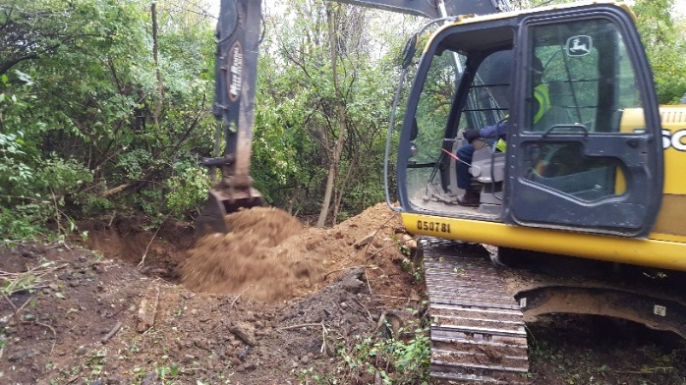
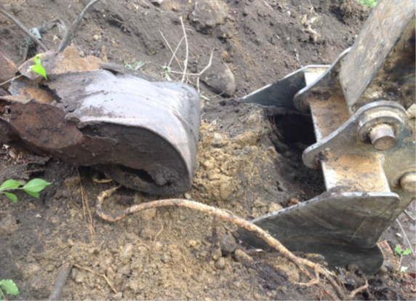
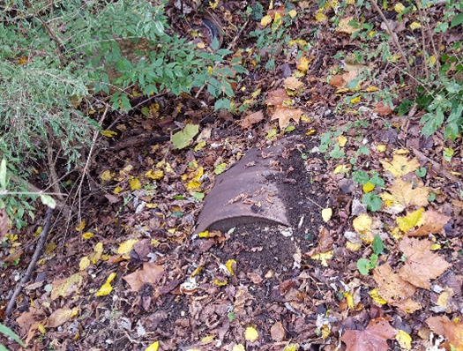
Site Investigation
Performed initial Site Investigation of the soil piles in November 2015
Soil borings and test pits in soil piles discovered presence of surface debris and fill material - origin unknown
DOEE study in August 2016 also confirmed these findings

Slide 4
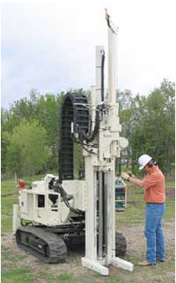
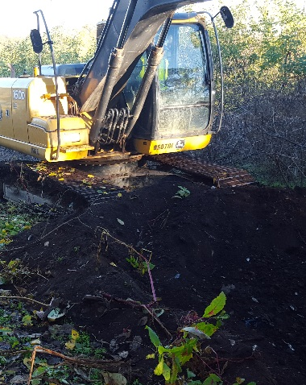
Investigation Methodology
Drilled 18 soil borings to 30 feet using a direct push Geoprobe
Excavated 12 test pits (10-25 feet in depth)
Installed and sampled groundwater from 9 temporary wells

Slide 5
Soil Pile Findings
Test pit material contained dredge spoils mixed with construction debris and general trash
Soil and groundwater results indicate multiple compounds above screening levels
Test pits revealed presence of petroleum-impacted non-hazardous waste
  Composite sample results
  Visual screening

Slide 6
Evaluation of Soil Pile Remedial Options -
Not yet Implemented
Excavation and offsite disposal
Sorting of material with offsite disposal and recycling
Partial excavation with onsite Solidification and Stabilization
Estimated 90,000 cubic Yards

Slide 7
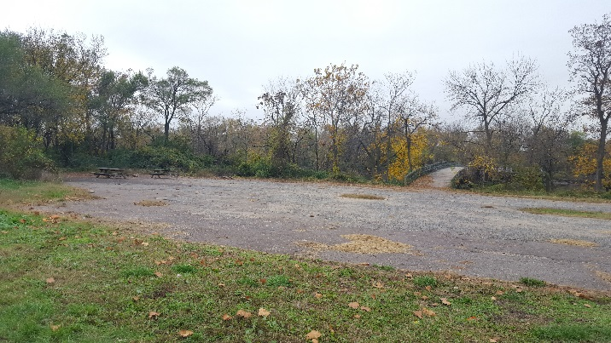
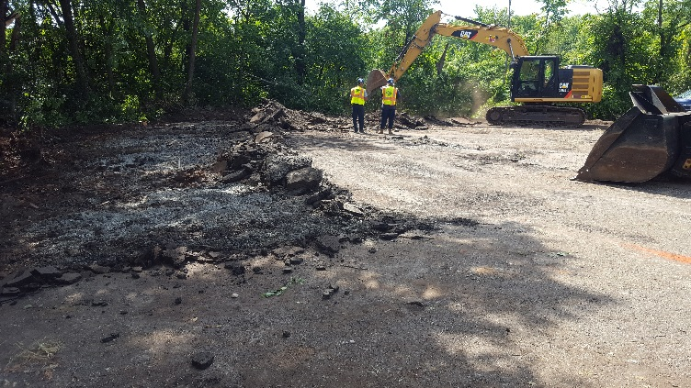
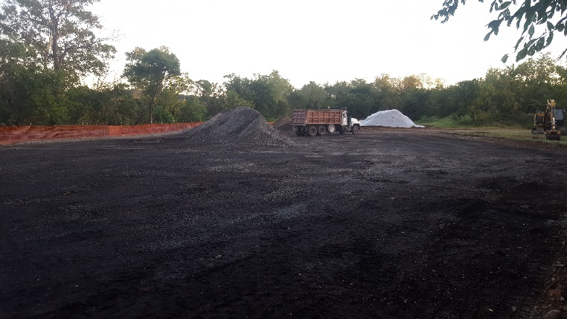
Asphalt Removal Project
The asphalt pad was deteriorated and did not fit with future plans for the Kingman Island
The asphalt pad and sub-base material were replaced with natural soil and green space
Removed >0.5 acre of asphalt-paved surface in September 2016

Slide 8
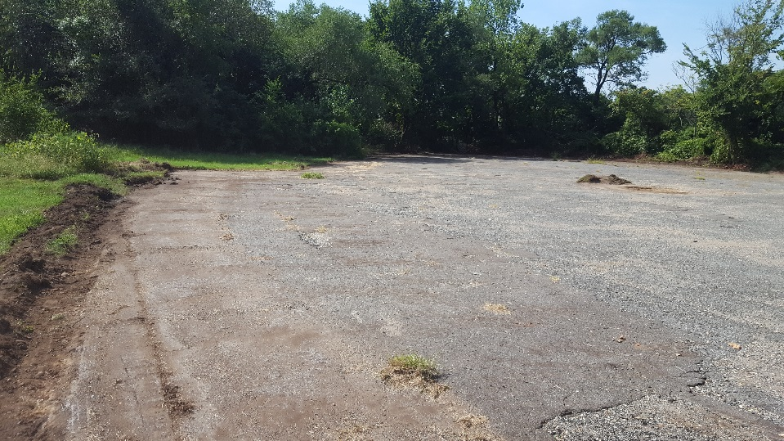
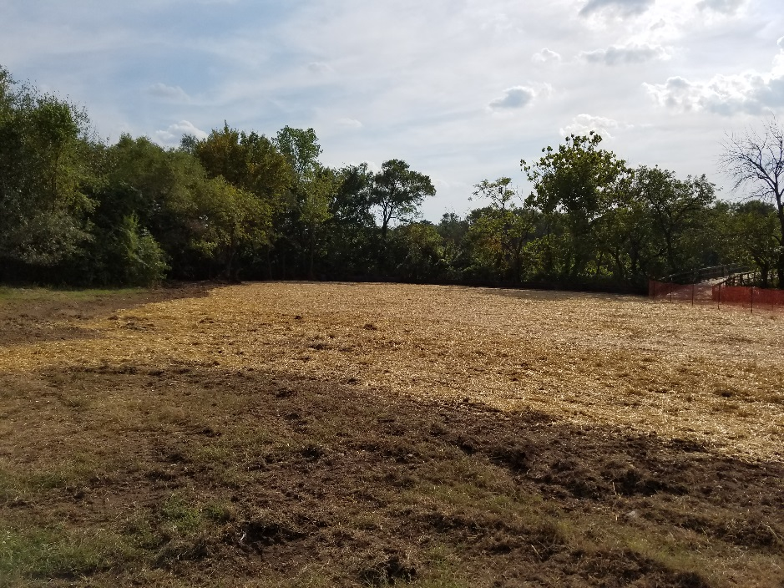
Paved Area Restoration Activities
Removed a 25,000 square foot asphalt pad
Graded and seeded excavated area with native meadow grass seed blend

Slide 9
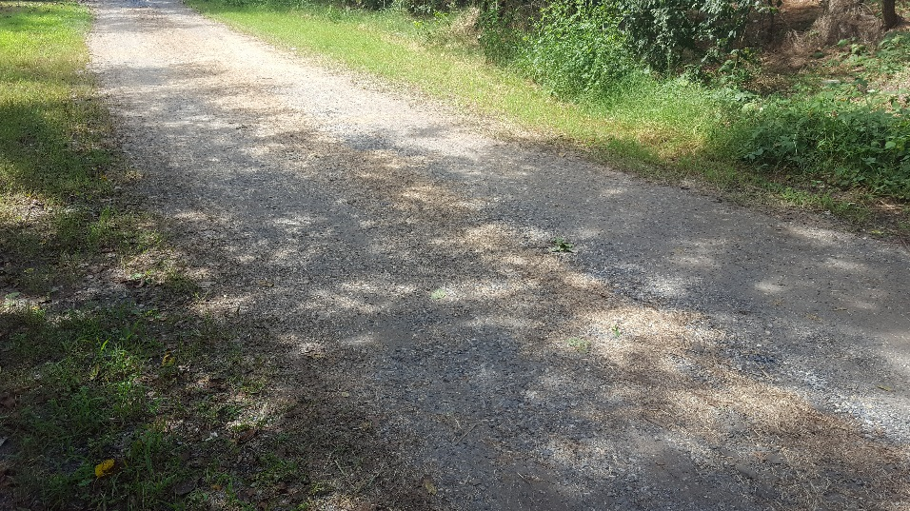
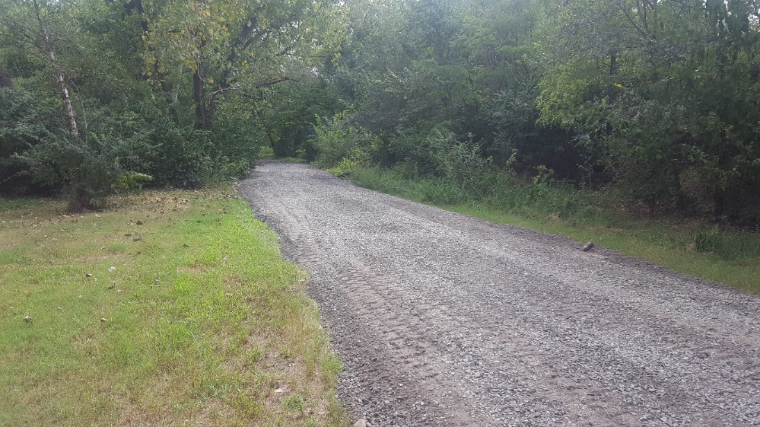
Paved Area Restoration Activities
Recycled >300 tons of asphalt material
Reused high quality sub-base material for on-site road improvements

Slide 10
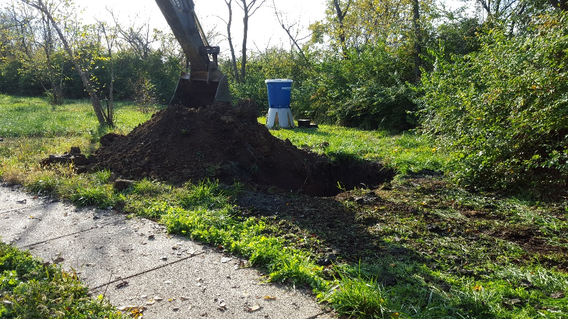
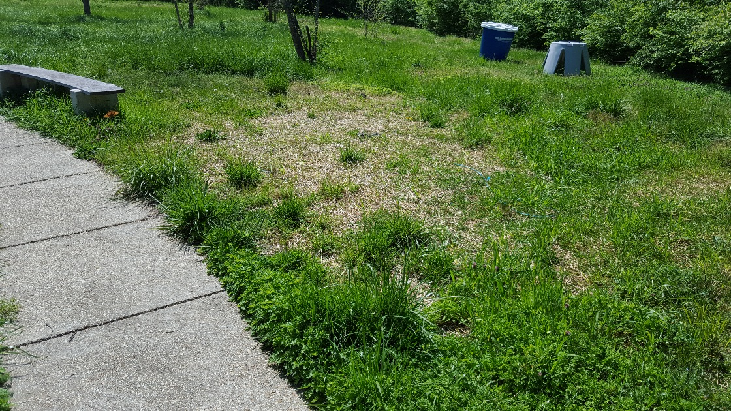
Soil Pile Test Pit Restoration Activities
Test pit locations graded & stabilized to create open space
Some areas transitioned to create recreation space for locating picnic benches
All disturbed area seeded with grass seed blend

Slide 11
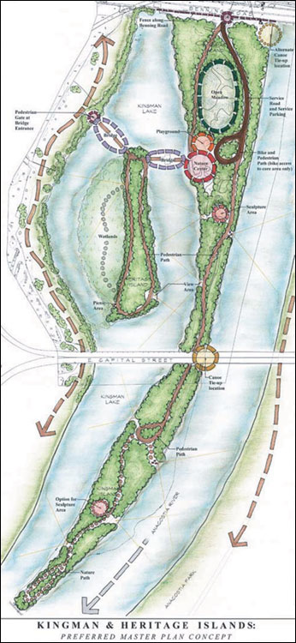
Green Restoration and Community Benefits
Study qualifies as a Green Remediation Project.
  Reduces the environmental foot print
  Increases economic and community benefits for both educational and recreational purposes
Project increases public green space:
  Reduces stormwater runoff
  Encourages native meadow vegetation growth
Space qualifies for Stormwater Retention Credits (SRCs) for voluntary green infrastructure.

Slide 12
QUESTIONS?
Dev Murali, PG, RPM dev.murali@dc.gov

