Slide 1
Washington Gas Site
Update September 14, 2017

Slide 2
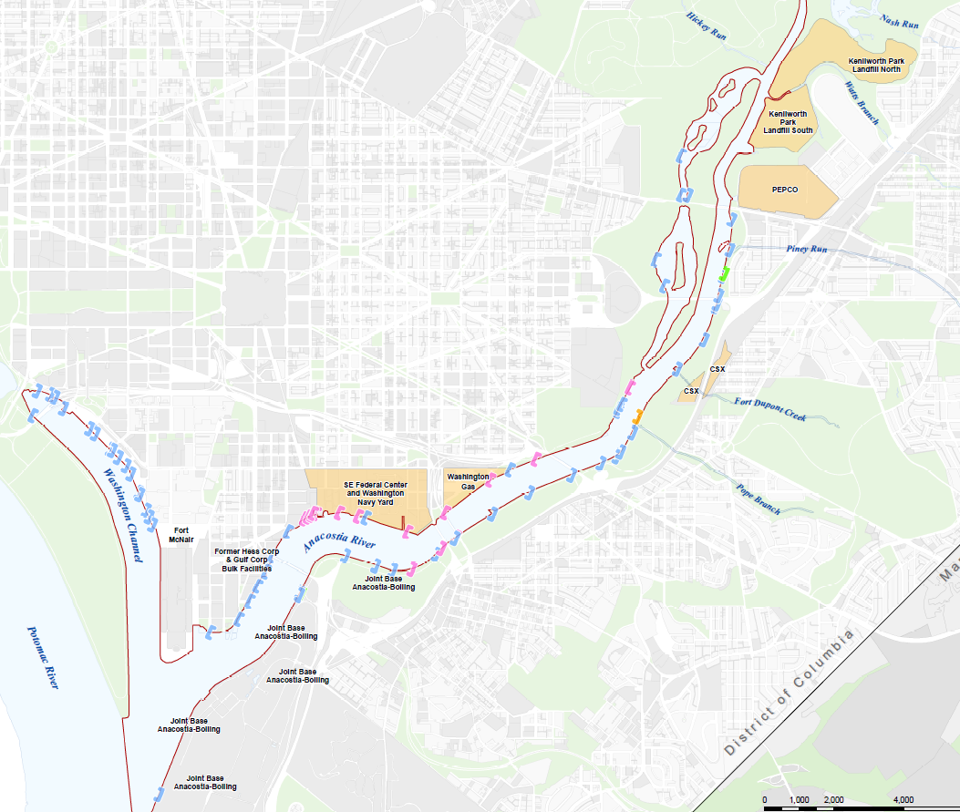
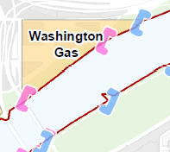

Slide 3
Washington Gas Site
WG manufactured gas from coal for lighting and heating from 1888 to the mid-1980s.
Wastes generated include coal tar, purifier box waste, wood chips, ash, cinders, and clinkers. Historical reports show that these wastes were occasionally placed as fill on the site.
The COCs include PAHS, VOCs (particularly benzene), cyanide, naphthalene, and heavy metals.
WG performed voluntary cleanup actions under EPA oversight and currently operates a pump and treat system that is designed to capture contaminated groundwater.

Slide 4
Washington Gas Site Pre-demolition (1951)
Washington Gas (EPA cleanup)
Government Property
Notes:
The MGP buildings, holders, tanks, and other facilities were demolished between 1983 and 1986. MGP-related aboveground oil storage tanks were removed in 1997.

Slide 5
Washington Gas Site Post demolition (2017)
Washington Gas (EPA cleanup)
Government Property

Slide 6
Washington Gas Site
September 2012 Consent Decree for “Government Property”
WG conducting investigation under NPS and DOEE oversight
NPS is lead agency under CERCLA
Two Operable Units
OU-1 Soil: Remedial Action completed, re-vegetation monitoring is on-going
OU-2 Groundwater and impacted river sediments: Investigation is on-going
Notes:
Consent Decree for Government Property only: a 4.2-acre parcel located between the WG East Station property and the River
The NPS as lead agency, in partnership with the District, oversees all of Washington Gas’s investigation and cleanup activities as part of a 2012 CD under CERCLA

Slide 7
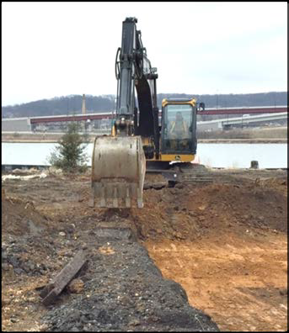
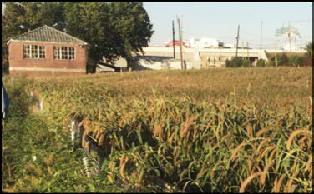
Washington Gas Site - OU1
Remedial Action Work Plan approved: excavation of top 3 feet – September 2014
Excavation of contaminated soil completed – July 2015
Revegetation monitoring on-going: Performance standards must be met over two consecutive years
First seeding event – October 2015
One year performance evaluation – November 1, 2016
Performance standards not met
Modification to seed list approved – March 2017
Reseeding completed – June and July 2017

Slide 8
Washington Gas Site – OU2
Activities Completed
Mobilization 1: soil borings – December 2015
Mobilization 2: hydraulic profiling – May 2016
Mobilization 3: well installation and groundwater study – December 2016
Mobilization 4: hydrographic survey – October 2016
Mobilization 5: In-river sediment investigation – August 2017
Manufactured gas impacts observed deeper and over a larger area than anticipated

Slide 9
Washington Gas Site – OU2 (continued)
To Be Completed
Mobilization 6: Additional land-side groundwater investigation – September 2017
Data gap study
RI Report (draft) – August 2018
Feasibility Study – 2018
If Treatability Study needed it may extend completion date to Jan 2020
Proposed Plan and Record of Decision – 2020

