Slide 1
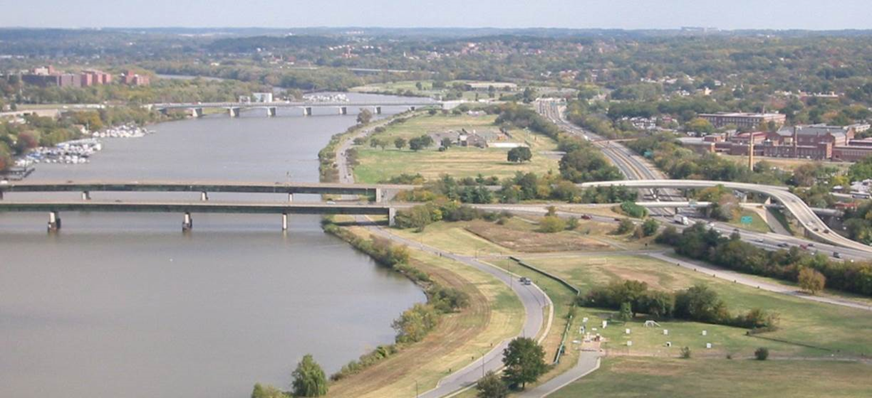
Anacostia Park
Notes:
National Park Service administers approximately 1,108 acres along both banks of the Anacostia River, and manages the bed of the Anacostia River.

Slide 2
NPS Mission
The National Park Service (NPS) preserves unimpaired the natural and cultural resources and values of the national park system for the enjoyment, education, and inspiration of this and future generations.
The NPS core values are a framework in which the National Park Service accomplishes its mission. They express the manner in which, both individually and collectively, the National Park Service pursues its mission. The NPS core values are:
Shared stewardship: We share a commitment to resource stewardship with the global preservation community
Excellence: We strive continually to learn and improve so that we may achieve the highest ideals of public service.
Integrity: We deal honestly and fairly with the public and one another.
Tradition: We are proud of it; we learn from it; we are not bound by it.
Respect: We embrace each other’s differences so that we may enrich the well-being of everyone.
Notes:
National Park Service administers approximately 1,108 acres along both banks of the Anacostia River, and manages the bed of the Anacostia River.

Slide 3
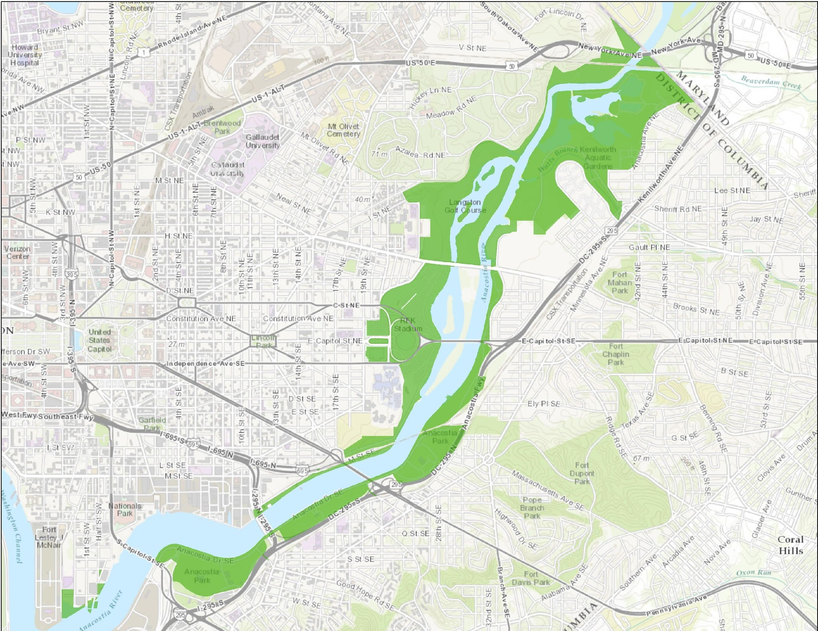
Anacostia Park
Notes:
National Park Service administers approximately 1,108 acres along both banks of the Anacostia River, and manages the bed of the Anacostia River.

Slide 4
Purpose of Anacostia Park
1933 - Capper-Cramton Act (PL 71-284)
“…to preserve the flow of water and prevent pollution in Rock Creek and the Potomac and Anacostia Rivers, to preserve forests and the natural scenery in and about Washington, and to provide recreational opportunities in the Nation’s Capital.”
Notes:
National Park Service administers approximately 1,108 acres along both banks of the Anacostia River, and manages the bed of the Anacostia River.

Slide 5
Vision for Anacostia Park
Anacostia Park can be a model urban park that demonstrates how NPS can support historically underserved communities and provide economic drivers for the redevelopment of urban areas. Residents and visitors enjoy high quality outdoor experiences, a healthy environment, and an enhanced quality of life.
We envision a park that offers:
A clean and healthy river
A recreation destination for neighboring disadvantaged communities
Hiking, biking, and paddling
Playing fields and other opportunities for youth sports activities
Restored wetlands that provide habitat and storm resiliency
Truly unique places and experiences
Notes:
National Park Service administers approximately 1,108 acres along both banks of the Anacostia River, and manages the bed of the Anacostia River.

Slide 6
CERCLA Authority
NPS exercises CERCLA lead agency authority at several Anacostia sites
CERCLA cleanups in national parks must attain NPS Organic Act standards
Fundamental park resources and values impacted by hazardous substances must be re-established in an unimpaired condition
Notes:
It is within this context that NPS, as the delegated CERCLA lead agency at sites under NPS jurisdiction, exercises CERCLA response authority. Within Anacostia Park, that includes:
Anacostia River sediments
Kenilworth Landfill
Washington Gas site
Poplar Point
It is also within this context that cleanup standards are determined. Like EPA-lead sites, cleanups at NPS-lead sites must satisfy two “threshold criteria.” Cleanups must be both protective (risk-based) and attain “applicable or relevant and appropriate requirements” (ARARs) which include requirements based on the location of the site. In this case, since these sites (especially the Anacostia River) are within a national park, the cleanup must satisfy the substantive requirements of the NPS Organic Act, specifically the mandate that resources must be preserved or re-established so as to leave them unimpaired for future generations.
Unimpaired does not mean “pristine” or free of contaminants but it does mean that the park’s fundamental resources and values must fulfill their role in achieving and preserving the core purposes of the park.
To satisfy this “non-impairment standard” with respect to the Anacostia River, which embodies several fundamental resources and values for the Park, the selected remedy must conserve and enhance those resources and values including the River’s ecological functionality, wetlands, habitat, native vegetation communities, and aesthetics so that the River fulfills its role in achieving the core purpose of the Park.
This is the NPS vision of what the Anacostia river sediments cleanup will achieve.

Slide 7
Anacostia River Sediments Project and Active Land Sites Status
Leadership Council for a Cleaner Anacostia River
December 7, 2016

Slide 8
Active Potential Environmental Cleanup Sites (PECs) along the Anacostia River in the District of Columbia
Kenilworth Landfill
PEPCO
CSX Transportation
Washington Gas
Washington Navy Yard
Southeast Federal Center
Poplar Point
Combined Sewer Overflows

Slide 10
Kenilworth Landfill Site
NPS lead
Two Operable Units
OU-1 Landfill
OU-2 Groundwater
OU-1 Supplemental Groundwater Report completed in 2016
OU-1 Additional investigations: January – March, 2017
Pore water samples
Pressure transducers
Surface permeability testing

Slide 11
Kenilworth Landfill Site (Continued)
OU-1 ROD anticipated – Early 2018
OU-1 Remedy Implementation – 2020
OU-2 FS initiated – September 2017

Slide 12
LEGEND
Proposed pore water sampling locations
Proposed pore water background sampling locations

Slide 14
PEPCO Benning Road Facility
DOEE lead
Draft RI Produced – 2016
Technical Memo #1 – Conceptual site model
Technical Memo #2 – Refined background evaluation work plan
Technical Memo #3 – Baseline human health ecological work plan
RI/FS work plan Addendum 3 - Additional field investigation
Additional Sampling – January-May, 2017
Sediment sampling
Near shore sampling
Site soil/groundwater sampling
Final RI Report – January 2018
Final FS Report – March 2018
ROD Anticipated – September 2018

Slide 15
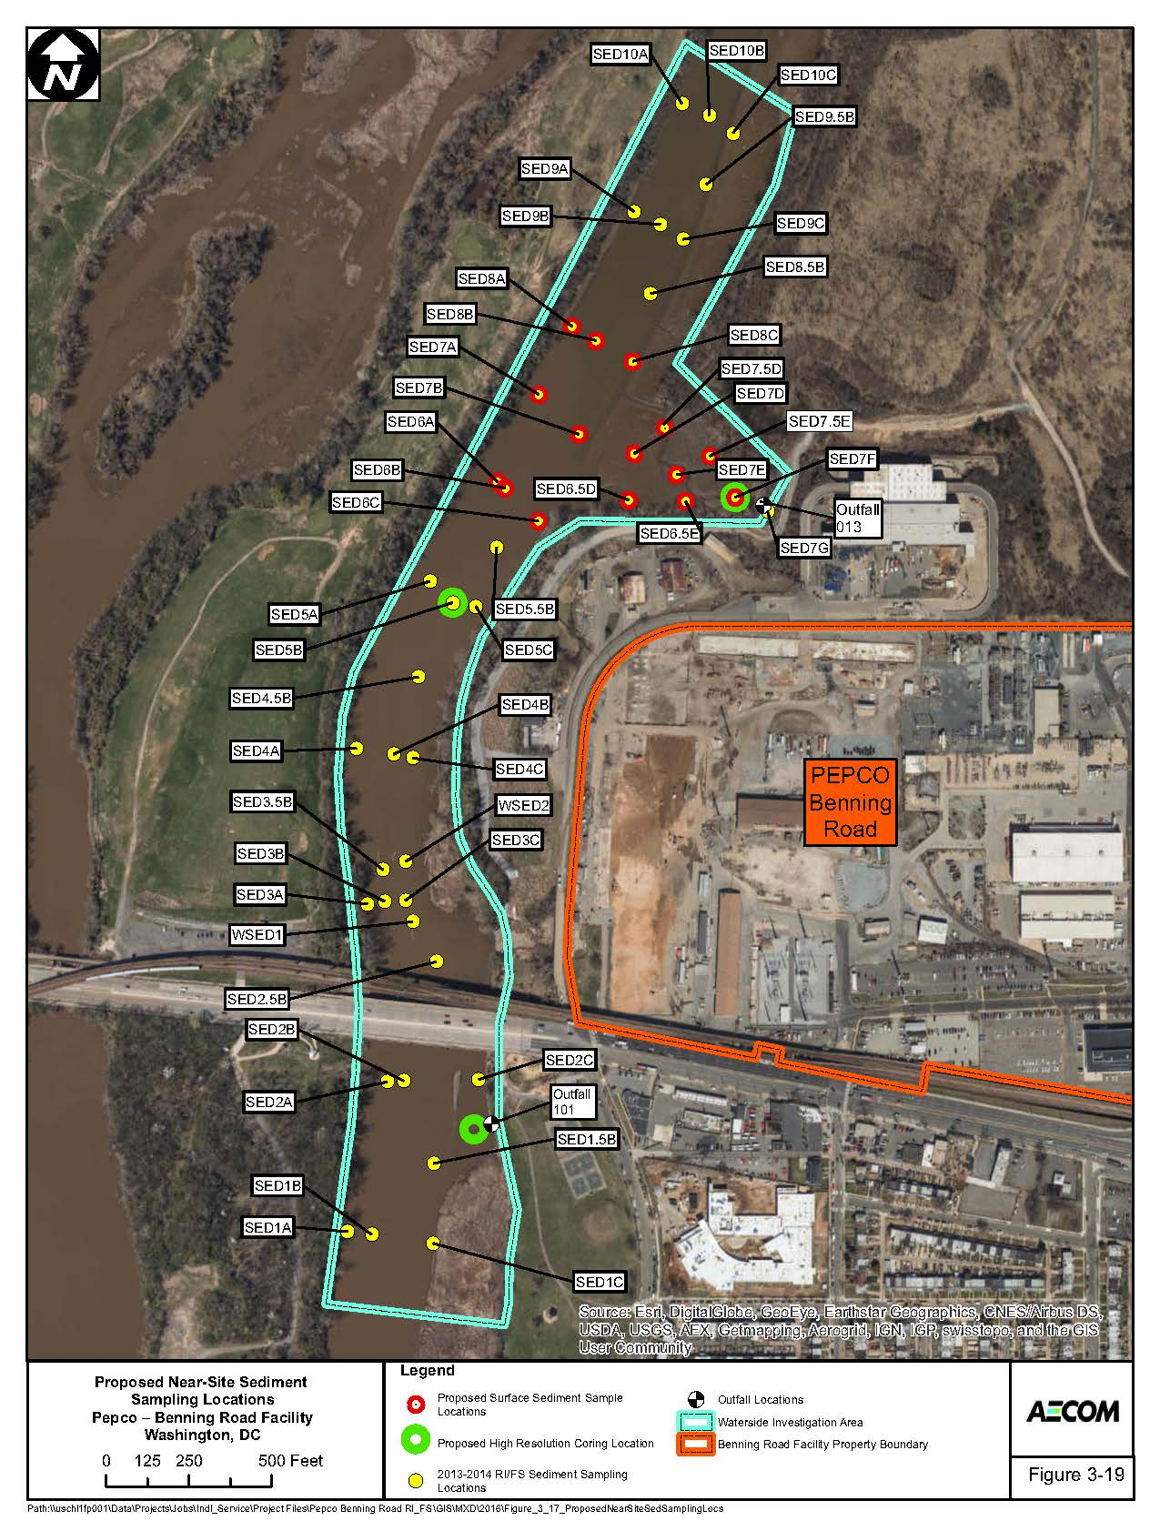

Slide 16
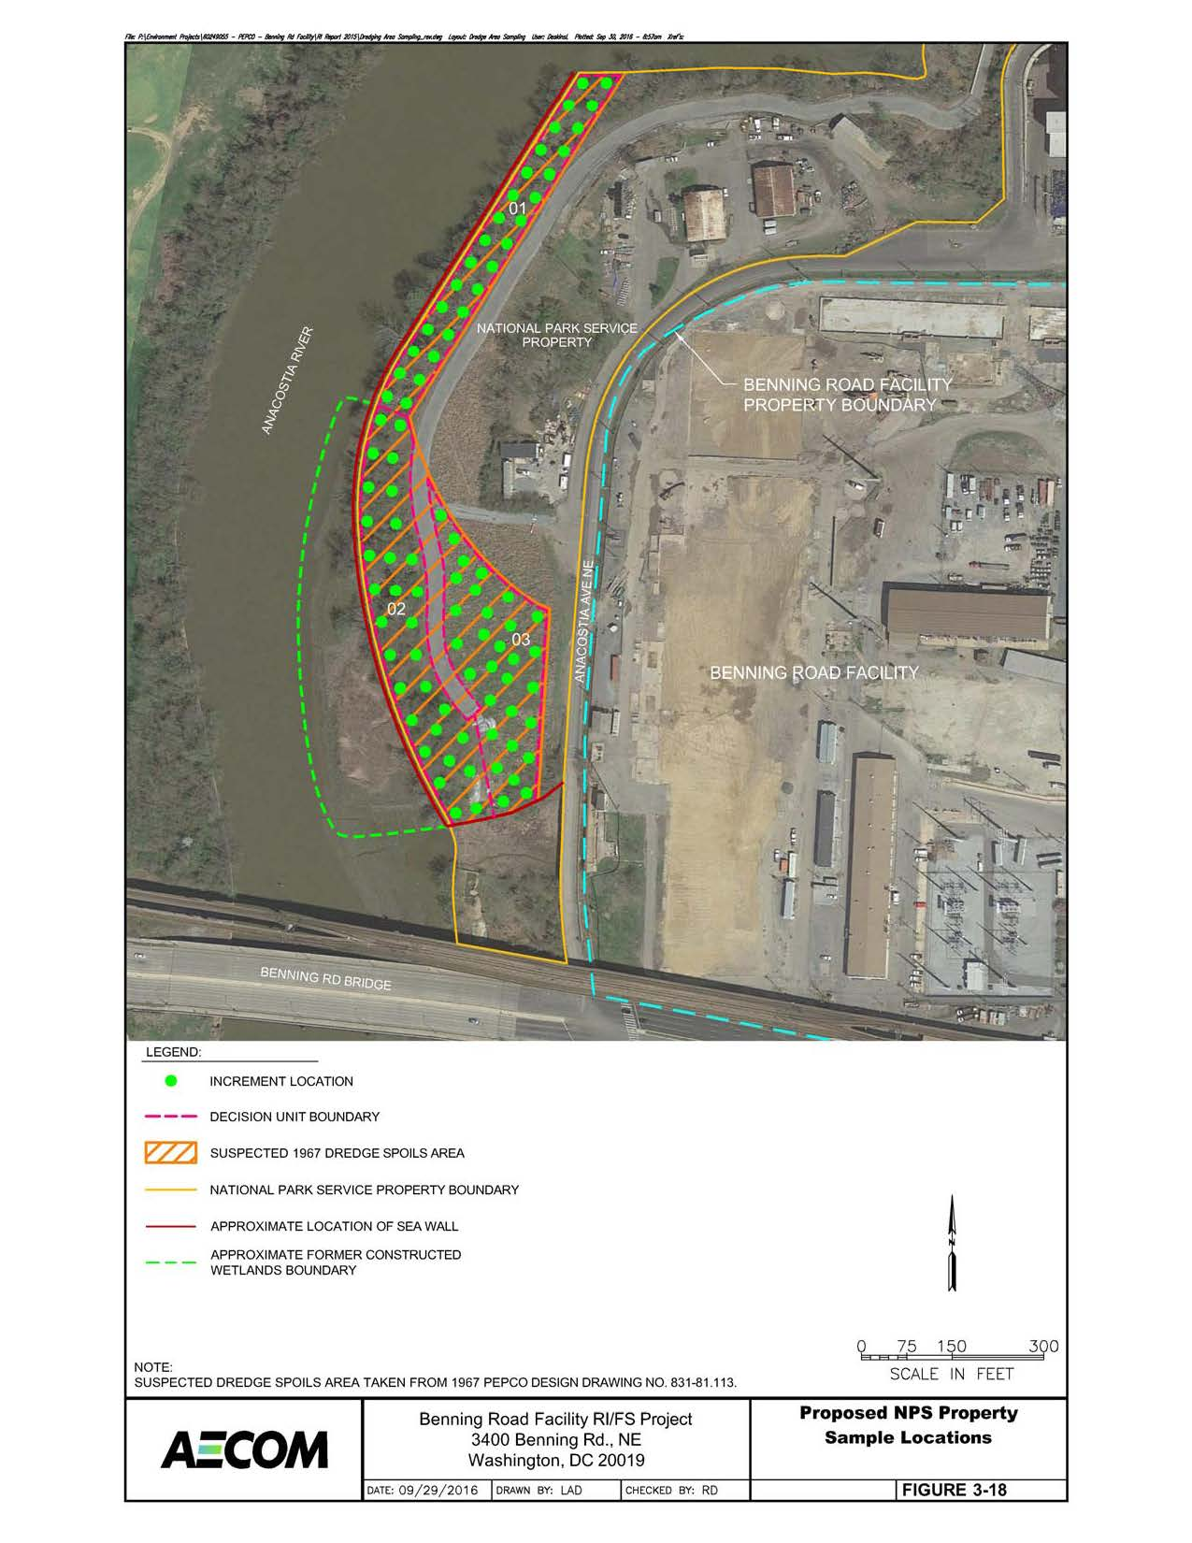

Slide 17
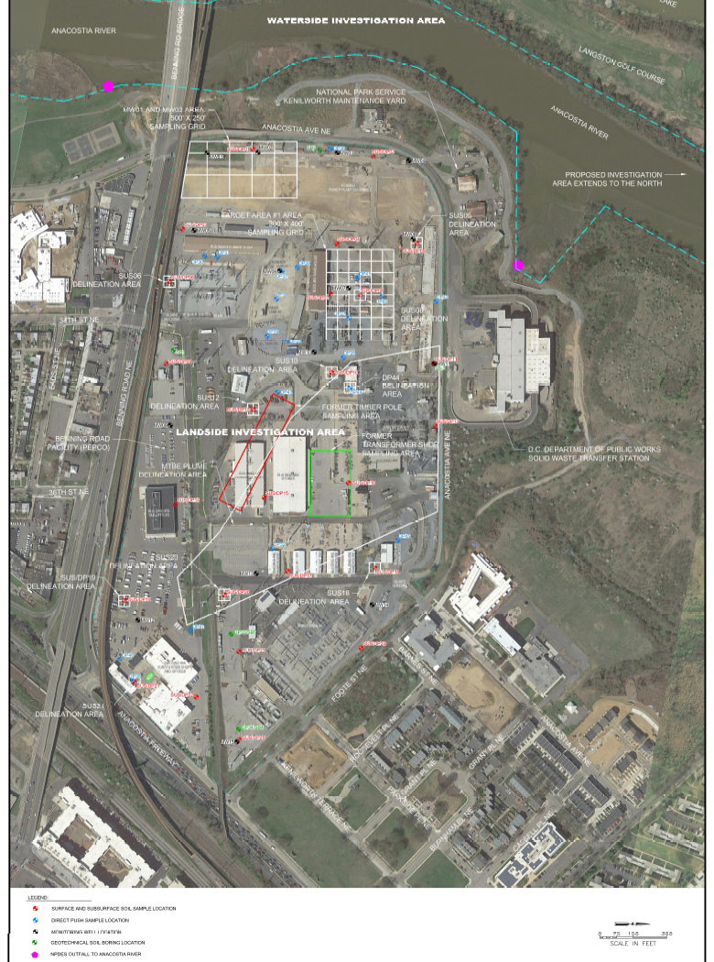

Slide 18
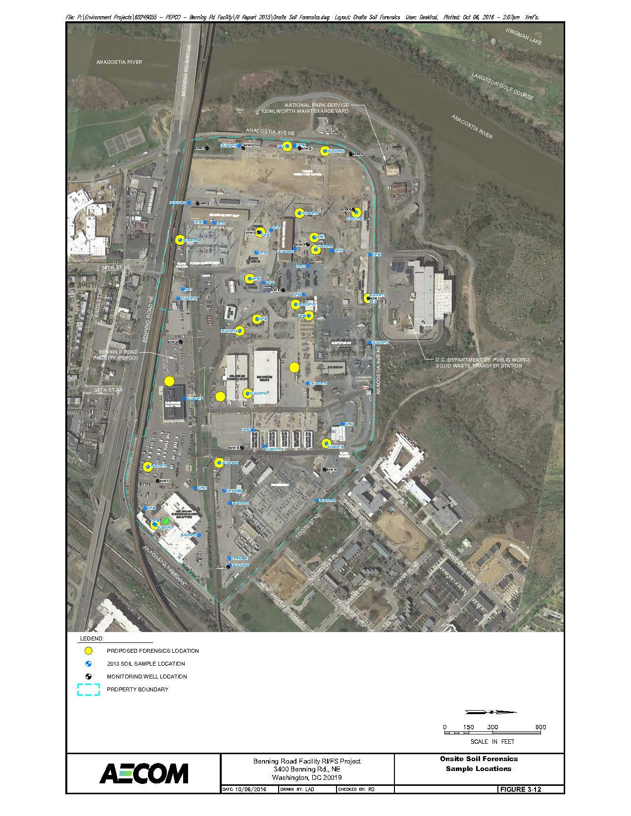

Slide 20
CSX Transportation
DOEE Lead
CWA violation/consent decree
Diesel oil release
Site Assessment
Facility (soil, groundwater, surface water) – 2008-2011
Fort DuPont Creek, Anacostia River – 2011
Landside Corrective Action
Landside soil removal – 2015
Groundwater free product removal – prior to 2015 soil removal
Post Remediation Groundwater Monitoring – ongoing
No Additional Sediment Sampling/Remediation Currently Planned

Slide 21
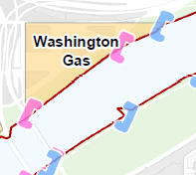

Slide 22
Washington Gas Site
NPS Lead
September 2012 Consent Decree
Two Operable Units
OU-1 Soil
OU-2 Groundwater
OU-1
Remedial Action: excavation of top 3 feet – July 2015
OU-2
Mobilization 1: soil borings – December 2015
Mobilization 2: hydraulic profiling – May 2016
Mobilization 3: well installation and groundwater study – ongoing
Mobilization 4: hydrographic survey – October 2016
In-river sediment investigation – Spring 2017
RI Report (draft) -August 2018
Feasibility Study – 2018
If Treatability Study needed it may extend completion date to Jan 2020
Notes:
Dawn

Slide 25
Washington Navy Yard Superfund Site
EPA lead
Large, complicated site
Two OU’s; 19 sites; multiple Site Screening areas consisting of former building usage
Multiple removal actions at sites and storm sewers from 1996-2008
OU-1 – base-wide groundwater operable unit
Final FS – August 2017
Draft Proposed Plan – October 2017
Draft Final ROD – September 2018
OU-2 – Near shore sediments
Sediment Sampling – March 2016
Final FS – September 2017
Proposed Plan – March 2018
Final ROD – October 2018

Slide 27
Southeast Federal Center
55.3 Acre parcel separated from the Washington Navy Yard in 1963
11.3 acre parcel-DOT Headquarters
44 Acre Parcel-GSA
GSA Lead
EPA 1999 Section 3013 Order on Consent
Six parcels remediated and prepared for redevelopment
DOT parcel; Parcels M,P,K,D and N
EPA 2014 RCRA Corrective Action Order for remaining 9 parcels
Statement of Basis signed by EPA-June 2015
SEFC won EPA Phoenix Award for Environmental Restoration at a Brownfield Site in 2013

Slide 29
Poplar Point
NPS Lead- approximately 100 Acre
Phase I RI Work plan recently approved by NPS; needs to be completed
RI/FS schedule unclear
NPS will continue to work with DOEE and DMPED to move forward

Slide 30
Combined Sewer Overflows
Anacostia River Tunnel (ART) completed –March 2018
ART takes into account all CSOs on Anacostia
After completion CSO overflows still possible
Estimated at 2 releases/yr.
Most releases at CSO 019 and ‘O’ Street
54 MG/yr (total): 33MG/avg yr at CS O19; 21 MG/avg yr at CSO 10
MS4s not being addressed by this project

Slide 31
All Planned Sediment Sampling will be Completed by June 2017
Anacostia River Phase 2 RI
PEPCO
Washington Gas
Washington Navy Yard

Slide 32
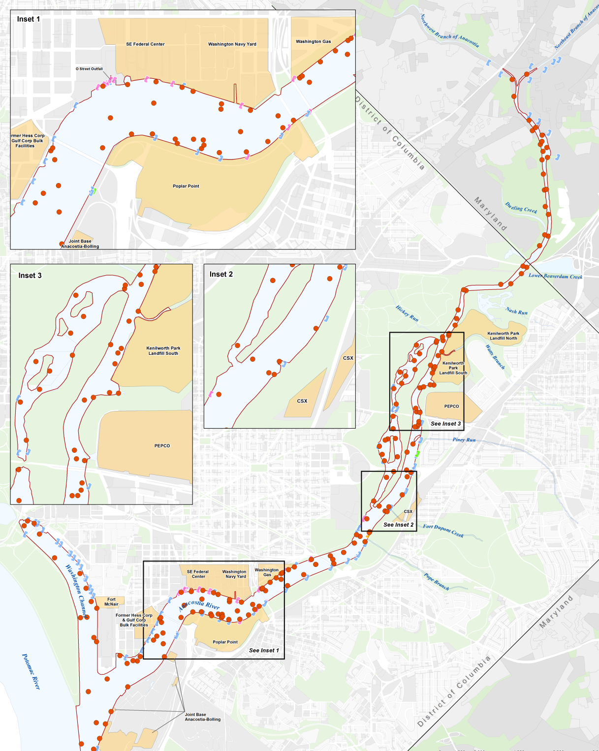

Slide 33
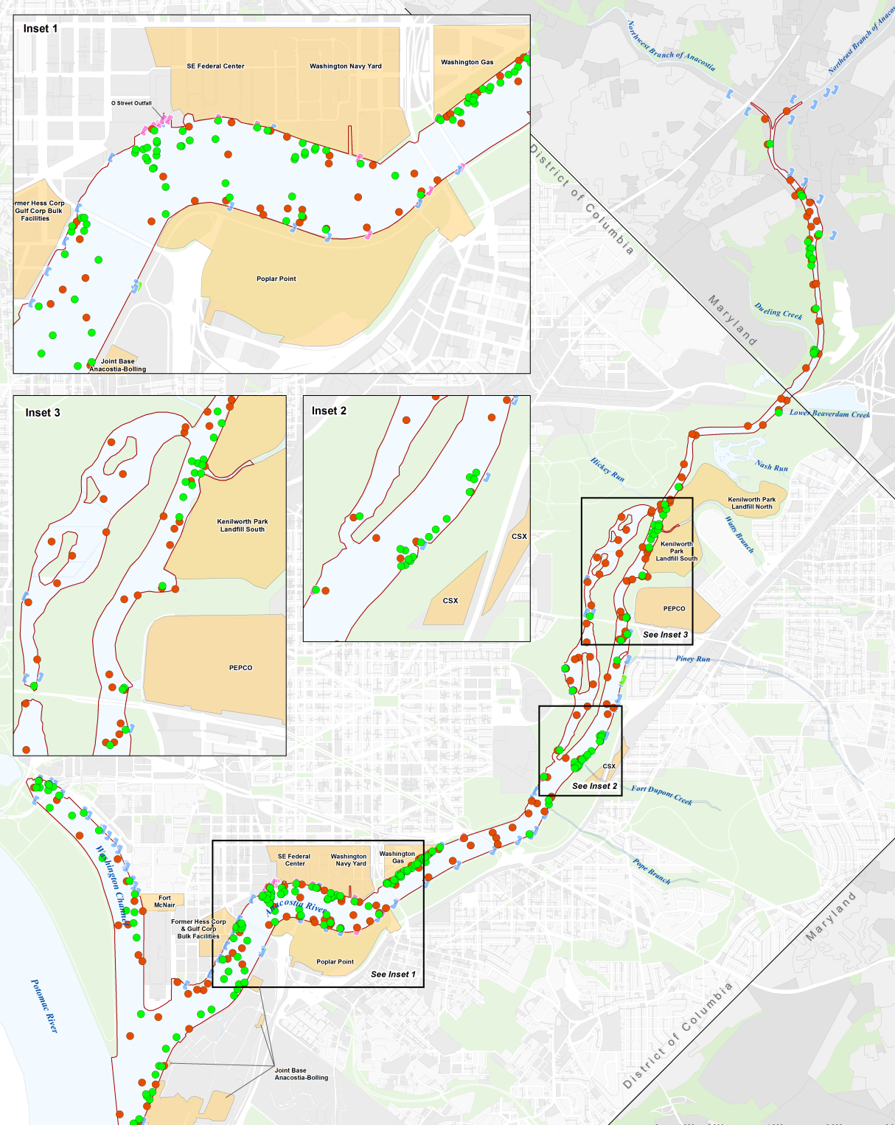

Slide 34
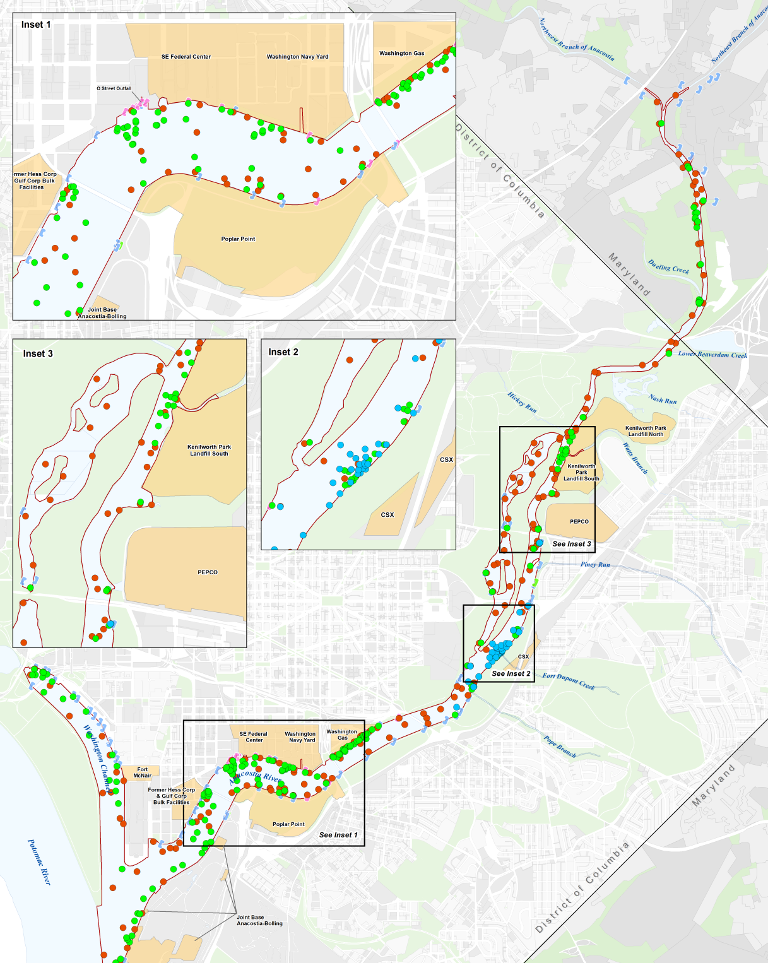

Slide 35
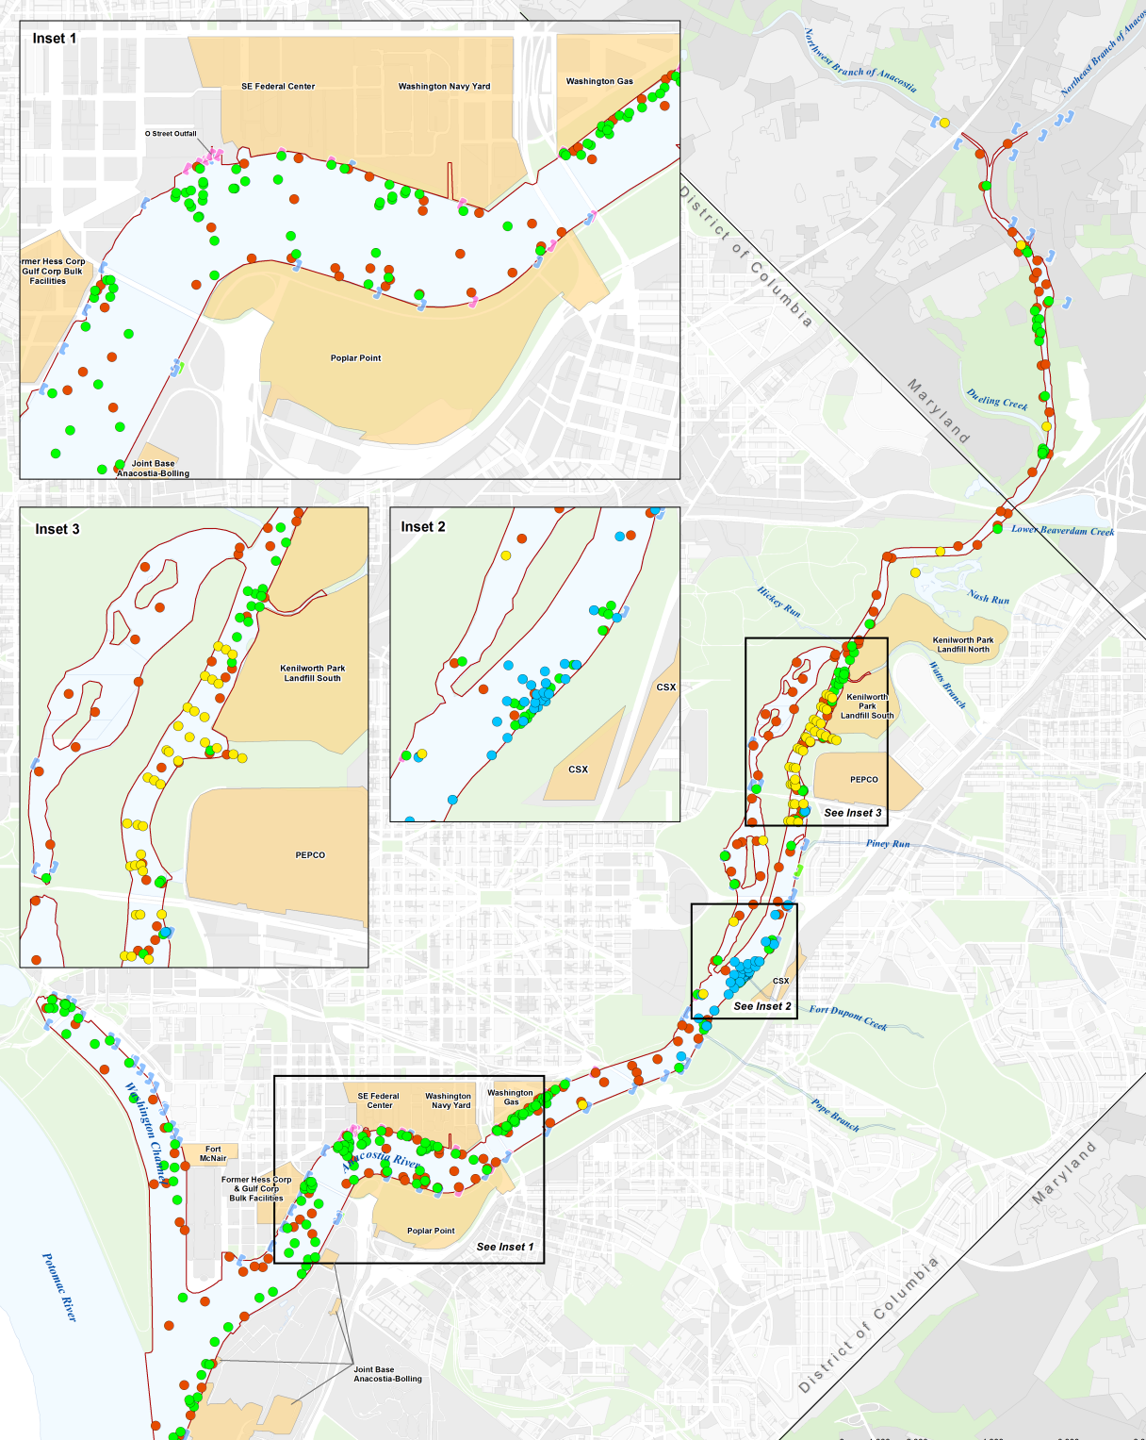

Slide 36
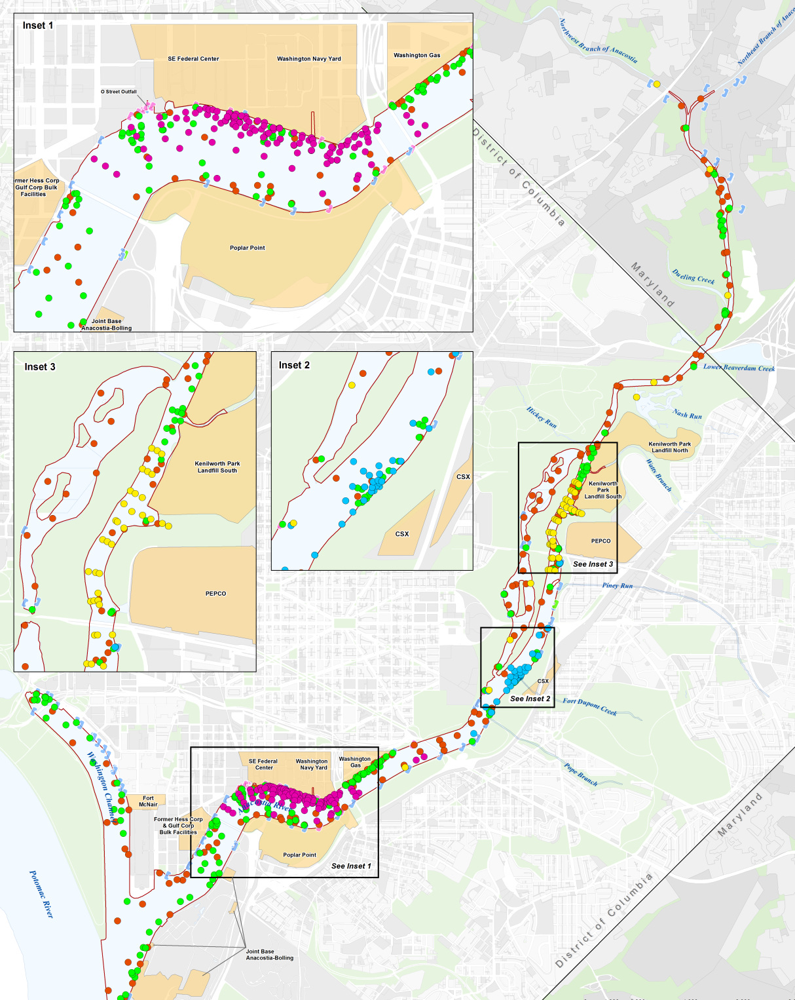

Slide 38
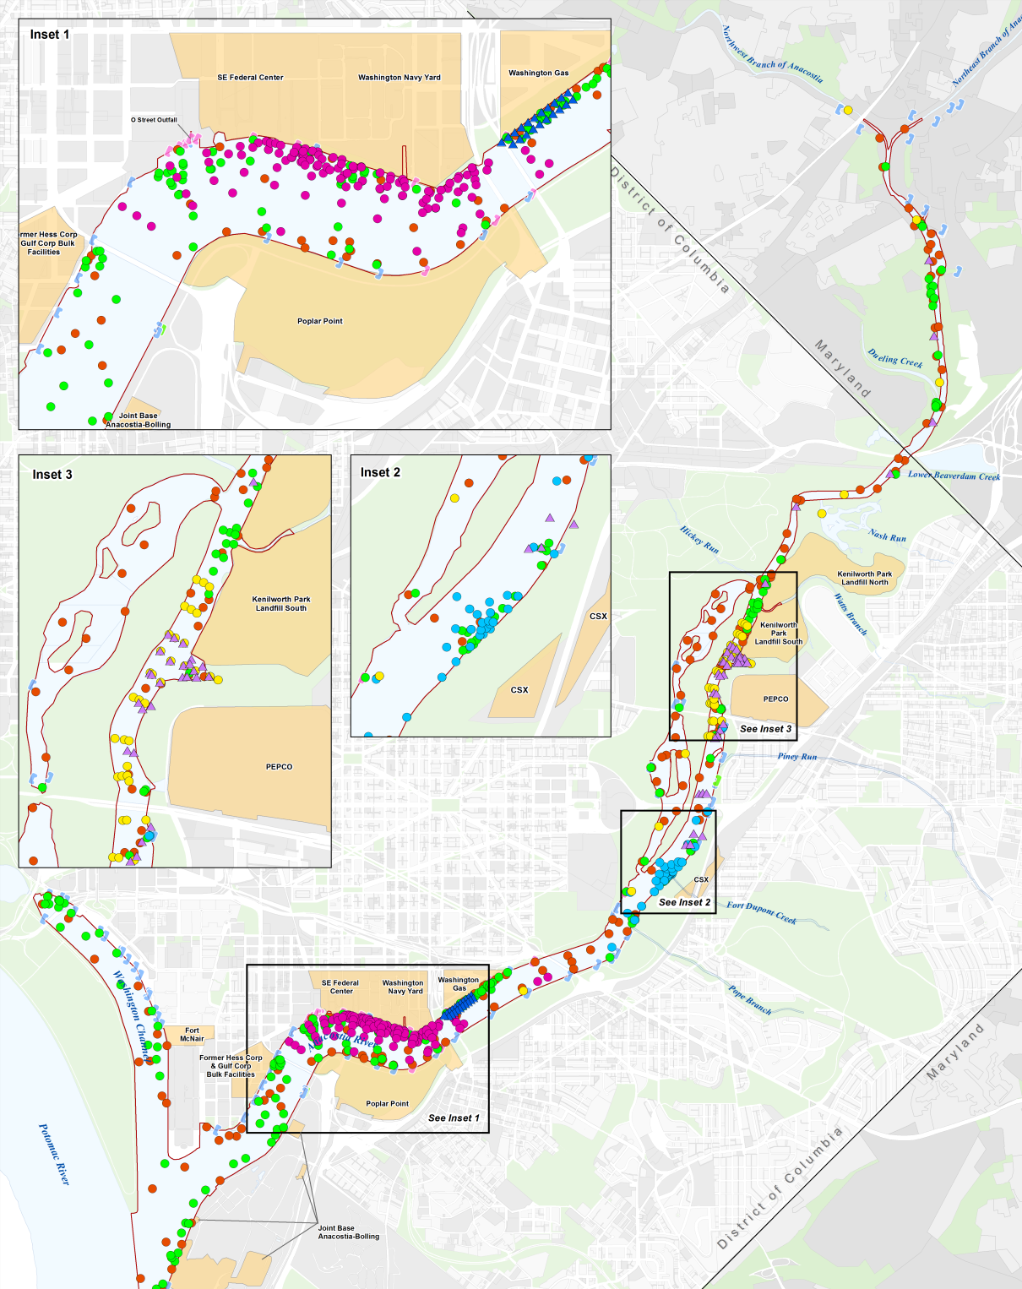

Slide 39
Most Sites Will Select Remedies in 2018
Anacostia River Sediment Site-ROD June 2018
Kenilworth Landfill- ROD early 2018
PEPCO-ROD September 2018
Washington Gas- OU-2 Draft Final RI Report Oct. 2018; FS Report-June 2020
Washington Navy Yard-OU-2 ROD Oct. 2018
CSOs- ART Complete March 2018

Slide 40
Questions?

Slide 41
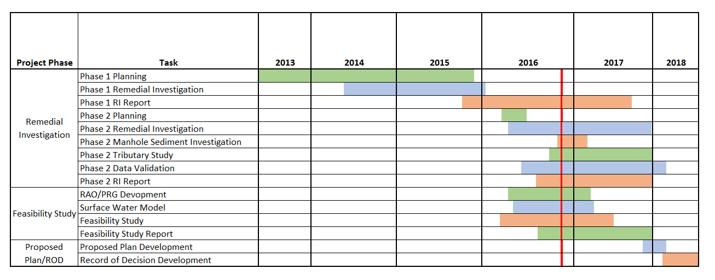
Project Schedule
Now

