Slide 1
The Commission on Out of School Time Grants and Youth Outcomes
Notes:
Walter: if appropriate, announce a few times that public members can register to speak to the commissioners by completing the speaker form found on the registration table and to submit the form to Debra

Slide 2
Meeting Agenda
Call to Order
Public Comment
Announcement of Quorum
Approval of the Agenda
Approval of Minutes
Introduction of New Commissioners
Office of Out of School Time Grants and Youth Outcomes Updates
Committee Updates
Adjournment
Notes:
Once quorum is reached (8 commissioners), Chairperson to call “The Commission on Out of School Time Grants and Youth Outcomes is called to order at [note the time].”
If quorum is not reached, the meeting is canceled.

Slide 3
Meeting Agenda
Call to Order
Public Comment
Announcement of Quorum
Approval of the Agenda
Approval of Minutes
Introduction of New Commissioners
Office of Out of School Time Grants and Youth Outcomes Updates
Committee Updates
Adjournment
Notes:
The OST Office will confirm if there are any public members speaking in advance. Ask if there is anyone in the room wishing to speak – if none, move to the next agenda item.
If there are public members, see the next slide on protocol.

Slide 4
Public Comment
Notes:
Protocol for public speaker
“Public speakers who registered in advanced will be permitted to speak first. Any additional public members may complete a form found by the sign-in sheet and submit to Debra Eichenbaum.” (Debra will supply a list of speakers to the chairperson, Mila will set the timer.)
Each speaker should provide their name and if applicable any affiliations.
Each speaker will be permitted to speak for up to 3 minutes.
After speaker finishes, ask “Commissioners, are there any questions for the speaker?”
After questions, thank the speaker for their comments, call the next speaker, and repeat.

Slide 5
Meeting Agenda
Call to Order
Public Comment
Announcement of Quorum
Approval of the Agenda
Approval of Minutes
Introduction of New Commissioners
Office of Out of School Time Grants and Youth Outcomes Updates
Committee Updates
Adjournment
Notes:
Roughly 7:10 pm
Role call attendance for the record:
Courtney Allen (phone)
Akeem Anderson (phone)
Margot Berkey
Anisah Crosby
Tacharna Crump
Myles Cliff or Tanisha Brown
Vanessa Gerideau
Gary Hill (phone or absent)
Mark Hecker
Burnell Holland
Jiselle O’Neal
Walter Peacock
Heather Peeler
Margaret Siegel
Mila Yochum
If eight or more members are present we have quorum.

Slide 6
Meeting Agenda
Call to Order
Public Comment
Announcement of Quorum
Approval of the Agenda
Approval of Minutes
Introduction of New Commissioners
Office of Out of School Time Grants and Youth Outcomes Updates
Committee Updates
Adjournment
Notes:
7:12pm
Ask Commissioners to “review and motion to approve the agenda.”
“Commissioner [insert name] motion to approve the agenda.”
“Commissioner [insert name] seconded the motion.”
“Any discussion on the agenda?”
“Those who approve the agenda, please say Aye”
“Those who oppose, please say Aye”
“Those abstaining, please say Aye”
“The motion carries with [insert number _____ or unanimous] approving.”

Slide 7
Meeting Agenda
Call to Order
Public Comment
Announcement of Quorum
Approval of the Agenda
Approval of Minutes
Introduction of New Commissioners
Office of Out of School Time Grants and Youth Outcomes Updates
Committee Updates
Adjournment
Notes:
7:15 pm
“A draft version of the minutes are provided. Are there changes or revisions to the minutes?”
If no changes, ask for a motion to approve the minutes. [If changes, note the changes then ask for a motion to approve the minutes with changes.]
“Commissioner [insert name ________________] motion to approve the minutes [with stated changes].”
“Commissioner [insert name ________________] seconded the motion.”
“Any discussion on the motion?”
“Those who approve the minutes please say Aye”
“Those who oppose the minutes, please say Aye”
“Those who abstain, please say Aye”
“The motion carries with [insert number _______ or unanimous] approving.”

Slide 8
Meeting Agenda
Call to Order
Public Comment
Announcement of Quorum
Approval of the Agenda
Approval of Minutes
Introduction of New Commissioners
Office of Out of School Time Grants and Youth Outcomes Updates
Committee Updates
Adjournment
Notes:
7:17 pm
Welcome Jason Spector and Kenneth Taylor who will be joining the Commission in the coming weeks as their confirmation becomes final with Council. Would you each like to provide a brief introduction?

Slide 9
Meeting Agenda
Call to Order
Public Comment
Announcement of Quorum
Approval of the Agenda
Approval of Minutes
Introduction of New Commissioners
Office of Out of School Time Grants and Youth Outcomes Updates
Committee Updates
Adjournment
Notes:
7:20 pm
Ask Mila to provide updates on the office.

Slide 10
Office of Out of School Time Grants and Youth Outcomes Updates
Notes:
Mila to speak first on:
1. Audit
2. Tax year prep reminder and then introduce Kevin (Kevin to introduce Debra).

Slide 11
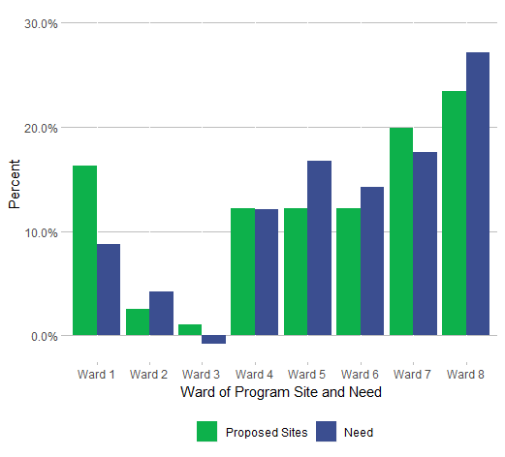
School Year 2019-20 Grant
89 subgrantees
$8,668,911 in awards
4 Competitions
Notes:
Overfunding in Wards 1 and 7 (ward 1 has a large number of program sites are located in Ward 1)
Even in Ward 4
Still need more funded programs in Wards 2, 5, 6, and 8

Slide 12
Summer 2020
4 Summer 2020 Grants Competitions closed on 12/10/19
Summer Strong – up to $120K, anticipate awarding up to $1.6 million
Small Nonprofit – up to $25K, anticipate awarding up to $225,000
Summer Enrichment – up to 100K, anticipate awarding up to $500,000
Coordinating Entity – up to 100K, anticipate awarding up to $500,000
Will be reviewed by three independent reviewers
Notes:
Number of applications received
41 Summer Strong - 5 weeks, 5 days, 5 hours for >30 youth
16 Small Non Profit - same dosage for >15 youth
6 Summer Enrichment - 6 weeks, 5 days, 8 hours for >30 youth at DCHA or DHS sites
5 Coordinating Entity - afternoons at DCPS or week long programs at DPR or teen weekend/evening hours
Less applications received because of Year Round grantees
1 information session held for Subcontractors (and briefly explain)
OST Office expects to receive the scores from UW by January 24th

Slide 13
School Year 2020-21
Request for Applications will released in March, after the budget is released
Continuation grantees from SY 2017-18 will need to reapply
Announcements will be made once the budget is approved by Council
Notes:
Debra to introduce Commissioner Tacharna Crump to lead a short discussion on SY 20-21 priorities.
Walter, around 7:30 we want to wrap up the discussion.

Slide 14
Meeting Agenda
Call to Order
Public Comment
Announcement of Quorum
Approval of the Agenda
Approval of Minutes
Updates: Office of Out of School Time Grants and Youth Outcomes
Vice Chairperson Nomination and Approval
Discussion: Meeting Dates Fiscal Year 2020
Committee Updates
Adjournment
Notes:
7:30 pm
Ask each committee chairperson to provide an update and address any items to the commission:
Commission Tacharna Crump or Gary Hill to provide and update on the Funding and Capacity Building.
Commission Mark Hecker on Outcomes Committee.
Ask if there is a Commissioner willing to chair the Coordination and Collaboration Committee. In the interim Mila will provide an update.
Ask Margot Berkey to provide an update on the Quality Committee.

Slide 15
Draft Quality Statements
Parent and Caregiver Quality Statement
Quality afterschool and summer programs provide children with activities that bring joy in learning and build character with dedicated staff who protect all children.
Teen Quality Statement
Quality afterschool and summer programs connect youth with other young people and supportive adults to have fun, engage, and prepare for the future.
Notes:
7:45- 7:50 pm
Once Margot is done with Quality Committee update, ask Burnell to provide an update on the Needs Assessment.

Slide 16
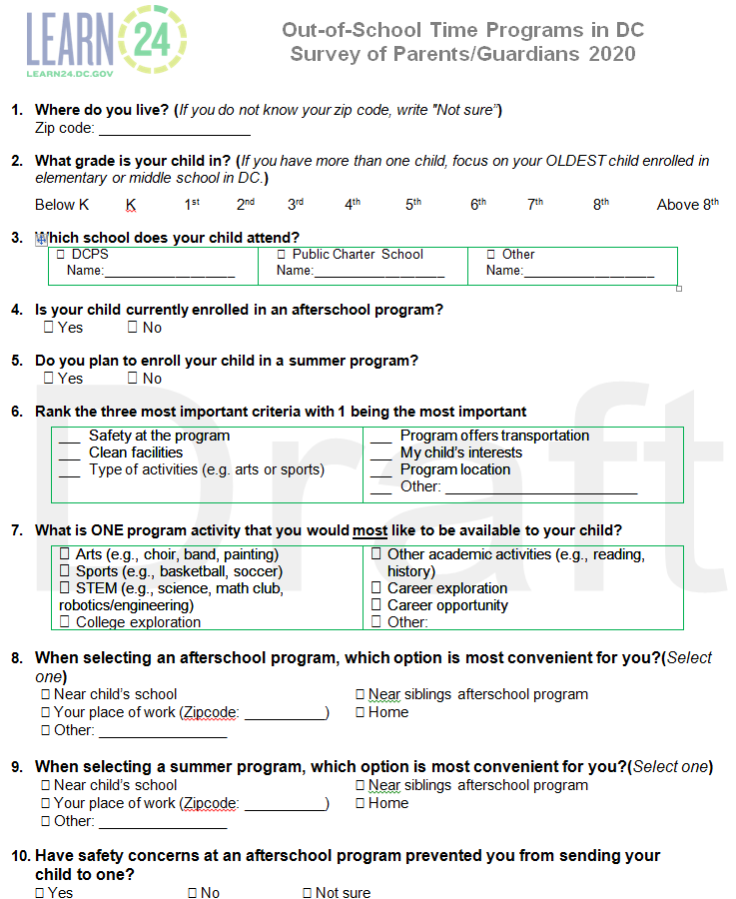
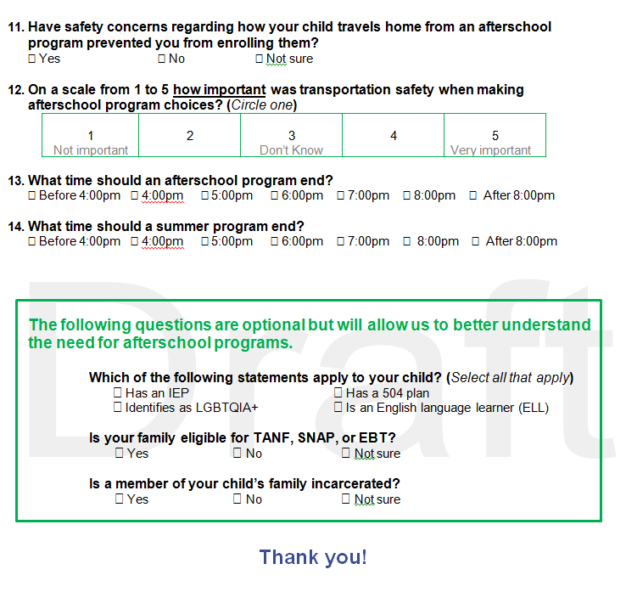
Notes:
7:50 pm – 8:15 pm

Slide 17
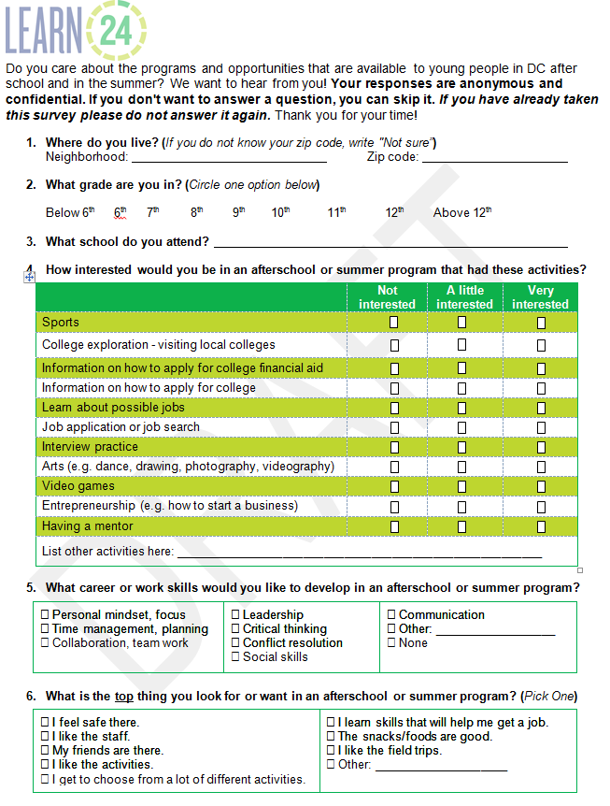
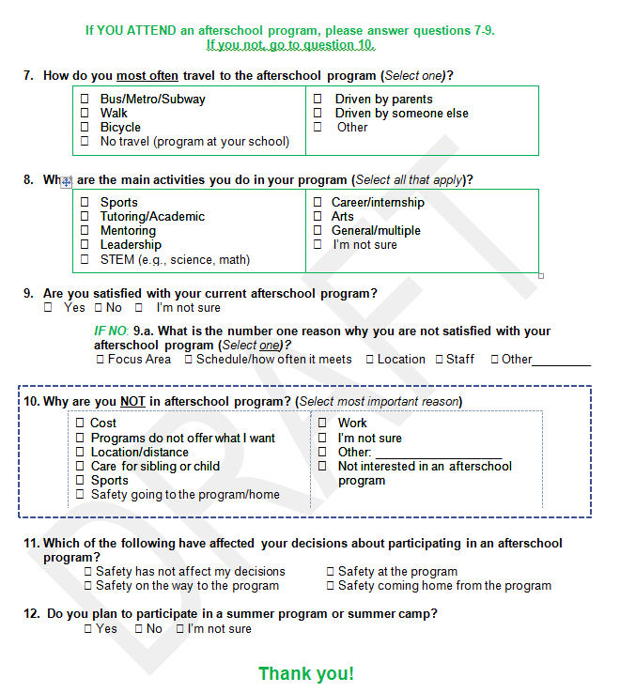
Notes:
7:50 pm – 8:15 pm
After Burnell is done with his update, Walter to provide an update on the Governance Committee.

Slide 18
Governance Committee
Notes:
8:15 -8:25 pm
Walter to provide an update…
In legislation, the Commission is asked to submit to the Mayor and the Council a report on the feasibility of expanding the Office's and Commission's coordination and standardization efforts to additional District agencies that fund or operate out-of-school-time programs, including the Department of Employment Services, Department of Human Services, Department of Behavioral Health, District of Columbia Public Library, Department of Youth Rehabilitative Services, Department of Health, and others as appropriate. The Commission shall publicize its recommendations, the rationale for the recommendations, and its plan, in partnership with the Office, to increase coordination.
We want to bring this to the attention of the Commission and get initial thoughts.
(Tentative plan is to have the OST Office draft a report on the number of agencies who fund or operate OST programs. The report will then share that coordination requires more resources and time. That the OST Office is still building and would need more FTEs therefore, at this time we do not recommending expanding efforts. However, the strategic plan and workplan has a focus on coordination and collaborate across agencies that we could reconsider in the future but not at this time.)

Slide 19
Meeting Agenda
Call to Order
Public Comment
Announcement of Quorum
Approval of the Agenda
Approval of Minutes
Introduction of New Commissioners
Office of Out of School Time Grants and Youth Outcomes Updates
Committee Updates
Adjournment
Notes:
By 8:25 pm to end by 8:30 pm
Ask Commissioners “Is there is any additional business or comments.”
If none, announce the next meeting:
“Our next public meeting is February 13, 2020 same place and location.”
Now, may I have a motion to adjourn.
“Commissioner [insert name] motioned to adjourn.”
“Commissioner [insert name] seconded the motion.”
“Any discussion?”
“Those who approve the adjournment please say Aye”
“Those who oppose the adjournment, please say Aye”
“Those who abstain, please say Aye”
“The motion carries with [insert number or unanimous] approving.”

