Slide 1
SPECIAL COMMISIONERS MEETING
Friday June 19, 2020
9:00 am
Via Webex

Slide 2
Agenda
Meeting Access
https://dcnet.webex.com/dcnet/j.php?MTID=md6a5bba1efa8cf5cf4f6889e8d71cf29
Call-in toll number 1-650-479-3208
Call to Order ………………………………………Brandon Andrews, Chair
Roll Call ………………………………………………Lavita Anthony, Exec. Assistant
Opening Remarks…………………………………Ayris T. Scales, Chief Service Officer
New Business (30 Mins)
Vote – FY20 Volunteer Generation Fund Grantees……Ayris T. Scales/Jenny Kessler, National Service Director
Overview -Volunteer Appreciation Awards ………Jaida Jackson, Partnership Engagement Specialist
Updates & Announcements ( 15 mins)…………Ayris T. Scales/Brenda Walker, Marketing & Comm. Specialist
CERT Online Training – June 29th
20th Anniversary – July 21st
Adjourn

Slide 3
OPENING REMARKS
Ayris T. Scales, Chief Service Officer

Slide 4
NATIONAL SERVICE
Vote: Volunteer Generation Fund
Ayris T. Scales - Chief Service Officer &
Jenny Kessler - National Service Director

Slide 5
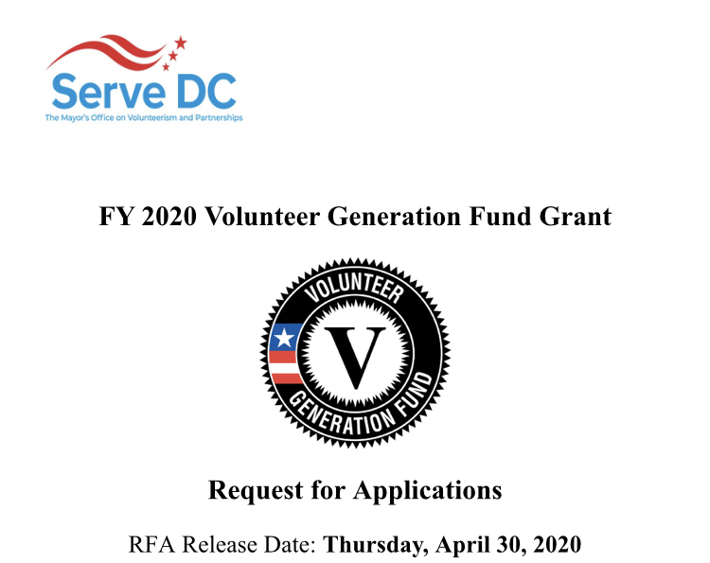
VOLUNTEER GENERATION FUND
VGF 2020
Capacity Building Partner:
Center for Nonprofit Advancement
Grantee Technical Support
Evolved VGF Focus:
Reimagining, Re-engaging, Re-Activating Volunteer
Engagement
Development of Volunteer Engagement
Toolkits, Multi-Media Assets, Technical
Assistance and Capacity Building Tools
Increased Budget and Cohort Size
by $25K and 5 slots respectively
= $75,000 for up to 10 orgs
31 Applicants

Slide 6
FY20 Volunteer Generation Fund Grant Recommendations
Deliverable Type | Organization Name
Database | CASA DC
 | DC Scores
Toolkit | East of the River Clergy Police Community Partnership
 | House of Ruth
 | Athletes United for Social Justice (Grassroots Project)
 | My Sister’s Place
Multimedia | District Alliance for Safe Housing (DASH)
 | Rock Creek Conservancy
 | Stoddard Baptist Nursing Home
Virtual Series | Academy of Hope- Adult Public Charter School

Slide 7
PARTNERSHIPS & ENGAGEMENT
Volunteer Appreciation Awards
Jaida Jackson, Partnership Engagement Specialist

Slide 8
Volunteer Appreciation Awards
Awards Announcement To General Public
July 21, 2020
Nomination Deadline Date
August 21, 2020
Awards Announcement Date
September 2020 (exact date to be announced)
Notes:
2020 Objective
As the year 2020 marks the 20th anniversary of Serve DC, and its rich legacy of cultivating, and curating volunteerism and service throughout the District, this year’s Annual Serve DC Volunteer Appreciation Awards will serve as an anchor event to celebrate this valuable lynchpin of the Commission.
In its virtual format, this convening will reaffirm the value of service and recognize residents, organizations, philanthropic and private industry partners that power community engagement and volunteerism throughout the District. It will also serve as the platform to announce the kick-off of the Serve DC 20th anniversary campaign and celebrations.

Slide 9
Volunteer Appreciation Awards
Ready, Set, Serve: Emergency Preparedness Award: Individual or group who has demonstrated an exemplary commitment to ensuring District residents and communities to: prepare, respond, and recover from emergencies and disasters through the activation of volunteerism and service.
The Award for National Service: Past or present AmeriCorps member that demonstrates exemplary commitment to volunteerism and national service, with a keen awareness of the DC Commission’s unique position, landscape, needs and investment priorities. This awardee also possesses an ability to effectively drive change and impact within AmeriCorps funded programs and across our local and national communities.
Donor Difference Award: An Individual or group of donor(s) who have made significant financial or in-kind contributions to the District of Columbia in support of critical initiatives and priorities, including: education, economic development, health and human services, public safety, environment, affordable housing or government operations.
DC Hope Community Impact Award - Community based organization that has demonstrated outstanding commitment to providing access to critical services and resources to District residents, especially within vulnerable communities— through service and volunteerism. Even in these unprecedented times, this awardee has made significant and intentional steps to reshape and reimagine volunteer operations and activations, for the purpose of sustaining hope for District residents.
Promising Partnership Award: Private sector or philanthropic entity that has worked to create sustainable solutions to address the District’s most critical social challenges and priorities. Through meaningful investments and strategic alignment with community based organizations and the public sector, this awardee is an industry leader and an example of best-in-class partnership ingenuity and innovation.
Mayor Bowser’s Prosperity Award: An individual or group that identifies a need within their local community and demonstrates a genuine commitment to creating solutions, thus ensuring a fair shot for neighbors and fellow residents. Through the coordination and activation of service and volunteerism, this awardee personifies #DCValues and utilizes civic engagement as a tool— to be the change they wish to see in the world. Their efforts, service and sacrifices also compel others to align and serve, creating great impact across our city.
Notes:
Previous Awards Categories
2018 Awards Categories
National Service Award - Individuals nominated must be District residents who have demonstrated exemplary commitment to volunteerism and service within a national service capacity or program, i.e. AmeriCorps and its affiliates.
Emergency Preparedness and Public Safety Award -Individuals nominated must be District residents who have demonstrated exemplary commitment to emergency preparedness and/or public safety through volunteerism and service.
Education Service Award - Individuals nominated must be District residents who have demonstrated exemplary commitment to supporting education through volunteerism and service. Youth Volunteer Service Award - Individual nominated must be District residents, age 24 or younger, who have demonstrated exemplary commitment to volunteerism and service.
The Advocate Award: HIV/AIDS - Individuals nominated must be District residents, who have demonstrated exemplary commitment to HIV/AIDS education and prevention through volunteerism and service.
The Community Service Award - Individuals nominated must be District residents, who have demonstrated exemplary commitment to their neighborhood and/or Ward through volunteerism and service.
2017 Awards Categories
Promising Partnership Award
Preparing the Whole Community Award
Community Preparedness Hero Award

Slide 10
UPDATES & ANNOUNCEMENTS
CERT Training Goes Virtual – June 29th
20th Anniversary – July 21st
How I Respond, I SERVE.
Agency Rebrand
20 Years. 20 Shares.
Volunteer Appreciation Awards
Ready for Recovery Series
Public Private Partnership Townhall
SDC Path Forward Video

Slide 11
THANK YOU
QUESTIONS….READY TO SERVE?
Ayris T. Scales | Chief Service Officer AYRIS.SCALES@DC.GOV

