Slide 1
Survival and Growth of Juvenile Eastern Lampmussels in the Anacostia River and Watershed
Luis Chevez, Fred Pinkney, Lance Yonkos and Jack Stanton
USFWSCBFO and UMD ENST department.

Slide 2
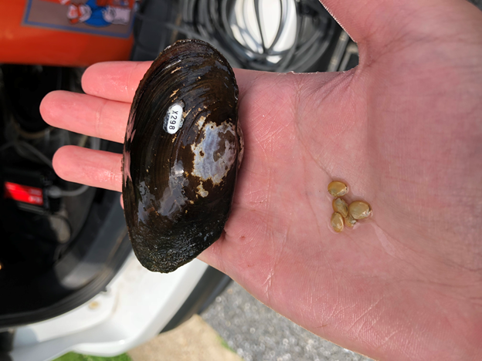
Purpose
Establish a baseline for juvenile freshwater mussel survival and growth within the Anacostia River and tributaries.
Why the Eastern Lampmussel (Lampsilis radiata)?
The Eastern Lampmussel is a hardy freshwater mussel native to the Anacostia and Potomac Rivers.
Notes:
If the mussels survive and demonstrate significant growth it would accredit efforts to repopulate the river with native mussels. This would benefit both ecosystem and the communities within the watershed because the mussels would help filter the water.
Photo above shows how mussels left for a couple of hours in water from the Anacostia river filter water in the tanks.

Slide 3
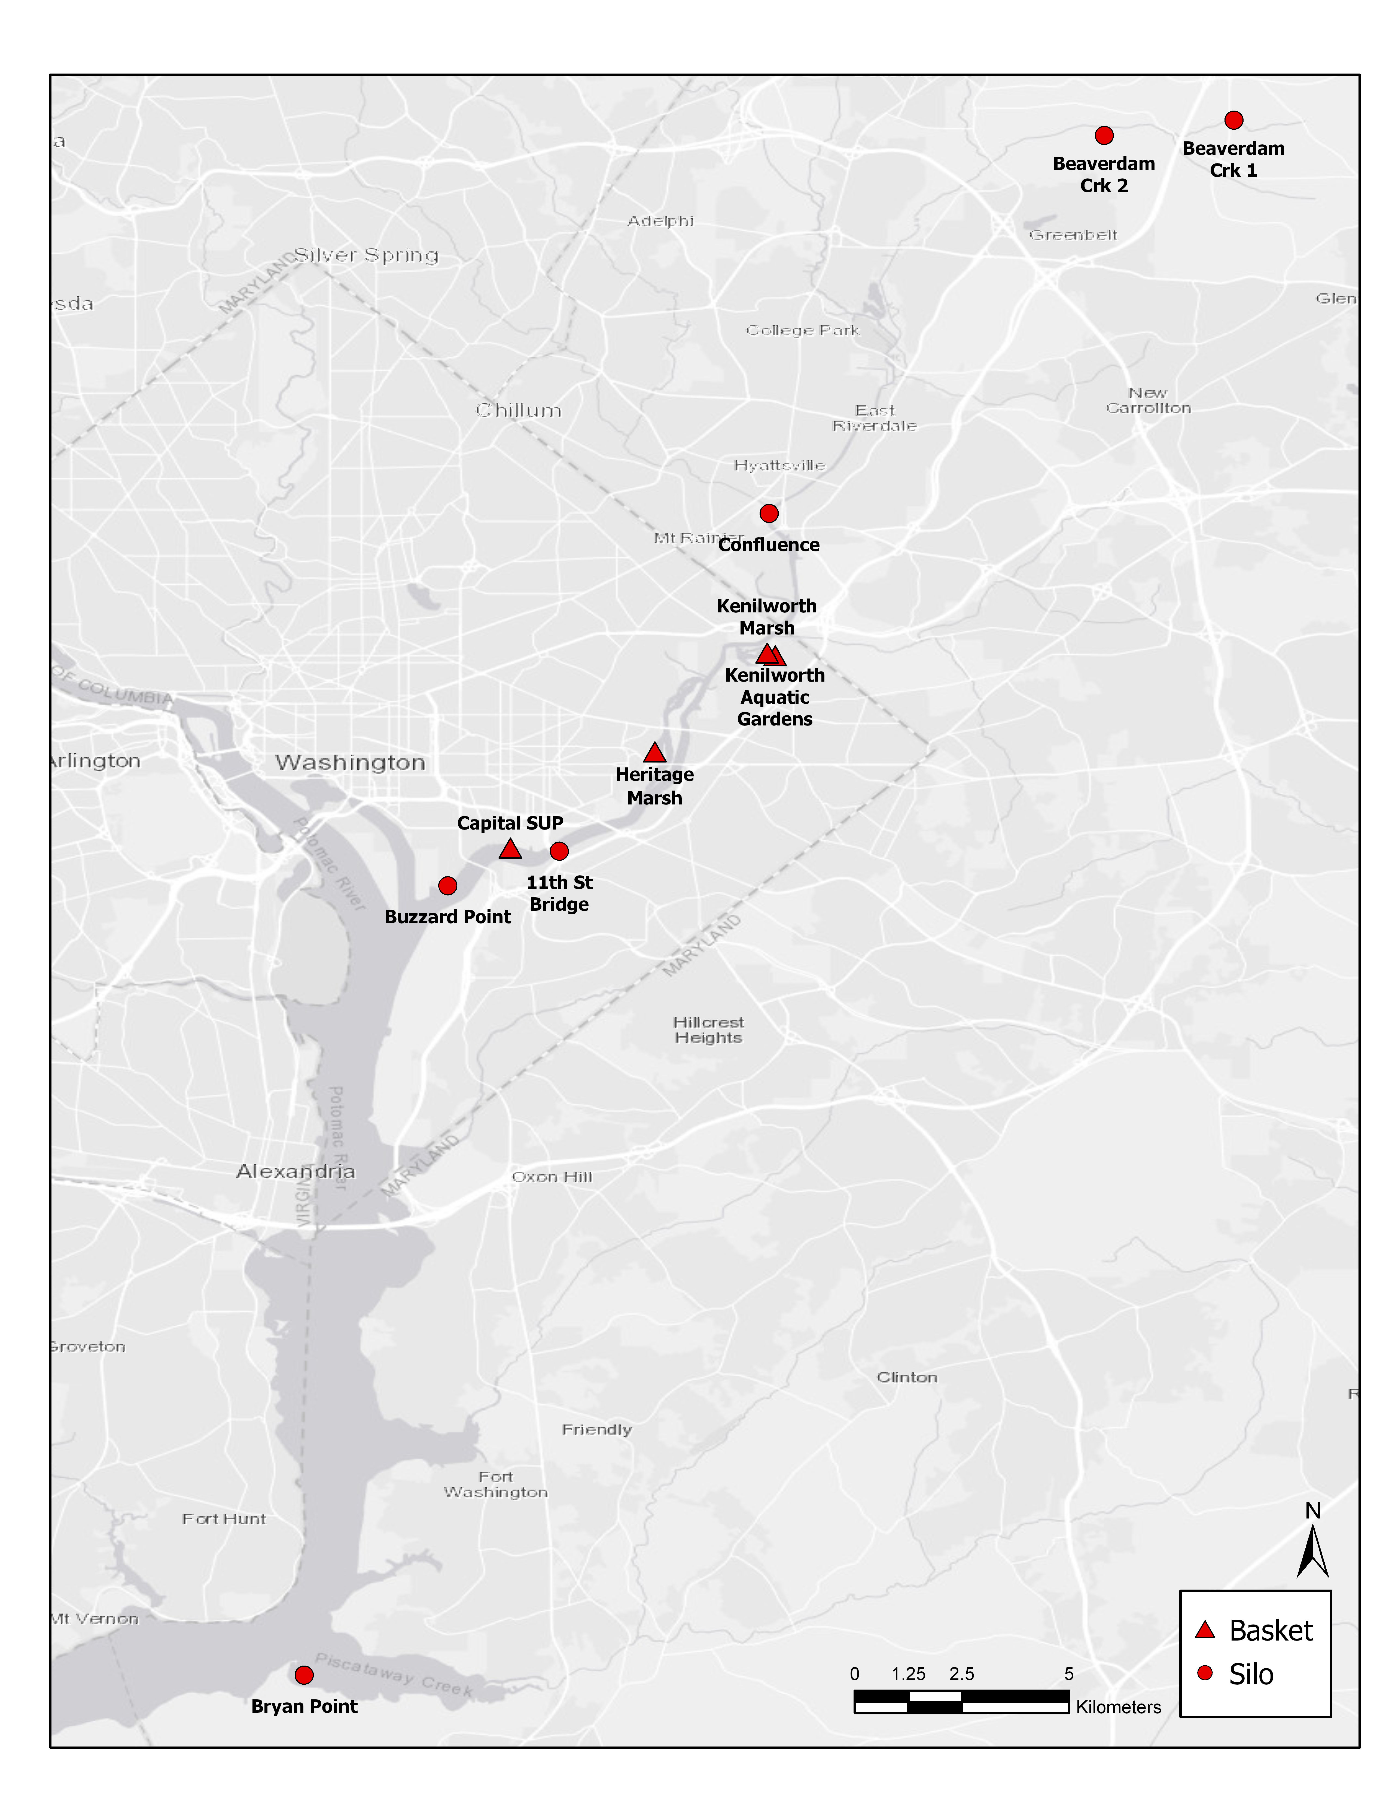
Experimental design
-Duration: 10 weeks
-10 sites with 80 mussels each.
-4 silos house 20 mussels each
-8 baskets house 10 each.
Notes:
Add map, experimental design

Slide 4
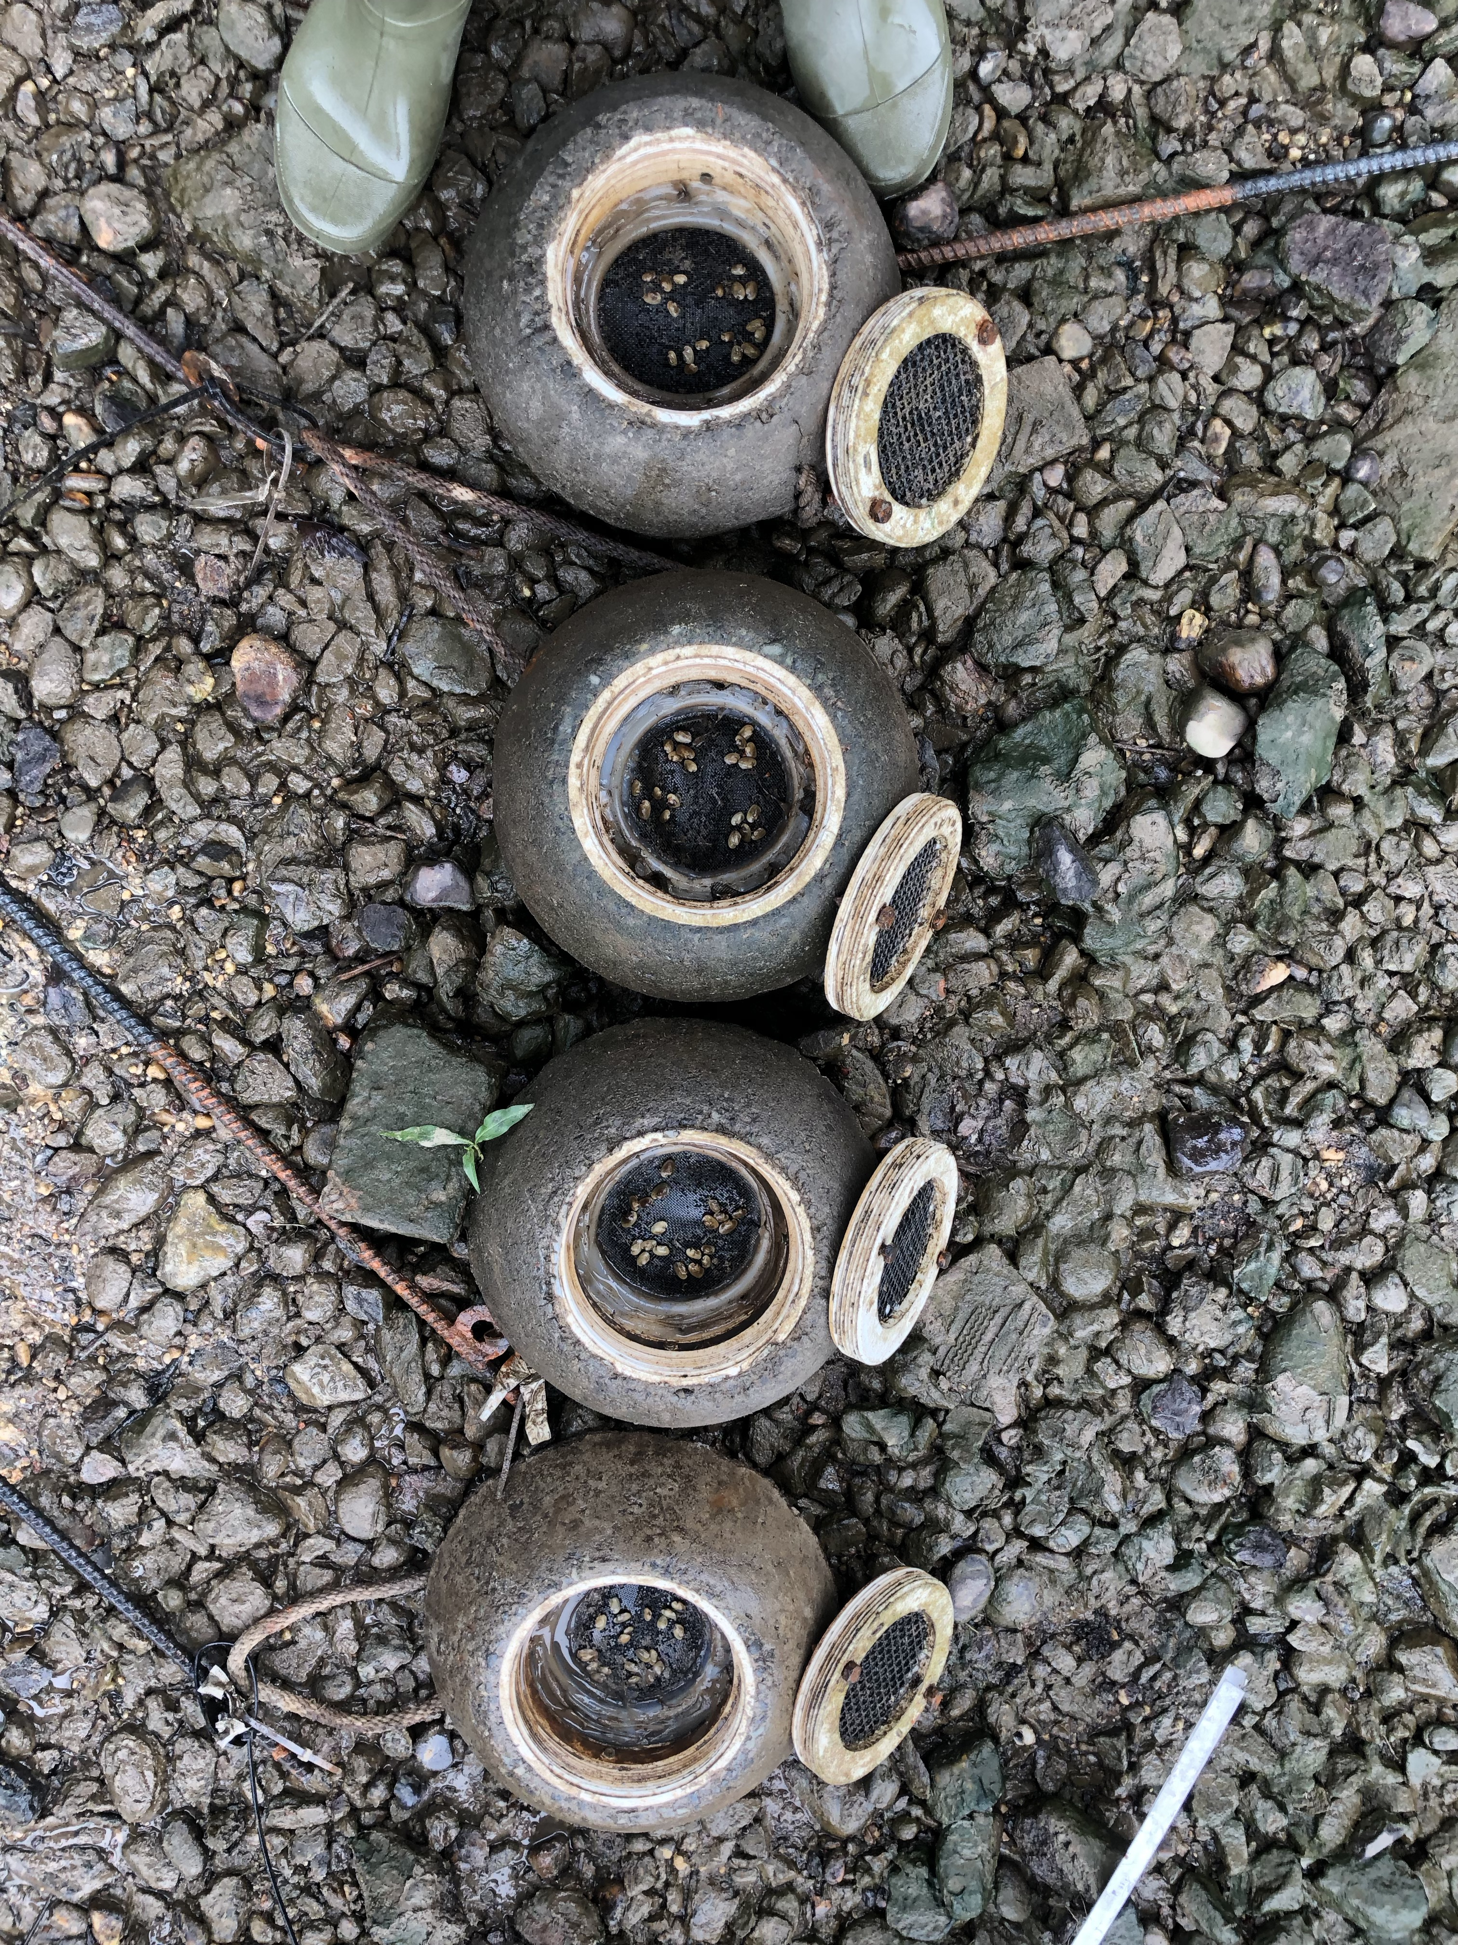
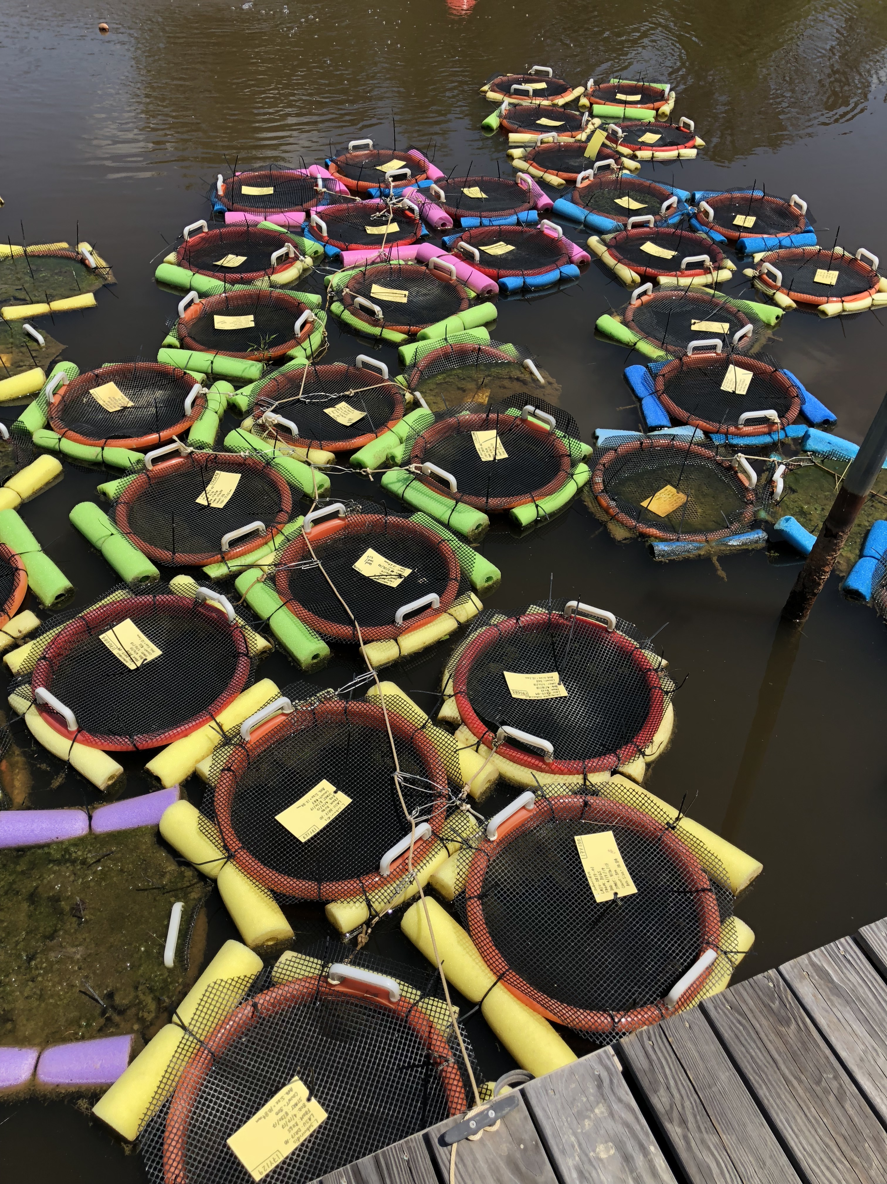
Why the different housings?
Silos imitate the natural behavior of mussels within the stream or riverbed.
The baskets are better for still or slowly moving water.
Notes:
The silos sit at the bottom of the stream or riverbed. They have have an opening at the bottom and one at the top, the water flowing over the top of the silo creates a vacuum effect pulling water from under the silo through the pocket the mussels sit in and out the top. This effect is called Bernouli’s flow. Since the streams with low flow don’t have enough energy to move water efficiently through the silo baskets are more optimal. The baskets resemble hatchery practices where the environment would provide the nutrients and support the growth of the mussels.
(Photos) The photo on the left shows how the silos would sit on the river or streambed. The photo on the right was taken at Harrison Lake National Fish Hatchery. These are the baskets the use in ponds to keep their mussels they are similar in design just on a bigger scale.

Slide 5
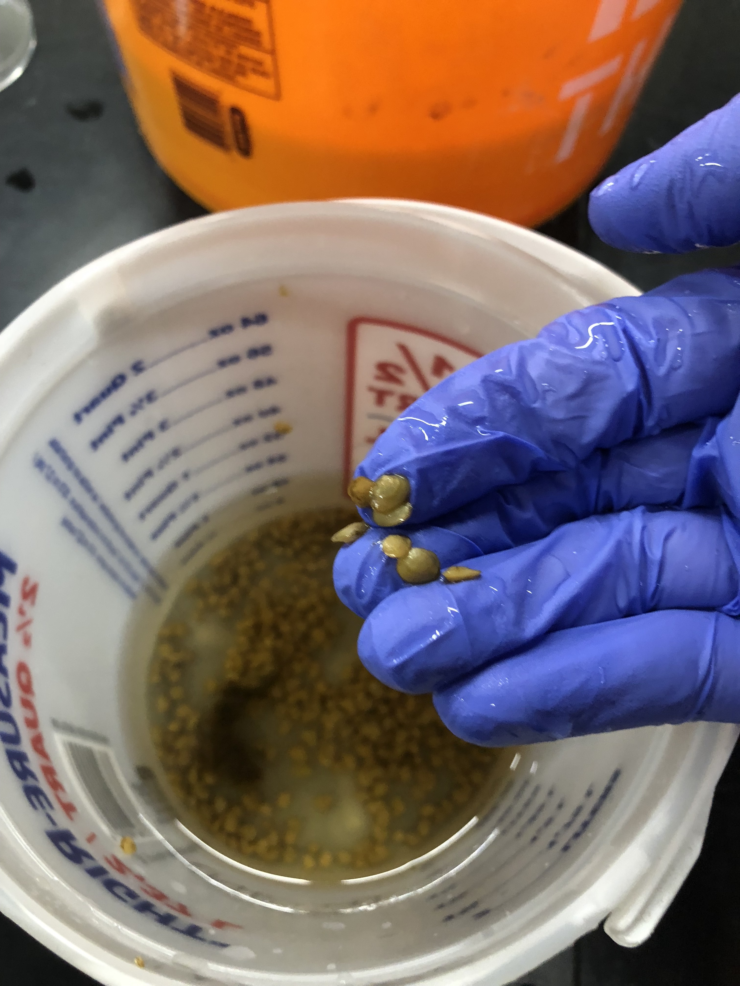
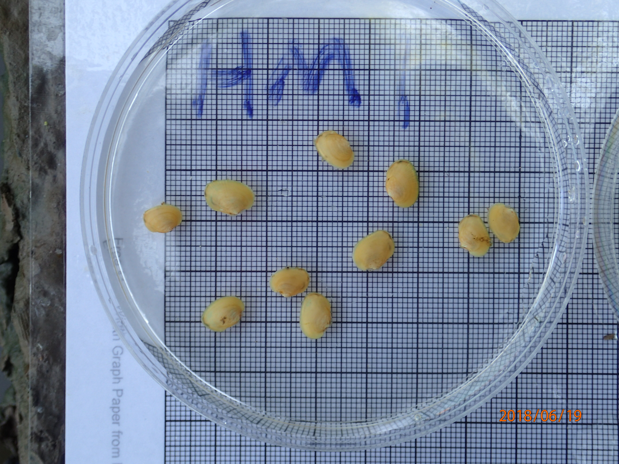
Deployment
1700 mussels were picked up from Harrison Lake National Fish Hatchery in Charles City, VA.
Notes:
The project only required 800 mussels so we decided to weed out the smaller mussels in hopes of using the larger more resilient juveniles for the study. A subset of mussels were randomly chosen to be measured with calipers to get the average size parameters of the batch being deployed. On site each set of mussels was photographed with a label for their site and housing number. Silos ranged from 1-4 and held 20 mussels each while baskets ranged from 1-8 holding 10 mussels each. Each site housed a total of 80 mussels.
(Photos) The photo on top depicts the juvenile mussels being separated into containers for deployment. The lower photo shows the 10x10mm grid that mussels were photographed on.

Slide 6
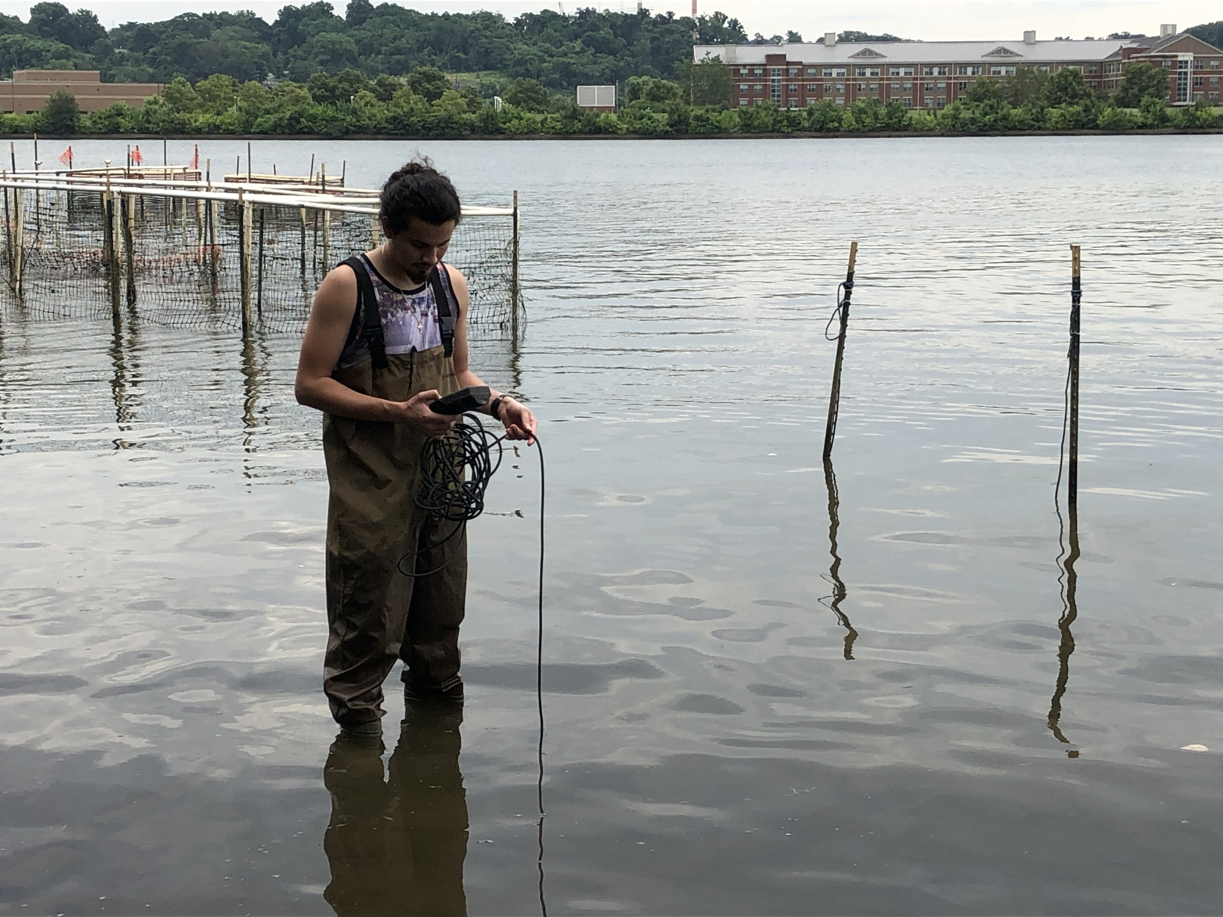
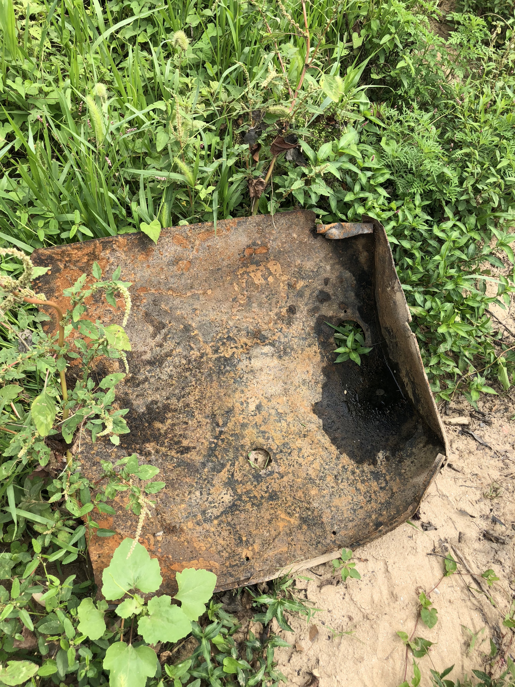
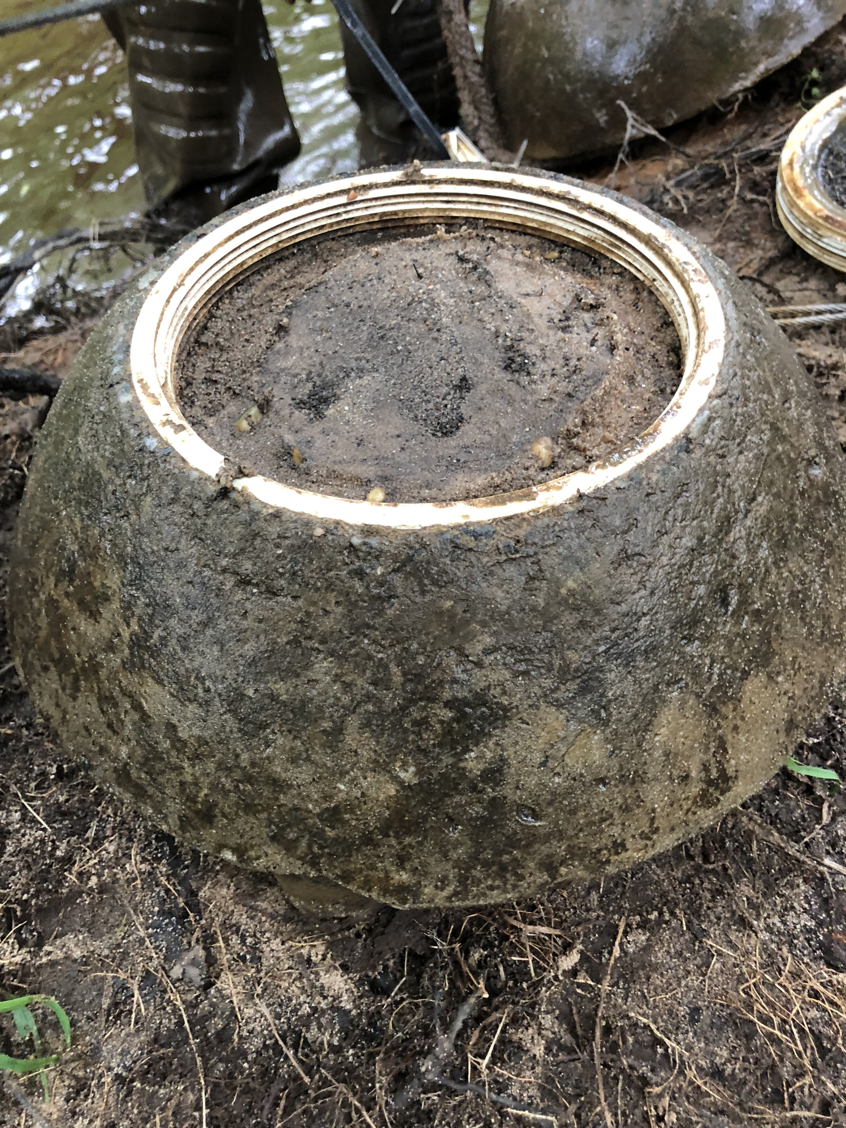
Monitoring
Sites were monitored on a weekly basis where water quality data was collected and basket repairs were made.
Notes:
Monitoring was a critical part of the study because of the unpredictability of the weather in Maryland. The storms would create stronger currents and carry more suspended sediment. With the higher amount of sediment in the water column the silos would fill to the brim with sediment at certain sites. Shown in the middle picture above.
The photo on the left depicts me using a YSI to attain water quality data. The picture on the right shows a piece of metal that was covering the silos at the confluence site.

Slide 7
Analysis
Notes:
Through the use of a program called ImageJ I was able to find the measurements of all the mussels in each housing and compare it to the measurements recorded during deployment. While I do not know how much each individual mussel grew I can attain the averages and compare the growth of each housing and site.

Slide 8
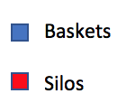
Results: (5 week survival)
Notes:
Mention the lost silos at confluence and the high rain which did not allow for the measurements of two sites.

Slide 9
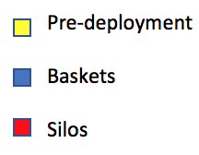
Results: (5 week length)

Slide 10
Conclusions
Tidal sites
Substantial growth and excellent survival.
Repopulation efforts at this part of the river would be supported by the data collected.
Non-tidal sites
Beaverdam Creek--adequate survival but little growth
Next steps: Anacostia Watershed Society study
Notes:
Talk about the limited growth in the non-tidal sites BD1 and BD2. Tidal sites had higher temperatures and maybe better nutrients.

