Slide 1
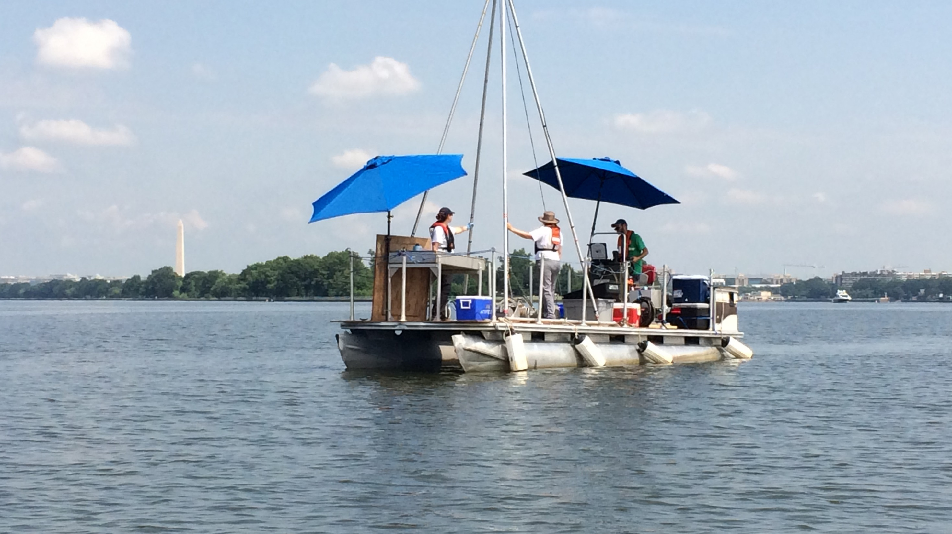
LEADERSHIP COUNCIL FOR A CLEANER ANACOSTIA RIVER
October 6, 2016 Meeting
Anacostia River Sediment Project
Update

Slide 2
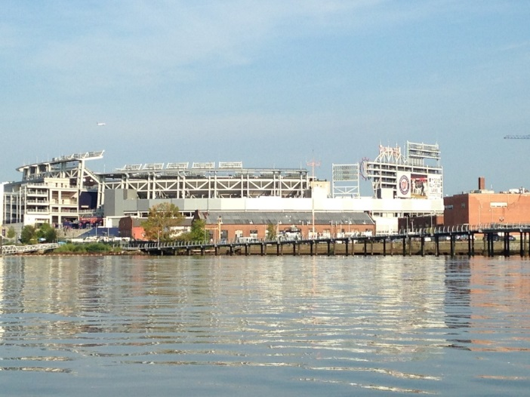
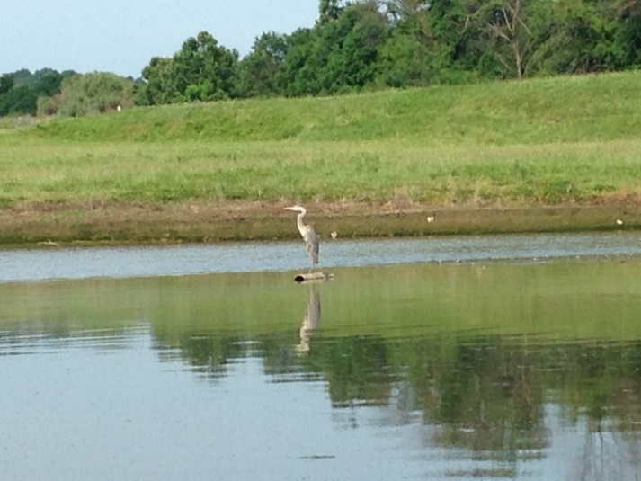
Project Study Area
Subareas
Main stem of Anacostia River (9 miles long)
Kingman Lake (1.8 miles long)
Washington Channel (2 miles long)
15 potential environmental cleanup sites (PECSes)

Slide 3
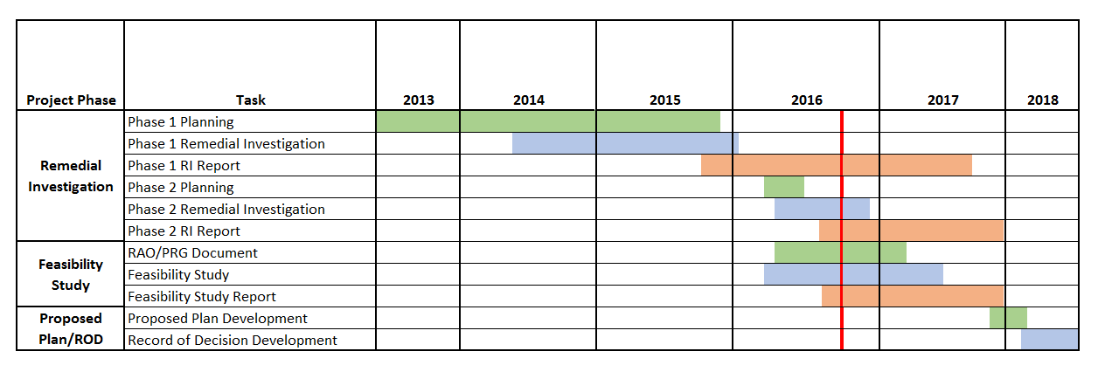
Project Schedule
Now

Slide 4
Remedial Investigation
Phase 1 RI Report issued in March 2016
Phase 2 RI sampling underway
  PECS sediment characterization
  *Bedload sediment from outfalls & tributaries
  *Suspended and bedload sediment from major tributaries
  *Surface water
  Biota characterization (benthic invertebrate tissue, larval fish toxicity, taxonomic identifications)
  Background whole fish and fish fillet
Forensic sediment sampling (river, outfalls, tributaries)
*Task is on-going

Slide 5
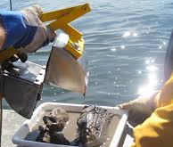
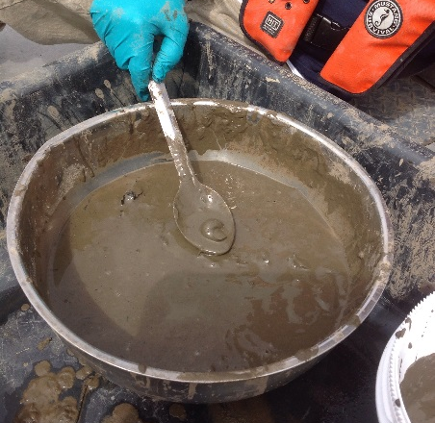
Surface Sediment Characterization
2014/2015 samples biased away from PECSes
2016 samples complete “total river” characterization
Forensic samples (38)
PECS and outfall/tributary nature & extent (64)
Ecological support samples (32)
Sampling completed summer 2016
2016 Sample
2014/2015 Sample

Slide 6
Subsurface Sediment Characterization
2014/2015 cores characterize away from PECSes (148)
2016 cores to complete "total river" characterization (109)
- Cs137 age dating cores (12)
- Archived samples for forensics (702)
- Archived samples for nature and extent (1,609)
Sampling completed summer 2016
2016 Sample
2014/2015 Sample

Slide 7
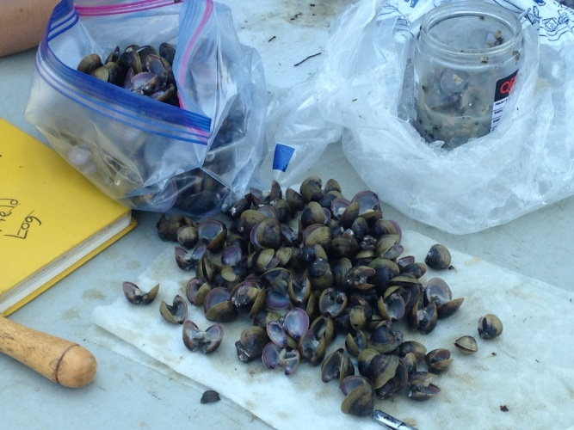
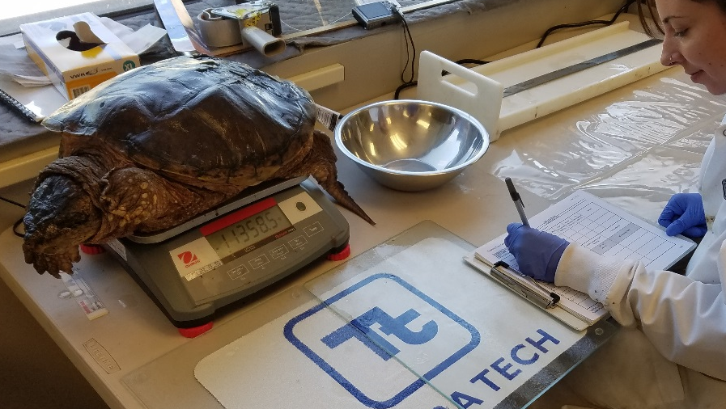
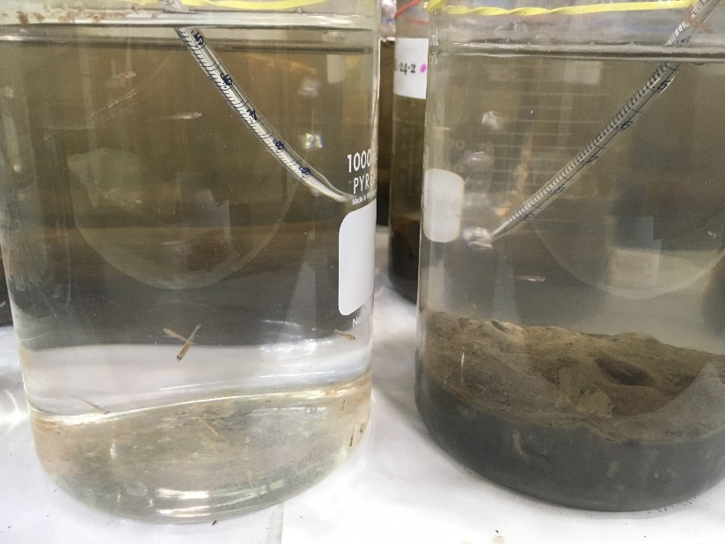
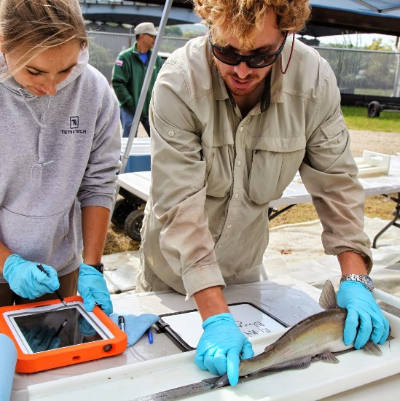
Biota and Fish Characterization in 2016
Tissue Sampling
Background fish : 80 composite samples
Crayfish: 45 specimens, 8 composite samples
Turtle: 7 specimens, 22 tissue samples
Benthic invertebrate: 25 composite samples
Larval fish toxicity tests
33 tests in Anacostia River
5 Potomac River reference tests

Slide 8
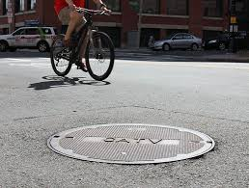
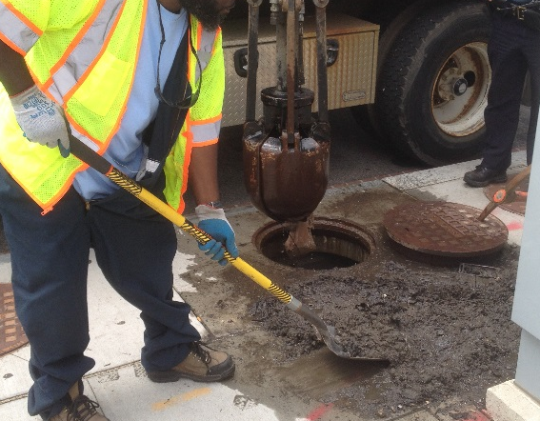
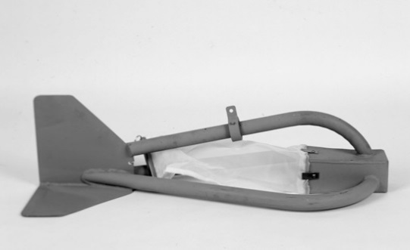
Outfall Bottom Sediment Sampling
Targeted Outfalls
  Municipal separate storm sewer system (MS4) outfalls: 27
  Combined sewer outfalls (CSO): 16
Bottom sediment from lowest manhole above high tide
Forensic and nature and extent sampling
Draft work plan under review by DOEE/NPS
Field work begins in 2016

Slide 9
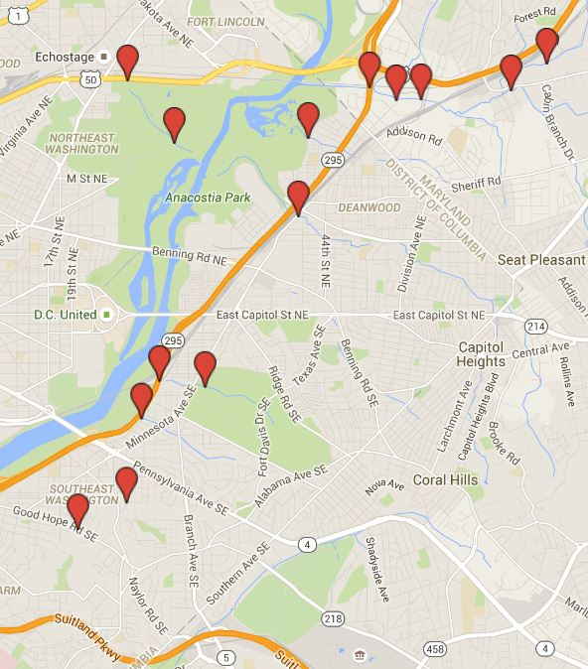
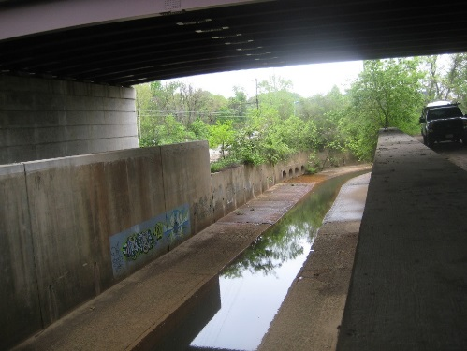
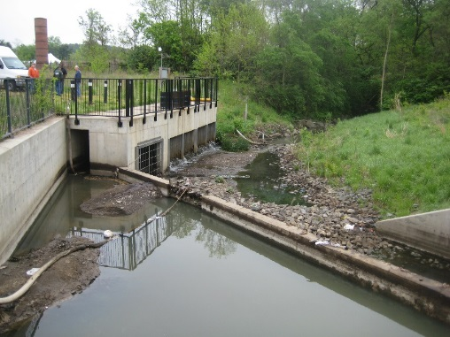
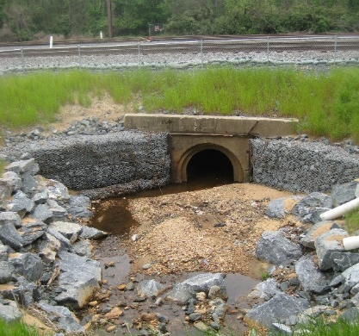
Tributary Suspended Sediment
One year study - self-performed by USGS in cooperation with DOEE
Three major tributaries
Continuous discharge/ concentrations for 6 storms and 1 dry weather
Northeast Branch
Northwest Branch
Lower Beaverdam Creek
Six small tributaries
Discharge and concentrations for 3 storms and 1 dry weather
Hickey Run Fort Dupont Tributary
Nash Run Pope Branch
Watts Branch Fort Stanton Tributary

Slide 10
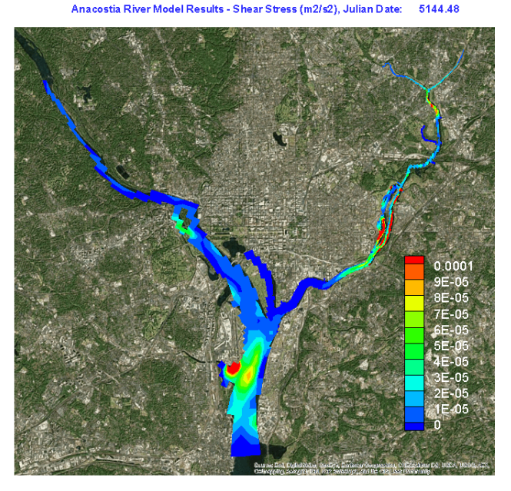
Feasibility Study
Conducting preliminary identification/evaluation of alternatives
Developing surface water model
Contaminant fate, transport, and deposition
Support remedy evaluation/selection
Updating human health and ecological risk assessments
Finalizing Applicable or Relevant and Appropriate Requirements
Will finalize RA Objectives/Preliminary Remedial Goals
Will conduct detailed evaluation of alternatives
Will select Remedy and prepare proposed plan

