Slide 1


Anacostia River
Hydrodynamic Modeling Update
March 9th, 2017

Slide 2
Presentation Outline
Modeling Status
Model Setup and Development
Results
Summary
Next Steps

Slide 3
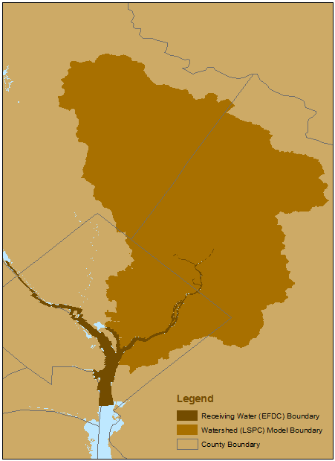
Modeling System
2 Linked Models
Watershed Model (LSPC)
  To simulate streamflow and pollutant loads from Anacostia watershed, including Maryland headwaters
  Provides boundary conditions for the receiving water model of the tidal Anacostia
Receiving Water Model (EFDC)
  To simulate hydrodynamics and fate/transport in the tidal Anacostia River
  Receives flow and water quality results from LSPC
  Tidal boundary on Potomac near Alexandria

Slide 4
Modeling System Development
Order of Development
  Hydrodynamics (flow, water surface elevation, temperature)
  Sediment Transport
  Water Quality/Fate and Transport
Modeling Component
  Watershed simulated first
  Receiving water developed next, relies on watershed model for input

Slide 5
Modeling Status
Model system setup complete
Hydrodynamic Calibration
  Watershed component (LSPC) calibrated for flow and temperature
  Receiving water component (EFDC) calibrated for water surface elevation, temperature
Sediment and Water Quality Calibration
  Watershed is calibrated for sediment based on currently available data, nearly complete for toxic fate and transport
  Ongoing tributary and manhole sampling will provide additional calibration data
  Receiving water model development is ongoing for sediment and toxic fate and transport

Slide 6
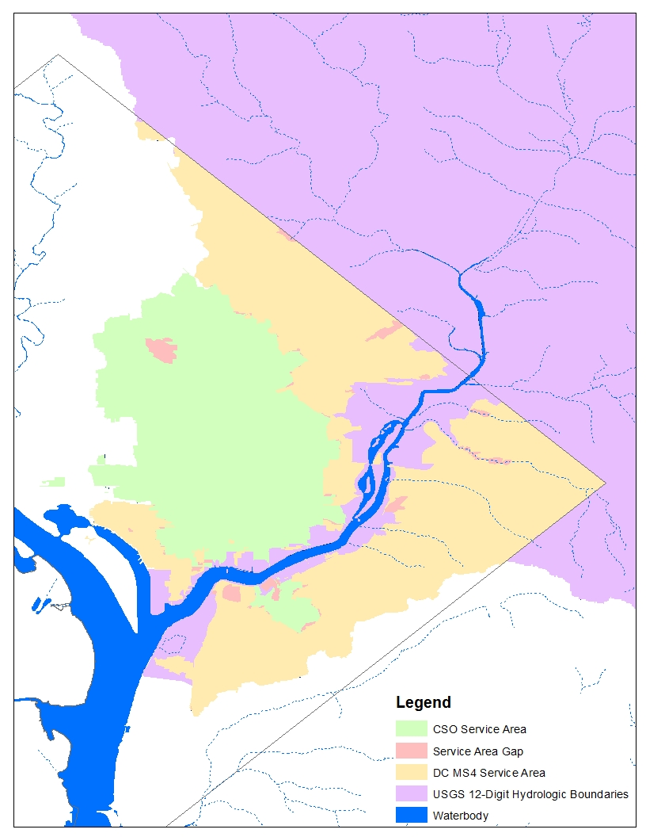
Model Setup
Watershed Delineation
  Objective of watershed delineation and
  representation is to provide background
  loads for the receiving water model (EFDC)
  Utilize local, recent datasets
  CSO and MS4 service areas
  Natural hydrologic boundaries
  Increased resolution vs. TAM/WASP
  107 Simulated watersheds vs. 17 in
  TAM/WASP

Slide 7
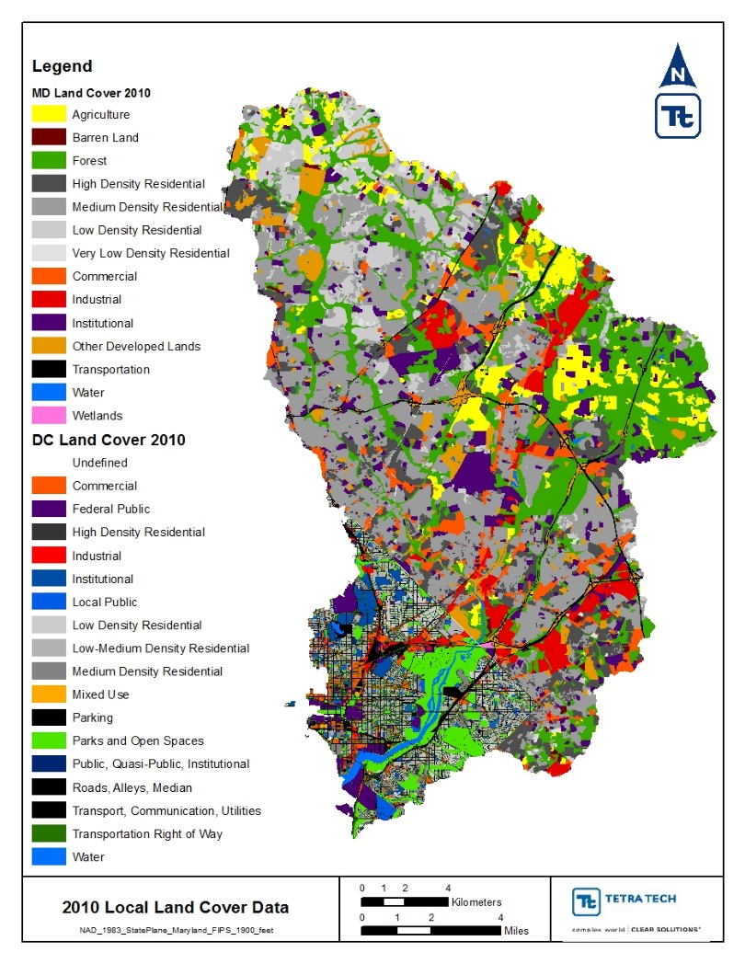
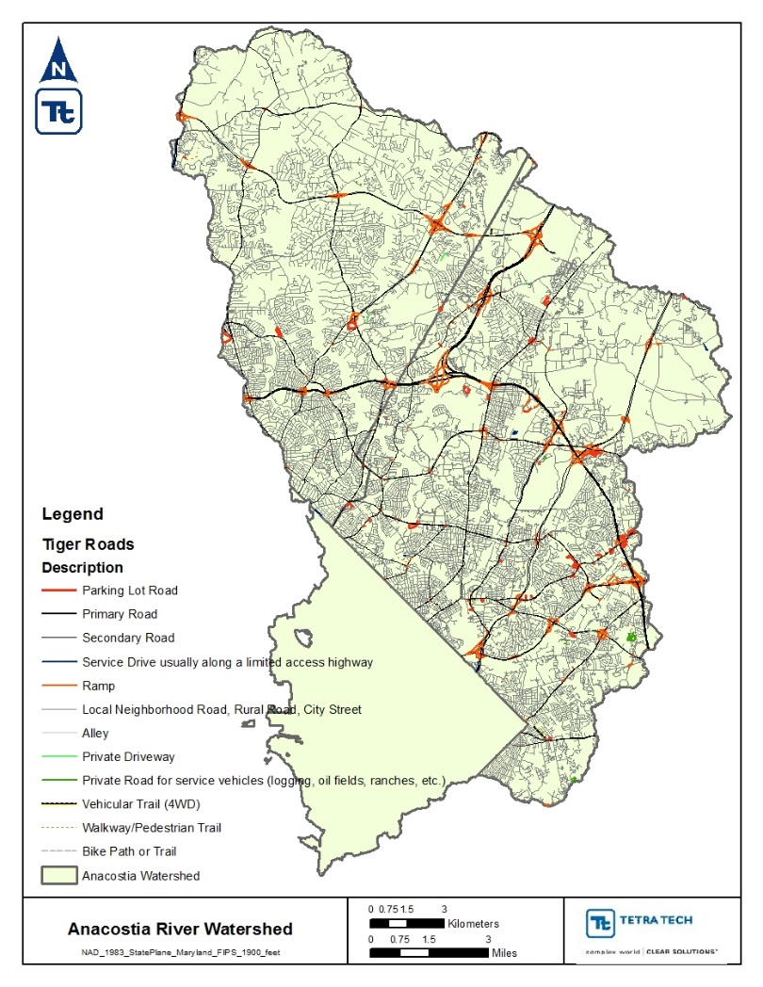
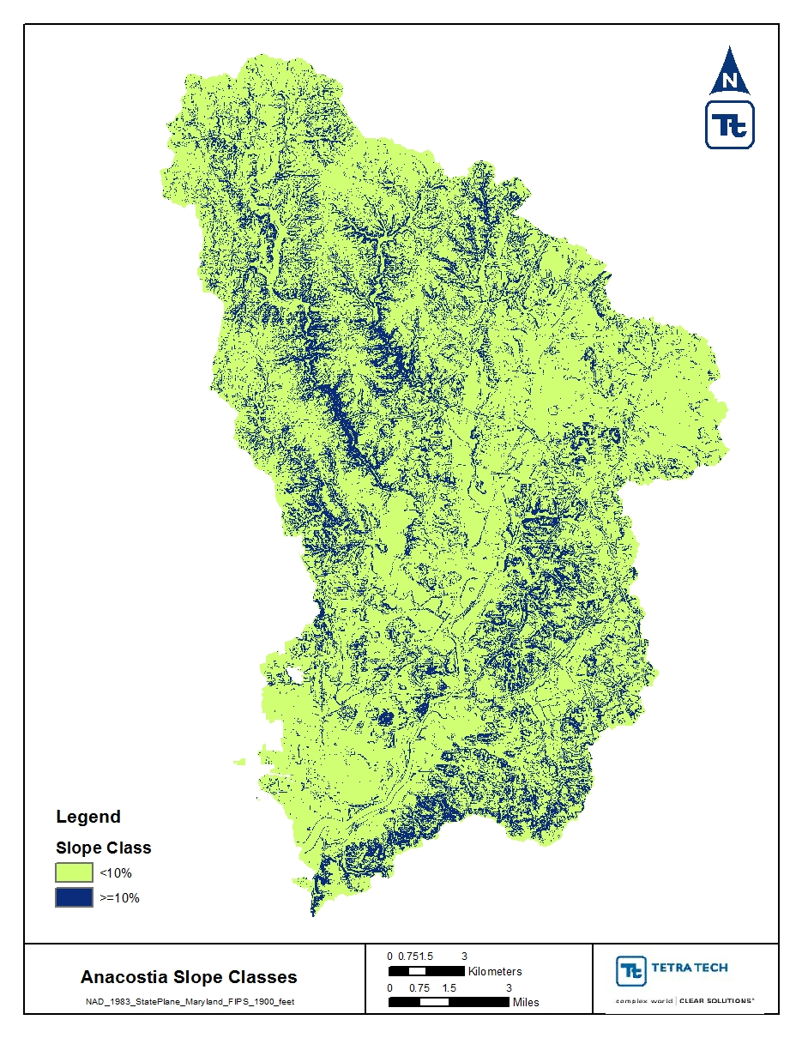
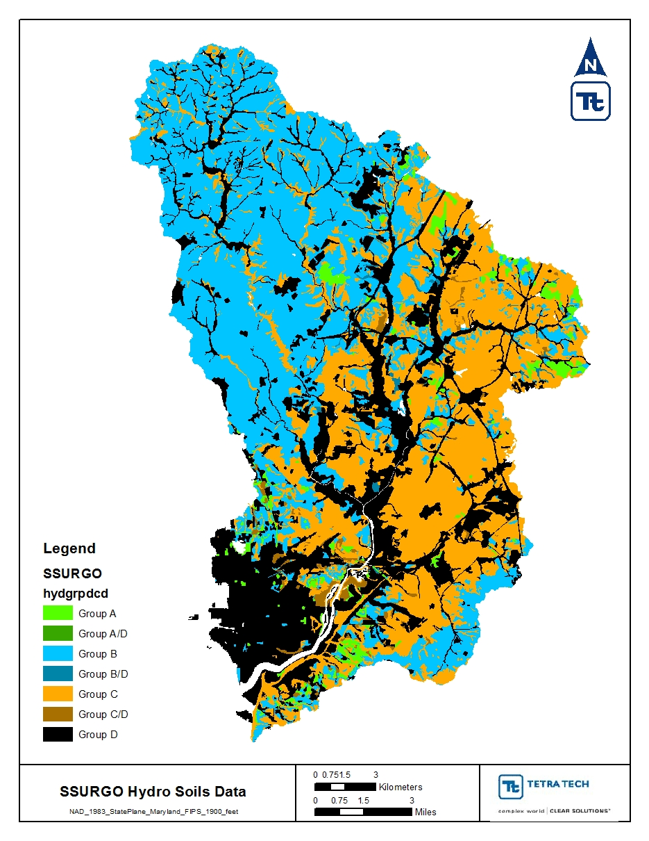
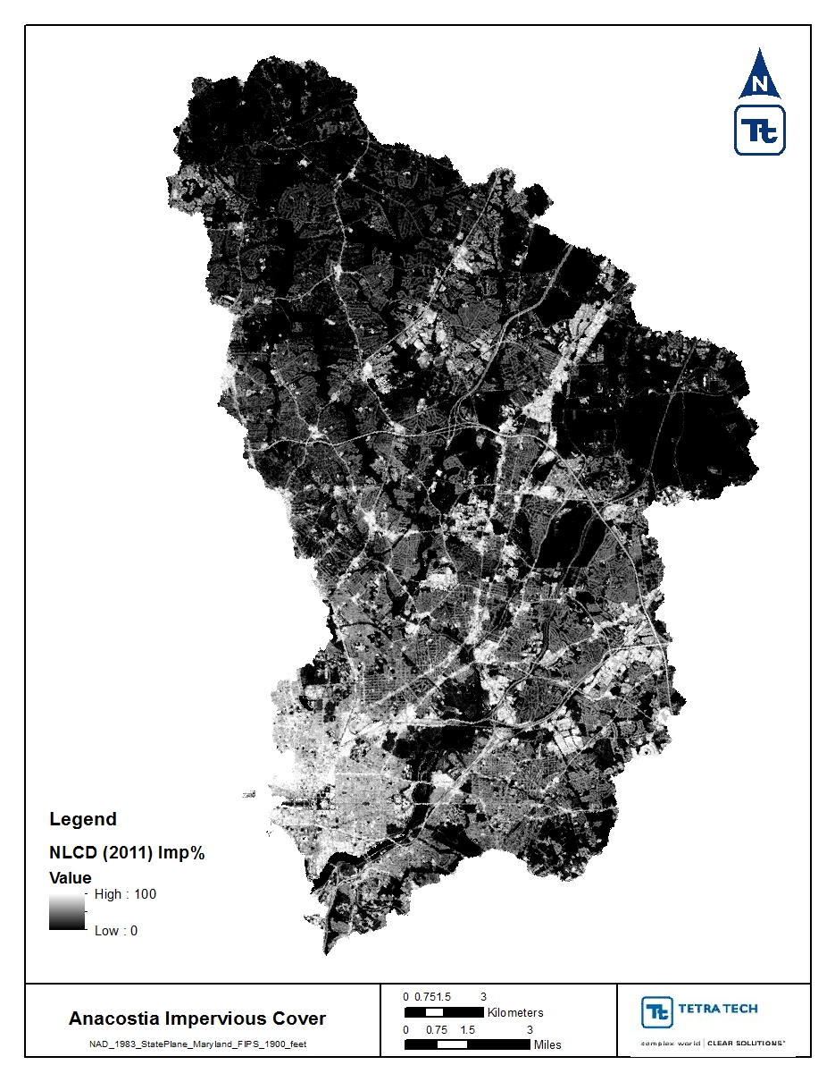
Model Setup
Hydrologic Response Unit
(HRU) Development
  HRUs are portions of a sub-basin that
  possess unique landuse/management/
  soil attributes
  Utilize locally and
  recently-developed
  datasets
  Increased resolution-
  21 HRU Groups
  vs. 9 in TAM/WASP

Slide 8
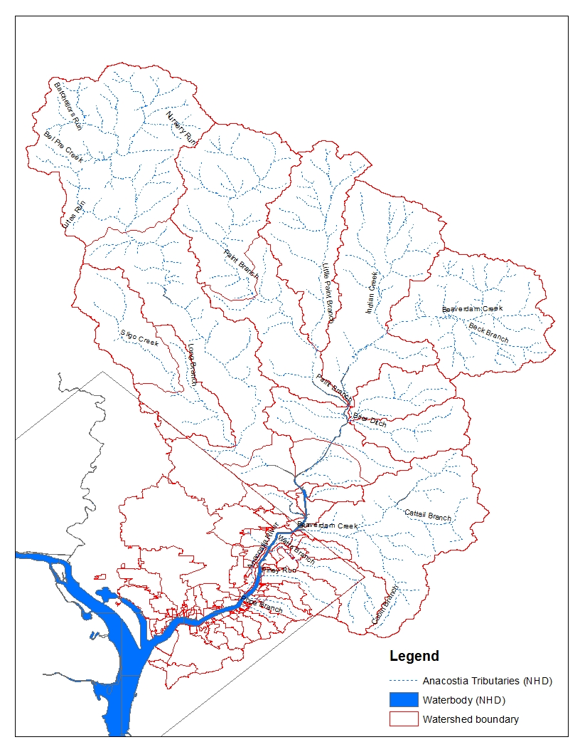
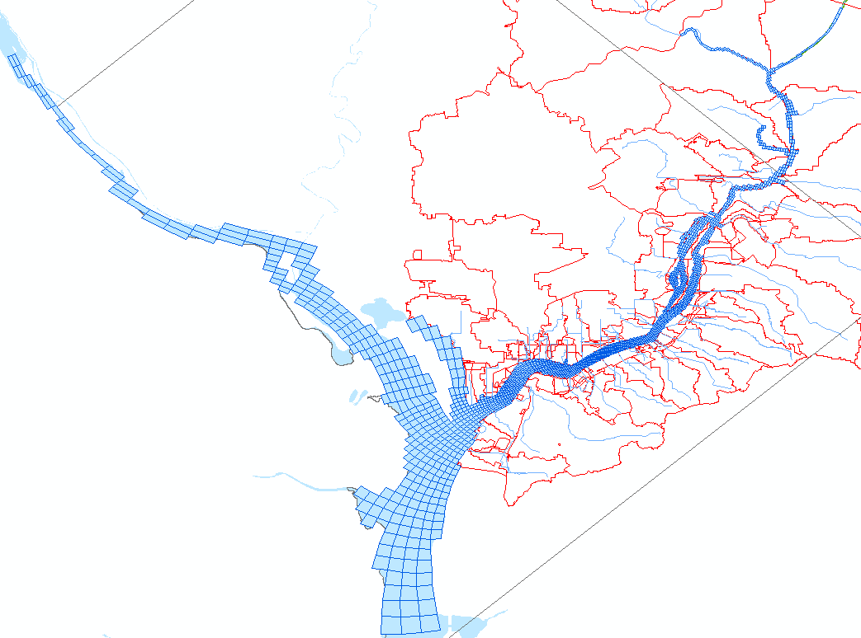
Receiving Water Model Configuration
2475 horizontal cells - Linked to LSPC
2 Open Boundaries on Potomac River
3-Dimensional: 10 layers
- Resolution down to ~30 meters x 30 meters

Slide 9
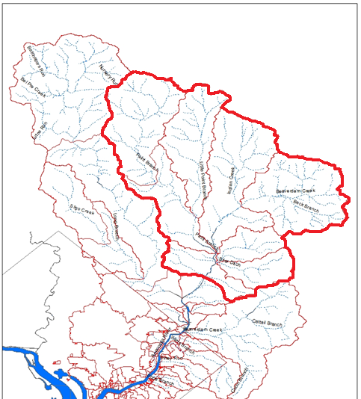
Example LSPC Calibration Results (NEB)
Line of Perfect Match
Northeast Branch (NEB):
Flow
43% of watershed
Tributaries include
Paint Branch, L.
Beaverdam Creek,
Indian Creek
Diverse land use
distribution, including
forested land

Slide 10
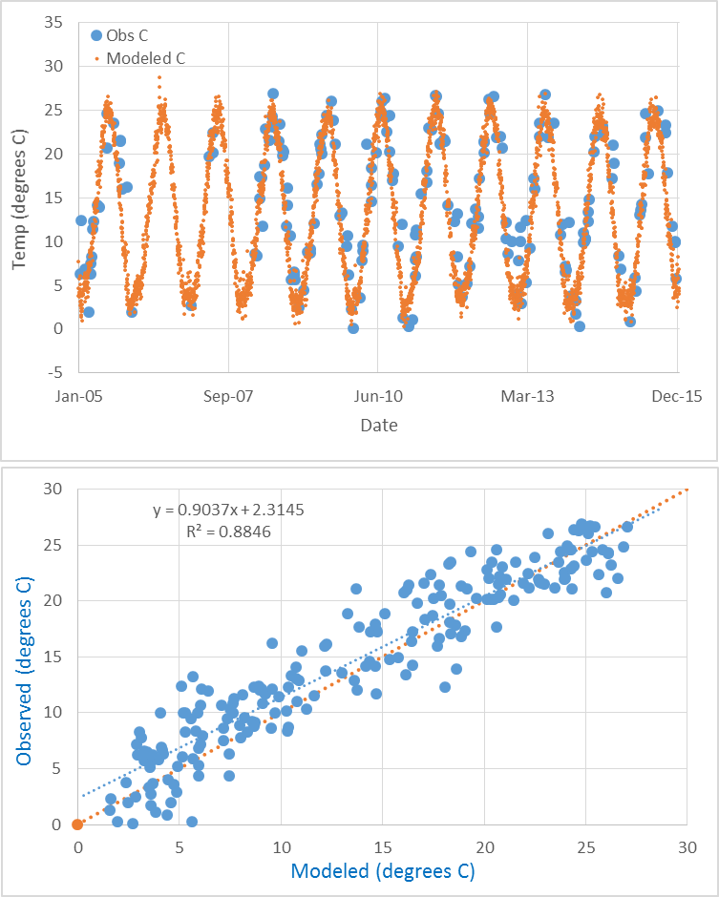
Example LSPC Calibration Results (NEB)
Northeast Branch (NEB):
Temperature
43% of watershed
Tributaries include
Paint Branch, L.
Beaverdam Creek,
Indian Creek
Diverse land use
distribution, including
forested land

Slide 11
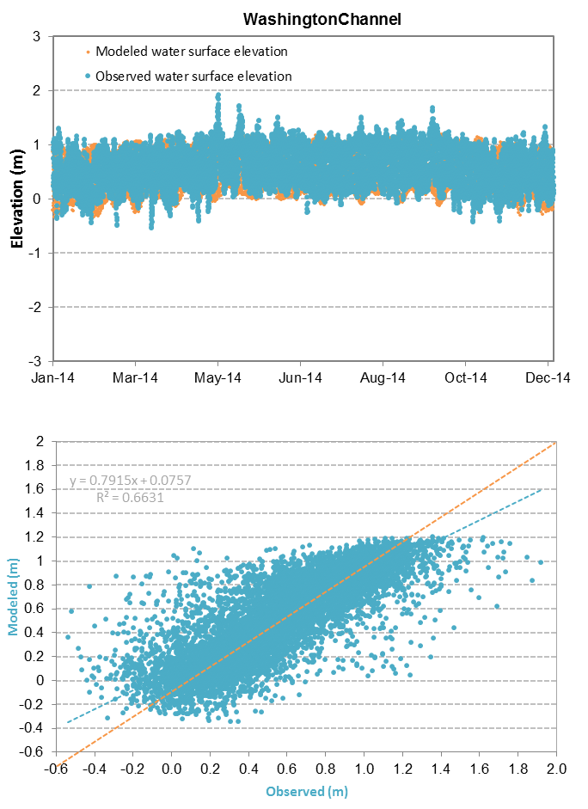
Example Hydrodynamic Calibration Results (Washington Channel)
Washington Channel:
Water Surface Elevation

Slide 12
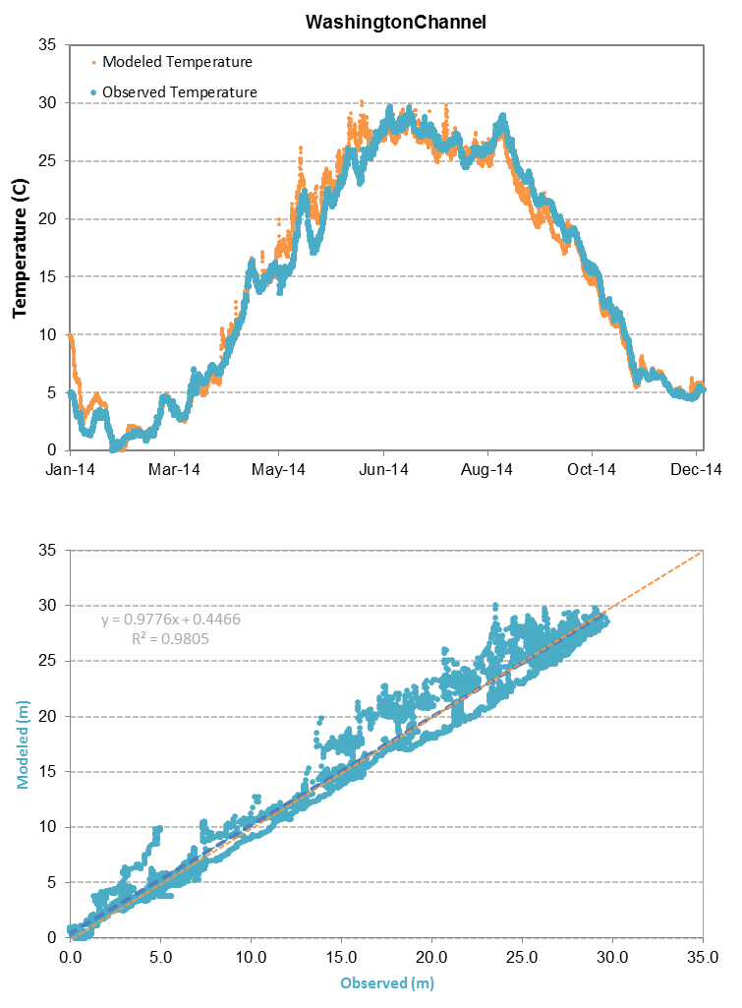
Example Hydrodynamic Calibration Results (Washington Channel)
Washington Channel:
Temperature

Slide 13
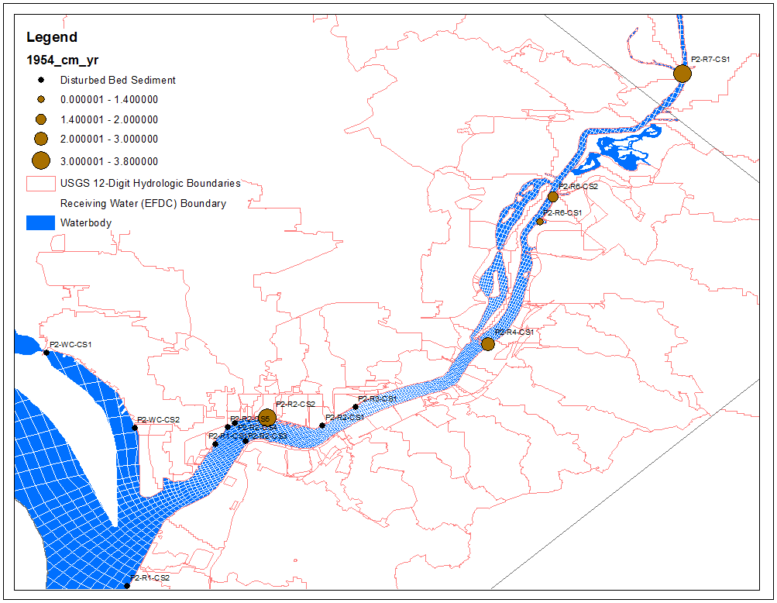
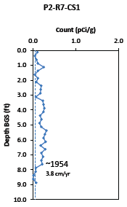
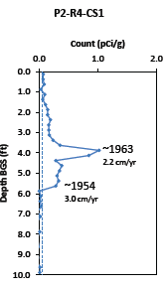
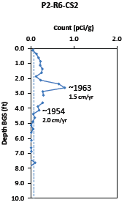
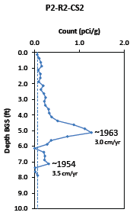
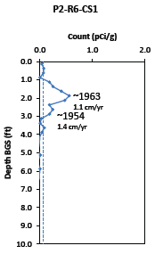
Sedimentation Data available for use in
Sediment Calibration-
2016 Cs137 Isotope Study

Slide 14
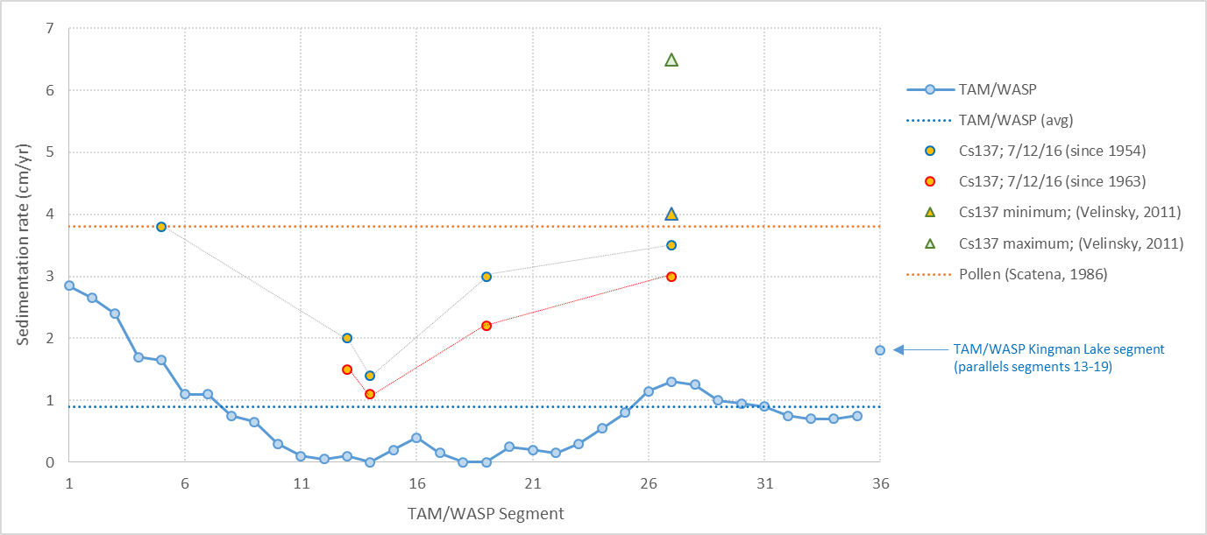
Sedimentation Data available for use in Sediment Calibration- Other Studies

Slide 15
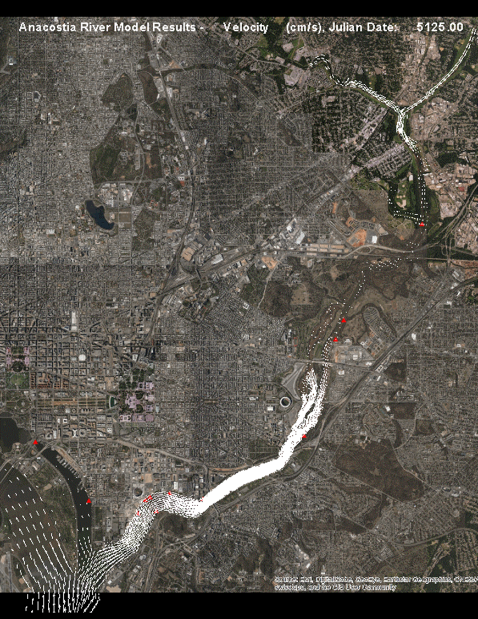
Velocity Animation

Slide 16
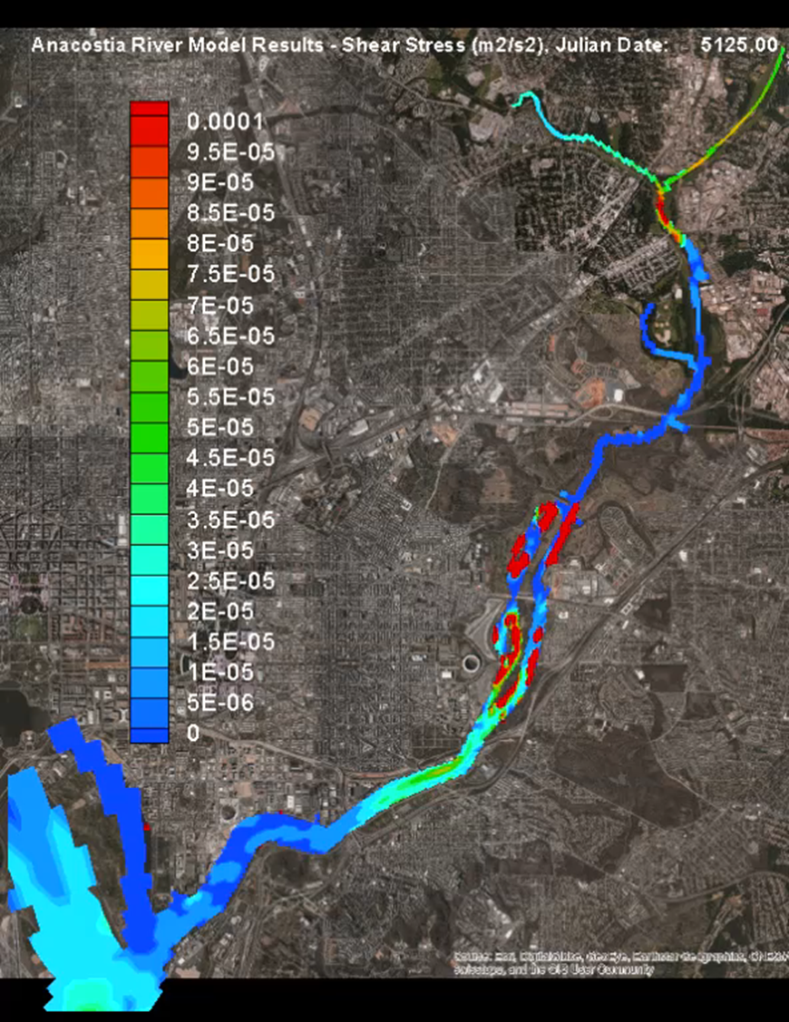
Shear Stress Animation

Slide 17
Summary
Model system setup complete
Hydrodynamic Calibration
  Watershed component (LSPC) is well-calibrated for flow and temperature
  EFDC uses LSPC results and is also well-calibrated
Sediment and Water Quality Calibration
  LSPC is calibrated for sediment, results will be presented in separate water quality presentation
  LSPC calibration for toxics is complete based on available data
    Ongoing tributary and manhole sampling will provide additional calibration data for LSPC in February/March 2017
  EFDC calibration is ongoing for sediment transport and water quality
  EFDC Sediment and toxic fate and transport results will be presented in a separate water quality presentation
    Results will be compared with observed water column and cesium radioisotope data
Monitoring Data
  Overall, tidal Anacostia River is adequately-characterized for modeling
  Tidal Anacostia water quality data spatially dense, temporally limited (i.e., change over time, wet/dry weather characterization)
  There are 2 ongoing efforts to collect tributary/upland water quality data ongoing to fully calibrate modeling system
    CSO and MS4 outfall sampling
    Tributary monitoring

Slide 18
Next Steps
Finalize first phase of toxics loading from watershed and suspended sediment transport in the receiving water
Link toxic load estimates to receiving water model to simulate fate and transport
Finalize receiving water fate and transport modeling based on available data
Obtain monitoring data expected in late February/early March, 2017 and compare with model results
Incorporate remedial alternatives recommended in FS
    Source removal/ dredging
    Capping
    Flooding
    Natural attenuation
    other
Documentation of modeling system and results

Slide 19
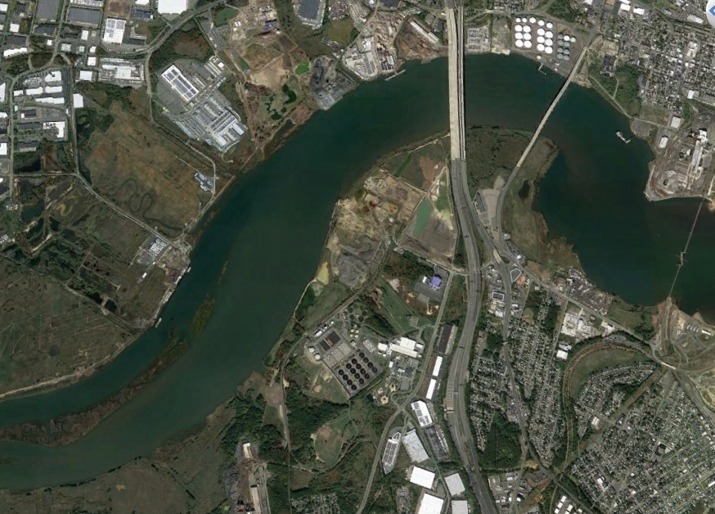
Hypothetical Remediation Site
Line of Perfect Match
Hypothetical Site
Historical discharge of pollutant(s)
Pollutant discharges no longer occur

Slide 20
Hypothetical Remediation Site
Line of Perfect Match
Hypothetical Site
Contamination of river bed sediments
Extent of contamination is mapped
Removal/dredging of contaminated sediments needs to be evaluated

Slide 21
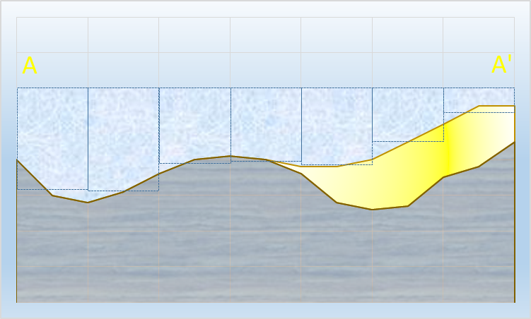
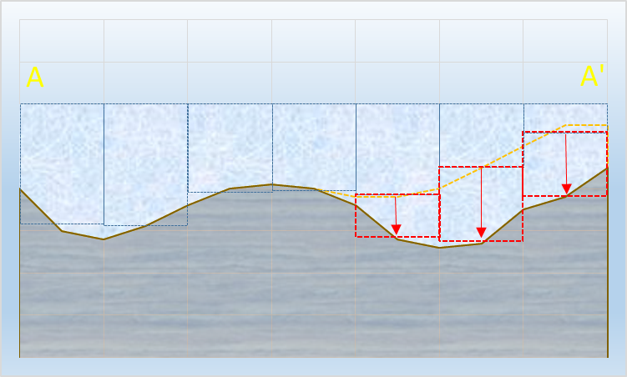
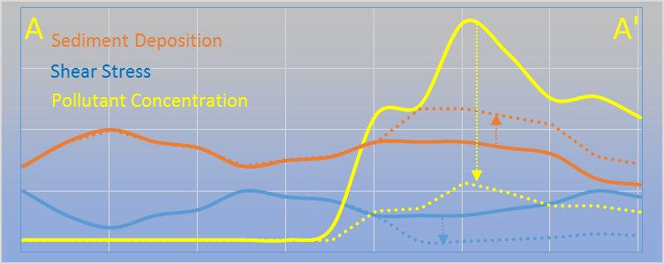
Hypothetical Remediation Site
River cross section (existing)
Line of Perfect Match
Water column
Contamination
Bed sediment
River cross section (post-dredge scenario)
A
A’
Results

