Slide 1
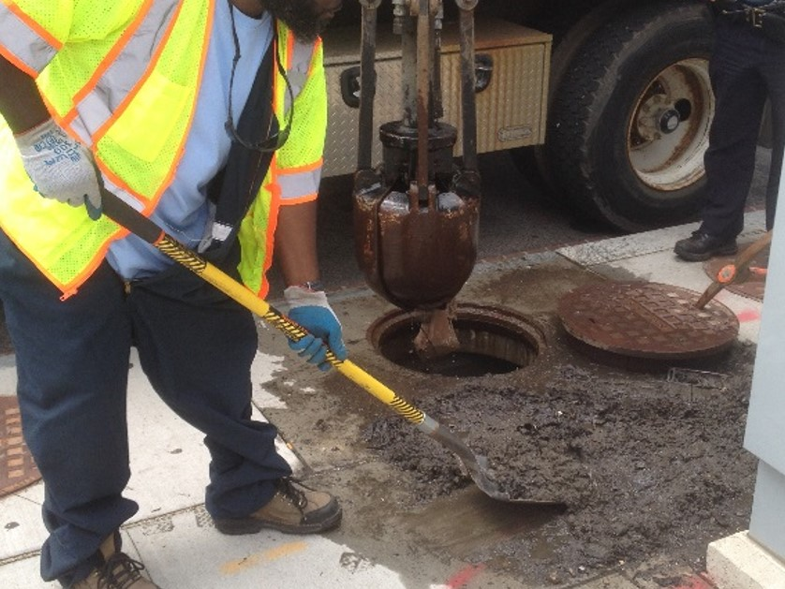
Anacostia River Sediment Project
Manhole Sediment Sampling
March 9, 2017
Update

Slide 2
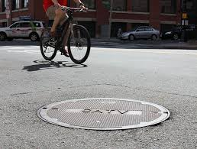
Presentation Overview
Objectives
Target Outfall Selection Process
Manhole Selection Process
Sediment Characterization and Analysis
Field Investigation Approach
Phase I Reconnaissance
Phase II Reconnaissance and Opportunistic Sediment Sampling
Current Project Status

Slide 3
Objectives of Manhole Sediment Sampling
Identify the lowest, above-tidal influence manholes associated with MS4 and CSS outfalls
Collect bottom sediment samples to characterize the nature and extent of chemical constituents
Generate hydrocarbon forensic data to support contamination source tracking efforts in the upstream watershed

Slide 4
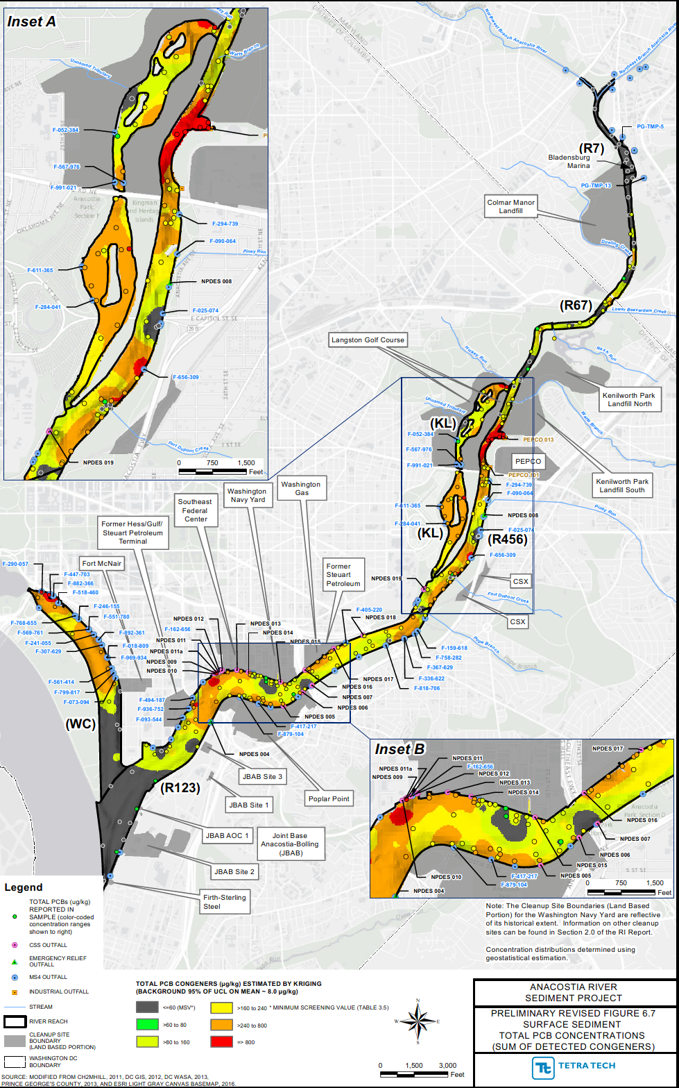
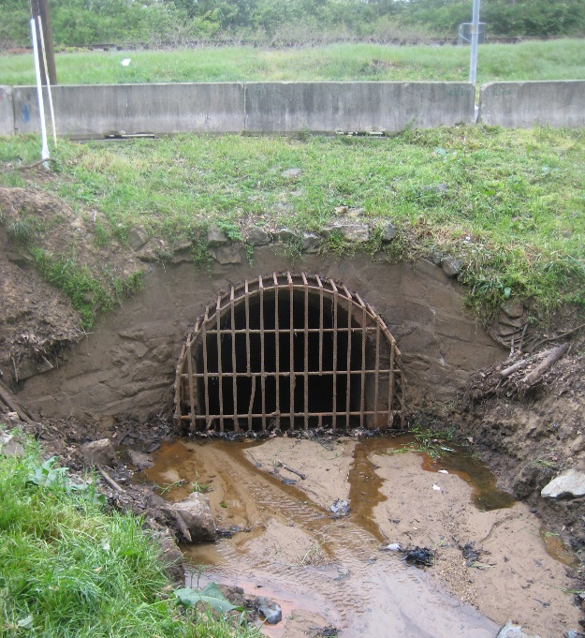
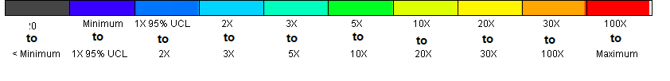
Total PCB Congeners in Surface Sediments
Target Outfall Selection
Outfall
Target outfalls selected based on Contamination detected in the Anacostia River surface sediment
Surface sediment characterization data collected in 2014, 2015, and 2016
Targeted Outfall
Multiple of Concentration Above Potomac R. Background

Slide 5
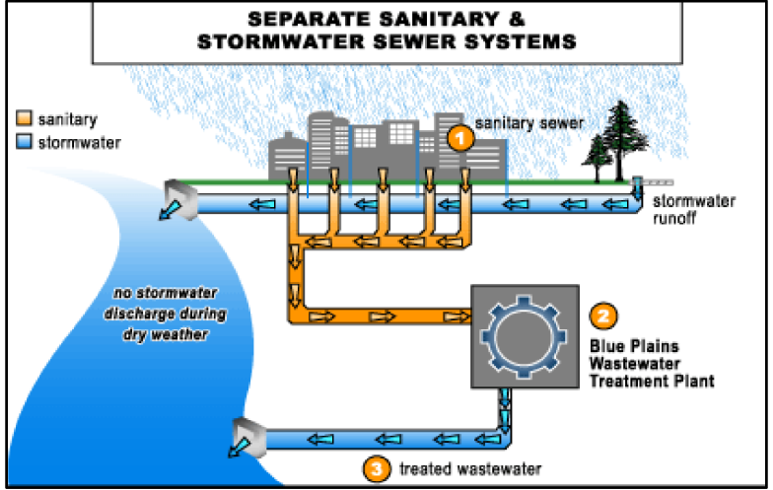
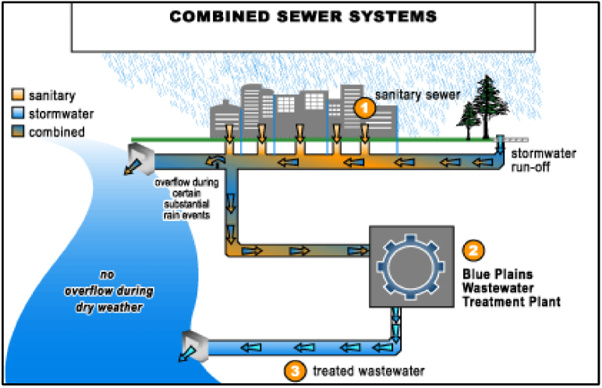
Separate and Combined Storm Sewer Systems
Separate stormwater sewer system:
municipal separate storm sewer system (MS4)
Combined sewer system (CSS)

Slide 6
Combined Sewer System Operation

Slide 7
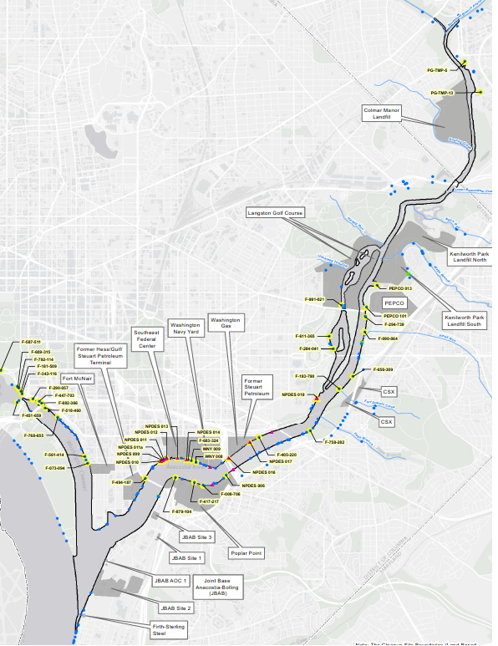
Target Outfall Selection
Target Outfalls for Manhole Sediment Sampling
43 outfalls targeted: DC Water, Prince George’s County, unknown system
Selected 27 out of a total of 72 Municipal Separate Storm Sewer System (MS4) outfalls
  23 DC Water MS4 outfalls included in study
  2 PG Co. outfalls – in planning stage
  2 non-DC Water outfalls will be sampled by Pepco
16 DC Water Combined Sewer System (CSS) Outfalls – all included

Slide 8
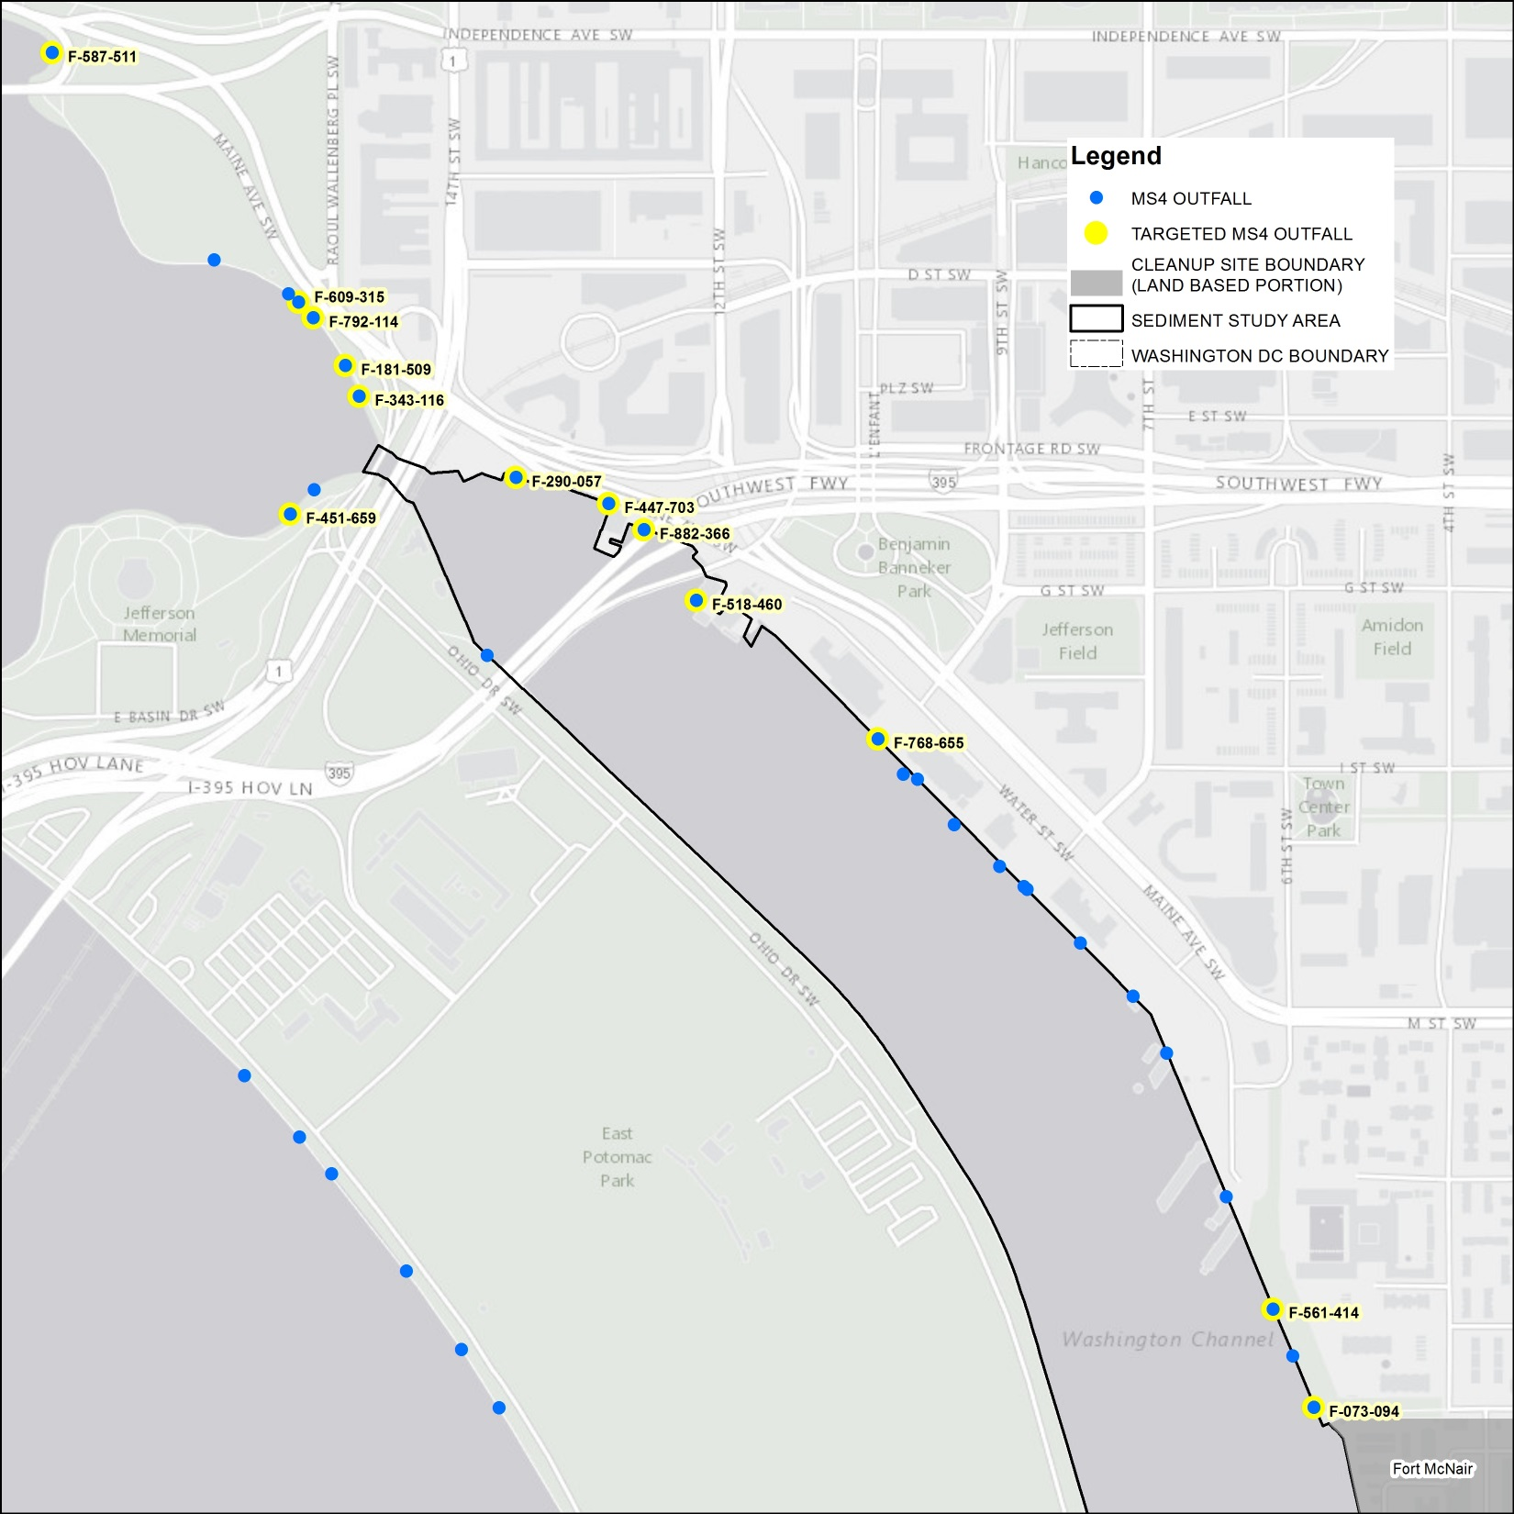
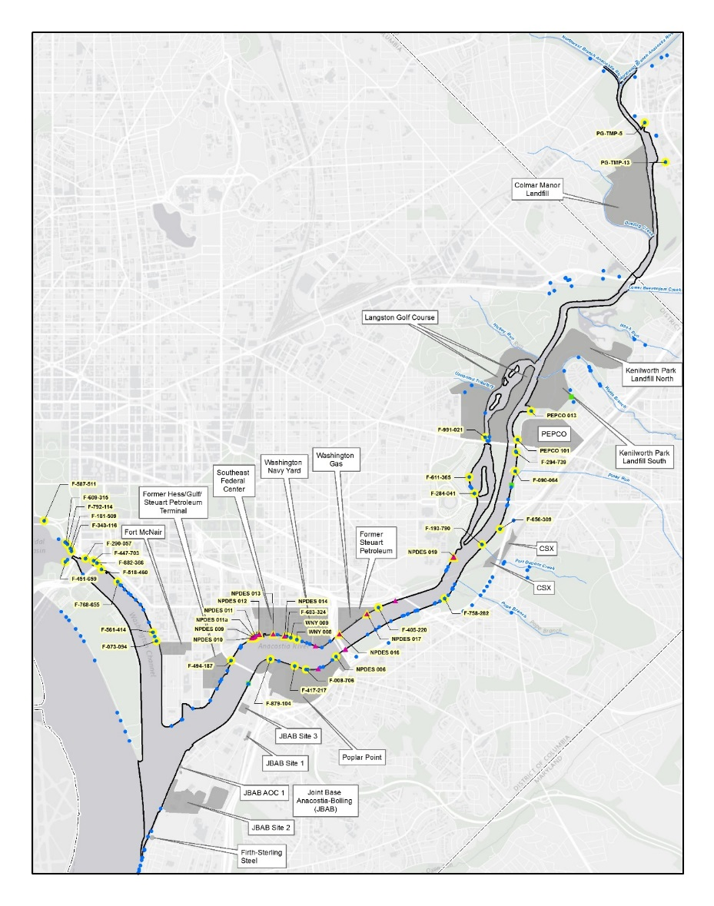
Washington Channel
Fort McNair
Target Outfalls for Manhole Sediment Sampling

Slide 9
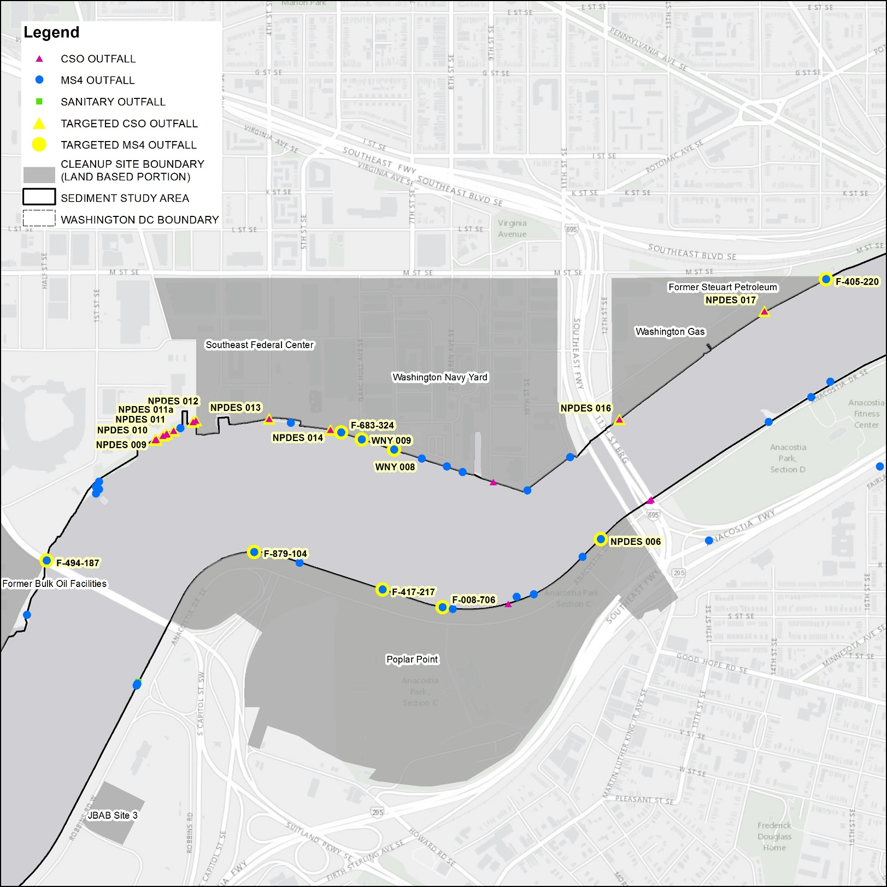

Washington Navy Yard
Target Outfalls for Manhole Sediment Sampling
Southeast Federal Center
Washington Navy Yard
Poplar Point
Washington Gas
Former Hess/Gulf/Steuart Petroleum

Slide 10
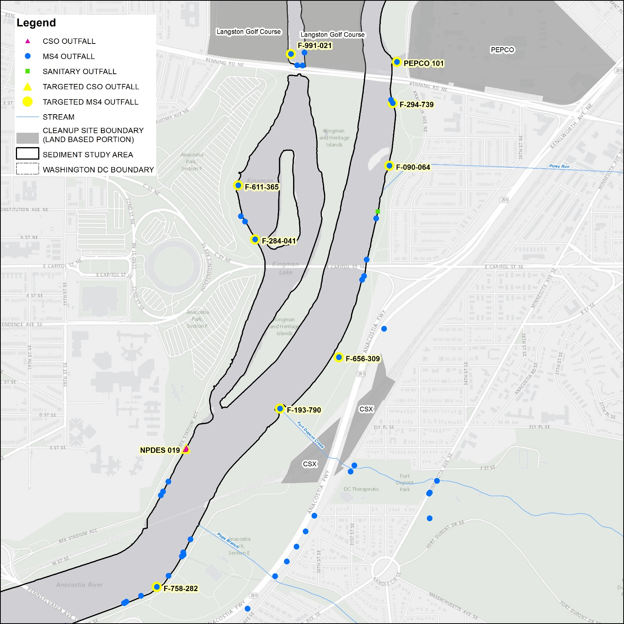

Langston Golf Course
Kenilworth Park Landfill
PEPCO
CSX
Target Outfalls for Manhole Sediment Sampling

Slide 11
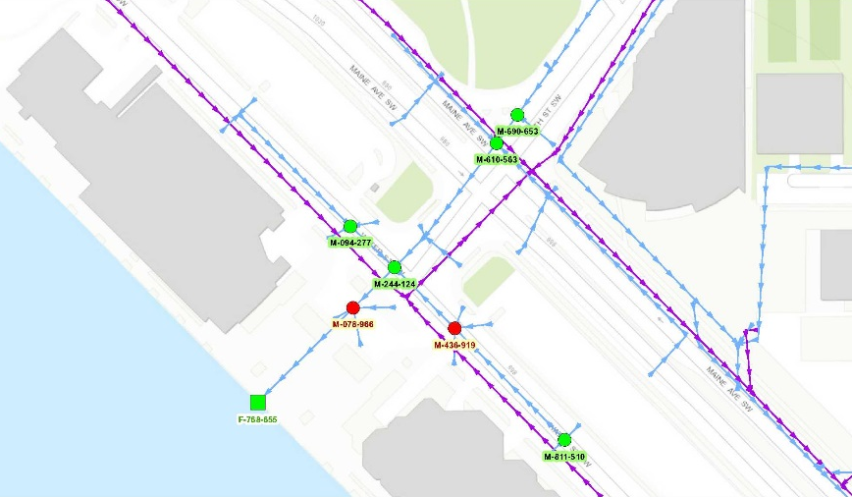
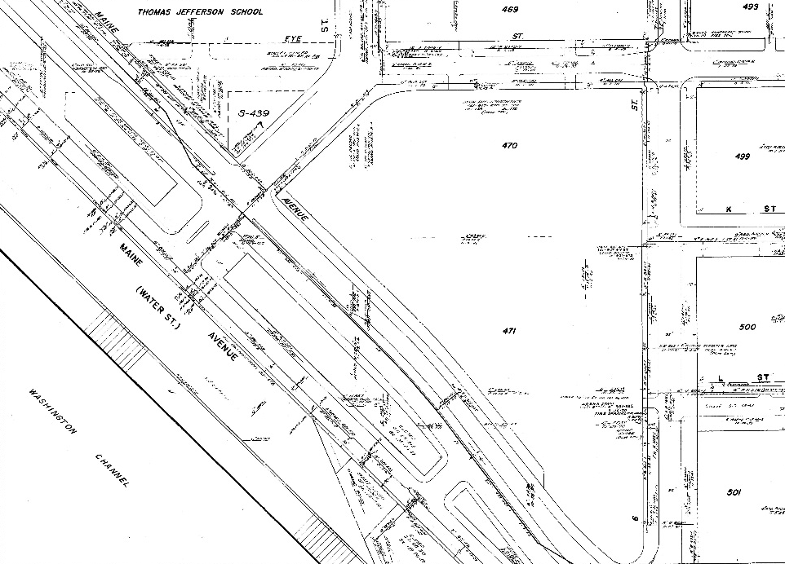
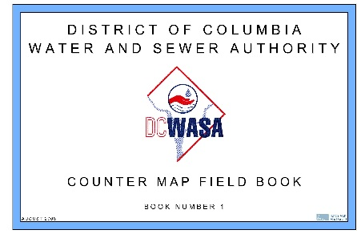
Manhole Selection
Mapped sewer piping for each outfall
  Obtained GIS data pertaining to MS4 and CSS infrastructure from DC Water:
    Network of gravity mains
    Matched piping network to outfalls
    Identified manhole locations in the network
  DC Water as-built drawings “Counter Maps” resource used to supplement GIS

Slide 12
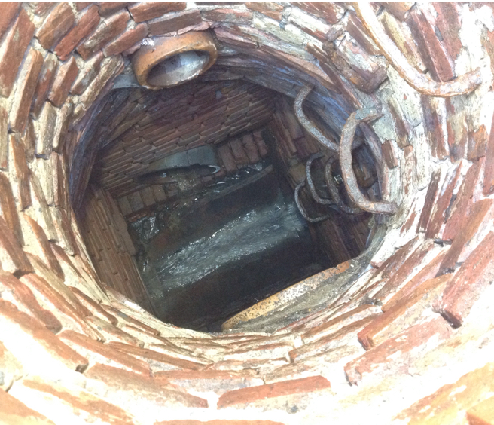
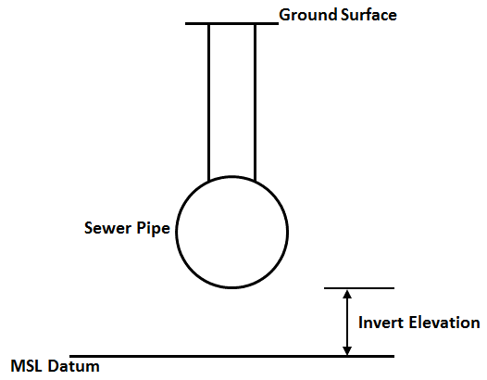
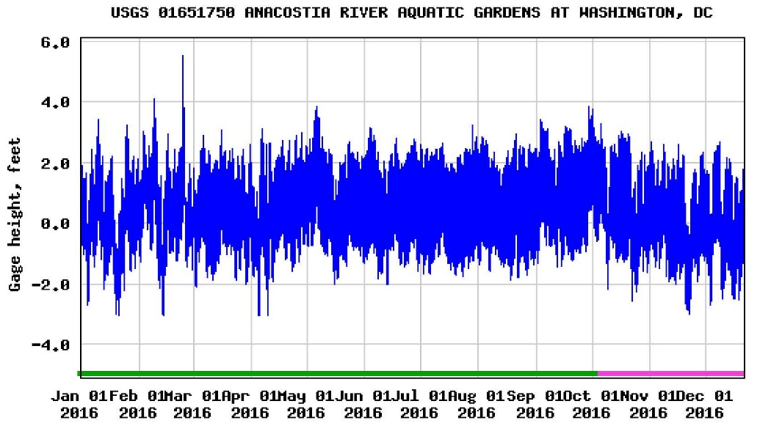
Manhole Selection
Estimated Manhole “Invert Elevation”
  GIS shapefiles
  Counter maps
  Estimated from adjacent areas
Compared invert elevation to river tide data to identify subset of manholes not typically influenced by tidal backflow (estimated as 3 feet AMSL)

Slide 13
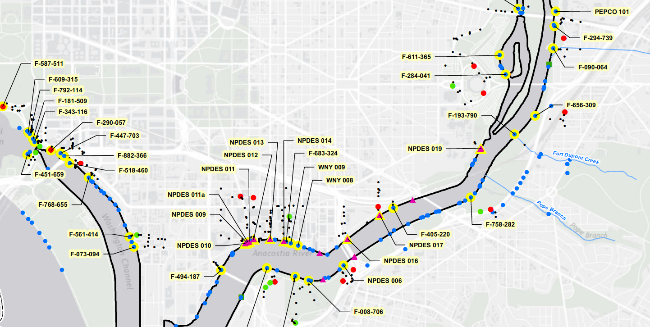
Manhole Selection
Lowest five manholes were
selected with preference given to those not influenced by tides
Total of 200 manholes targeted
.
Selected manhole
Manholes accessed to date
.

Slide 14
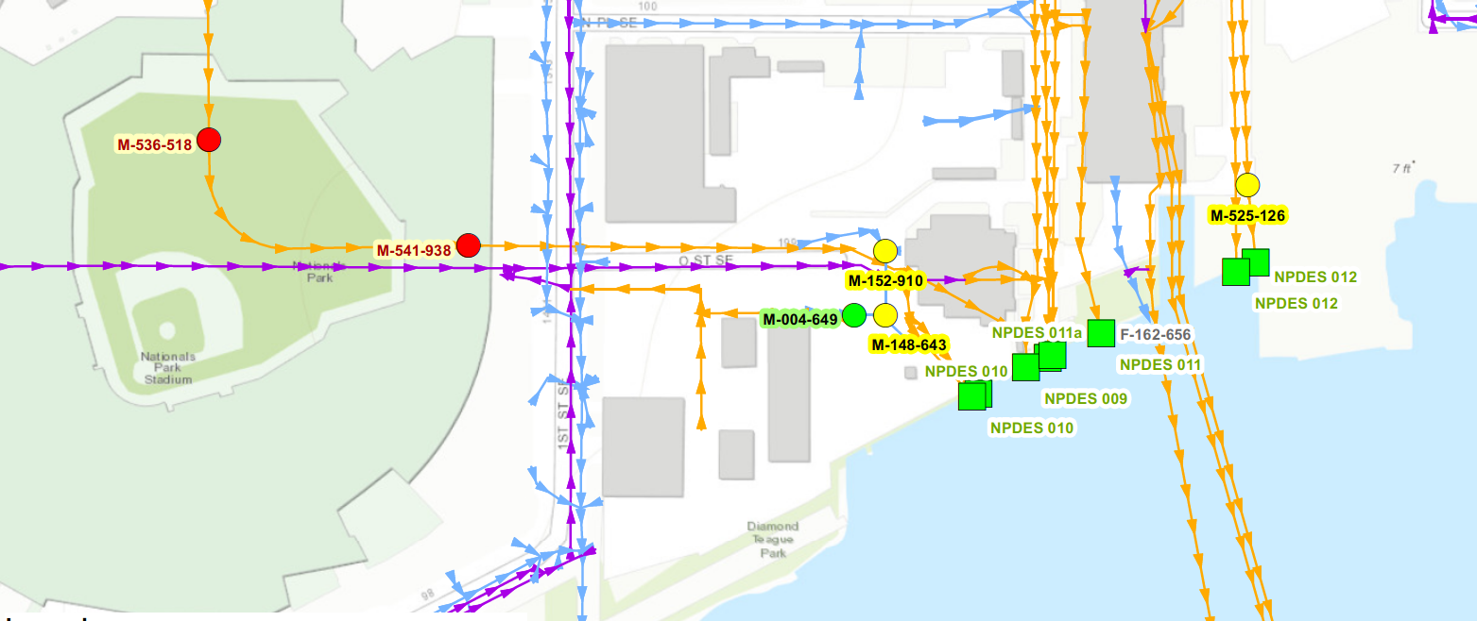
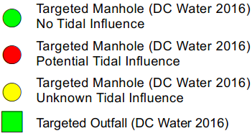

Example Results of Manhole Selection Process

Slide 15
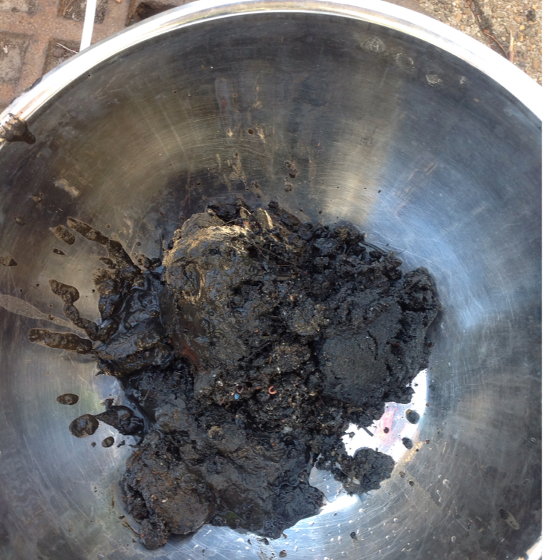
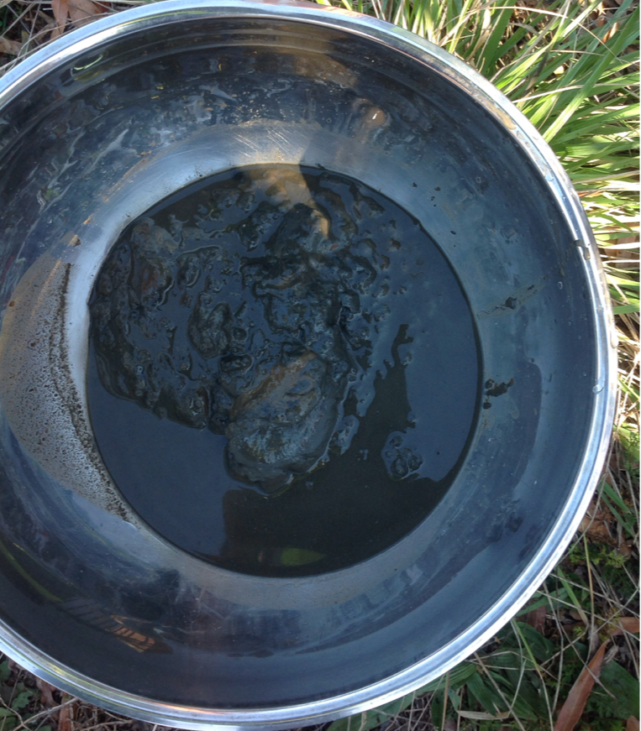
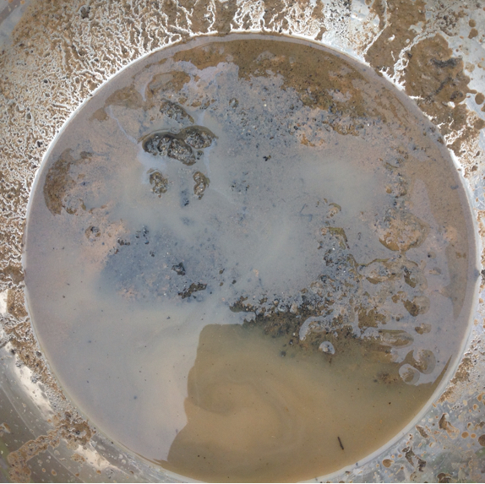
Sediment Chemical Analysis
Characterization Objectives
Priority pollutants
  Volatile organic compound
  Semivolatile organic compound
  Metals
  Pesticides
  Polychlorinated biphenyl (PCB) Aroclors
  Dioxins and Furans
  Total Cyanide
Grain size
Total organic carbon
Forensic Objectives
  Total Petroleum Hydrocarbons (Modified)
  51 alkylated polycyclic aromatic hydrocarbons (aPAHs)
  Hydrocarbon biomarker compounds (biomarkers)
  PCB congeners

Slide 16
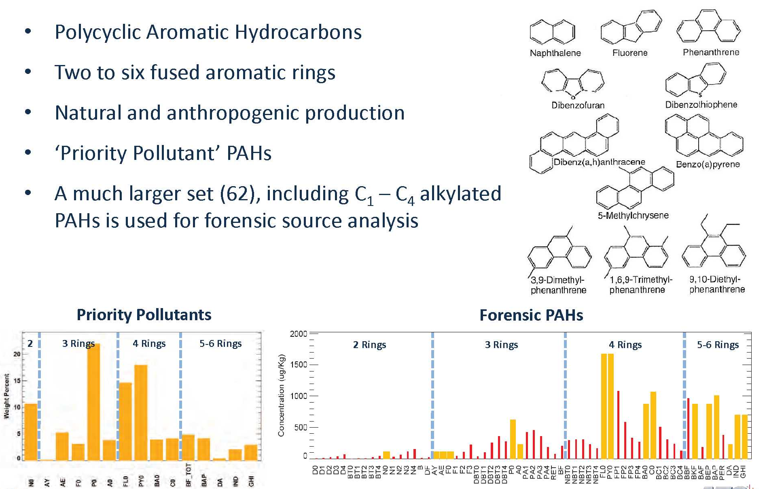
Alkylated PAH Forensic Analyses

Slide 17
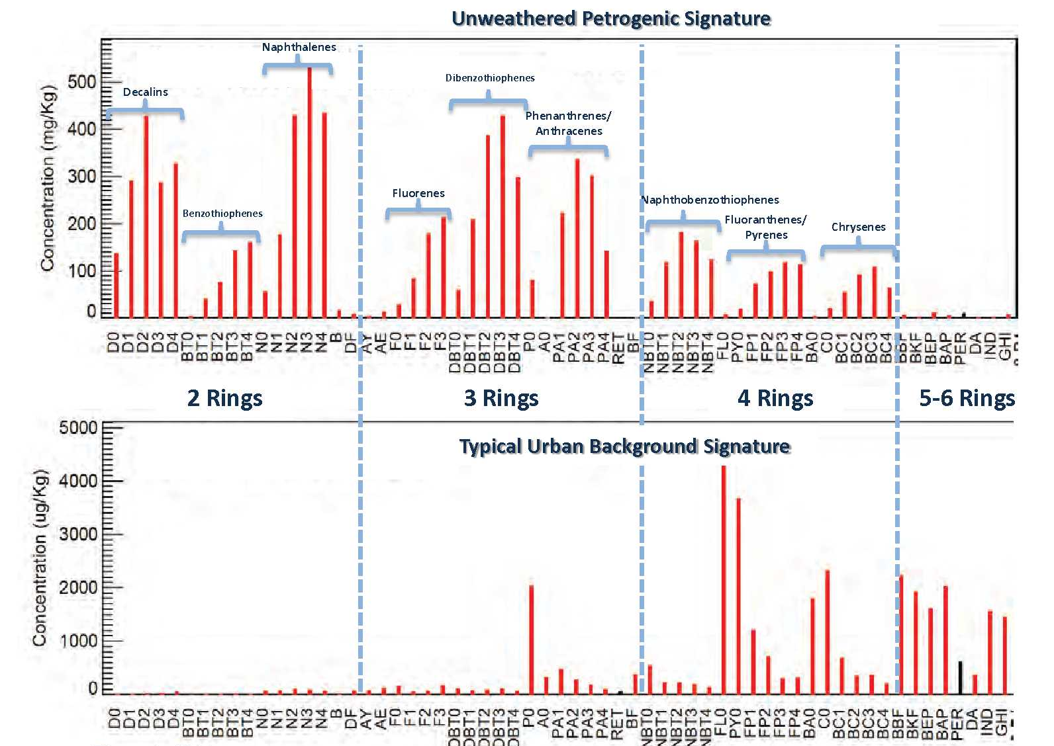
Example Interpretation of Alkylated PAH Forensic Results

Slide 18
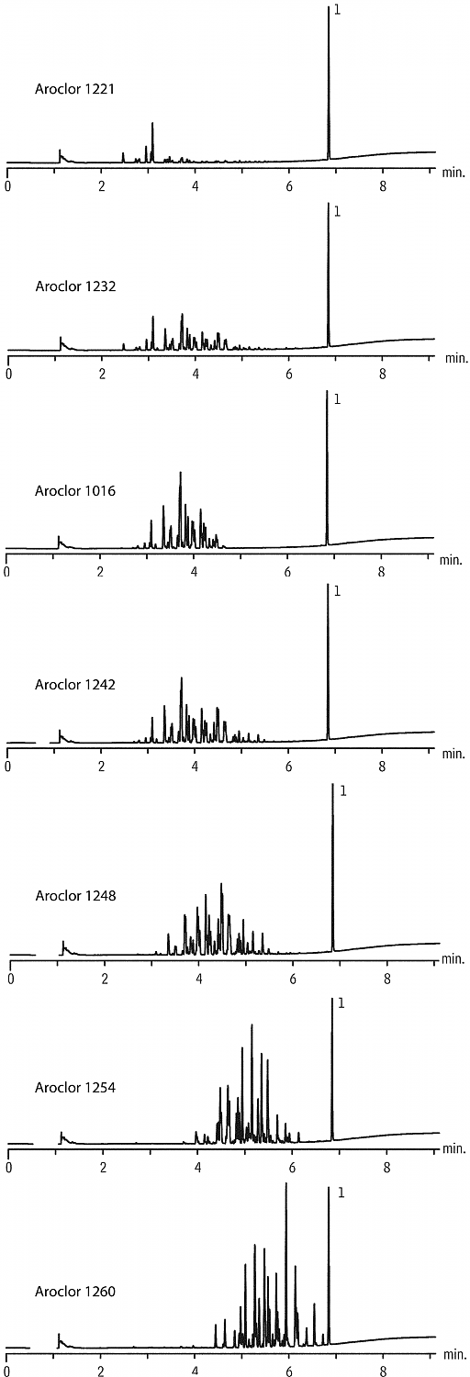
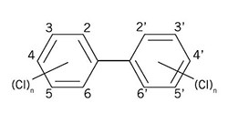

PCB Aroclors and Congeners
Aroclor 1221
Aroclor 1232
PCB Congener
  Set or compounds with similar composition and structure
  Each PCB contains 1 to 10 chlorine atoms attached to a biphenyl structure
  209 unique compounds or congeners
PCB Aroclors
  Mixture of up to 100 congeners, grouped together based on an average percent weight chlorine basis
  Identified by 4 digit numbering with last two digits the chlorine weight percent
Aroclor 1016
Aroclor 1242
Aroclor 1248
Aroclor 1254
Aroclor 1260

Slide 19
Example PCB Congener Forensic Evaluation
Potential non reporting of Aroclor 1254
Likely degradation of Congener 180/193)
Potential non reporting of Aroclor 1242
Potential over reporting of Aroclor 1248
Congener profile for the sample (Blue)
Difference between the congener data and expectation based on fraction for Aroclor(s) reported and typical Aroclor congener composition (Red, negative indicates congener result less than expected from reported Aroclor fractions and typical Aroclor composition)
Potential over reporting (Aroclor 1248) and non-reporting (Aroclors 1242 and 1254)
Also evidence of some degradation (congener 180/193)

Slide 20
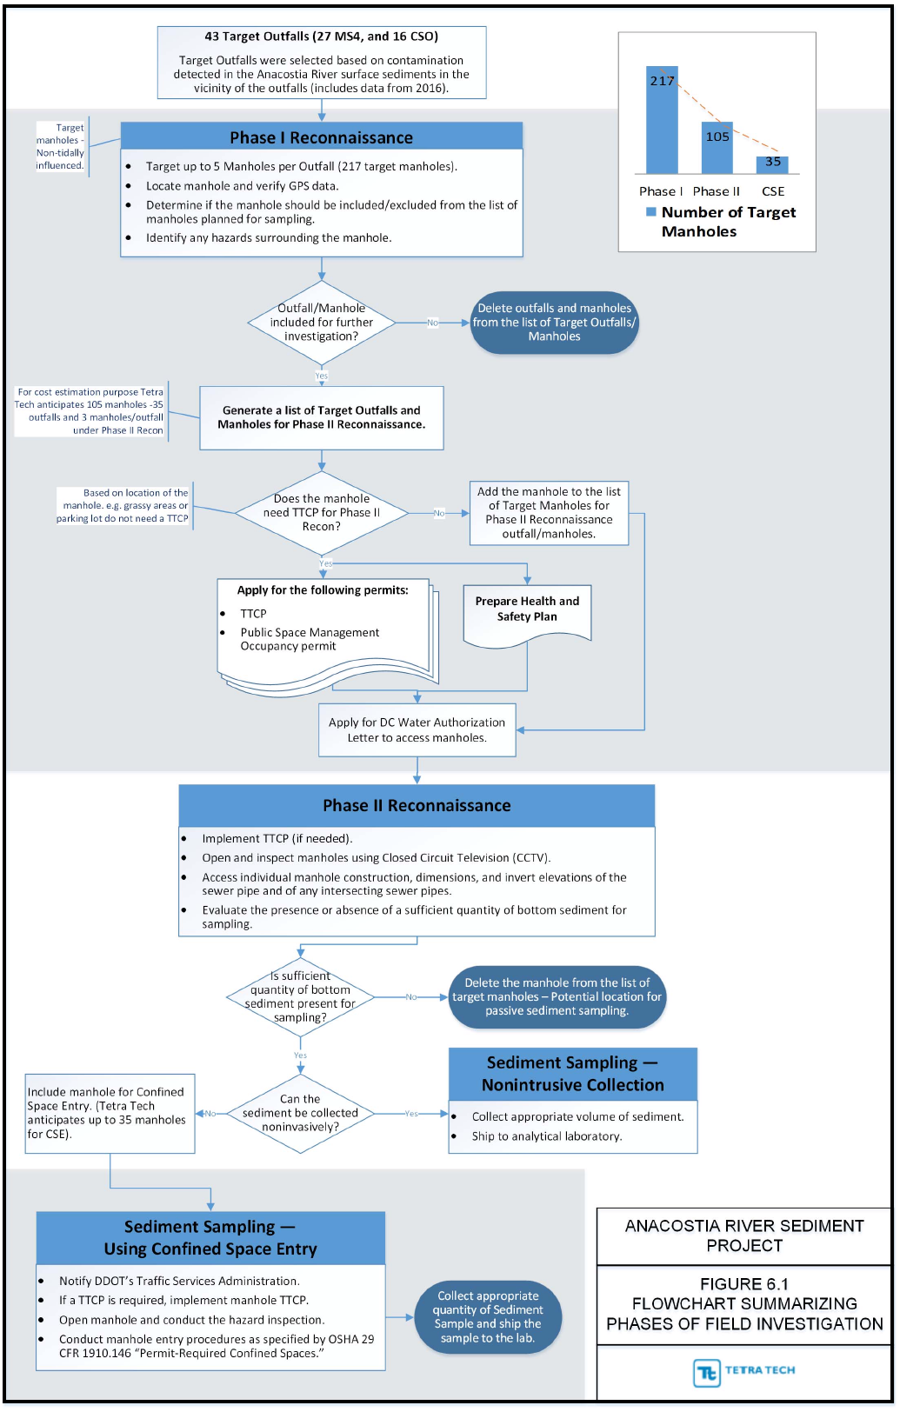
Field Investigation Approach
Phase I - Reconnaissance
Verify manhole locations and GPS coordinates
Determine manhole accessibility and permitting requirements for sampling
Phase II – Access and Opportunistic Sampling
Open and inspect manholes using Closed Circuit Television (CCTV)
Evaluate the presence or absence of bottom sediment
Collect sample if sediment present
Characterization and forensic analysis
Phase III – Other Sampling Approaches
Confined Space Entry
Passive Sampling

Slide 21
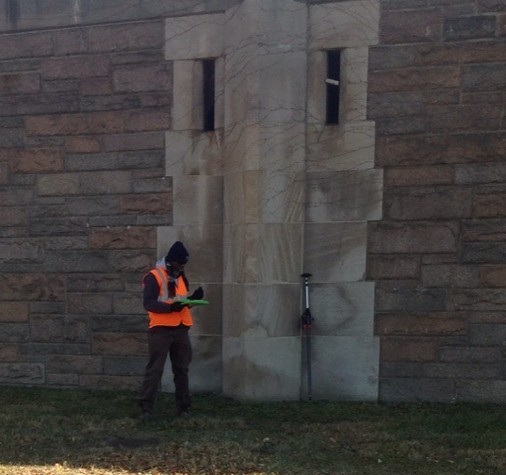

Phase I - Reconnaissance
Fieldwork initiated on 11/21/16 as defined in the approved FSP
Phase I completed on 12/31/16
Field-identified 200 manhole locations

Slide 22
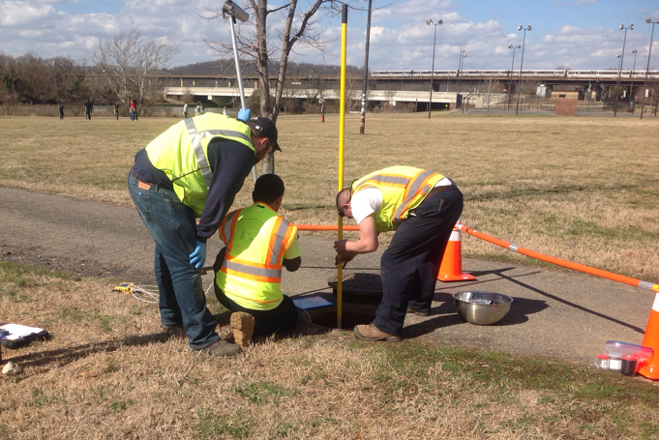
Phase II Field Activities
95 Manholes selected for Phase II – three per outfall based on access while maintaining maximum coverage
Phase II field activities initiated on 2/21/16
25 manholes accessed as of 3/3/16 (focused on subset not requiring traffic control measures
9 manholes contained sufficient quantities of sediment for sampling
M-420-231

Slide 23
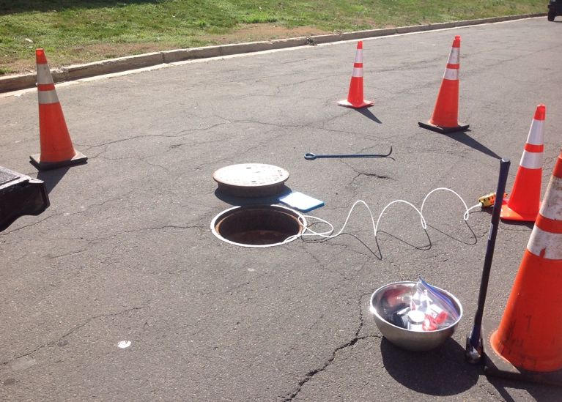
Phase II Field Activities (Continued)
Evaluate potential external hazards and secure the work area.
Remove cover and store safely
Vertically profile air quality parameters (oxygen, flammable and explosive gasses, and hydrogen sulfide) within the manhole using a multi-gas meter
M-591-847

Slide 24
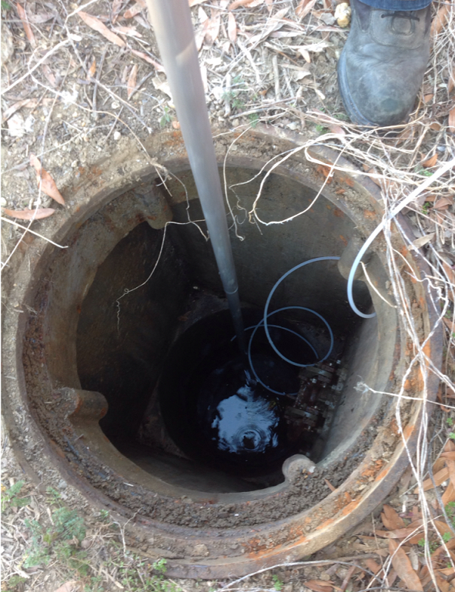
Phase II Field Activities (Continued)
Document manhole dimensions, depth/elevation of the trunk pipe invert, and depths to intersecting sewer pipes
Assess potential tidal influence based on measured invert elevation
Video the trunk pipe via CCTV and assess presence and quantity of sediment and presence water flow

Slide 25
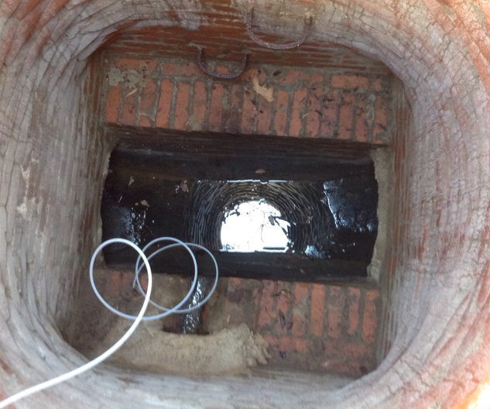
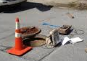
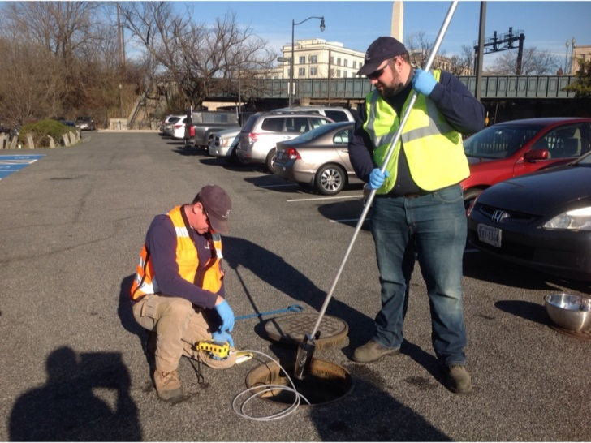
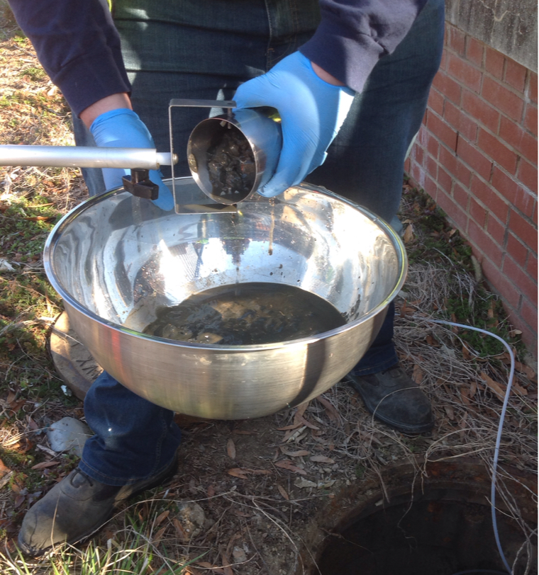
Phase II Field Activities (Continued)
If there is water flow, measure water depth and water quality parameter data (specific conductance, pH, temperature, ORP)
If sufficient sediment is present and can be collected from the surface, collect the required quantity of sediment sample.

Slide 26
Current Project Status
To date, inspected 25 manholes and collected nine sediment samples
Prince George’s County manhole access expected in late March
Anticipate completing Phase 2 by mid-April and Phase 3 (if needed) by the end of April
Laboratory analysis, data validation, data evaluation completed in mid-June
Investigation results will be reported in the Phase 2 RI Report

