Slide 1
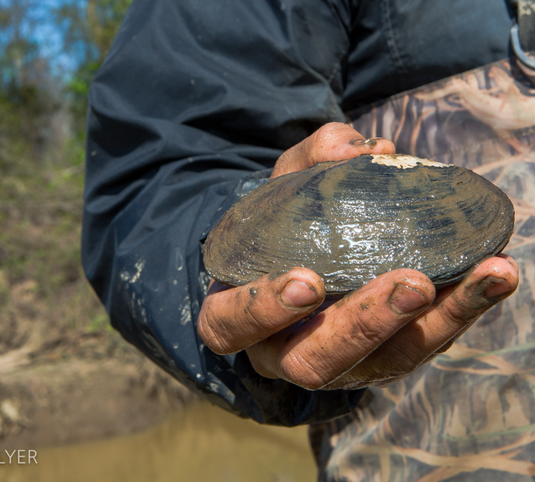
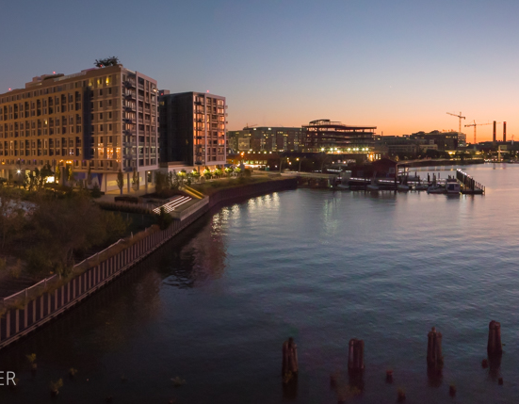
Anacostia River Sediment Project Progress Update Leadership Council for a Cleaner Anacostia December 12, 2019

Slide 2
Anacostia River Sediment Project (ARSP) Schedule
Proposed Plan and supporting documents released on December 27, 2019
30-day public comment period begins
Public meeting and other outreach meetings in January 2020
Interim Record of Decision: September 30, 2020
Preliminary Assessment/Site Investigation
Remedial Investigation
Focused Feasibility Study
Proposed Plan
Interim Record of Decision
Remedial Design for Interim Actions
Interim Remedial Actions
Long-term Management
Final ROD

Slide 3
ARSP Interim ROD Process
Study Area
Implement phased approach using adaptive management
Remediate areas with highest PCB contamination (Early Action Areas) coupled with regular performance monitoring
Proceed until cleanup objectives are achieved
Notes:
A rule of thumb for readability – if the slide can be printed on Letter size paper and read comfortably, it will be readable when printed full size. If the font size is too small to be read when printed on Letter paper, it is too small for a poster.
This slide will work well for a 3 or 4 column layout.

Slide 4
ARSP Interim ROD Process
REMEDIAL INVESTIGATION / FEASIBILITY STUDY
PROPOSED PLAN FOR INTERIM ROD
EARLY ACTION
ADAPTIVE MANAGEMENT
FINAL ROD

Slide 5
ARSP Interim ROD Process
PROPOSED PLAN
FOR INTERIM ROD
REMEDIAL INVESTIGATION
EARLY ACTION
River-wide Feasibility Study:
Bathymetric Survey
Surface Water Model
Contaminant Source Assessment
Manhole Sediment Investigation
Tributary Study
Groundwater Model
Passive Sampler & Mussel Report
Focused Feasibility Study
Public Participation:
Stakeholder Meetings
Response to Stakeholder Comments
Proposed Plan:
Early Actions to achieve progress toward Remedial Action Objectives
Hot Spot Remediation:
River-wide Early Actions
PECS Clean-ups
Upstream Tidal/
Non-tidal Source Control:
Tributaries
Outfalls
Early Action Planning
Interim ROD
Performance Monitoring

Slide 6
ARSP Interim ROD Process
ADAPTIVE MANAGEMENT
FINAL ROD
Additional Remedial Action (if needed):
Operable Unit-specific
Potential Environmental Cleanup Site-specific
Performance Monitoring (Long Term):
Forage and Game Fish
Surface Sediment
Pore Water/Passive Sampling
Surface Water
Tributaries
Outfalls
Baseline & Performance Monitoring:
Forage and Game Fish
Benthic Invertebrates
Pore Water/Passive Sampling
Surface Sediment
Tributaries
Surface Water
Outfalls
Final Remedy Planning

Slide 7
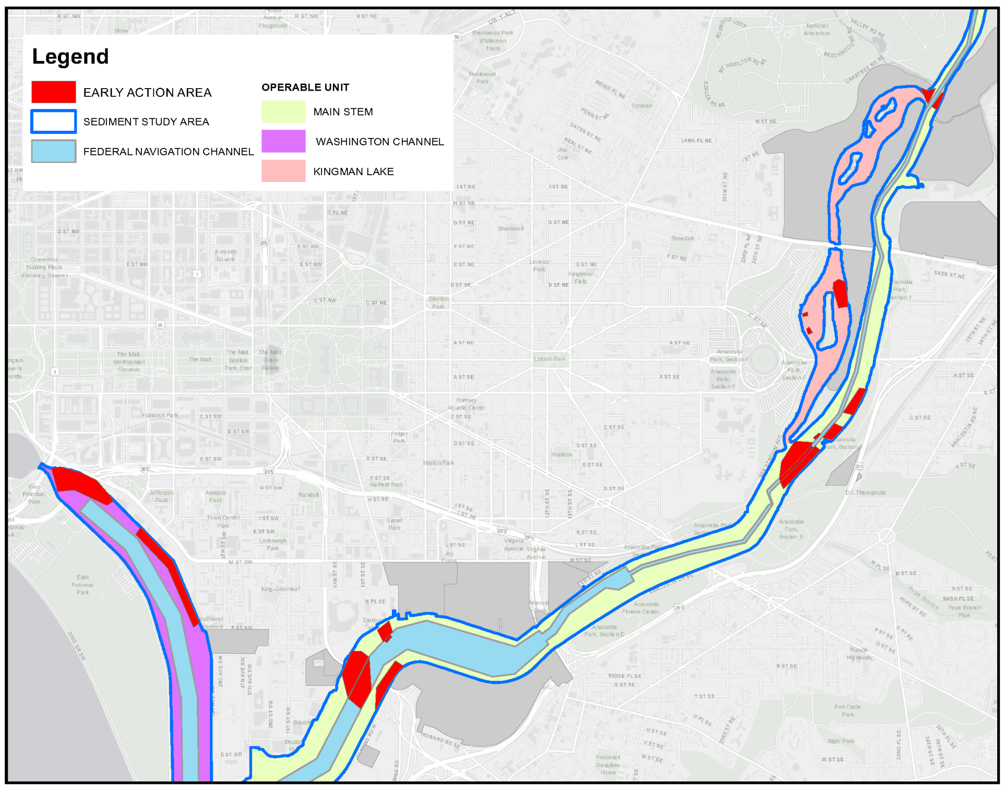
Early Action Area Locations
Delete all red areas
Inside this oval!!
7

Slide 8
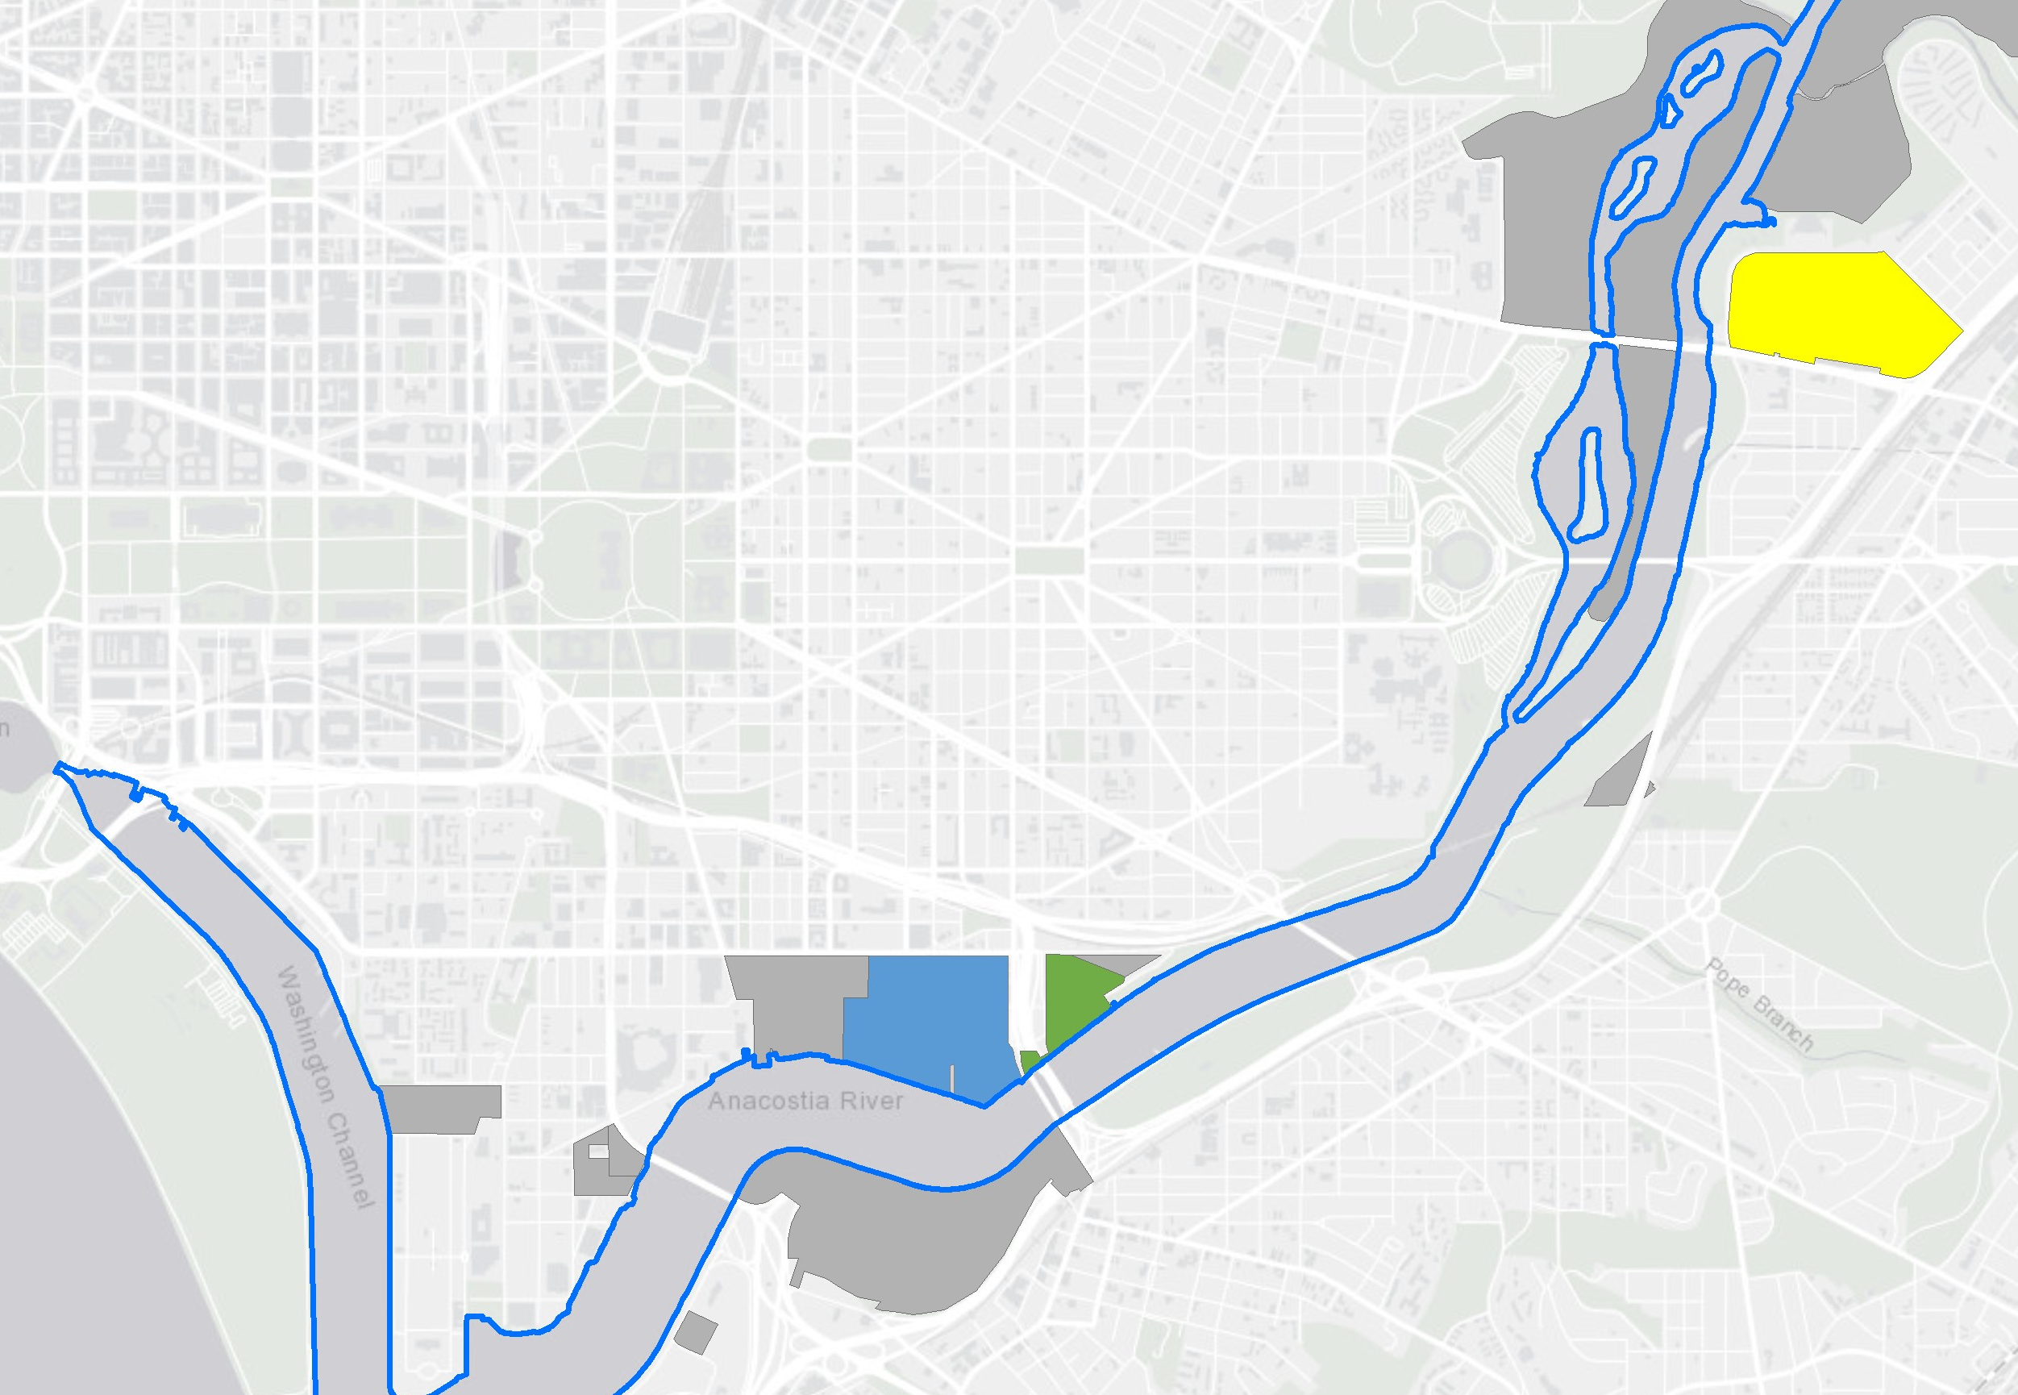
Active Potential Environmental Cleanup Sites (PECS)
Pepco
Washington Gas Light
Washington Navy Yard NPL Site
8

Slide 9
Implementation Process
Interim Record of Decision for EAAs:
Sample to confirm lateral extent of EAAs and design assumptions, such as depth considerations in Kingman Lake
Finalize design for each Operable Unit
Secure access areas near EAAs
Identify permitting requirements and obtain permits
Possible Implementation Schedule:
Kingman Lake 2021
Washington Channel
2022
Main Stem 2023
(possibly in conjunction with PECS remedies)

