Slide 1

OPEN MEETINGS ACT TRAINING FOR BOARDS OF TRUSTEES FOR DC PUBLIC CHARTER SCHOOLS
TRAINING SERIES II
Presented By: Joan Lelma
Attorney Advisor, OOG
September 9, 2026

Slide 2
Office of Open Government (OOG)
The Office of Open Government (OOG) and the Office of Government Ethics (OGE) are within the Board of Ethics and Government Accountability (BEGA). OOG enforces the Open Meetings Act (OMA), provides OMA advice and training to DC public bodies. OOG advocates for fair and efficient DC Freedom of Information Act (DC FOIA) processing.
OGE investigates alleged ethics laws violations by District government employees and public officials and provides binding ethics advice.
OOG began operations in April of 2013.
The Office of Open Government is led by Director Niquelle M. Allen, Esq.

Slide 3

Staff of OOG
Niquelle Allen, Director
Louis Neal, Chief Counsel;
Anthony J Scerbo, Attorney Advisor;
Brandon Lewis, Trial Attorney;
Joan Lelma, Attorney Advisor;
Kimberly Brown, Paralegal Specialist;
&
Kevin Brown, IT Specialist.

Slide 4
OOG’s Functions
Interprets the Open Meetings Act and monitors compliance of DC public bodies with the statute. The OMA requires that public bodies provide proper notice of, access to, and detailed records of their meetings;
Provides training and guidance on the Implementation of the D.C. Freedom of Information Act of 1976 (DC FOIA), which concerns transparency and the availability of public records.
The Office of Open Government advocates for government openness and transparency.

Slide 5
Functions of OOG Continue -
OOG provides guidance (incl.
formal Advisory Opinions) on
compliance with the OMA.
https://www.open-dc.gov/documents
OOG enforces the OMA on
basis of complaints from the
public or its own
investigations, and, as a last
resort, may sue public
bodies in the Superior Court
of DC for injunctive relief,
declaratory relief, and/or
civil fines.

Slide 6

The “PREAMBLE”
“The public policy of the District is
that all persons are entitled to full
and complete information
regarding the affairs of government
and the actions of those who
represent them.”
D.C. Official Code § 2–572 -
Statement of policy.
©Getty

Slide 7
Rules of Construction
“[The Open Meetings Act] shall be construed broadly to maximize public access to meetings. Exceptions shall be construed narrowly and shall permit closure of meetings only as authorized by this act.”
D.C. Official Code
§ 2–573. Rules of construction.

Slide 8
Public Bodies are Subject to the OMA
The following entities must adhere to the OMA →
Gov’t. Councils (incl. the Council of the District of Columbia);
Boards;
Local School Advisory Teams (LSAT);
Commission or similar entity;
Board of Directors of an instrumentality;
Board which supervises or controls an agency;
Advisory Boards that take official action by the vote of its members convened for such purpose; and
Boards of Trustees for Public Charter Schools

Slide 9
NOT PUBLIC BODIES
District Agency
Mayor’s Cabinet
Advisory Neighborhood Commissions (ANC)
District of Columbia Courts
Professional Staff OF Public Bodies (outside presence of a quorum)

Slide 10
What Constitutes a Meeting under the OMA?
A meeting is a gathering of a quorum of the members of a public body to consider, conduct, or advise on public business (D.C. Official Code § 2-574).
A quorum means a simple majority of the members of the public body are present. That is half of the members plus one. Quorum can be otherwise determined by Enabling Legislation, Mayor’s Order, Regulations, or the public body’s by-laws.
Notes:
Note that if a public body meets by chance, the members must not discuss public business.

Slide 11

Public Business Includes:
  Gathering information;
  Taking Testimony;
  Discussing;
  Deliberating;
  Recommending; or
  Voting
Shutterstock
Notes:
If a public body meets by chance, the members must not discuss public business.

Slide 12
What Constitutes an Open Meeting?
A Public Body’s meetings must be open to the public, unless the OMA permits closure.
A meeting is open if the following occurs (D.C. Official Code § 2–575(a)):
  The public is permitted to be physically present;
  The news media is permitted to be physically present;
  The meeting is televised;

Slide 13

FINAL OPEN MEETINGS LEGISLATIVE MEASURE:
OR “the public body takes steps reasonably calculated to allow the public to view or hear the meeting while the meeting is taking place, or, if doing so is not technologically feasible, as soon thereafter as reasonably practicable” (D.C. Official Code § 2–575(a)(4)).
B-26-0633 – the Open Meetings Clarification Temporary Amendment Act of 2026 has amended the OMA to include the above as one of the occurrences for when a meeting is deemed open to the public.
* The Temporary Bill passed on May 5, 2026, and was enacted as Act 26-361, as of July 14, 2026. The 30-day Congressional review has ended, and the Act is now D.C. Law 26-167, effective August 20, 2026.
Notes:
If a public body meets by chance, the members must not discuss public business.

Slide 14
Means of Gathering Under the OMA
Meeting may be held:
  in person;
  by telephone; or
  via video conference.
Notes:
If a public body meets by chance, the members must not discuss public business.

Slide 15
A MEETING IS NOT:
A Chance or Social Gathering Where No Public Business Is Discussed;
A Committee or Subcommittee Meeting of Less than Quorum of Full Body;
A Press Conference; or
An E-mail Exchange.
Notes:
Note that if a public body meets by chance, the members must not discuss public business.

Slide 16
Electronic Meetings
A Public Body Can Meet via Video Conference, Phone Conference, or Other Electronic Means IF:
Reasonable arrangements
are made to accommodate
the public’s right to attend;
ALL meetings are recorded;
and
ALL provisions of the OMA
are adhered to.

Slide 17

Notice of Meetings
D.C. Official Code § 2-576
A public body must provide advanced public notice before an open or closed session meeting.

Slide 18
OMA REQUIREMENTS:
What Notice is Required?
Notice must be given 48 Hours or 2 Business Days before the meeting (whichever is greater).
Notice must be physically posted in the school, office, or a place readily accessible to the public.
Notice must be posted on the Public Charter School’s website and the District of Columbia Government website (Central Meeting Calendar) at www.open-dc.gov.
Notice must include, Time, Date, Location, and Planned Agenda.
If there is a Closed Session, notice must include OMA Citation justifying the Closure and Description of the Matters to be Discussed.

Slide 19
Notice Requirements Continue:
The Boards of Trustees for DC PCS must timely post upcoming meetings and an annual schedule of meetings.
Note, Boards of Trustees of Public Charter Schools are not required to publish meeting notices in D.C. Register.

Slide 20
Contents of Agenda
The following statement MUST be included at the end of all Draft and Final Agendas:
“This meeting is governed by the Open Meetings Act. Please address any questions or complaints arising under this meeting to the Office of Open Government at open.govoffice@dc.gov.”
3 DCMR § 10409.2

Slide 21
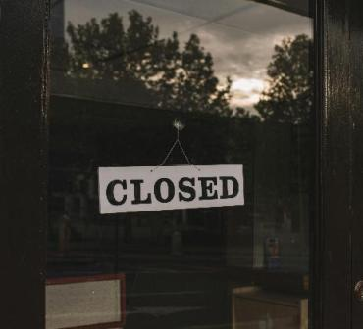
Closed/Executive Session
©Stock

Slide 22
CLOSED SESSIONS
CLOSED PORTIONS (EXECUTIVE SESSIONS)
of a MEETING MAY OCCUR PURSANT TO D.C. OFFICIAL CODE § 2-575(b)

Slide 23
Executive Session/Closed Session Justification
Court Order/Statute
Specific Negotiations – Contract, including employment contract
Attorney/Client Privilege, or to Approve Settlement Agreements
In Rosenhoffer v. Batavia (Case No. 2026-Ohio-3149) (Ohio Ct. App. Aug. 17, 2026), The Ohio Twelfth District Court of Appeals emphasized that the presence of an attorney does not automatically protect an entire executive session under the attorney-client privilege; the public body must establish that the particular communications satisfy the requirements of that privilege. This case is instructive for the District of Columbia.
Notes:
Explain each one in brief

Slide 24
Executive Session/Closed Session Justification Continues -
Trade Secrets
Preparation, administration, or grading of scholastic, licensing, or qualifying examinations
To discuss matters such as appointment, employment, and discipline of government appointees, employees, or officials, or of Public Charter School personnel, if the body is the Board of Trustees of a Public Charter School
To discuss matters involving personal identifiable information (such as official school records with date of births and grades) of students
Notes:
Explain each one in brief

Slide 25
Executive Session/Closed Session Justification Continues -
Concerning Boards of Trustees of a Public Charter School, to meet with an eligible chartering authority to be evaluated – mere presence of the authority is insufficient
Training members of a public body or staff
Specific Collective Bargaining Negotiations
Deliberation concerning an adjudication action
Public Safety – To protect the public from potential terrorist activity or substantial danger to public health and safety
To plan, discuss, or hear reports concerning … investigations of alleged criminal or civil misconduct or violations of laws or regulations – If disclosure would harm the investigation
Notes:
Explain each one in brief

Slide 26
INTENT - CLOSED SESSIONS
Notice must include a statement of intent to
close the meeting or any portion of the
meeting, including citations to the reason for
closure under § 2-575(b), and a description of
the matters to be discussed.
D.C. Official Code § 2-576(5)

Slide 27

PROTOCOL CLOSED/EXECUTIVE SESSION
OPEN
Establish Quorum & Open Public Meeting -
Conduct Business for Open Meeting
MOVE
Move to Enter Exec. Session with a Motion that includes the OMA Citation and the Subject to Justify Closure
TAKE
Video of How to Enter Executive Session - https://youtu.be/VChmtbbDAgE
Record Vote (by virtue of new legislative measure, each individual voting still self-identify), and—if Motion Passes—Enter Closed/Executive Session

Slide 28
Final Open Meetings Legislation
28
  The all votes are “recorded” (D.C. Official Code § 2–577(a)(3)) requirement does not mean the statute allows for votes at public body meetings to be stated in the meeting minutes or otherwise recorded as an aggregate. Each member must self-identify and state how he/she votes.
D.C. Law 26-167, effective August 20, 2026

Slide 29
PROTOCOL CLOSED/EXECUTIVE SESSION
On June 16, 2026, Director Allen adopted rules which amend Chapter 104 (Office of Open Government) to Title 3 (Elections and Ethics) of the District of Columbia Municipal Regulations (DCMR) by providing procedural requirements public bodies must follow to enter close sessions of meetings covered by the OMA. The rules became effective after publication of a Notice of Final Rulemaking in the D.C. Register on June 26, 2026.
The Notice of Final Rulemaking is accessible at the Office of Open Governments (OOG) website - https://www.open-dc.gov/documents/notice-final-rulemaking-chapter-104-office-open-government-0.
It is also accessible at https://www.dcregs.dc.gov/Common/NoticeDetail.aspx?NoticeId=N145700.

Slide 30
PROTOCOL CLOSED/EXECUTIVE SESSION
Chapter 4 Title 3 DCMR as amended includes § 10411.4(a), which requires that prior to entering closed session, the presiding Officer must “Publicly identify the specific statutory exemption [exception] authorizing closure; and Provide a general description of the specific subject matter to be discussed.”
“Merely reciting or tracking the statutory language of the exemption, without additional description of the specific matter to be discussed, shall not, by itself, satisfy the requirement to state the subjects to be discussed” 3 DCMR § 10411.4(c)
Notes:
Explain each one in brief

Slide 31
PROTOCOL CLOSED/EXECUTIVE
SESSION
DISCUSS
Only Discuss Matters Listed Under D.C. Official Code § 2-575(b) for Which the Presiding Officer Gave the Public Notice Prior to Closure.
See Title 3 DCMR Subsection 10400.6 of Section 10400 as amended, includes § 10411.5.

Slide 32
PROTOCOL CLOSED/EXECUTIVE
SESSION
RECORD
Record the Executive Session (separately from Open session)
RE-OPEN
Re-Open Public Session and, Where Appropriate, Report Publicly any Official Action taken in Closure, and Adjourn

Slide 33
EMERGENCY MEETINGS
“When an emergency meeting is convened, the presiding officer shall open the meeting with a statement explaining the subject of the meeting, the nature of the emergency, and how public notice was provided” (D.C. Official Code § 2-576(4).

Slide 34

Recording Requirements
D.C. Official Code § 2–578
ALL Meetings Shall Be Recorded!
  Open AND Closed Sessions
  ONLY Where a Recording is Not Feasible, Detailed Meeting Minutes Shall Be Taken
© iStock

Slide 35
Publication Requirements
D.C. OFFICIAL CODE § 2-578
How to Handle Your Meeting Records

Slide 36

Publication Requirements
DRAFT DETAILED MEETING MINUTES MUST BE PUBLICLY AVAILABLE NO LATER THAN THIRTY (30) BUSINESS DAYS AFTER THE MEETNG; A NOTATION MUST BE INCLUDED AT THE TOP OF THE DOCUMENT THAT DETAILED MEETING MINUTES WILL BE POSTED TO THE WEBSITE ON THE NEXT MEETING DATE.
AUDIO RECORDINGS, VIDEO RECORDINGS, AND TRANSCRIPTS (COPY OF THE FULL RECORD) MUST BE AVAILABLE NO LATER THAN SEVEN (7) BUSINESS DAYS AFTER THE MEETING.
* Ensure there are no copyright restrictions in posting minutes publicly.
©Dreamtime

Slide 37
Contents of Meeting Minutes (DCMR § 10409.6)
“Detailed meeting minutes shall contain . . . :
(a) The date, time, and place of the meeting or session;
(b) The names of members of the Public Body recorded as either present or absent; and
(c) Any motions, and amendments thereto, a record of all votes taken, and general description of all matters considered…”

Slide 38
Record Preservation
3 DCMR § 10409.8 requires compliance with District record preservation law and the District of Columbia General Records Schedules (DGRS) concerning the disposition of its electronic meeting recordings and written meeting minutes.
D.C. Official Code § 2-578(a) requires preservation of all meeting recordings for a minimum of 5 years.

Slide 39
CANCELLATIONS
A meeting cancellation is a change in schedule.
In most instances, cancellation requires as much notice to the public as possible, But Not Less Than 48 Hours or 2 Business Days, whichever is greater, before the meeting occurs.
To establish a record, the meeting notice to the public, must state “Cancelled.”

Slide 40
PUBLIC COMMENT
No public comment period is required by the OMA or its regulations.
Your enabling legislation may require you to provide a time for public comment.
Your bylaws may also allow public comment, or you may have a standing order permitting public comment.

Slide 41
PARLIAMENTARY PROCEDURE
The Office of Open Government provides access to the Robert’s Rules of Order training portal.
The link to the trainings presented by Susan Leahy, MA. CSP, Founder of Robert’s Rules Made Simple is as follows: https://forms.gle/dbMmroGvfM8YiuJ38.
There is a Google form to be filled out to gain access to the trainings.
You can also access the portal by using the following QR Code →

Slide 42
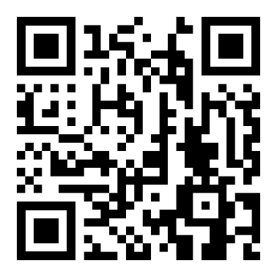

PARLIAMENTARY PROCEDURE Continues – QR Code

Slide 43


COMPLAINTS AND ENFORCEMENT

Slide 44

COMPLAINTS
An aggrieved party, including anonymous parties, may complain to OOG for relief.
May be prospective or may refer to past meetings.
Except for allegations of imminent prospective violations, a public body gets 30 days to respond (with possible extension of up to 5 business days).
The Director may seek to resolve dispute through conciliation; dismiss the complaint; release an Advisory Opinion; or take any other steps permitted by the OMA and its regulations.

Slide 45
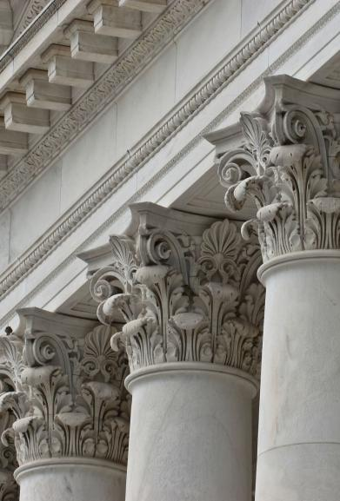
ENFORCEMENT
The OOG may bring a lawsuit in the Superior Court of the District of Columbia for injunctive and/or declaratory relief for any violations of the OMA BEFORE or AFTER the meeting takes place (D.C. Official Code § 2-579).
The court may order an appropriate remedy, such as requiring additional forms of notice, postponing a meeting, or a fine of up to $500 per violation.

Slide 46

TEST YOUR KNOWLEDGE
©iStock

Slide 47
Question
How many members of a Public Charter School Board are required to form a quorum if the Board has five members?

Slide 48
Answer
Three members are required to form a quorum of a five-member Board, in the absence of Enabling Legislation, Mayor’s Order, Regulations, or the Board’s by-laws to the contrary.
Whenever, the number of members of a public body is an odd number, quorum can be determined by dividing the number of members (5) by two (5/2 = 2.5), and round the number to the next whole value (3).

Slide 49
Question
Does the OMA permit a public body to conduct public business via email?

Slide 50
Answer
No, the OMA specifically prohibits a public body from conducting public business by email.
D.C. Official Code § 2-577(c) states as follows: “[e]-mail exchanges between members of a public body shall not constitute an electronic meeting.”

Slide 51
QUESTION
The Board of Trustees of a Public Charter School has decided to reschedule a meeting of the Board. The first intended meeting was posted in the office of the Public Charter School, on its website, and on Central Meeting Calendar (CMC)? Is it sufficient for the Board to post the notice of the rescheduled meeting on its website alone?

Slide 52
Answer
No, notice of the rescheduled meeting must be provided in the same manner notice was given for the cancelled or initial meeting.
D.C. Official Code § 2–576(1) – “Notice shall be provided when meetings are scheduled and when the schedule is changed.”
Notice of the rescheduled meeting must be provided in a location readily accessible to the public, such as the office of the Public Charter School, on the School’s website, and Central Meeting Calendar. In addition, the annual schedule must be amended to reflect the rescheduled meeting.

Slide 53
QUESTION
The Board of Trustees of a Public Charter School rescheduled its meeting.
Should the Board delete the previous meeting notices or print cancelled across all the notices?

Slide 54
Answer
The Board must print cancelled across all the meeting notices. The Board must not delete the meeting notices.

Slide 55
Question
There are thirteen members of a Public Charter School Board that commenced its meeting with eight members. Thirty minutes into the meeting Mr. Green left the meeting. Ms. Black left fifteen minutes after Mr. Green and the meeting continued with six members.
Has the Board violated the OMA by continuing the meeting after Mr. Green and Ms. Black left the meeting?

Slide 56
Answer
The Charter School Board did not violate the OMA after Mr. Green left the meeting because the Board maintained quorum. Thirteen members – (13/2) 6.5 rounded to the nearest whole number is 7 (quorum).
However, the Board violated the OMA after Ms. Black left and the Board continued the meeting with six members because it was below quorum of seven members.
D.C. Official Code § 2-574(1)(A)

Slide 57
ACCESS TO HELPFUL RESOURCES
OOG’s website – www.open-dc.gov
OMA Compliance Checklist
https://www.open-dc.gov/documents/oma-compliance-checklist
D.C. Official Code - https://code.dccouncil.gov/us/dc/council/code/titles/2/chapters/5/subchapters/IV
D.C. Municipal Regulations - https://dcregs.dc.gov/Common/DCMR/RuleList.aspx?ChapterNum=3-104

Slide 58
Contact Information
OOG, open.govoffice@dc.gov, (202) 481-3411
Niquelle M. Allen, Dir. of Open Govt., niquelle.allen@dc.gov
Louis L. Neal, Jr., Chief Counsel, louis.neal@dc.gov
Anthony J. Scerbo, Attorney Advisor, anthony.scerbo1@dc.gov
Brandon W. Lewis, Trial Attorney, brandon.lewis@dc.gov
Joan Lelma, Attorney Advisor, joan.lelma@dc.gov
Kimberly Brown, Paralegal Specialist, kimberly.brown6@dc.gov
Kevin Brown, IT Specialist, kevin.brown@dc.gov

Slide 59
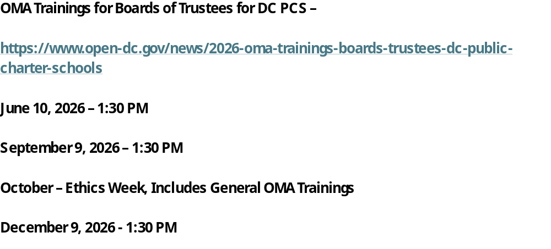
Upcoming Training

Slide 60
Upcoming Training
Ethics Week 2026
October 13-16, 2026 (15th - OOG Trainings)
Schedule and Access Info:
https://bega.dc.gov/event/begas-2026-ethics-week

Slide 61

©Fotolia

