Slide 1
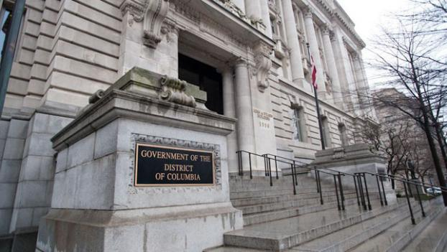
OPEN MEETINGS ACT TRAINING
For Public Bodies & points of contact

Slide 2

OPEN MEETINGS ACT (OMA)
D.C. OFFICIAL CODE
§§ 2-571 to 2-580

Slide 3

OOG Mission
“To ensure that government operations at every level are transparent, open to the public, and promote civic engagement.”

Slide 4
OPEN MEETINGS
WHAT IS A MEETING?
  Gathering of a Quorum of the Members of a Public Body;
  The Members of the Public Body Consider, Conduct, or Advise on Public Business;
    Public Business includes: Gathering Information; Taking Testimony; Discussing; Deliberating; Recommending; and Voting;
  Gathering May Be Held: In Person; By Telephone Conference; Video Conference; or By Other Electronic Means of Communication.

Slide 5
OPEN MEETINGS
A MEETING IS NOT:
  A Chance or Social Gathering Where No Business is Discussed; or
  A Press Conference.
NOTE: If There is NO QUORUM Then The Public Body Cannot Conduct a Meeting.

Slide 6
OPEN MEETINGS
A Public Body’s Meeting Must Be Open to the Public, Unless the OMA Permits Closure.
A Meeting is Open if:
    Public is Permitted to be Physically Present.
    News Media is Permitted to be Physically Present.
    Meeting is Televised.

Slide 7
NOT MEETINGS
E-MAIL EXCHANGES BETWEEN MEMBERS OF A PUBLIC BODY
SUBCOMMITTEE MEETINGS

Slide 8
DEFINITION OF PUBLIC BODIES SUBJECT TO THE OMA
Government Council (including the DC Council)
Board, Commission, or Similar Entity
Board that Supervises, or Controls, an Agency
Advisory Board that Takes Official Action by the Vote of its Members Convened for Such Purpose

Slide 9
EXCLUDED FROM THE OMA
Courts
Governing Bodies Of Public Charter Schools
Mayor’s Cabinet
Professional or Administrative Staff of Public Bodies When Gathered Outside the Presence of a Quorum
Advisory Neighborhood Commissions

Slide 10

Notice

Slide 11
NOTICE REQUIREMENTS
As early as possible, but notice must be given 48 Hours or 2 Business Days before each Meeting, whichever is greater . . .
Notice must be physically posted in the office of the public body or a place readily accessible to the public, AND
Notice must be posted on
the website of the Public Body or the District of Columbia.
Upcoming meetings and an Annual Schedule of Meetings in the DC Register.
Notes:
Public bodies should provide as much notice as possible under the OMA. This will ensure sufficient time to correct a defective notice and not preclude from occurring.

Slide 12
NOTICE REQUIREMENTS
Notice must include:
  Time
  Date
  Location
  and Proposed Agenda.
If there will be a Closed Session, notice must include the OMA Citation and state the reason justifying the Closure.
Notes:
Public bodies should provide as much notice as possible under the OMA. This will ensure sufficient time to correct a defective notice and not preclude from occurring.

Slide 13
NOTICE REQUIREMENTS
The following statement MUST be included at the end of all Meeting Agendas:
“This meeting is governed by the Open Meetings Act. Please address any questions or complaints arising under this meeting to the Office of Open Government at opengovoffice@dc.gov.
Notes:
Public bodies should provide as much notice as possible under the OMA. This will ensure sufficient time to correct a defective notice and not preclude from occurring.

Slide 14
NOTICE REQUIREMENTS
OMA Justification for Closed Meeting
Court Order / Statute
Negotiations
Attorney / Client Privilege
Trade Secrets
Testing/ Grading
Personnel
Training
Collective bargaining negotiations
Administering, preparing or grading tests
Deliberations
Public safety
Investigations

Slide 15
PROTOCOL FOR CLOSED/EXECUTIVE SESSION
Open the Public Meeting and Establish a Quorum
Move to Enter into Executive Session / Second (Motion Must incl. Reference to OMA Citation, to Justify Closed/Executive Session)
Take Roll Call Vote – and if Motion Passes - Enter into Closed/Executive Session
(more…)
Notes:
When resuming the open session the public if appropriate is to put on the record any official action taken during the closure.

Slide 16
PROTOCOL FOR CLOSED SESSION
Only Discuss the Matter(s) referenced in the Draft Agenda
Record what is discussed in Executive Session
Re-Open the Public Meeting, when appropriate report publicly any official action taken in closure and Adjourn
Notes:
When resuming the open session the public if appropriate is to put on the record any official action taken during the closure.

Slide 17
RECORDING REQUIREMENTS
AUDIO RECORDING
VIDEO RECORDING
TRANSCRIPT – confer with Vendor to ensure no copyright restrictions with posting minutes publicly
DETAILED MEETING MINUTES
Notes:
The OOG has opined that it is feasible to record meetings by electronic means.

Slide 18
PUBLICATION REQUIREMENTS
AS OPINED BY THE OOG, DRAFT DETAILED MEETING MINUTES MUST BE PUBLICLY AVAILABLE NO LATER THAN THREE (3) BUSINESS DAYS AFTER THE MEETING.
AUDIO RECORDINGS, VIDEO RECORDINGS, AND TRANSCRIPTS (COPY OF THE FULL RECORD) MUST BE AVAILABLE NO LATER THAN SEVEN (7) BUSINESS DAYS AFTER THE MEETING.

Slide 19
RECORD MAINTENANCE
3 DCMR § 10409.8 requires compliance with District record preservation law and the District of Columbia General Records Schedules (DGRS) concerning the disposition of its electronic meeting recordings and written meeting minutes.
D.C. OFFICIAL CODE § 2-578(a) Requires preservation of all meeting records for a minimum of 5 years.
Notes:
The OOG has opined that it is feasible to record meetings by electronic means.

Slide 20

OTHER REQUIREMENTS

Slide 21
Does the Public Have a Right to Comment?
Only if the public body’s enabling legislation mandates a period for public comment.
However, a public body may allow public comment absent a statutory requirement to do so.
A public body has the right to regulate the time allotted and duration of public comments if they choose to allow them, unless the requirement is already spelled out in enabling legislation or by-laws.

Slide 22
Parliamentary Procedure
A Public Body may conduct public meetings using the latest edition of Robert’s Rules of Order
The Director of Open Government may provide advice and training on parliamentary procedure.

Slide 23
How Do We Cancel ?
A Meeting Cancelation is a Change in Schedule.
In Most Instances, Requires as Much Notice to the Public as Possible, But Not Less Than 48 Hours or 2 Business Days, Whichever is Greater, Before Meeting was to Occur.
To Establish a Record the Meeting Notice to the Public Must State “Cancelled.”

Slide 24
Can We Hold an Electronic Meeting?
A Public Body Can Meet via Video, Electronic, Conference, or Other Electronic Means If:
Reasonable Arrangements Made to Accommodate Public’s Right to Attend;
Meeting are Recorded;
All Votes are Taken by Roll Call; an
All Provisions of the OMA are Adhered To
Notes:
The public body must adhere to all other provisions of the OMA when conducting electronic meetings.

Slide 25
Can We Hold an Emergency Meeting?
Yes, a Public Body may meet in case of an emergency. Presiding officer must:
Notice Must Be Given to the Public at the Same Time it is Given to the Members;
Open the Meeting with a Statement Explaining the Subject of the Meeting;
Explain the Nature of the Emergency; and
Explain How Public Notice was Provided.

Slide 26
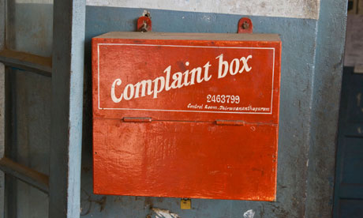
COMPLAINT PROCESS

Slide 27
COMPLAINTS
An aggrieved party, including anonymous parties. may complain to the Office of Open Government for relief if a meeting may have been conducted in violation of the OMA.
May refer to past meetings.
Submitted in writing in person; online; mail; or email.
14 business days to resolve a complaint (additional info; dismissal; binding opinion; or conciliation).

Slide 28
APPEALS FOR OMA ADVICE
OR OPINIONS
An aggrieved party may appeal to the Board of Ethics and Government Accountability (BEGA) for reconsideration of an OMA opinion issued by the OOG Director:
In response to a public official’s or employee’s request for advice; or
That is ‘sua sponte’ (without outside prompting).

Slide 29


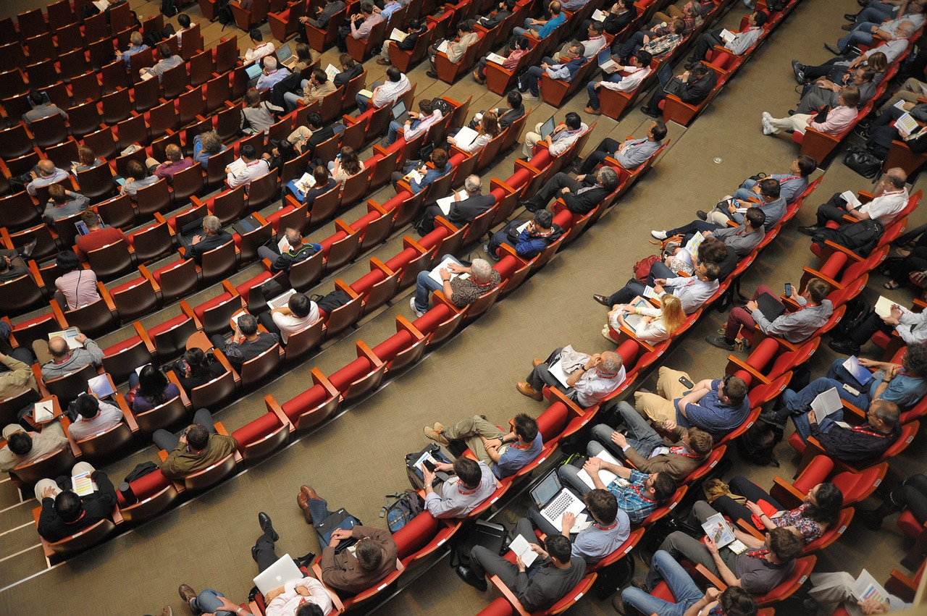
OPEN MEETINGS ACT SUMMARY

Slide 30
Questions & Contact
OMA Questions? Contact OOG:
Director | Attorney Advisor | Computer Systems Analyst
Niquelle Allen | Johnnie Barton | Tiffany Montgomery
niquelle.allen @dc.gov | johnnie.barton2 @dc.gov | tiffany.montgomery @dc.gov
202-481-3406 | 202-741-5373 | 202-741-0627

Slide 31
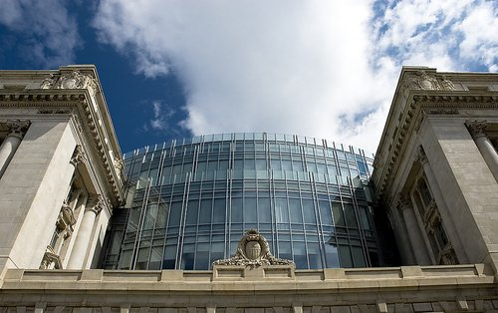
THANK YOU !

Slide 32
Image Credits
1 Wilson Building – brodylevesque ♦ 2 Analyzing – pixabay ♦ 3 Files – myrfa/pixabay ♦ 4 Open Doors Exit – mcmurryjulie/pixabay ♦ 5 Ideas – pexels ♦ 6 Bubbles – pexels ♦ 7 Board – pexels ♦ 15, 16,20,23 Calendar/Gavel/Mic – pexels ♦ 26 Conference – pixabay ♦ 33 Complaint – theguardian ♦ 36, 37, 38 OOG website ♦ 39 ODAI website ♦ 40 Board/Study/Meeting – pexels ♦ 45 DC gov - glassdoor

