Slide 1


BASIC TRAINING FOR BEGINNERS freedom of information act of 1976 ("DC Foia")

Slide 2
D.C. Official Code §§ 2-531 – 2-540
§ 2–531. Public policy.
§ 2–532. Right of access to public records; allowable costs; time limits.
§ 2–533. Letters of denial.
§ 2–534. Exemptions from disclosure.
§ 2–535. Recording of final votes.
§ 2–536. Information which must be made public.
§ 2–537. Administrative appeals.
§ 2–538. Oversight of disclosure activities.
§ 2–539. Definitions.
§ 2–540. Short title.

Slide 3
Additional sources for interpreting DC FOIA and processing requests
DC FOIA REGULATIONS 1 DCMR § 400 et seq. - DCRegs
An Independent agency’s DC FOIA regulations
Mayor’s Office of Legal Counsel Advisory Opinions (“MOLC”) Freedom of Information Act (FOIA) - Appeals | DC
case law- including federal when the statutory provision in DC FOIA is also in federal foia. Although not binding it is instructive. See District of Columbia v. Fraternal Order of Police Metro. Police Labor Comm., 33 A.3d 332, 342 n.8 (D.C. 2011).

Slide 4
Additional sources for interpreting DC FOIA and processing requests
Department of Justice Guidance https://www.justice.gov/oip/doj-guide-freedom-information-act-0
OOG FOIA Advisory Opinions FOIA Advisory Opinions | Open DC (open-dc.gov)
Agency Program Manuals PM 1300.1I Freedom of Information Act (FOIA) 04232019.pdf (dc.gov)
Office of Government Information Services (“OGIS”) The Office of Government Information Services (OGIS) | National Archives

Slide 5

What are records under DC FOIA ?

Slide 6
Proactive disclosure
AVAILABLE without a FOIA request
Records that must be available to the public without the need of a FOIA request include:
Employee’s salary, title and employment dates;
Contracts expenditures;
Budgets;
Manuals;
Policies;
Rules;
Opinions;
Orders; and
Meeting minutes of open proceedings of public bodies.
See (D.C. Official Code § 2-536)

Slide 7
Public records include:
“public record” includes all books, papers, maps, photographs, cards, tapes, recordings, vote data (including ballot-definition material, raw data, and ballot images), or other documentary materials, regardless of physical form or characteristics prepared, owned, used, in the possession of, or retained by a public body. Public records include information stored in an electronic format.
See D.C. Official Code §§2-539(10); 2-502(18); 2-1701(13).

Slide 8

“I’ll text you that information.” is the text a public record?
NICK tells A fellow employee:
“I’m looking for my government issued cell phone and will text those government statistics the office has compiled to your government cell phone.”

Slide 9

Are text messages public records?
A. No, text messages are not public records.
B. No, if its between government employees, its private.
C. It is up to each agency director to decide if they want agency text messages to be records.
D. Yes, they meet the definition of public record.

Slide 10
D. Yes; they meet the definition of public record.
In a March 16, 2022, advisory opinion, The director of Open government opined that A district government employee that conducts government business via a text or similar electronic method under the scope of employment, creates a public record under DC FOIA.
https://www.open-dc.gov/sites/default/files/FOIA%20Advisory%20Opinion_Text%20Messages_OOG%202022-001_03162022.pdf

Slide 11


What if we store agency records on a personal server and email account at the agency director’s home or offsite?

Slide 12
The CHOICES are:
A. They are Still agency records subject to foia. b. They are not maintained by the government and therefore not public records.
C. They are not government records and lose their character once on the private server or stored offsite.

Slide 13


‘A’ is the correct response. They are public records, subject to foia.

Slide 14

Back to the definition of “public record”
The term “public record” applies where the content is “prepared” or “used” by a public body; the means of storage is immaterial. Government personnel cannot evade DC FOIA simply by preparing records on media they happen to own.

Slide 15
Competitive Enter. Inst. V. Office of Sci. & Tech. Policy, 827 F.3d 145, 146
HOLDINGS: [1]-Where an agency refused to provide requested records on the basis that the agency head maintained them on a private e-mail account in his name at a site other than the government e-mail site which the agency had searched, the requestor's FOIA compliance action was erroneously dismissed because an agency could not shield its records under FOIA by the expedient of storing them in a private e-mail account controlled by the agency head; [2]-If the agency head controlled what would otherwise be an agency record, then it was still an agency record and still must be searched or produced; [3]-It was not apparent that the domain where an e-mail account was maintained controlled the e-mails therein to the exclusion of the user; [4]-The agency's claim was inconsistent with the purpose of FOIA, which was to serve the citizens' right to be informed about their government.
Competitive Enter. Inst. v. Office of Sci. & Tech. Policy, 827 F.3d 145, 146

Slide 16
D.C. Official Code
§ 2-532(a)
ANY person has a right to inspect, and at his or her discretion, to copy ANY public record of a public body except as expressly provided by the FOIA exemptions.

Slide 17

Who is “any person” that may submit a DC foia request?
(D.C. Official Code § 2-532(a))
.

Slide 18

Does “Any person” refer to:
A. any district of Columbia resident.
B. Any Natural person.
C. A person, natural or corporate, Regardless of their residency or location.

Slide 19

The correct response is ‘C.’
While you must be a Virginia resident to submit a FOIA request for its (VIRGINIA’S) records, Under DC FOIA “any person” includes non-residents and corporate entities.
See D.C. Official Code
§§2-539(8); 2-502(9)

Slide 20

Does “any person” include anonymous requesters ?

Slide 21
Anonymous foia request
From: NOWAY2_TELL_WHO_I_AMHAHA@GMAIL.COM
To: FOIA
Date: 1/26/2024
Subject: DC FOIA Request
DEAR FOIA OFFICER, I AM REQUESTING COPIES OF ALL RECORDS YOU HAVE THAT MENTION “RAY’S BOOM BOOM ROOM NIGHTCLUB.” I AM WILLING TO PAY UP TO $100 FOR THESE RECORDS. THE RECORDS MAY BE SENT TO ME OR ANY CORRESPONDENCE REGARDING THIS REQUEST AT MY EMAIL ADDRESS, NOWAY2_TELL_WHO_I_AMHAHA@GMAIL.COM.
THANK YOU AND HAVE A WONDERFUL DAY!

Slide 22
WHAT WOULD YOU DO?
(A) EMAIL THE REQUSTER AND ASK FOR THEIR NAME, TELEPHONE NUMBER AND MAILING ADDRESS.
(B) DELETE IT FROM YOUR INBOX AS TRASH.
(C) SEND IT TO YOUR SUBORDINATE TO HANDLE IF YOU ARE A SUPERVISOR, OR TO YOUR SUPERVISOR IF YOU’RE A SUBORDINATE AND REQUEST THEY HANDLE IT.
(D) PROCESS THE REQUEST WITH THE EMAIL ADDRESS YOU HAVE.

Slide 23

‘D’ IS CORRECT
1 DCMR § 402.3, does not require that the requester identify him or herself. In relevant part, this provision states, “[a] request shall include a daytime telephone number, e-mail address or mailing address for the requester.” See FOIA Appeal 2017-90R. The exceptions are when an individual requests records pertaining to himself/herself and, therefore, possesses the ability to waive his/her own privacy interests, or when a requester seeks a fee waiver based on affiliation with educational, news media, or other entities.

Slide 24

We work with private contractors. Do “any records” include private contractors’ records?

Slide 25
The Choices are:
A. DC FOIA doesn’t reach these records.
B. Yes, if the contractors are performing a government function.
C. DC FOIA doesn’t address this issue.
D. Yes, But only if the contractors don’t mind sharing the records.

Slide 26
‘B’ is the correct response
“A public body shall make available for inspection and copying any record produced or collected pursuant to a contract with a private contractor to perform a public function, and the public body with programmatic responsibility for the contractor shall be responsible for making such records available to the same extent as if the record were maintained by the public body.”
D.C. Official Code § 2-532(a-3).

Slide 27

RESPONDING TO A FOIA REQUEST
For records, other than body-worn camera recordings, an agency must respond within 15 business days.
See D.C. Official Code § 2-532(c)(1).
For body-worn camera recordings an agency must respond within 25 business days.
See D.C. Official Code § 2- 532(c)(2)(A).

Slide 28
RESPONDING TO A FOIA REQUEST
In unusual circumstances, the agency may invoke an additional 10-day extension by written notice to the requester setting forth the reasons for extension and expected date for the determination See D.C. Official Code § 2- 532(d)(1).
D.C. Official Code § 2-532(e) provides that failure to timely respond to a FOIA request is deemed a denial of the Request.

Slide 29

What are Unusual circumstances?

Slide 30
What are Unusual circumstances?
The FOIA officer believes the request for the review of 20 emails, given other non-foia responsibilities and the FOIA assistant on leave, to be unusual circumstance and invokes the extension.
A. Sounds unusual and I think its alright.
B. DC FOIA states what are unusual circumstances.
C. DC FOIA does not provide guidance on the issue. This is decided by the agency guidelines.

Slide 31
‘B’ is correct.
B. DC FOIA states what are unusual circumstances.
D.C. Official Code § 2-532(d)(2)
Unusual circumstances are defined as:
  The need to search for, collect, and appropriately examine a voluminous amount of separate and distinct records that are demanded in a single request;
  The need for consultation, which shall be conducted with all practicable speed, with another public body having a substantial interest in the determination of the request or among 2 or more components of a public body having substantial subject-matter interest therein, or;
  For body-worn camera recordings, the inability to procure a vendor that is able to perform the redactions within the 25-day time period provided under subsection (c)(2) of this section.

Slide 32

communication may result in cooperation!

Slide 33

The court’s take on communication and cooperation
In a 2016 decision the court stated:
“FOIA requester and the District entity receiving a request are not—or should not be—in an inherently adversarial relationship. Litigation is authorized as an enforcement mechanism, but it is not meant to be the inevitable path. Each case has presented its own discrete issues, but the constant is an apparent inability or unwillingness by both parties to communicate effectively to achieve the objectives animating FOIA. Both parties seem to have forgotten what FOIA is all about.”
FOP v. District of Columbia, 139 A.3d 853 (2016).

Slide 34

“I NEED IT YESTERDAY!” requests to EXPEDITE PROCESSING FOIA requests
YOU RECEIVE A DC FOIA REQUEST SEEKING EXPEDITED PROCESSING. THE REQUEST STATES and DEMONSTRATES A “COMPELLING NEED” AS PER 5 USC §552(a)(6)(E)(i)(I), (II) - FEDERAL FOIA’s EXPEDITED REVIEW PROVISION.

Slide 35

YOU may:
(a) ignore the request completely;
(B) Process the request under normal FOIA time frames and explain there is no expedited review under District law; or
(c) expedite the request and respond to the requester prior to the 15- calendar Day period and any lawful extension;

Slide 36

‘B’ Is The correct response. process the request under normal FOIA time frames and explain there is no expedited review under District law.
While there is a provision to expedite Federal FOIA requests, there is no such provision in DC FOIA.

Slide 37
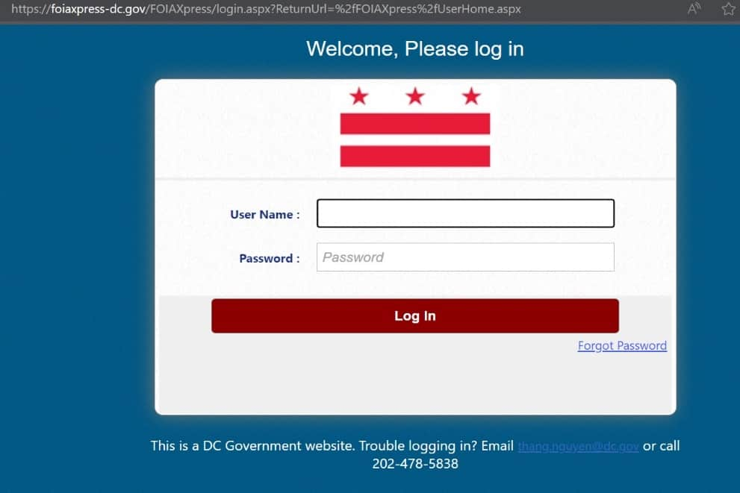
Agency website reads “Please use the Portal for submitting all foia requests. it’s the quickest method to get a response!”
The FOIA Portal may be the simplest and best means to submit and process FOIA requests, But may an agency require the public to submit through the portal?

Slide 38
The Choices are:
A. Yes, because FOIA’s public Policy is to minimize costs and time delays to persons requesting information
(D.C. Official Code § 2-531).
B. Yes, Because of the ease of use of the portal.
C. No, an agency may not restrict the method a requester uses to submit a FOIA request.

Slide 39
‘C’ is the correct response. an agency may not restrict the method a requester uses to submit a FOIA request.
1 DCMR § 402.1, “A request for a record of an agency may be made orally. . . .”
1 DCMR § 402.3, “…. requests “may be mailed, faxed or emailed.”
Email, faxes, and mail requests must state “foia request” on the subject line or envelope.
(FOR SUBMISSIONS TO OAG)
1 DCMR § 1302.1 Unless agreed to in advance and confirmed in writing by the Office’s Freedom of Information Act Officer, or the Chief Deputy Attorney General in the absence of a designated Freedom of Information Act Officer, a request for a record shall be made in writing.

Slide 40

Categories of exemptions
D.C. official Code § 2-534
(1) TRADE SECRETS AND COMMERCIAL OR FINANCIAL INFORMATION OBTAINED FROM OUTSIDE THE GOVERNMENT, TO THE EXTENT THAT DISCLOSURE WOULD RESULT IN SUBSTANTIAL HARM TO THE COMPETITIVE POSITION OF THE PERSON FROM WHOM THE INFORMATION WAS OBTAINED.
(2) PERSONAL PRIVACY: INFORMATION OF A PERSONAL NATURE WHERE THE PUBLIC DISCLOSURE THEREOF WOULD CONSTITUTE A CLEARLY UNWARRANTED INVASION OF PERSONAL PRIVACY
(2A) ANY BODY-WORN CAMERA RECORDINGS RECORDED BY THE METROPOLITAN POLICE DEPARTMENT:
  (A) INSIDE A PERSONAL RESIDENCE; OR
  (B) RELATED TO AN INCIDENT INVOLVING DOMESTIC VIOLENCE, STALKING OR SEXUAL ASSAULT AS DEFINED BY THE D.C. CODE.

Slide 41
(3) INVESTIGATORY RECORDS COMPILED FOR LAW ENFORCEMENT PURPOSES INCLUDING RECORDS OF COUNCIL INVESTIGATIONS AND INVESTIGATIONS CONDUCTED BY THE OFFICE OF POLICE COMPLAINTS.
BUT ONLY TO THE EXTENT THAT THE PRODUCTIONS OF SUCH RECORDS WOULD INTERFERE WITH:
• (I) ENFORCEMENT PROCEEDINGS;
• (II) COUNCIL INVESTIGATIONS; OR
• (III) OFFICE OF POLICE COMPLAINTS ONGOING INVESTIGATIONS
• DEPRIVE A PERSON OF A RIGHT TO A FAIR TRIAL OR AN IMPARTIAL ADJUDICATION, CONSTITUTE AN UNWARRANTED INVASION OF PERSONAL PRIVACY;
• DISCLOSE THE IDENTITY OF A CONFIDENTIAL SOURCE AND, IN THE CASE OF A RECORD COMPILED BY A LAW-ENFORCEMENT AUTHORITY IN THE COURSE OF A CRIMINAL INVESTIGATION, OR BY AN AGENCY CONDUCTING A LAWFUL NATIONAL SECURITY INTELLIGENCE INVESTIGATION, CONFIDENTIAL INFORMATION FURNISHED ONLY BY THE CONFIDENTIAL SOURCE;
DISCLOSE INVESTIGATIVE TECHNIQUES AND PROCEDURES NOT GENERALLY KNOWN OUTSIDE THE GOVERNMENT; OR ENDANGER THE LIFE OR PHYSICAL SAFETY OF LAW-ENFORCEMENT PERSONNEL.

Slide 42
EXEMPTION 4 COMMON LAW DISCOVERY PRIVILEGES
ATTORNEY WORK PRODUCT. APPLIES TO DOCUMENTS PREPARED BY OR FOR AN ATTORNEY IN ANTICIPATION OF LITIGATION, NO MATTER THE STATUS OR STAGE OF THE LITIGATION; ATTORNEY CLIENT PRIVILEGE PROTECTS CONFIDENTIAL COMMUNICATIONS BETWEEN AGENCY AND ATTORNEY.
DELIBERATIVE PROCESS
THE METHOD THROUGH WHICH AN AGENCY CREATES POLICIES, OPINIONS, RULES AND REGULATIONS.
TO QUALIFY FOR THIS EXEMPTION, THE RECORD MUST BE BOTH PRE-DECISIONAL AND DELIBERATIVE. PRE-DECISIONAL DOCUMENTS ARE THOSE "GENERATED BEFORE THE ADOPTION OF AN AGENCY POLICY. A DOCUMENT IS DELIBERATIVE IF IT IS A PART OF THE AGENCY GIVE-AND-TAKE—OF PROCESS—BY WHICH THE DECISION ITSELF IS MADE.”

Slide 43
Exemptions (CONT.)
5. FUTURE EXAMINATION TEST QUESTIONS
6. INFO SPECIFICALLY EXEMPTED BY OTHER STATUTES. See Newspapers, Inc. v. mpd, 546 A.2d 990.
7. NATIONAL SECURITY MATTERS
8. ANTITRUST INVESTIGATIONS- D. C. OFFICIAL CODE § 28–4505.
9. ARSON INVESTIGATIONS- D.C. OFFICIAL CODE § 5–417.
10. EMERGENCY RESPONSE PLANS
11. SOCIAL SECURITY AND FEDERAL EMPLOYER ID NUMBERS; (D.C. OFFICIAL CODE § 47-2851.06) (Business License Center)
12. WHISTLEBLOWERS, UNLESS THE NAME OF THE EMPLOYEE IS ALREADY KNOWN. D.C. OFFICIAL CODE §§ 1–615.51; 2-233.01 et seq.
13. HOMELAND SECURITY RECORDS, D.C. OFFICIAL CODE § 7-2271.04.
14. SEALED CRIMINAL RECORDS, CHAPTER 8 OF TITLE 16
15. CRITICAL INFRASTRUCTURE (APPLIES TO D.C. WATER AND SEWER AUTHORITY AND ENTITIES REGULATED BY THE PUBLIC SERVICE COMMISSION).

Slide 44
Exemptions (CONT.)
16. TEACHER EVALUATIONS D.C. OFFICIAL CODE § 38–2615(a).
17. Certain information of private vehicles for hire. D.C. OFFICIAL CODE § 50-301.2a
18. Information and records of the Clemency Board. D.C. OFFICIAL CODE § 24-481.07
19. RECORDS IN THE CUSTODY OF THE UNCLAIMED-PROPERTY ADMINISTRATOR. D.C. OFFICIAL CODE § 41-1604.1 et seq.
20. WORK ORDER DATA RE DEFICIENCIES AND VULNERABILITIES OF PUBLIC-SCHOOL, PARKS AND RECREATION FACILITIES. D.C. OFFICIAL CODE § 10–551.07e(2)
21. PHYSICAL AND MENTAL EVALUATIONS AND THEIR RESULTING REPORTS PURSUANT TO THE DC HEALTH OCCUPATIONS REVISION ACT OF 1985. D.C. OFFICIAL CODE § 3-1201.01 et seq. [currently under Congressional review – August 1, 2024)

Slide 45

(A) Contact requester and seek clarity.
(B) put request on hold until requester inquires about the request.
(c) Put the request on hold; Immediately Contact requester and seek clarity; Inform requester of the status; and document attempts to reach requester.
I’m sincerely clueless as to this request
FOIA requestor seems to want this…or maybe that(?!)
It’s unclear to me, So, I should…

Slide 46

The correct answer is “c”
Put the request on hold; Immediately Contact requester and seek clarity; Inform requester of the status; and document attempts to reach requester

Slide 47
402.4 A request shall reasonably describe the desired record(s).Where possible, specific information regarding names, places, events, subjects, dates, files, titles, file designation, or other identifying information shall be supplied.
402.5 Where the information supplied by the requester is not sufficient to permit the identification and location of the record by the agency without an unreasonable amount of effort, the requester shall be contacted and asked to supplement the request with the necessary information. Every reasonable effort shall be made by the agency to assist in the identification and location of requested records.
407.3 If a requested record cannot be located from the information supplied . . . the requester shall be so notified.
405.6 When the Freedom of Information Officer, pursuant to § 402.5, contacts the requester for additional information, then the request is deemed received when the Freedom of Information Officer receives the additional information.

Slide 48

HMMMMM…very interesting.
Scenario:
In addition to other information, A Responsive record to a foia request contains a citizen’s Name, home address and telephone number.
THE Foia officer denies the request and withholds the entire record. is this the correct decision?
A. yes, to protect the citizen’s personal privacy.
B. No, it became public once turned over to the district.
C. Redact the personal information then release.
D. Redact the name and release.

Slide 49
‘C’ is the correct answer
Redaction rule
(D.C. OFFICIAL CODE § 2-534(b)).
ALLOWS FOR THE RELEASE OF THE RECORDS BY CONCEALING THE EXEMPT PORTIONS FROM PUBLIC VIEW.
THE JUSTIFICATION FOR THE DELETION MUST BE EXPLAINED FULLY IN WRITING, AND THE EXTENT OF THE DELETION MUST BE INDICATED ON THE PORTION OF THE RECORD WHICH IS MADE AVAILABLE OR PUBLISHED, UNLESS INCLUDING THAT INDICATION WOULD HARM AN INTEREST PROTECTED BY AN EXEMPTION UNDER WHICH THE DELETION IS MADE.
“IF TECHNICALLY FEASIBLE, THE EXTENT OF THE DELETION AND THE SPECIFIC EXEMPTIONS SHALL BE INDICATED AT THE PLACE IN THE RECORD WHERE THE DELETION WAS MADE.”

Slide 50

Requester says,
“I want the information in an excel spreadsheet.”

Slide 51

Agency does not keep requested information in spreadsheet form.
A. FOIA officer should create a spreadsheet for requester.
B. supply records in the form the agency maintains.
C. Send records to a third-party vendor that can timely create the spreadsheet.

Slide 52

‘B’ is the correct response.
FOIA does not require an agency to CREATE documents or opinions in response to an individual’s request for information or to obtain records from another agency. Nor does an agency have to respond to questions disguised as a foia request
Dugan v. DOJ, 82 F. Supp. 3d 485, 2015.

Slide 53
Gone, Up in smoke!
ON THURSDAY, A FEW RECORDS CONTAINED SOLEY ON THE DIRECTOR’S EXTERNAL HARD DRIVE WERE DESTROYED BY A SMALL OFFICE FIRE CAUSING THE HARD DRIVE TO EXPLODE
THE NEXT DAY, FOIA OFFICER RECEIVES A FOIA SUBMISSION REQUESTING COPIES OF SOME OF THE DESTROYED DOCUMENTS.

Slide 54
YOU SHOULD:
(A) ASK THE DIRECTOR IF HE/SHE IS ABLE TO RECREATE THE DOCUMENTS.
(B) WAIT UNTIL DC FIRE AND EMS COMPLETES THEIR REPORT REGARDING THE CAUSE OF THE FIRE. FIRE AND EMS SAY IT WILL TAKE 6 MONTHS TO COMPLETE ITS REPORT.
(C) IMMEDIATELY NOTIFY REQUESTER THAT THE DOCUMENTS WERE DESTROYED AND NO LONGER EXIST.

Slide 55

“C” IS THE CORRECT RESPONSE.
REMEMBER THERE IS NO OBLIGATION UNDER DC FOIA TO CREATE RECORDS THAT DON’T EXIST.
407.3 IF A REQUESTED RECORD . . . . IS KNOWN TO HAVE BEEN DESTROYED OR OTHERWIS DISPOSED OF, THE REQUESTOR SHALL BE SO NOTIFIED.

Slide 56

Foia fees
A PUBLIC BODY MAY ESTABLISH AND COLLECT FEES NOT TO EXCEED THE ACTUAL COST OF SEARCHING FOR, REVIEWING, REDACTING, AND MAKING COPIES OF RECORDS.
DOCUMENTS MAY BE FURNISHED WITHOUT CHARGE OR AT A REDUCED CHARGE WHERE A PUBLIC BODY DETERMINES THAT WAIVER OR REDUCTION OF THE FEE IS IN THE PUBLIC INTEREST BECAUSE FURNISHING THE INFORMATION CAN BE CONSIDERED AS PRIMARILY BENEFITING THE GENERAL PUBLIC.
  (D.C. OFFICIAL CODE § 2-532(b)).
(A) Commercial - search, duplication and review.
(B) Educ., Non-Commercial, Sci. Research, Media - duplication.
(C) If not A or B - search and duplication.

Slide 57
FEEs
A REQUESTER SEEKING A WAIVER OR REDUCTION OF FEES SHALL PROVIDE A STATEMENT IN HIS OR HER REQUEST LETTER EXPLAINING HOW THE REQUESTED RECORDS WILL BE USED TO BENEFIT THE GENERAL PUBLIC (1 DCMR § 408.10).
ADVANCE PAYMENT IS ALLOWED WHEN:
  THE REQUEST WILL EXCEED $250, OR
  THE REQUESTER HAS PREVIOUSLY FAILED TO PAY. (D.C. OFFICIAL CODE § 2-532(B-3))
FEES ARE PAYABLE TO THE GENERAL FUND.

Slide 58

DENIals
Denial by a public body must contain:
The specific reasons for the denial, including citations to the particular exemption(s) under § 2-534 relied on as authority for the denial;
(2) The name(s) of the public official(s) or employee(s) responsible for the decision to deny the request; and
(3) Notification to the requester of any administrative or judicial right to appeal under D.C. Official Code § 2-537.

Slide 59
Appeals
A requestor who receives a letter of denial or where an agency fails to supply the record within the statutory time frame, may file an administrative appeal:
with the Mayor’s Office (D.C. Official Code § 2-537(a)); or
institute proceedings in D.C. Superior Court (D.C. Official Code § 2-537(a)(1)).

Slide 60
Appeals
Within 5 days, excluding Saturdays, Sundays, or legal Holidays of receipt of an administrative FOIA appeal, the agency must file a response.
An agency may request additional time to file the response to the FOIA appeal by filing a written or emailed request with a copy to the requester, within 5 days excluding Saturdays, Sundays, or legal Holidays of receipt of an administrative FOIA.
Failure of an agency to respond to an administrative appeal during the 5-day period or an extension granted constitutes a waiver of its right to respond to the appeal.

Slide 61
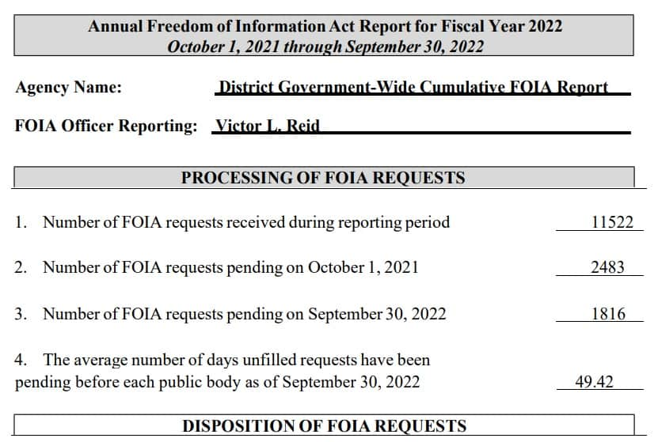
Annual reporting requirements
On or before February 1 of each year, the Mayor shall request from each public body and submit to the Council, a report covering the public-record-disclosure activities of each public body during the preceding fiscal year.
The Corporation Counsel (OAG) shall submit an annual report on or before February 1 of each calendar year, which shall include for the prior fiscal year, a listing of the number of cases arising under this section, the exemption involved in each case, the disposition of the case, and the costs assessed pursuant to D.C. Official Code § 2-538(c).

Slide 62
OOG CONTACT INFO
Niquelle M. Allen, Esq.,
Director
Niquelle.Allen@dc.gov
(202) 481-3406
Brandon W. Lewis, Esq.
Attorney Advisor
Brandon.lewis@dc.gov
(202) 579-1043
Joan Lelma, Esq.
Attorney Advisor
Joan.lelma@dc.gov
(202) 948-3623
Kimberly Brown
Paralegal Specialist
Kimberly.brown6@dc.gov
(202) 893-3902
Louis L. Neal, Jr., Esq.,
Chief Counsel
louis.neal@dc.gov
(202) 384-2945
Anthony J. Scerbo, Esq.
Attorney Advisor
Anthony.Scerbo1@dc.gov
(202) 731-2926
Kevin Brown
IT Specialist
Kevin.brown@dc.gov
(202) 579-3756

Slide 63

Thank you!

