Slide 1
Nicholas Weil, Trial Attorney Office of Open Government
Recent Records-Access Cases
July 11, 2023
(supplemental materials incl. citations)

Slide 2
PART I: Procedure

Slide 3
Administrative Appeals to the Mayor’s Office of Legal Counsel (the MOLC)…
(procedural rules at 1 DCMR § 412)
…OR…
…Judicial Appeals to Superior Court
(Case Management Plan (summary of procedure) at
< dccourts.gov/sites/default/files/divisionspdfs/
CivilDivisionCaseManagementPlan-CivilActionsBranchFinalJune2016.pdf >

Slide 4
PART II:
Finding the Law

Slide 5
Administrative (MOLC, etc.) Opinions
(research sources)
Lexis (since 1998):
Example — searching for opinions on exemptions:
(“freedom of information act appeal” or “foia appeal”) and exempt* and (“2 534” or 204)
Westlaw:
(“freedom #of information act appeal” or “foia appeal”) and exempt! and
(“2 534” or 204)
FREE public sources (though less robust search engines):
dcregs.dc.gov (10/2009–present) and dcregisterarchives.dc.gov (4/2003–9/2009)
Older opinions:
“Brute force” method: Go to MLK (Central) Library’s Washingtoniana Collection (4th Fl.)
or similar collection, consult the indexes at the start of each year of the Register for Freedom
of Information Act Appeals, FOIA, District of Columbia F----…, or similar terms

Slide 6
Searching All States’/Territories’ Records-Access Opinions
(to account for variations in short title)
foi or foia or "f o i" or "freedom of information" or "public records" or "public record" or sunshine or "open records" or "right to know" or "public information" or "records access" or "record access" or "government access" or "data practices"

Slide 7
PART III:
Specific Appellate Opinions

Slide 8
Legal Boilerplate Okay,
but not Question Marks??
Compare
Chi. Justice Project v. District,
Case No. 2022 CA 001175 B (D.C. Super. Ct. Sept. 21, 2022) (long, legalistic request),
with
In re Rose,
Case No. 2019-211 (M.O.L.C. Nov. 5, 2019), 70 D.C. Reg. 006045 (Apr. 21, 2023) (simple request, but asked in question syntax).

Slide 9
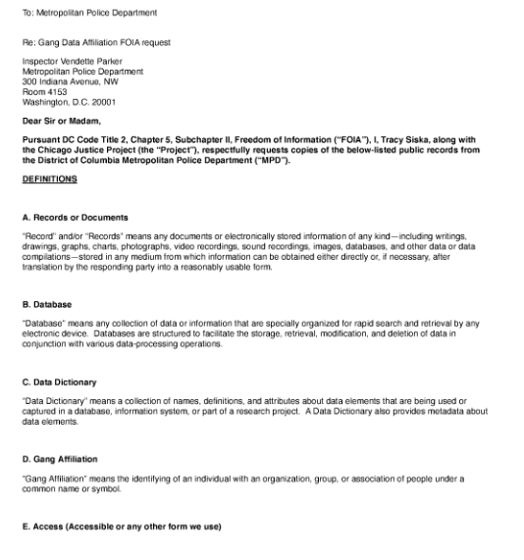
Notes:
Image description: Preliminary language to FOIA request to Metropolitan Police Department. Legal boilerplate, titled “DEFINITIONS”

Slide 10
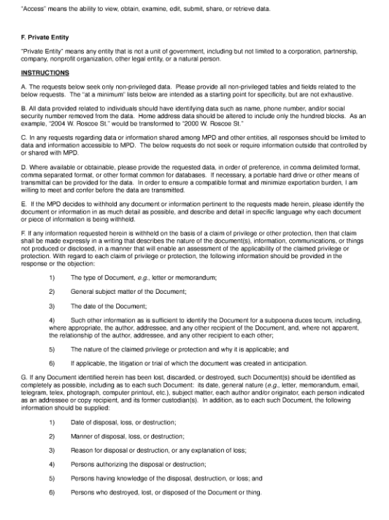
Notes:
Image description: continued legal boilerplate, titled “INSTRUCTIONS”

Slide 11
CJP’s Request # C2 (finally!)
C2: “Please provide Records sufficient to show each public or private entity—whether on the federal, state, or local level—that can view or otherwise has access to the data within each Database detailed in Request A 1.”
Notes:
Image description: Request C2 reads, “Please provide Records sufficient to show each public or private entity—whether on the federal, state, or local level—that can view or otherwise has access to the data within each Database detailed in Request A 1.”
“Records” and “Database” are terms defined in the boilerplate on slide # 5.

Slide 12
Rose’s request, MOLC’s analysis
“[Y]ou state that the Metropolitan Police Department . . . denied your request for the following records:
“The head of the unit of Rio de Janeiro, Brazil police investigating communist activity in that country is said to have had contact with the police in Washington, DC sometime between 1933 and 1939. The person in question was…Captain [(NAME)].
“Do you have any records of communication with this Brazilian officer?”

Slide 13
Rose’s request, MOLC’s analysis (cont’d)
“. . . MPD [respond]s that it sent a letter to you acknowledging your request and informing you of [its] fee schedule, and you responded as follows:
“While I am willing to pay, I do not need more than a simple ‘yes or no plus the date’ . . . if Brazilian police captain [(NAME)] was asked to have some kind of contact with the police in Washington, DC in 1936–1937. A ‘by whom’ he was asked would likewise be nice if it is available. I DO NOT need copies of any documents.
“Based upon these statements, MPD denied your request on the grounds that [D.C.] FOIA does not require agencies to perform research, analyze data, answer written questions, or create records in order to respond to a request.
“We agree with MPD that it is not obligated create [sic] records for you. . . . Moreover, [D.C.] FOIA does not require MPD to perform legal research for you.”

Slide 14
The leading MOLC opinions mentioning “Glomar”:
MOLC Opinion Nos. 2019-18 (Hannagan) and 2019-84 (Zangari)

Slide 15
Public interests vs. privacy interests:
MOLC Opinion No. 2019-238 (Zavala): affirmed exercise of Exemption 2 because adequate public interest not demonstrated w/ respect to third-party Uber receipts
MOLC Opinion No. 2019-236 (Esfino): affirmed exercise of Exemption 2 because adequate public interest not demonstrated w/ respect to V.I.S. (victim-impact statement)
MOLC Opinion No. 2019-179 (Pearson): “[T]here is a public interest associated with the resume and application [of] a successful candidate for a government position that outweighs the applicable privacy interest.”

Slide 16
Requestor of records including PII (SSN, etc.) was himself the subject of the records:
MOLC Opinion No. 2019-188 (Winters)

Slide 17
More court cases (D.C.)
--Kane v. District, 180 A.3d 1073 (D.C. 2018)
--(ANC can’t be sued in its own right—generally, plaintiff must sue District at-large)
--Gooch v. D.C. Metro. Police Dep’t
1:22-cv-02804-UNA (D.D.C. Oct. 25, 2022) (wrong court(?))
2023 CA 002404 B (D.C. Super. Ct.)

Slide 18
More Court Cases
(extra-juris., incl. D.D.C.)
U.S. Right To Know v. Univ. of Vt., 255 A.3d 719 (Vt. 2021) (Vt. & D.C. differ in definition of public record/document)
Summers v. Fox, 169 N.E.3d 625 (Ohio 2020) (3d-party delivery of requested info. didn’t moot action)
McCarley v. Dep’t of Rehab. & Corr., 199 N.E.3d 910 (Ohio Ct. App 2022) (state statute provided for damages for violation, but plaintiff would have needed to send request by trackable method)
Eddington v. D.O.D., 35 F.4th 833 (D.D.C. 2022) (U.S. law) (no “mailbox rule” for e-mailed FOIA requests)
Lamb v. Sec’y of State, 628 S.W.3d 339 (Tex. Ct. App. 2021) (presidential electors not a “governmental body” for purposes of state’s public-information statute)

Slide 19
More Court Cases (cont’d)
(extra-juris., incl. D.D.C.)
State v. Webb, 786 So.2d 602 (Fla. Dist. Ct. App. 2001) (misdemeanor for school-board member’s violation of public-records statute)
--background: rcfp.org/school-board-member-jailed-failing-release-records (May 31, 1999)

Slide 20
Adequacy of Search
(D.C. Ct. of App. & M.O.L.C.)
Doe v. M.P.D., 948 A.2d 1210 (D.C. 2008)
F.O.P. v. District (the “Peaceoholics” case), 79 A.3d 347 (D.C. 2013)
F.O.P. v. District (the “no void-for-volume” case), 139 A.3d 853 (D.C. 2016)
Leith v. M.P.D., Case No. 2019-133 (dictum), (M.O.L.C.
May 20, 2019), 66 DCR 14745 (Nov. 1, 2019)

Slide 21
Caselaw Standard for
Responsive Adequacy:
(1)(a) show that search was “reasonably calculated to uncover all relevant documents” (and follow any leads along the way that likely will yield (not just might yield) more responsive records),
and (b) evaluate your search in hindsight, as you go along, and don’t just stick to the initial, provisional plan you might have had at the top;
and (2) be prepared to “adequately explain” (such as in an affidavit) “both how the search was conducted and why it was conducted in that manner” (practice tip: it’ll be easier to support that with a contemporaneous record kept in a routine/consistent, organized way)

Slide 22
Board of Ethics and Government Accountability (bega.dc.gov)
Office of Government Ethics
Office of Open Government
open-dc.gov
(202) 481–3411
opengovoffice@dc.gov

Slide 23
CONTACT INFORMATION
For assistance with OMA/FOIA questions or comments, please reach us at 202-481-3411 or opengovoffice@dc.gov.
Niquelle M. Allen, Esq.,
Director of Open Government
Johnnie Barton, Chief Counsel
Sheree DeBerry, Attorney Advisor
Nick Weil, Trial Attorney
Anthony J Scerbo, Attorney Advisor
Kimberly Brown, Paralegal Specialist
Kevin Brown, IT Specialist

