Slide 1

Overlap of Domestic Violence and Child maltreatment, Related Trauma and Needs
Joyce N. Thomas, RN, MPH, PNP, FAAN
President/CEO and Co-Founder
714 G Street, SE, Washington, DC
www.stopchildabusenow.org

Slide 2

Every Child Deserves a Childhood

Slide 3
Overview
Statement of the Problem
From the Eyes of a Child
Case Scenarios
District of Columbia Statistics
Lessons Learned from Center for Child Protection and Family Support
Identification of Needs

Slide 4
Statement of the Problem
Studies document link between domestic violence and child
maltreatment (Bragg, 2003; Holden, 2003; Herrenkohl et al 2008).
Domestic violence contributes a to increased reports of child neglect (DePanfilis, 2006).
Co-occurrence of domestic violence and child maltreatment results in more African American children being placed in the foster care system (Chipungu and Bent-Goodley, 2004).
Even when there are no physical injuries, children exposed to violence in their home, neighborhood or community, are likely to feel trauma and experience negative outcomes over the course of their lifetime (Holden, 2003).

Slide 5
Continuation:
The effects of witnessing violence are not limited to just repeating the violence, these children appear to have problems with social adjustments, depression, anxiety, aggression, shyness, and other school related problems (Holden, 2003).
Many women dealing with domestic violence have other challenges such as: poverty, homelessness, chronic health conditions, and often, have a history of mental illness and/or addiction (House of Ruth, 2012).
The children typically have developmental delays and emotional and behavioural problems(CCPFS, 2012).
Notes:
Source: House of Ruth

Slide 6
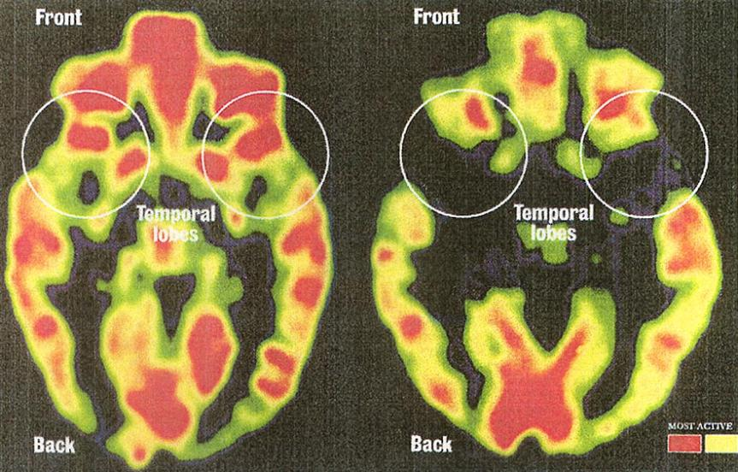
Toxic Stress Can Affect Brain Development
Organizational changes
Brain chemistry imbalances
Structural changes
Healthy Child
Severe Emotional Neglect
Centers for Disease Control and Prevention
Notes:
A growing body of research on how early life experiences influence the neurobiology of the developing brain is helping us to understand how chronic stress and trauma can impact the cognitive, physical, emotional, and social development of children (Teicher, 2002) .
Research indicates that the youngest children are often the most vulnerable to the impact of violence and chronic stress due to the sequential nature of brain development which starts with the brainstem or “survival” regions of the brain and continues up into the limbic and cortical regions of the brain (Perry, 1997).
Infants’ brains have the capacity to adapt to their environment, but this can lead to a brain that is maladapted to everyday life.
The two PET scans compare the brain of a healthy child and the brain of a Romanian orphan who was institutionalized shortly after birth and experienced extreme emotional deprivation during infancy. The regions of red show the highest activity, yellow is the next most active area of the brain, and the greenish to the dark areas are the least active areas. The scan of the child with emotional neglect indicates that the temporal lobes which receive information from the senses and helps to regulate emotions are very inactive while the brainstem area, shown at the bottom of the scan, is more active compared to the “healthy child.” These changes are associated with more emotional and cognitive problems.

Slide 7
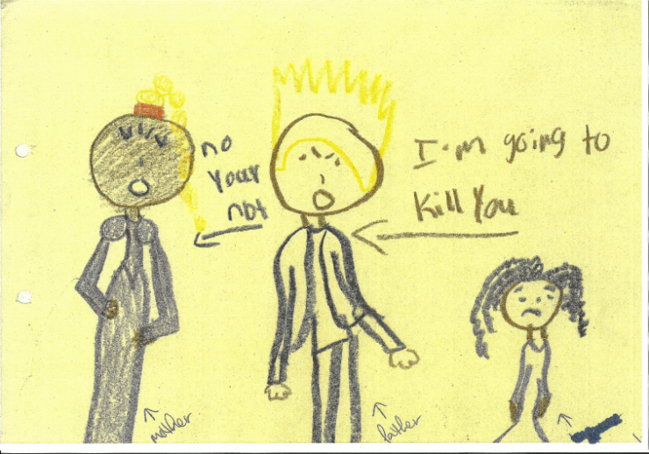
Domestic Violence Through the Eyes of a Child
.

Slide 8
Children are Caught In the Middle!
Child
Child Welfare System
DV
Victim
Abuser

Slide 9
Case Scenario: Witness to DV
Jessy is a 10-year old, female with behavioral problems (i.e., aggressive behavior, disrespectful, poor attention span) at home and at school. This behavior has become progressive worse in the past several months. The mother indicated Jessy had witnessed her biological father being physically abusive towards her mother, and this domestic violence situation had gone on for over eight years. Her father left the home several years ago, and this child had not been in touch with their biological father until recently, and this has caused new tension in the home between Jessy’s mother and her boyfriend.
The boyfriend became jealous of her after her children recently began contact with their biological father. The boyfriend engaged in stalking and then made physical threats against the mother and the child. This mother’s boyfriend’s behavior escalated to physical violence, and the child was injured during an altercation.

Slide 10
Case Scenario: Child Fatality
A father with history of risk factors (e.g., anger management, on medication for mental health problems, depression, suicide attempts, frequent psychiatric hospitalizations,) was given custody of his biological newborn because the child’s mother was placed in state guardianship due to her inability to manage her medical condition.
During the pregnancy, domestic violence was documented to have occurred between the father and his girlfriend (biological mother), while she was in the hospital prior to the birth of the baby.
At age six months, the infant was known to be crying excessively and the father was unable to cope. He admitted to “placing his hand around the baby’s neck with his thumb on her throat, and the baby stopped crying and died.”
The father was convicted of first degree child abuse for the death of the infant.
There were five agencies (e.g. Adult protective services, Human Resources, Child welfare and a private hospital) involved with the family prior to the death of the child.
Notes:
Source: Public records state of Maryland

Slide 11
Domestic Violence in District of Columbia (2012 Statistics)
31,815 domestic violence-related calls were made to the Metropolitan Police Department,
approximately 1 every 17 minutes ( Metropolitan Police Depart, 2013).
4,673 petitions for Civil Protection Orders were filed in 2012, a 7% increase in filings from 2011.
5,478 people were served at the two Domestic Violence Intake Center (DVIC) locations in 2012. The DC Superior Court location served 3,465 clients, and the DVIC satellite office in Southeast Washington (DVIC-SE) served 2,013.
In 2012 there was a 48% increase in the number of DVIC/DVIC-SE clients served who sought services because they were victims of stalking. (DC Office of the Attorney General, 2012

Slide 12
Lessons Learned from Center Programs
City-Wide Protocol on DV and Child Abuse (1997)
Balancing Employment and Parenting (2001-2006)
Child Victim Services (1997-2012)
Balanced and Restorative Justice (2009-2013)
Safety Net and Parent Support (2011-2016)
Notes:
Source: Center for Child Protection and Family Support

Slide 13
Intervention Model
Theoretical Assumptions About the Problem
Evidence Based Model
Goals and Objectives of the Project
Curriculum Development: Riding the Parenthood Wave
Demographics of Target Population
Structure/ Organization
Staff/ Trainers
Evaluation Findings/ Lessons Learned
Outcomes
Notes:
Source: BEAP Project, DHHS Office of Child Abuse and Neglect, Field Initiated Demonstration Project 2001-2006, evaluated by George McFarland of McFarland Associates, Silver Spring, Maryland

Slide 14
Impact of DV on Child Growth and Development
Children see their mother assaulted and demeaned
Children hear cursing, loud arguments, and threats against their mother
Children feel the tension in the home
Children learn unhealthy lessons about problem solving
Children have difficultly bonding with mothers
Notes:
Source (2012): Lessons Learn from Clinical Services at Center for Child Protection and Family Support

Slide 15
Continuation:
Children develop a negative core belief about themselves.
Children are denied the love and nurturance of both parents.
Children are frightened to talk with strangers about the situation (i.e. police, attorneys, social workers).
Children fail to get nurturance during childhood.
Violence becomes normalized

Slide 16
Challenges in Providing Parenting to Abused Woman:
Transient nature of participants
In adequate child care during sessions
In addition to the domestic violence, mother experience many difficult life circumstances
Program usually have limited resources for incentives

Slide 17
Benefits of Parenting Programs for Mothers that have Experienced Domestic Violence
Development of Strategies for Co-parenting
Improvement in child rearing practice
Opportunities for peer support
Referrals for other services for self and children
Reduction of Isolation
Strengthening of self confidence

Slide 18
Needs
Consistent demographic data
Qualitative and quantitative outcome data
Resources for referrals need expansion
Education and training for child servicing agencies
Public awareness about the impact on young children
Affordable housing for homeless families

Slide 19
joyce@centerchildprotection.org
Phone: (202) 544-3144
FAX: (202) 547-3601

